Slide 1
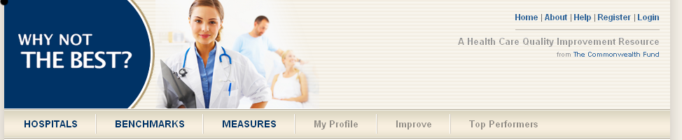
Using WhyNotTheBest.org to Benchmark and Improve Performance: A Webinar
Stories from the Field
November 16, 2012
Introductions and Demo: Anne-Marie J. Audet, M.D., Sc.M., S.M., Vice President, Health System Quality and Efficiency, and Martha Hostetter, Consulting Editor and Web Content Developer, The Commonwealth Fund
Presenters:
Joy Gill, clinical data analyst, Adventist Healthcare
Justine Carr, M.D., chief medical officer and senior vice president of quality and safety, Steward Health Care System
Kim Paull, director of analytics, Rhode Island Office of the Health Insurance Commissioner
Kevin Quinn, vice president, payment method development, Xerox State Healthcare

Slide 2
Learning Objectives
1. Overview of WhyNotTheBest.org, one of six national quality reporting and benchmarking sites – with 7,000 registered users
Whose quality is reported
What measures of quality are reported
Sources of data
2. Live demo
How to create reports
Visualizing performance: Maps
3. Examples from “power users”
Health System: Chief Medical Officer, Clinical Data Analyst
(Steward Health Care System, Adventist Healthcare)
State Office of the Health Insurance Commissioner (RI)

Slide 3
What Is WhyNotTheBest.org?
December 2008 launch at the IHI Annual Forum
WhyNotTheBest.org addresses a health system reform strategy: public reporting and ease of access to performance data as lever to raise benchmarks and achieve high-quality, efficient care.
Site was created to fill a unique niche:
Provide health care leaders with easily accessible, standardized public data on organization-level performance :
How are we doing over time?
How are we doing compared to the benchmark, to others like us?
Provider Resource. Most performance reporting sites target consumers; WhyNotTheBest.org is designed for health care providers and leaders to stimulate and support their quality improvement strategies.
Transparent and aligned with national standards. Compared to numerous ranking and scoring sites
Measure methodologies are transparent and in public domain
Site provide resources for improvement

Slide 4
Who Uses WhyNotTheBest.org?
Audiences: Chief Executive Officers, Chief Medical and Quality Officers, Chiefs of Nursing, Chief Information Officers; Data Analytic Experts, private-sector performance assessment groups, business coalitions.
Tool used to prepare reports for hospital boards, train staff in process improvement, compare quality across markets or regions, track progress.
Recommended as one of top hospital profiling sites by Wall Street Journal and featured in health blogs: ABC News, WSJ, and US News and World Report.
Included as resource for HHS Value Exchange Networks.
Veterans Administration outreach to Fund re: design of its own performance reporting site.
Partnerships with 15 states in reporting hospital quality indicators, patient safety indicators, prevention quality indicators.

Slide 5
What’s Unique About WNTB?
Scope of Measures, Benchmarks, and Flexibility in Generating Reports
Hospital quality: 30 Hospital Quality Alliance measures
Patient experiences: 10 measures from the Hospital Consumer Assessment of Healthcare Providers and Systems (HCAHPS)
All-payer data from 15 states: AHRQ Patient Safety Indicators, Prevention Quality Indicators, and Inpatient Quality Indicators
Rates of health information technology adoption: AHA survey
Population health and utilization/costs: Institute of Medicine
Providers Profiled
Over 5,375 hospitals
Over 400 multi-hospital systems
Geographic visualization of performance
Interactive maps of national, state, county, and HRR-level performance
Map overlays of delivery system reform – PCMHs, CVEs, Beacons
Improvement Resources and Wide Range of Benchmarking Capabilities
65 Health care delivery improvement tools
57 Case studies

Slide 6
WhyNotTheBest.org
What Does it Include?
Health Care Settings | Measures | Filters | Bench-marks | Data Sources
Hospitals Safety Net Hospitals Teaching Hospitals Academic Medical Centers Hospital Systems Level Profiled Organization System Counties HRRs State National | Process: HQA, HIT Adoption Patient Experience Outcomes: Readmissions; Mortality; ACS Admissions; AHRQ Patient Safety Indicators, Prevention Quality Indicators, and Inpatient Quality Indicators Population Health Resource Use | Bed size Ownership Type (For Profit, Not-For Profit, Public, Government) | Top 1% Top 10% Top25% National Average State Average Hospital types HRRs Health Systems | CMS Hospital Compare State All Payer Discharge data (15 states) IOM Population Health and Utlization Indicators AHA surveys

Slide 7


Resources
www.commonwealthfund.org
www.Whynotthebest.org

Slide 8

Transparency & why not the best.org
Joy Gill
Clinical Data Analyst, System Quality

Slide 9







About Adventist HealthCare, Inc.
Founded more than 100 years ago, Adventist HealthCare is a faith-based, not-for-profit organization serving the Washington D.C. metro area and northwestern New Jersey.

Slide 10
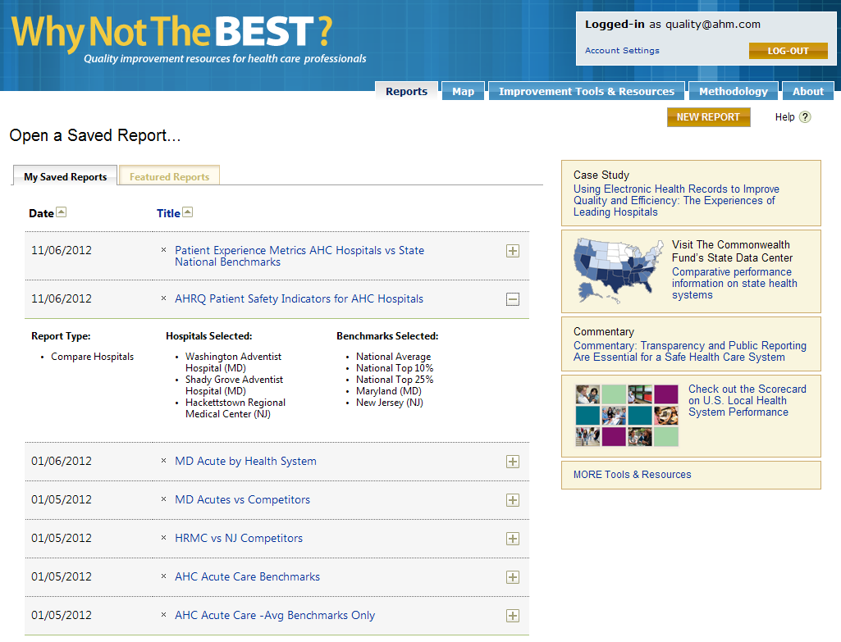

Transparency & Education of Users
We set up a common logon and created reports for users based on common needs

Slide 11
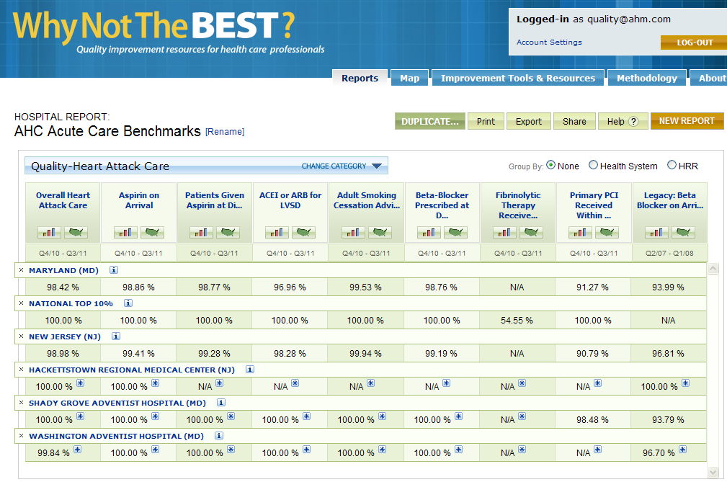
Performance Benchmarking

Slide 12
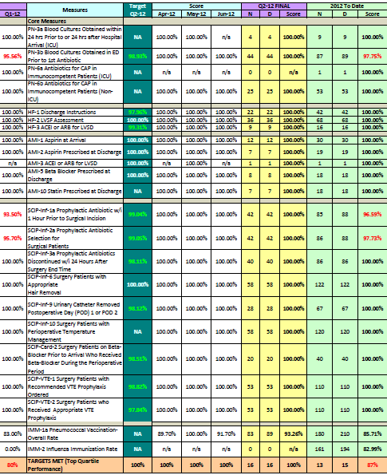
Performance Benchmarking

Slide 13
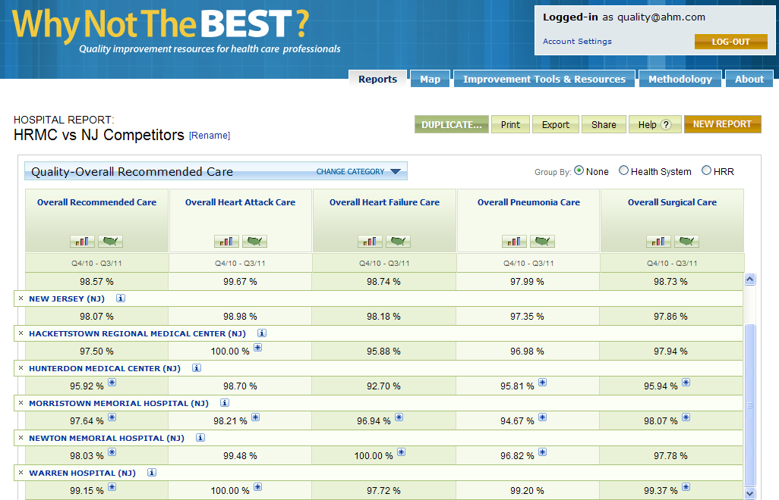
Market Competition Performance

Slide 14
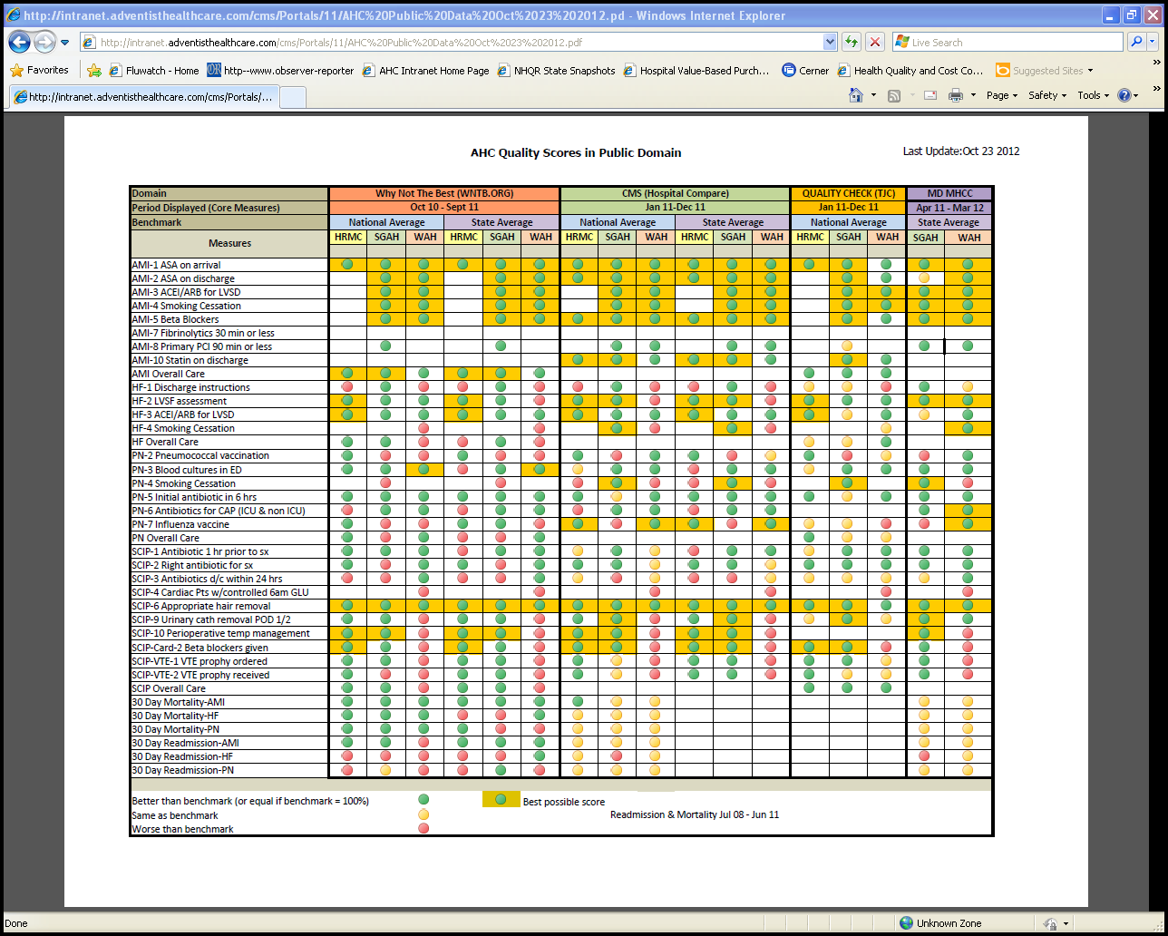
Consolidation of Public Domain Performance Scores

Slide 15
Summary
Consult with marketing & strategy departments for advice on how to best utilize regional & network toolsets
Footnote the performance periods; lag time can be a challenge
Build reference pages for your internal customers to help them get confortable with transparency and the language of quality data

Slide 16


Slide 17
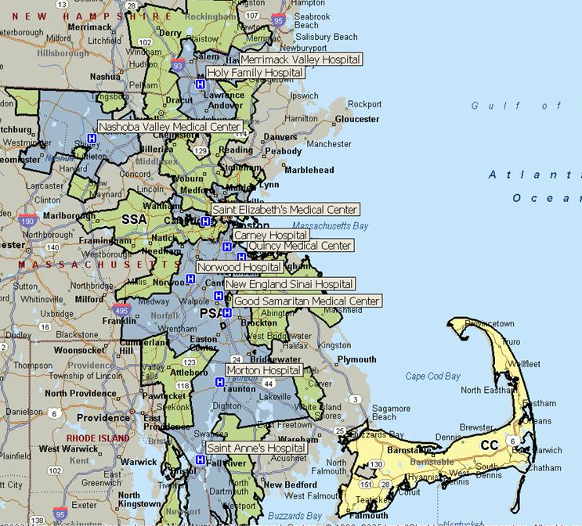
Steward Health Care System
Largest community-based, integrated system in New England
11 acute care hospitals
- 25% of acute hospital beds across
eastern Massachusetts
- Largest inpatient Behavioral
Health provider in MA
Largest community physician network in New England
Serving over 1,200,000 patients annually
Over 4,000 on medical staff
- 2,300 affiliated through Steward contracting network (SHCN)
- 600+ employed by Steward Medical Group
Additional Key Elements:
Steward Home Health & Hospice
NE Sinai Rehab facility
PET Imaging Company
Good Samaritan Radiation Oncology Center
Steward Home Medical Equipment

Slide 18
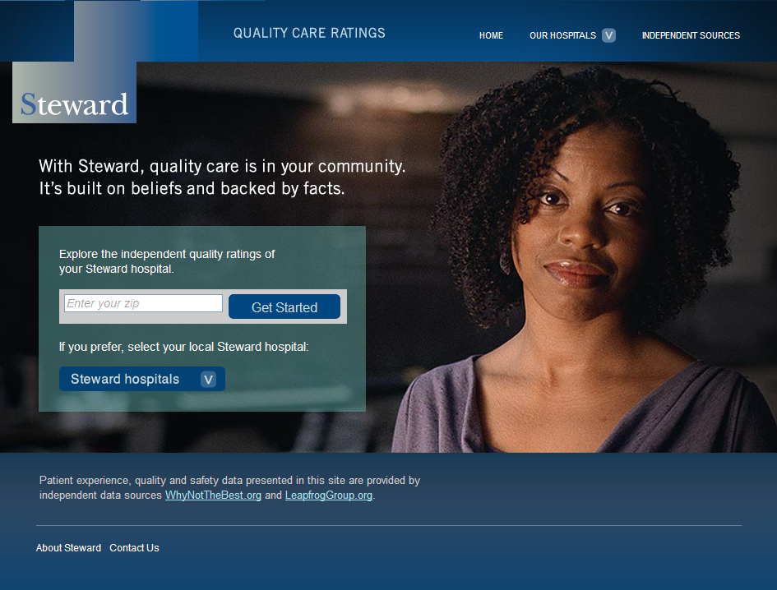
Goal
Consumer information on Quality, Safety and Patient Experience that is:
Easy to access
Easy to understand
Fully transparent
Unedited data
http://quality.steward.org/

Slide 19
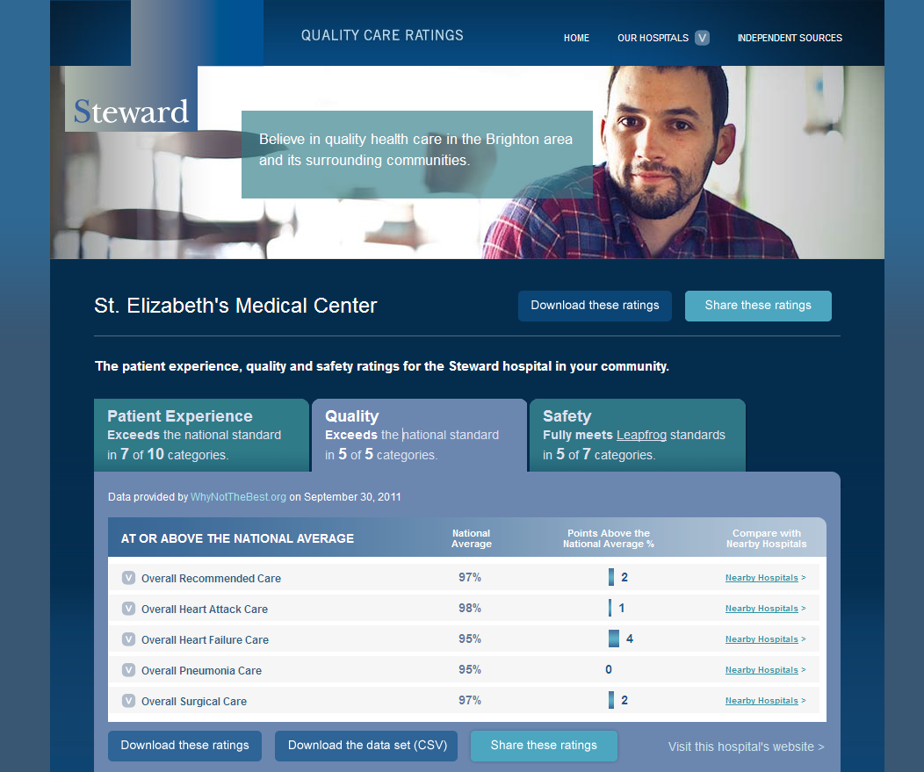
Patient
Quality
Scores
Sorted to show
Where we score in relation to national average
How we compare to 6 nearest non-Steward hospitals
http://quality.steward.org/

Slide 20
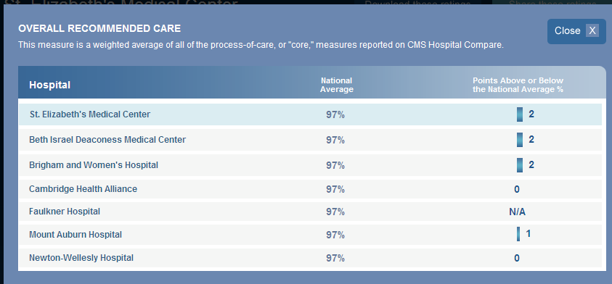
Comparison of Scores:
Six nearest non-Steward hospitals are not better than St. Elizabeth’s.
http://quality.steward.org/

Slide 21
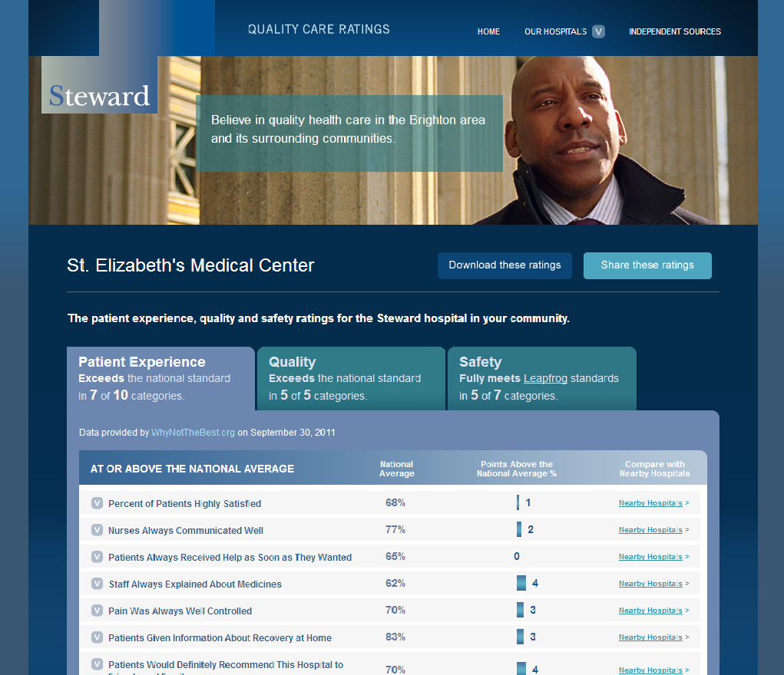
Patient Experience Scores
Data from WNTB
Compared to national average
http://quality.steward.org/

Slide 22
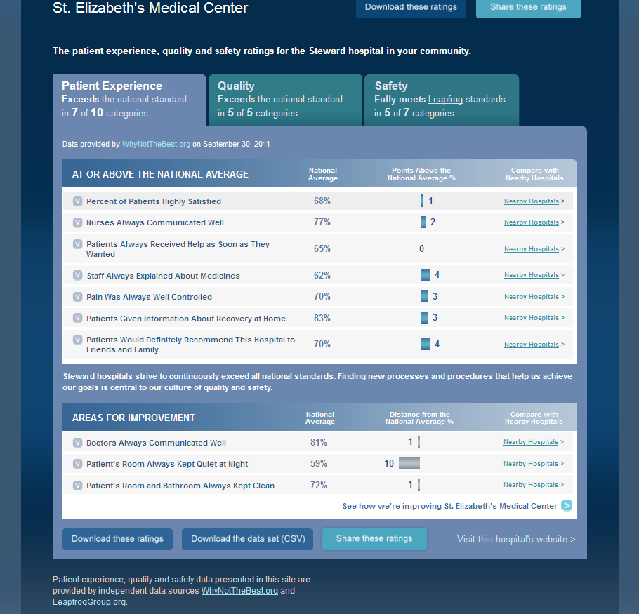
Patient Experience Scores
Sorted to show
Where we exceed national average
Where we fall short of national average
Opportunity to compare to 6 local non-Steward hospitals
http://quality.steward.org/

Slide 23
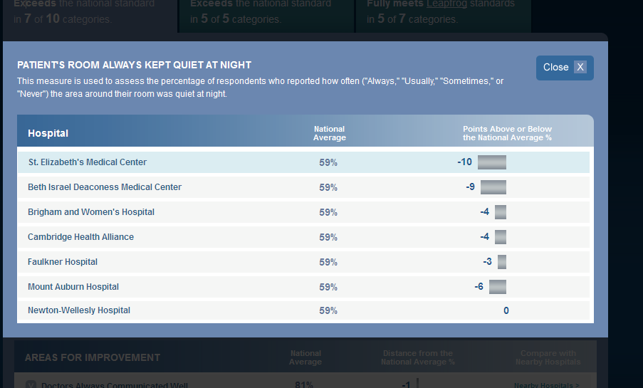
Comparison of low score
Shows that most local hospitals are also struggling with keeping room quiet at night
http://quality.steward.org/

Slide 24
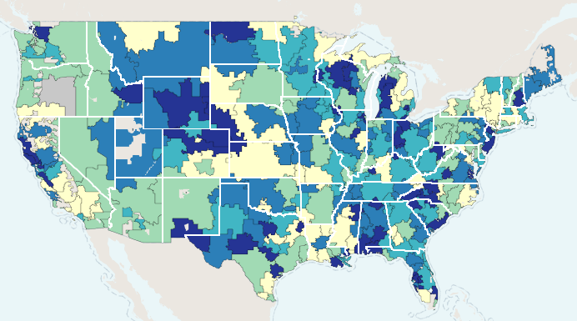
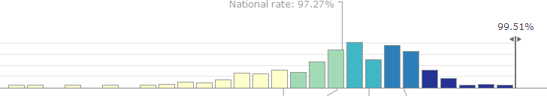
Internal Use: National Performance Overall Recommended Care

Slide 25
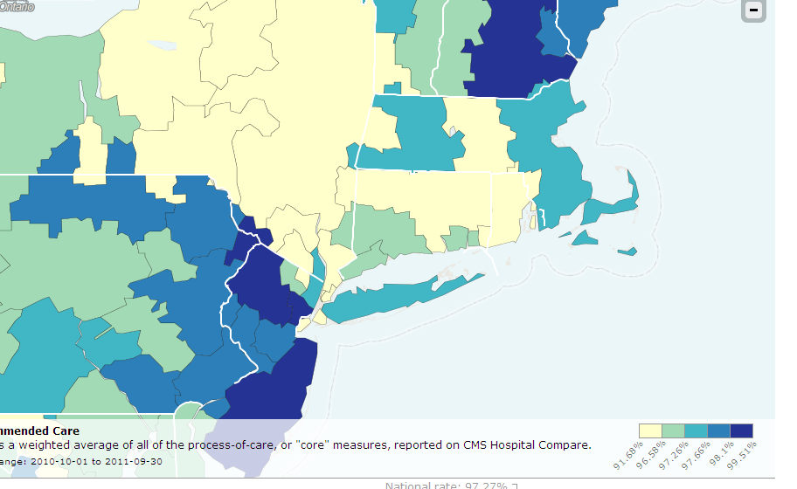
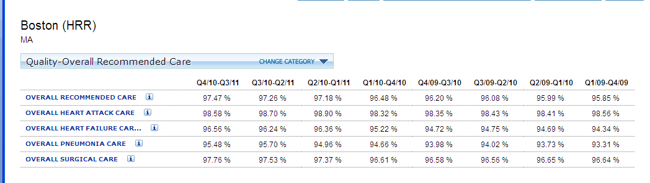
Internal Use: Regional Performance Overall Recommended Care

Slide 26
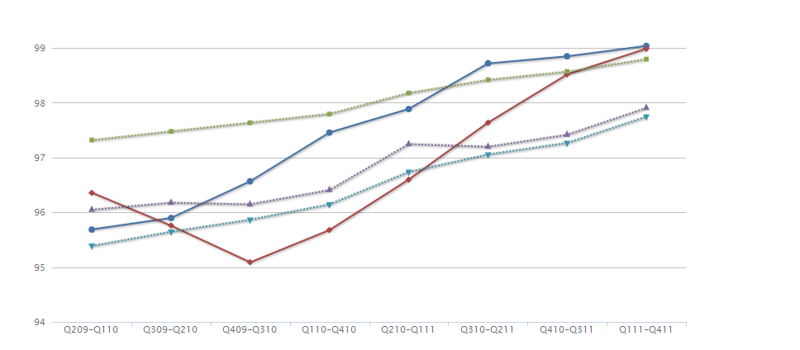
Internal Use: Trended Data Overall Recommended Care Trends
St. Anne’s
St. Elizabeth’s
Nat’l Top 25%
MA Avg
Nat’l Avg

Slide 27
Rhode Island Hospital Payment study
Commonwealth Fund Webinar
Nov. 16, 2012

Slide 28
Study Background
Purpose is to understand how and why payments for inpatient and outpatient hospital care in Rhode Island vary
To what extent do payments vary? What factors drive that variation?
Update to study performed in 2010, co-sponsored by two Rhode Island state agencies
Xerox (formerly ACS) is the technical lead
Collected and analyzed data
Developed findings, including review of payments and quality data
Anticipated release is late November, early December

Slide 29
Study Overview
Xerox found extensive payment variation in the Rhode Island market.
Rhode Island is not alone: our literature review reveals that, among neighboring states and in the rest of the nation, variation is the norm
Particularly concentrated in the commercial market and in certain specialty areas
System hospitals tend to receive higher payments
What drives variation?
Cost?
Specialty services?
Teaching status?
Quality?
Market share?

Slide 30
WHY WE NEEDED WNTB
A Short History of Payment Methods:
Paying More to Those Who Do More
In the beginning More = more charges, more cost
Fee for service More = more services
The DRG revolution More = treating sicker patients
The next revolution?? More = better outcomes
Measures should be:
Quantifiable
Relevant and fair
Comparable
Dependable
Measures may be:
Patient satisfaction
Structure
Process
Outcomes

Slide 31
BENEFITS OF WTNB
Compilation of hospital-specific measures from different sources
Including patient safety indicator measures calculated by the Commonwealth Fund specifically for WNTB
Well documented, with easy links to further information
Easy interface to select and save hospitals and measures
A key caveat: Analysts must make their own judgments about relevance and dependability of the measures

Slide 32
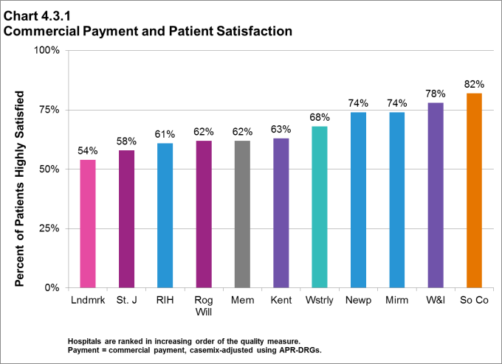
EXAMPLE: PATIENT SATISFACTION Note: Comparison with payment levels not shown, pending release of the study

Slide 33
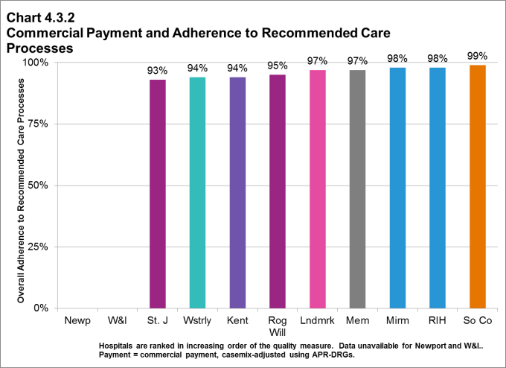
EXAMPLE: RECOMMENDED CARE PROCESSES Note: Comparison with payment levels not shown, pending release of the study

Slide 34
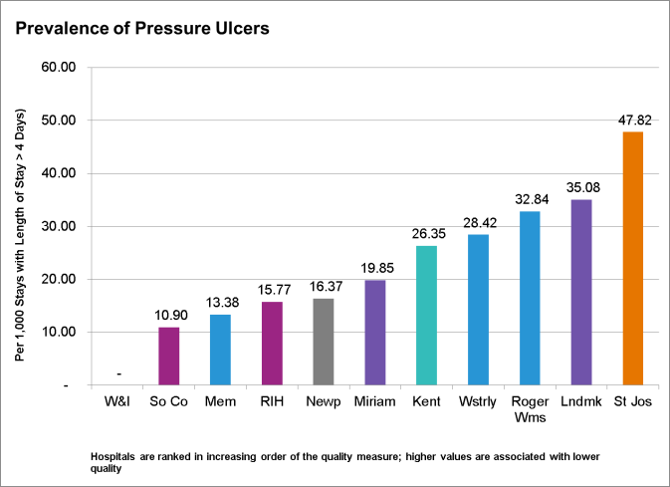
EXAMPLE: PATIENT OUTCOME Note: Comparison with payment levels not shown, pending release of the study

Slide 35
Thank you for participating in today’s webinar.
To download the slides, visit www.commonwealthfund.org/Events.aspx
To get started using WhyNotTheBest.org, visit: www.WhyNotTheBest.org
To see a demo of how to use WhyNotTheBest.org, visit www.WhyNotTheBest.org/About

