Slide 1
The Commonwealth Fund 2011 International Health Policy Survey of Sicker Adults in Eleven Countries
Robin Osborn, Moderator
The Commonwealth Fund
January 11, 2012

Slide 2

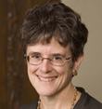
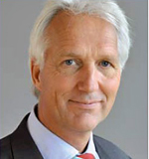
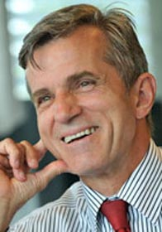
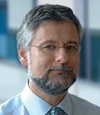
Today’s Webinar Presenters
Robin Osborn, M.B.A.
Vice President and Director
International Program in Health Policy and Innovation
The Commonwealth Fund
(Moderator)
Cathy Schoen, M.S.
Senior Vice President for Policy, Research and Evaluation
The Commonwealth Fund
Arno Timmermans, M.D., Ph.D.
President and Medical Director
Dutch College of General Practitioners
Thomas Björn Zeltner, M.D.
President, Swiss Foundation Science et Cité
Former Secretary of State for Health and
Director-General of the Swiss Federal Office of Public Health (1991-2009)
Martin Roland CBE, D.M., M.B. B.Ch.
Special Advisor, RAND Europe
Professor of Health Services Research
University of Cambridge

Slide 3
Health Spending per Capita, 2009 Adjusted for Differences in Cost of Living
Dollars
% GDP
* 2008.
Source: OECD Health Data 2011 (June 2011).

Slide 4
Health Systems
 | Coverage | Primary Care | Hospitals
England | National Health Service | Patient registration required Gatekeeping Free at the point of use | Mostly public Global budgets and case-based payments
Netherlands | Universally mandated private health insurance | Patient registration required Gatekeeping Free at the point of use | Mostly non-profit Global budgets and case-based payments
Switzerland | Universally mandated private health insurance | Registration not required No gatekeeping requirement (except in some insurance plans) Cost-sharing (deductible and annual out-of-pocket spending cap) | Mostly public Payment varies by canton (state): global budgets, per diem, and case-based
United States | Private insurance (most under 65); Medicare (age 65+); Medicaid (some low income); Uninsured (16% of population) | Registration not required No gatekeeping requirement (except in some insurance plans) Cost-sharing (currently no annual limit) | Mostly non-profit Case-based or per diem payment

