Slide 1


The Potential of Shared Savings Models to Support Integrated Health and Social Services for
Complex Patients
Ruben Amarasingham, MD, MBA
President and CEO
PCCI
Dallas, TX
August 1, 2016

Slide 2
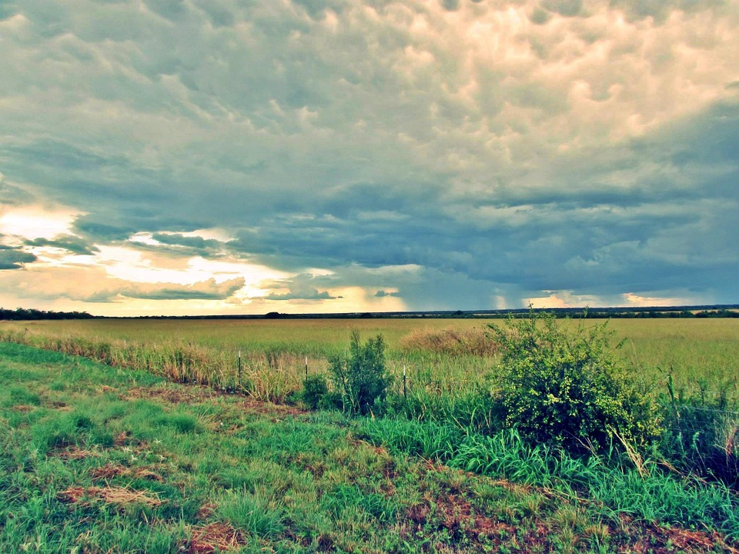
Who We Are
PCCI
Our Mission
We are a non-profit that uses scientific research and applied analytics to improve the quality, efficiency and experience of health care, at Parkland Health & Hospital System, Dallas and beyond.
To reimagine & expand the knowledge-base of healthcare delivery in the age of machines
Our Vision
A world where every clinical outcome is positive.
Our People
pccipieces.org
Physicians, Data Scientists, Quality & Safety Science, Community Engagement professionals

Slide 3
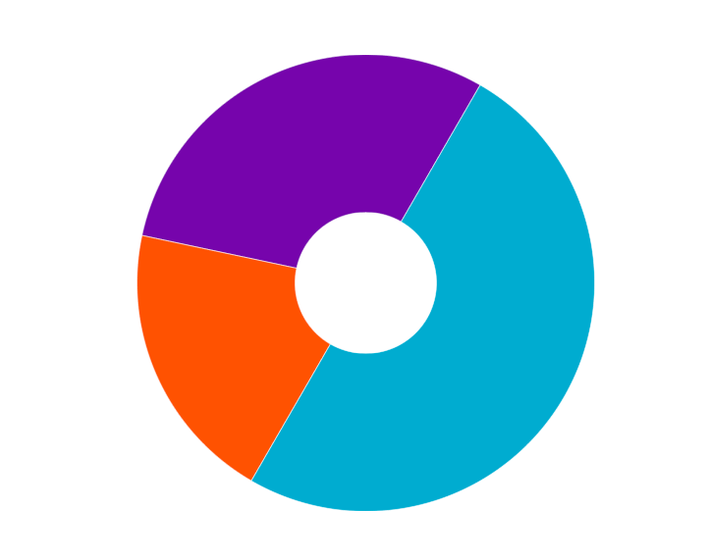
The Role of Social Determinants in Health
Health Behaviors
30%
Social, Economic, Environmental
50%
Clinical Care
20%
Adapted From: Booske, B.C., Athens, J.K., Kindig, D.A., Park, H., & Remington, P.L. (2010). County Health Rankings [www.countyhealthrankings.org]

Slide 4





Community Based Organizations (CBO) address many health-related social needs...
Core Needs
Crisis and Emergency
Food Insecurity
Housing and Utilities
Interpersonal Violence
Transportation
Supplemental Needs
Family & Social Supports
Education
Employment & Income
Health Behaviors
Legal
Senior services
CBOs

Slide 5

..but CBOs are frequently disconnected, fragmented, under-capitalized and over-looked.
Hospitals
How do we align, connect, and integrate across social and health sectors within communities?
CBOs

Slide 6
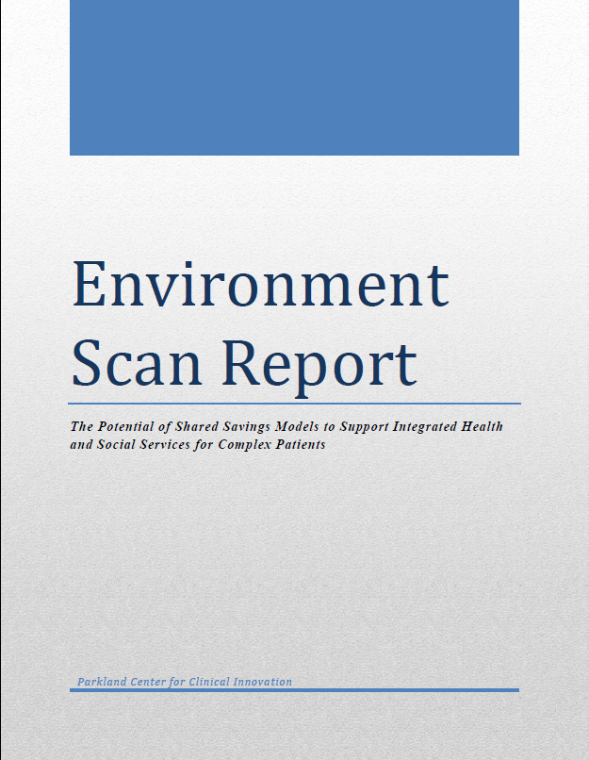
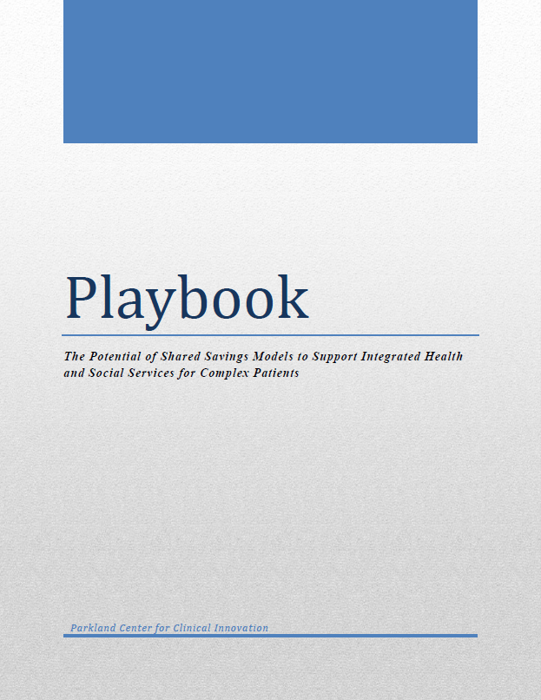


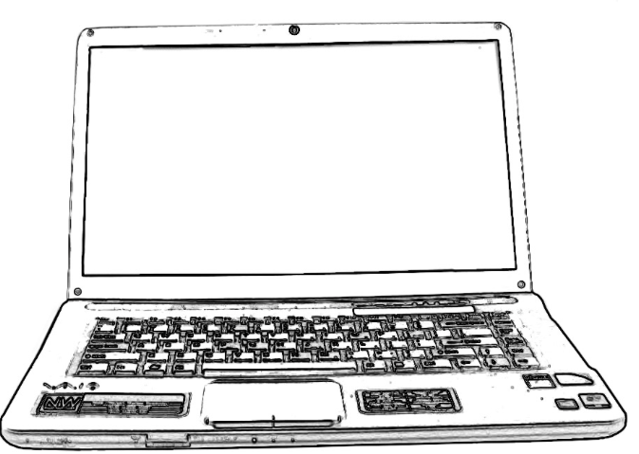
Objectives
Objective 1
Environmental scan of innovative programs
Objective 2
Identify emerging phenotypes and challenges
Objectives 3
Playbook to assist communities
For more information on the playbook, or to receive a copy, please reach out to PCCI:
@PCCIPIECES
/company/pcci
www.pccipieces.org

Slide 7

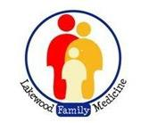











































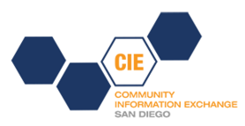













Methods | 64 Communities and Organizations Evaluated
Mixed method approach
Literature review, Delphi expert panel, and interviews with innovative programs to develop a maturity rubric for communities participating in these types of efforts
Semi-qualitative surveys and interviews of 64 communities and organizations, including our stakeholders in Dallas, to identify phenotypes, challenges and solutions

Slide 8
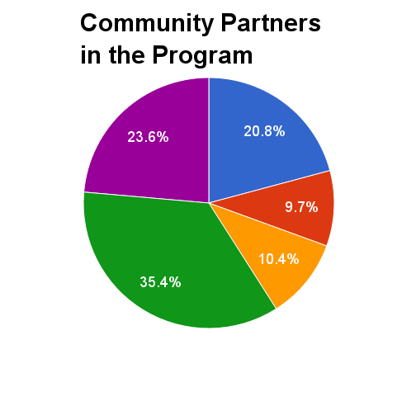
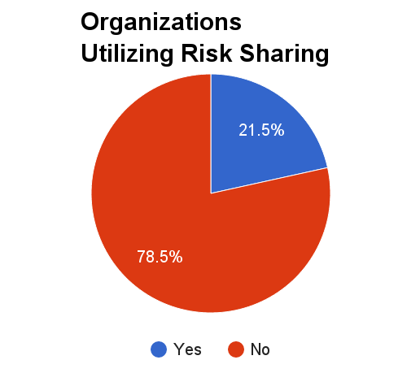
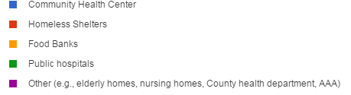
Key Findings | Program Types

Slide 9
Key Findings | Program Distribution Across Rubric
10
8
6
Data Sharing and Reporting
4
Innovation Leader
2
Government Enabled
Bottom-up
2
4
6
8
10
Care Coordination and Financial Alignment

Slide 10

Challenge #1 Sustainability
Key Findings | 5 Common Challenges
Many programs are grant funded and may not be sustainable after the grant funding is complete. Cost savings and improvement in outcomes may be difficult to sustain after the initial “low hanging fruits”.
Solutions Identified:
Payment reform around transitional care activities and population health has been critical.
Coalition of CBOs establishing alignment with hospital strategic plans.

Slide 11
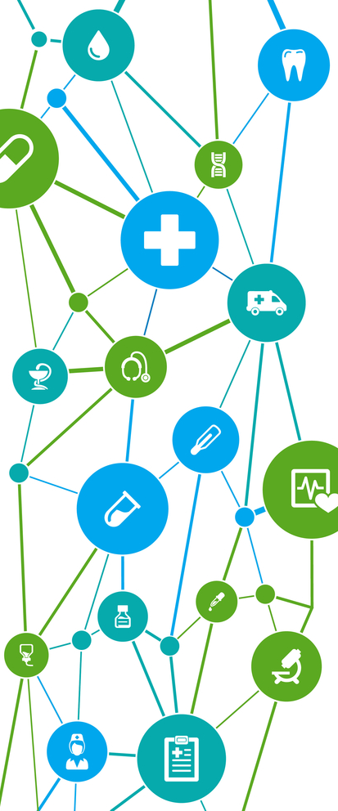
Challenge #2
Key Findings | 5 Common Challenges
Accurate and timely measurement of outcomes and cost savings
Many programs lack the infrastructure and know-how to define and measure the most relevant outcomes and to accurately estimate cost savings.
Solutions Identified:
Establishing a common data dictionary and data set requirements across hospitals, health systems, community based organizations with a common methodology for analysis.

Slide 12

Challenge #3
Key Findings | 5 Common Challenges
Sharing of savings
Limited mechanisms and knowledge of how to share savings.
Solutions Identified:
Identification of local philanthropies, foundation and trusts that would provide funding to accelerate experimentation around financial partnerships.
Partner around areas of health system penalties or incentives aligned with a CBO’s specific core competency.

Slide 13



Challenge #4
Key Findings | 5 Common Challenges
CBO data and technology expertise
Many CBOs lack a technical platform, the infrastructure and the know-how to integrate data from different sources, such as EMR, claims data, data from CBOs, and HIEs.
Many programs lack the infrastructure to consult multiple data sources during the healthcare or social services provision; so services are not well coordinated
CBO #1
CBO #4
Solutions Identified:
Utilize in work-flow case management systems at the CBO level that could integrate with EMR systems
Hospitals have tremendous data and technology expertise, that can serve as data anchors for community efforts.
CBO#2
CBO #3

Slide 14

Challenge #5
Key Findings | 5 Common Challenges
Cross-sector workflow evidence base
Programs struggle to define cross-sector, multi-organization, clinical and social workflows.
Solutions Identified:
Increasing demonstration grants provide critical support to experiment and establish this evidence base
National collaboratives and learning networks
Information clearing-houses to extract maximum value on significant but isolated experimentation occuring across the country

Slide 15

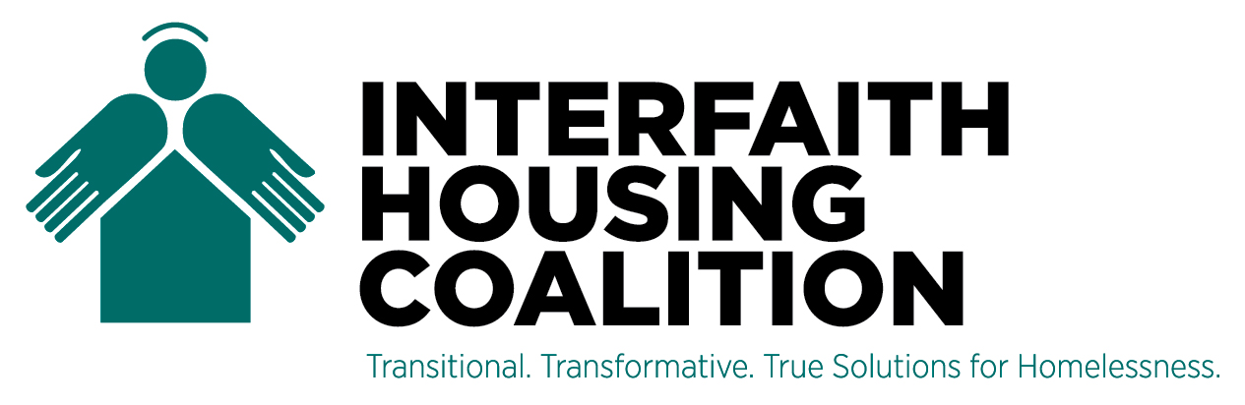
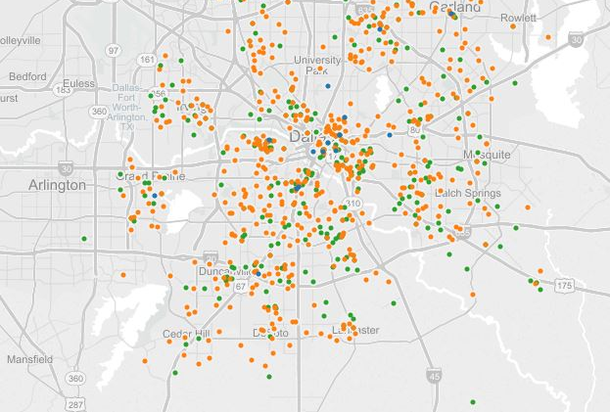
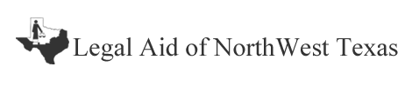

















PCCI Related Work:
The Dallas Information Exchange Portal
Some of our current and future partners
North Texas Food Bank programs (654 Impacted Programs)
NTFB Partner Agencies
(316 Piece Iris™
Implementations)
MDHA Projects
(28-47 Pieces
Iris™ Implementations)
Parkland Community
Oriented Primary Care
Clinics

Slide 16

Contact Information
Project deliverables including the environmental scan report and the playbook will be available at:
Commonwealth Fund
www.commonwealthfund.org
PCCI¹
www.pccipieces.org
Dr. Ruben Amarasingham²
@RAmarasingham
Contact PCCI:
Disclosures:
¹PCCI is party to an exclusive license agreement with Pieces Technologies, Inc.
²Dr. Amarasingham is President and CEO at both PCCI and Pieces Technologies Inc.
@PCCIPIECES
/company/pcci
lindsey.duda@phhs.org

