Slide 1


Slide 2
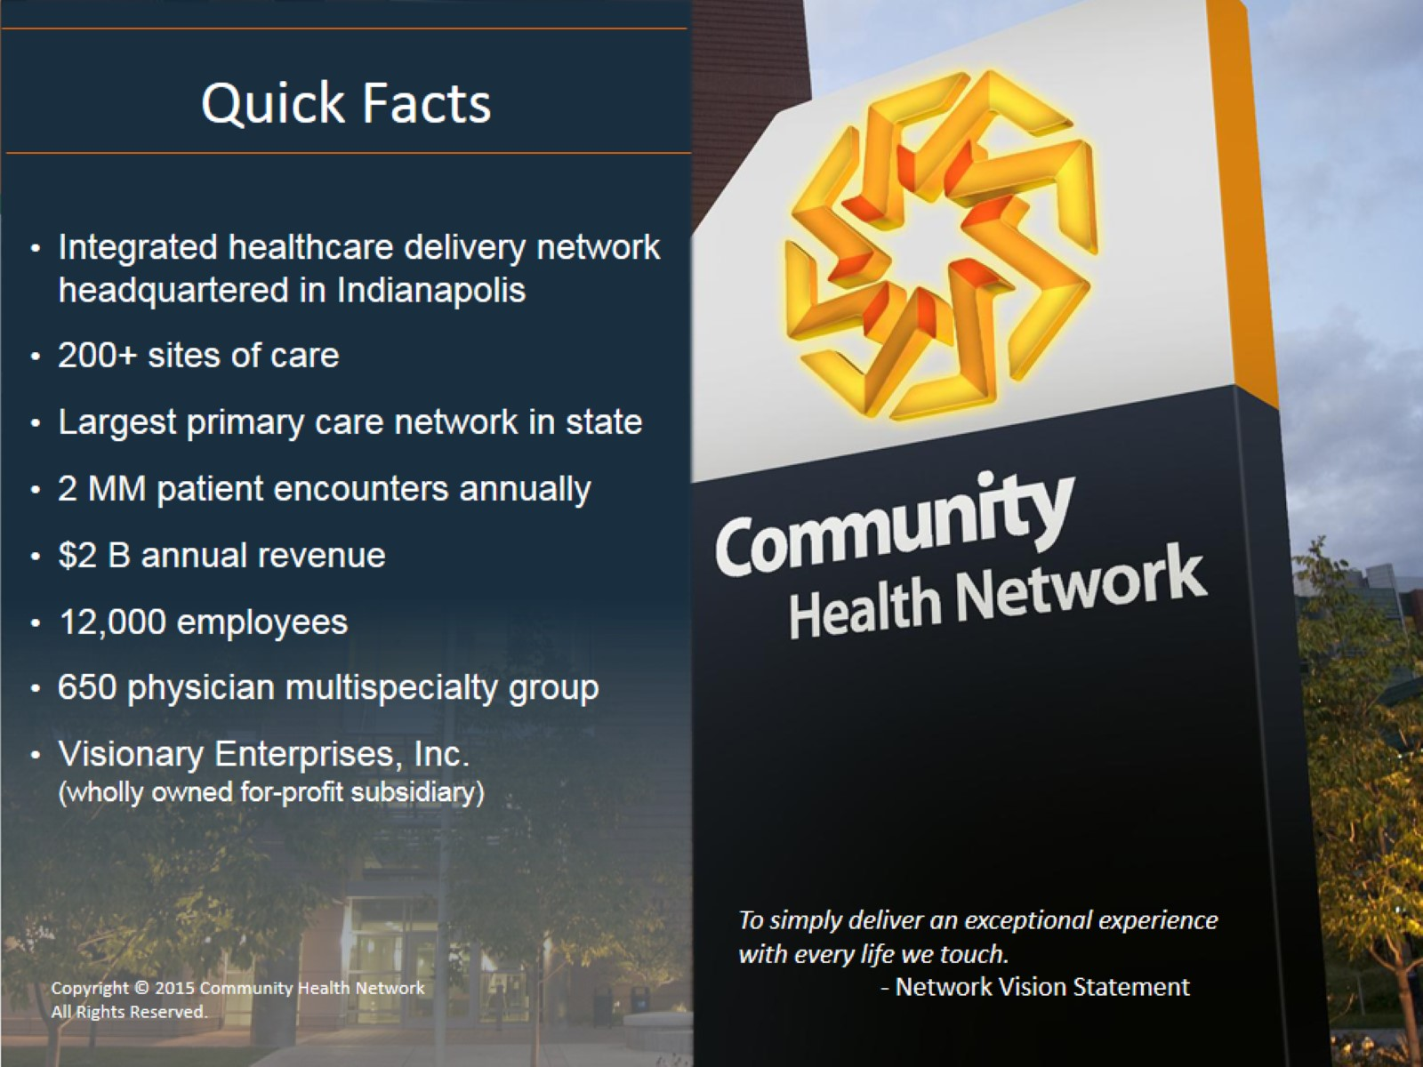

Slide 3
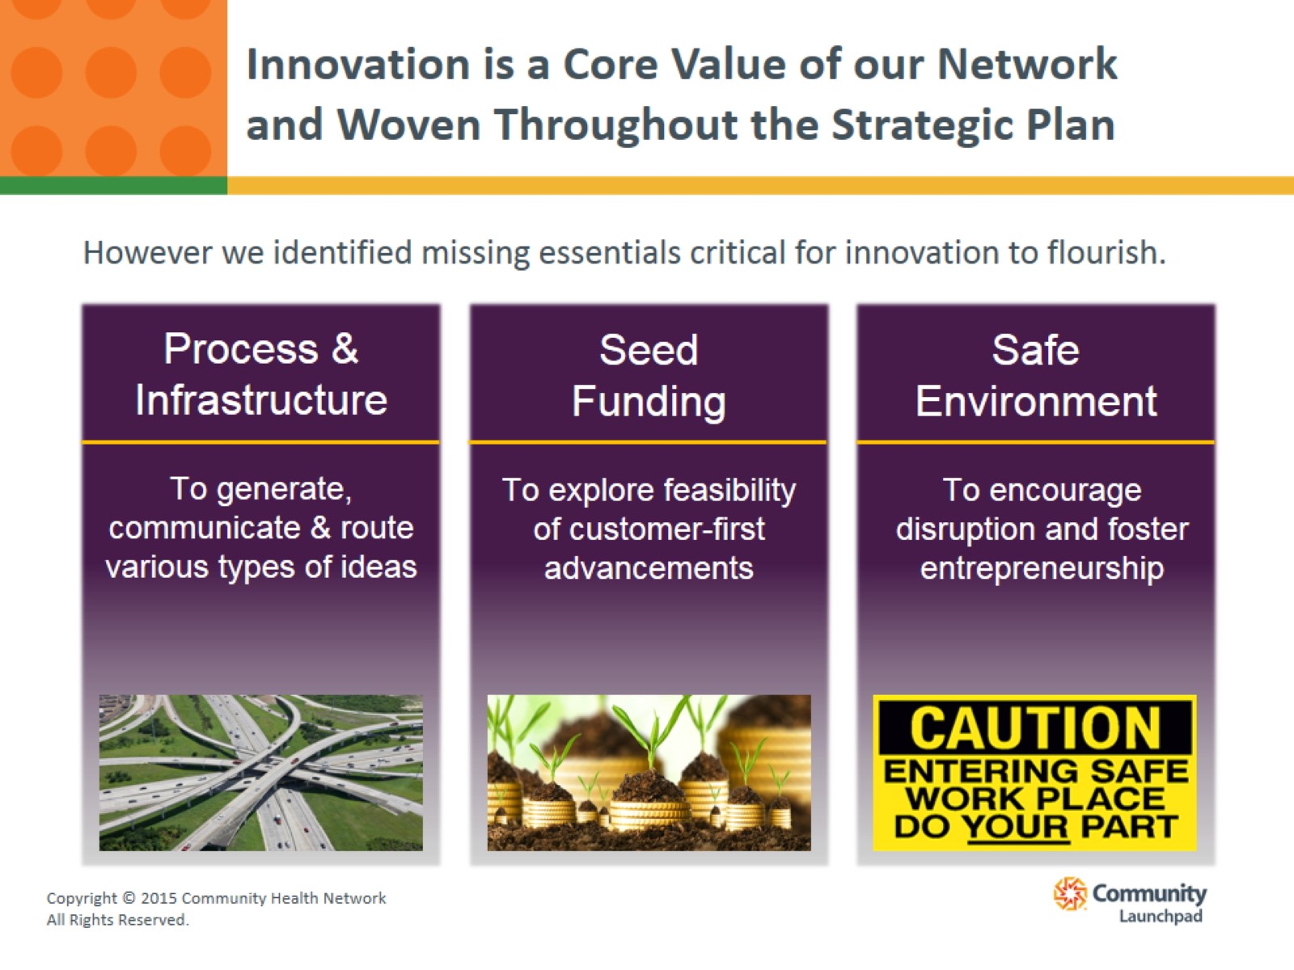
Innovation is a Core Value of our Network and Woven Throughout the Strategic Plan

Slide 4
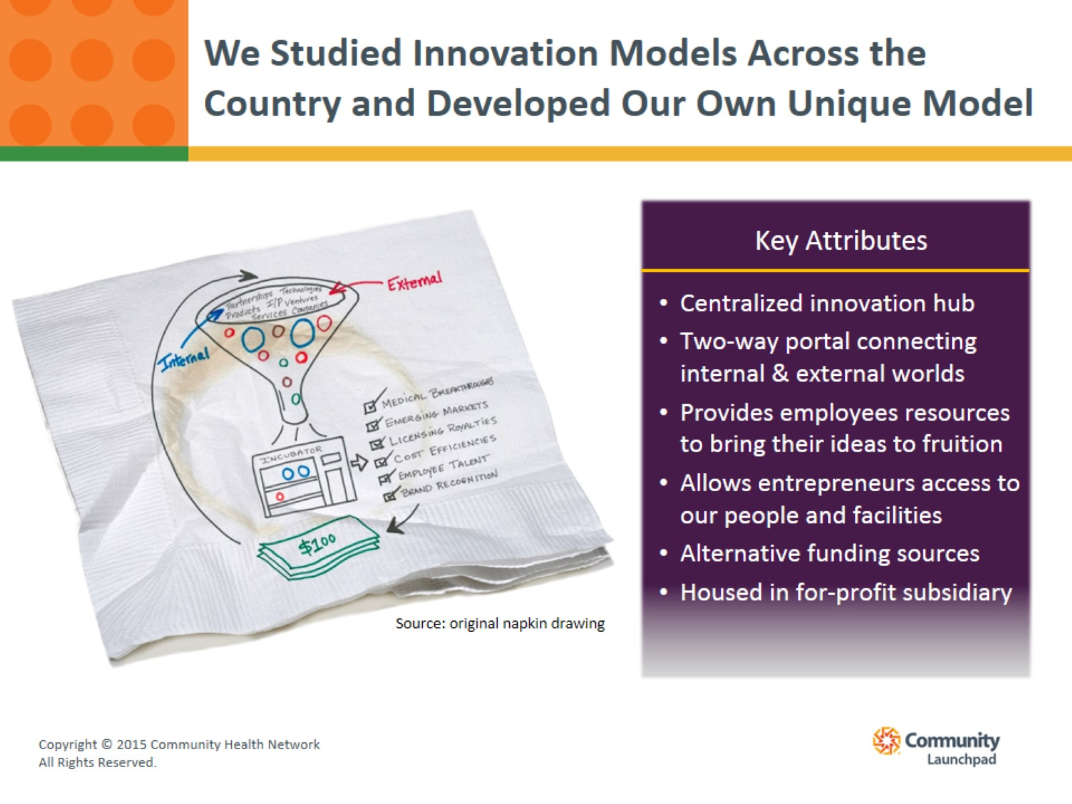
We Studied Innovation Models Across the Country and Developed Our Own Unique Model

Slide 5
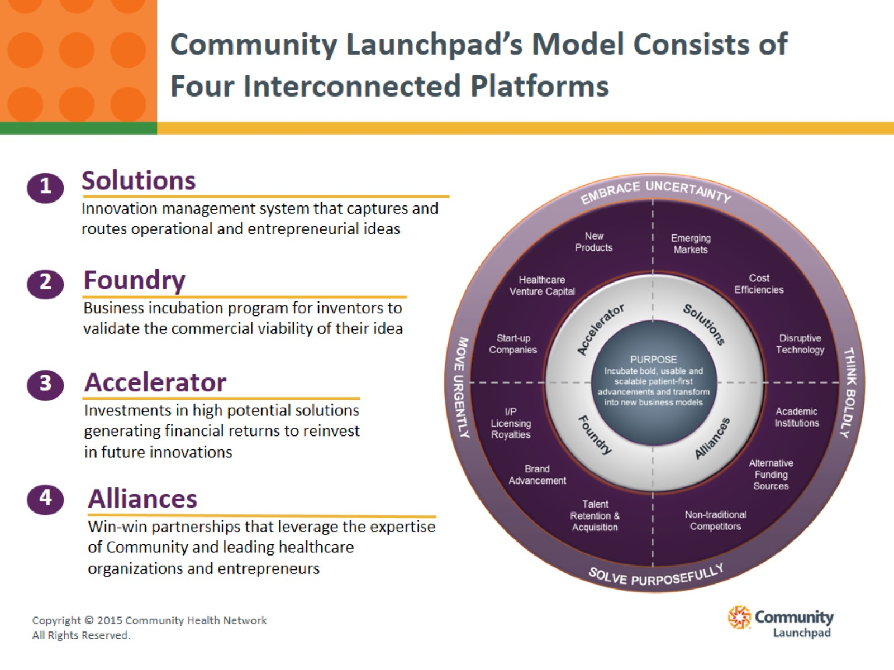
Community Launchpad’s Model Consists of Four Interconnected Platforms

Slide 6
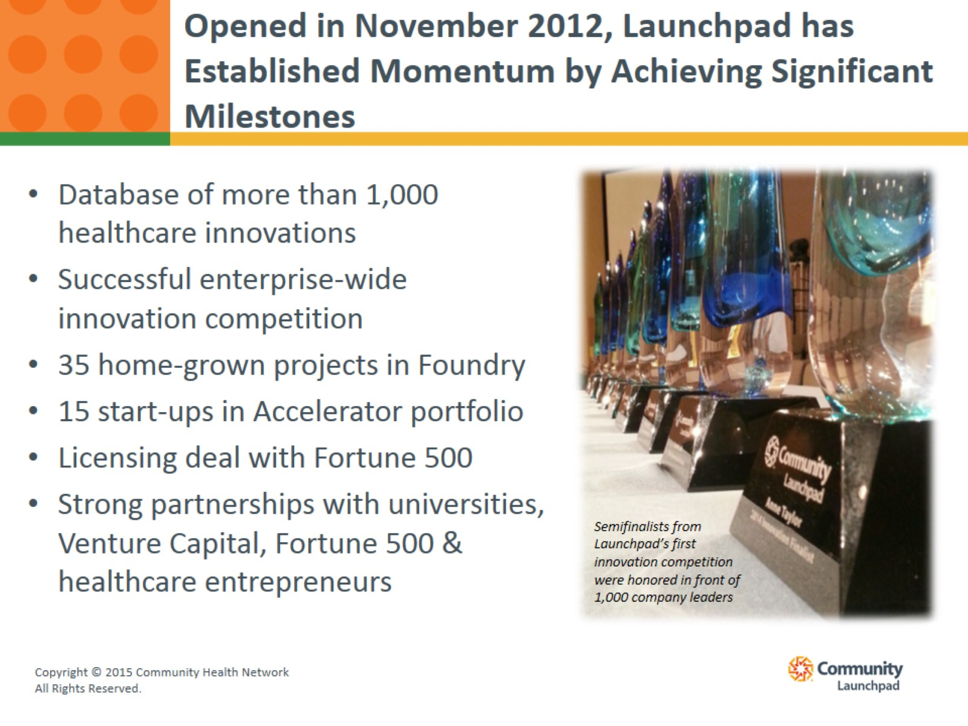
Opened in November 2012, Launchpad has Established Momentum by Achieving Significant Milestones

Slide 7
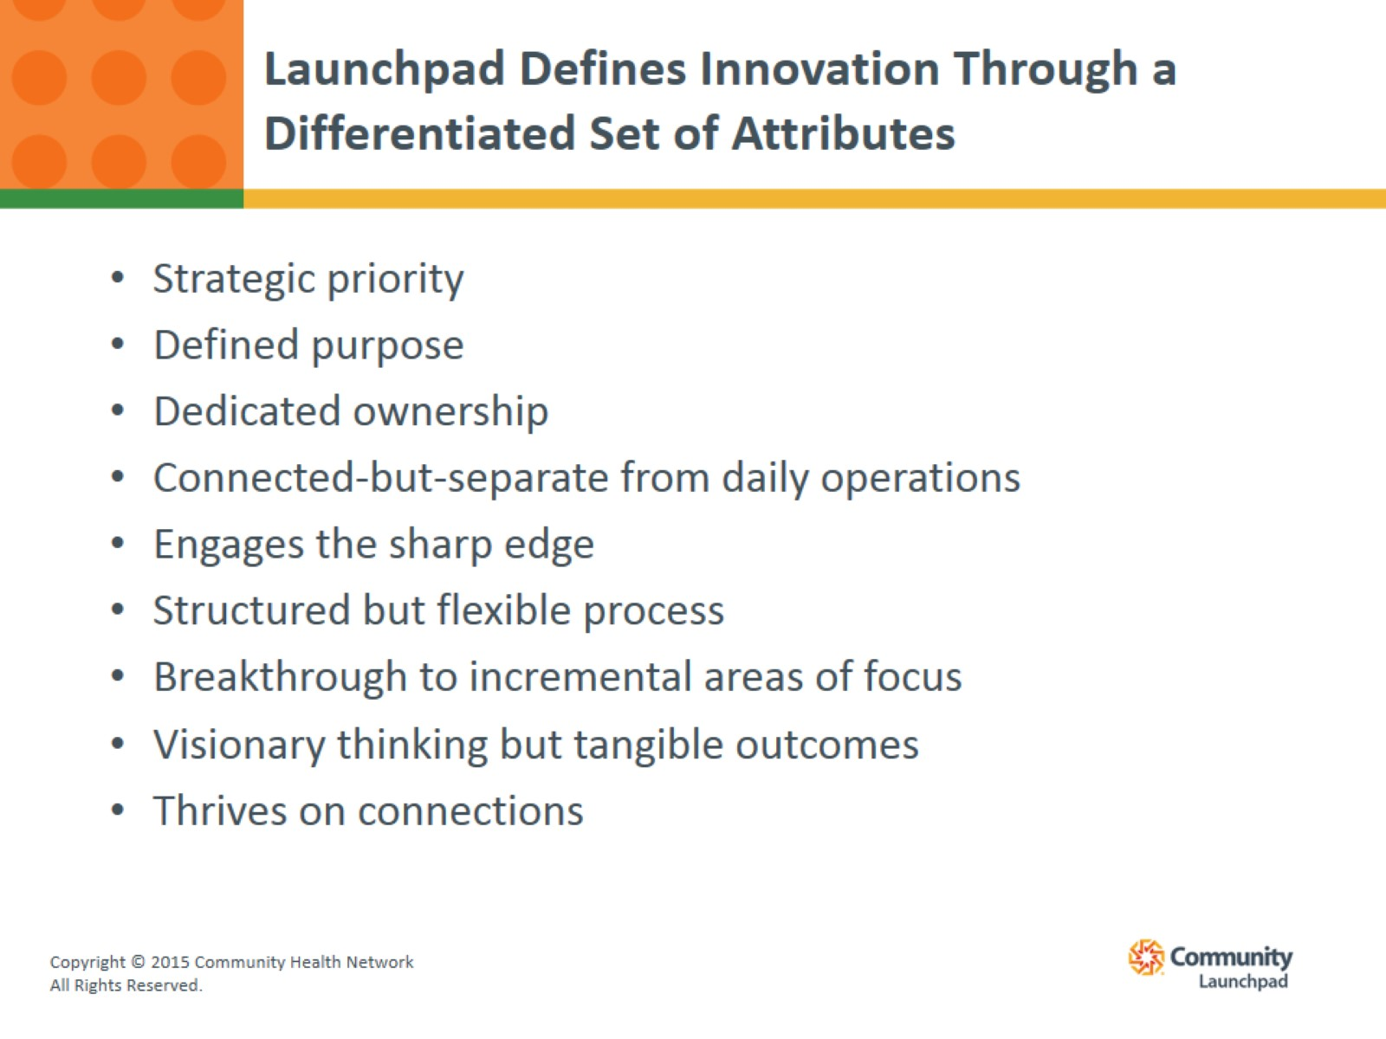
Launchpad Defines Innovation Through a Differentiated Set of Attributes

Slide 8


