Slide 1




Evaluating the Quality and Safety of
Patient-Facing Mobile Apps
May 7, 2015
David W. Bates, MD, MSc
Chief Innovation Officer and Chief, Division of General Internal Medicine,
Brigham and Women’s Hospital
Division of Renal Medicine

Slide 2
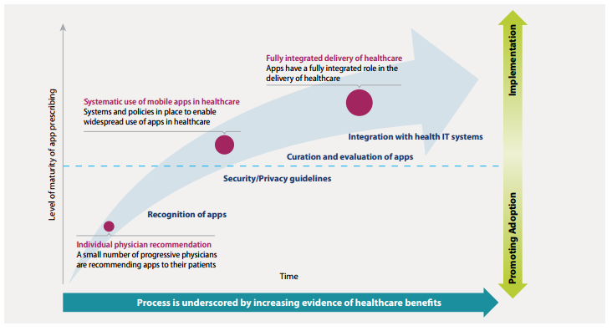


The Trajectory of Mobile Apps
As of 2013, 43,000+ apps exist relating to health or wellness
IMS Institute for Healthcare Informatics. Patient Apps for Improved Healthcare: From Novelty to Mainstream.; 2013.

Slide 3
Patient-Facing Mobile Apps
Little evidence exists that apps are being designed or deployed specifically for vulnerable populations
“Inverse care law” suggests apps may increase disparities in care
The goal of our work is to provide critical insight into the landscape of mobile applications in the care of vulnerable populations.
Jameson JE. Inverse care law. Lancet. 1971;1:648-649.

Slide 4
Approach
Lit Review
App Review
Interviews with Experts
Usability Study (UCSF)

Slide 5

Literature Review
Studies were identified by searching PubMed/Medline, Embase, the Cochrane Central Register of Controlled Trials, Web of Science, and the NTIS Bibliographic Database from 2008-2014.
7,301 titles and abstracts
Selected by either
of 2 reviewers
 |  | R2 |  | Total
 |  | Yes | No
R1 | Yes | 250 | 245 | 495
 | No | 346 | 6460
Total |  | 596 |  | 7301
6,337
irrelevant
Kappa = 0.41
841
possibly original research
123
possibly systematic review
Full text review
Abstraction of content

Slide 6

App Review
We identified mobile applications targeting high-need high-cost patients in three ways:
Systematic review of the iOS (“iTunes”) and Android (“Google Play”) app stores
Systematic review of medical professional society websites
Asking experts to suggest apps

Slide 7
Systematic Search
 | iOS | Android
Total Apps Considered | 946 | 1173
Not a healthcare app | 346 | 319
Not patient-facing | 193 | 215
Not in English | 18 | 49
Highly similar | 13 | 21
Limited engagement | 24 | 89
Peripherally related | 66 | 56
Poor ratings or reviews | 33 | 8
Last updated before 2014 | 63 | 200
Other | 29 | 64
Possibly Useful | 161 | 152
iOS only | Both | Android only
35 | 126 | 26

Slide 8
Professional Society Search
194 professional societies identified
53 societies mentioned, recommended, or developed an app
232 patient-facing apps identified

Slide 9
Preliminary Findings

Slide 10
Preliminary Findings

Slide 11
Preliminary Findings

Slide 12
Preliminary Findings

Slide 13
Conclusions
Apps have the potential to improve healthcare
Apps also have the potential to cause harm as they become increasingly integrated with the healthcare system
What if low blood glucose values not recorded?
What if no one alerted about suicidal ideation?
Apps may not be being directed at patients who can benefit the most from them
Level of evidence to date appears to be limited

Slide 14
Team
Karandeep Singh, M.D.
Kaitlin Drouin, M.S., M.A.
Lisa P. Newmark
Adam Landman, M.D., M.S., M.I.S., M.H.S.
Erika Pabo, M.D., M.B.A.
Jaeho Lee, Ph.D.
Ronen Rozenblum, Ph.D., M.P.H.
Elissa Klinger, M.S.
David W. Bates, M.D, M.Sc.
Acknowledgments: Support for this research was provided by The Commonwealth Fund. The views presented here are those of the authors and not necessarily those of The Commonwealth Fund or its directors, officers, or staff.

