Slide 1

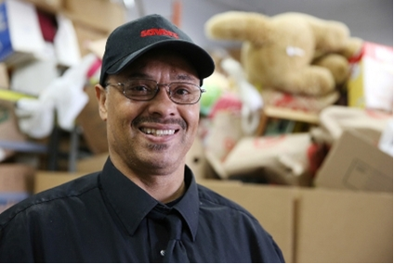
Hennepin County, Minnesota
Jennifer DeCubellis
Asst. County Administrator- Health
Sept 2014

Slide 2
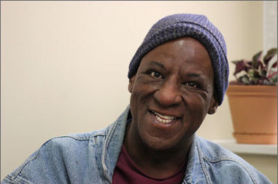
Who We Are
    Medicaid Demonstration Project
      County Health Plan, Hospital, Community Clinics, and Social Services collaborating on resident health
      Reduce costs & improve outcomes for the Counties most vulnerable, high need populations
      Leveraging social service, health, & corrections systems
    Population served
      9,000 Medicaid Expansion Adults (0-133% FPL)
        Characteristics:
        70% racial/ethnic minority
        60% behavioral health concerns
        32% unstable housing
        Significant utilization of crisis services
2

Slide 3

Factors Impacting Health Outcomes
20% - Access to and quality of health care
80%
Social and economic factors (40%)
Health behaviors (30%)
Built environment (10%)
Adapted from <http://www.countyhealthrankings.org/our-approach>
Notes:
Solid research and agreement that this is true for all populations
It is the 80% which often impacts Jail recidivism as well

Slide 4
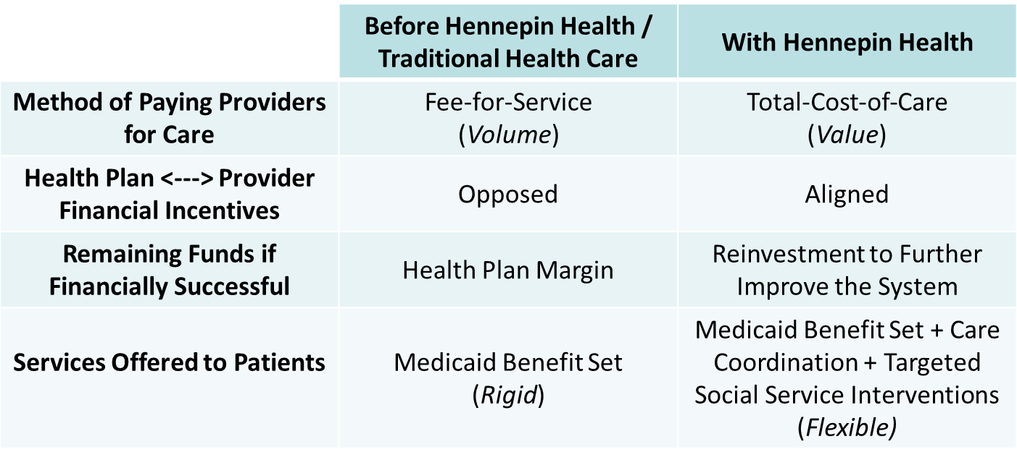
Financial Model: Impact
Notes:
Mentioned earlier that members are prospectively enrolled in HH, and that the partner organizations are paid a fixed PMPM fee
Dramatically altering the financial incentives has been a powerful force for change and innovation
Getting providers, human services, and health plan rowing in the same direction, making the use of those dollars more flexible, and working toward the same outcomes has allowed us to reform the delivery of care to meet the needs of the population
Managed Care Model
Same pmpm, contracts
Leveraging funding across health, social services, corrections for collective impact

Slide 5
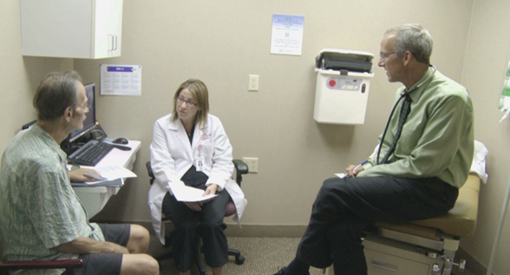
Key Characteristics of Model
Key Characteristics of Model
Key Characteristics of Model
Key Characteristics of Model
Care Coordination
  Coordination across systems (reduce waste, leverage resources, improve lives)
Social Determinants of Health
  Basic needs and environmental factors need to be addressed to stop the revolving door (high cost- poor outcomes)
  Housing
  Pathways out of poverty –vocational supports
  Close system gaps and disparities (system failures)
Flexibility in Spending- Business approach to utilization of funds with ROI/Impact decisions
Data sharing- Break the cycle, close the gaps

Slide 6
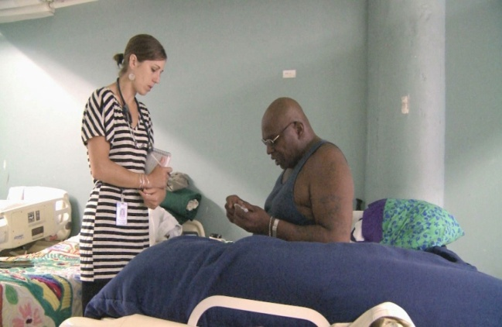
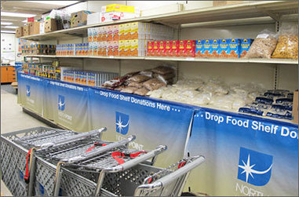
Challenges
Data Sharing
  Limitations on behavioral health
  Limitations on sharing: welfare healthcare/corrections
Get the dollars to the “community table”
Align incentives to change the system
Rules in the way (sample)
  Institute of Mental Disease- Detox
  Rehab- 3 day stay requirements
  Observation Status (midnight rule)

Slide 7
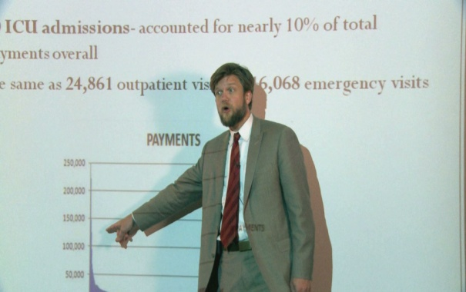
Results and Outcomes
Health Spending- 3 yrs -16% pmpm decrease (note pop expansion yr 3)
Crisis Services-
  ED costs down -9.1%/1000,
  Inpt costs down -3.2%/1000
Housing- (112 patients)
  -52% decrease ED costs pmpm,
  -72% decrease inpatient costs pmpm
Pathways out of Poverty-
    Vocational supports -55% decreased health costs
Workforce creation- >65 new positions
ROI/Business Case modeling
7
Notes:
Workforce- CHW 19, peer specialists 2, community paramedics 2, social service navigator 3, housing navigator , care coordinators 39

Slide 8
In Summary
System costs trending down year over year
System is sustainable, replicable
Further decreases anticipated with reinvestment and ROI modeling
Prospective payments critical to invest upfront in dramatic change
Creating new workforce opportunities
Patients and provider satisfaction improving
  ……………AT LOWER COSTS

Slide 9
Thank You
Jennifer DeCubellis, Asst County Administrator- Health
612-596-9416
Jennifer.decubellis@hennepin.us
Videos and more information:
www.hennepin.us/healthcare

