Slide 1

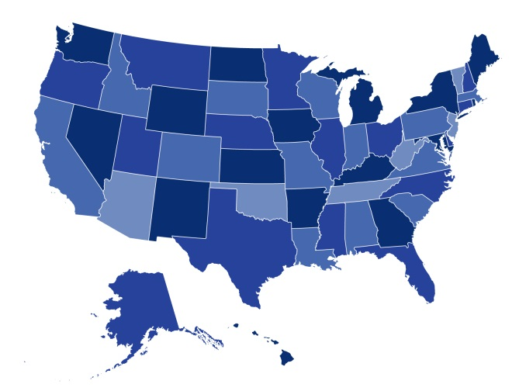

The Affordable Care Act's Health Insurance Marketplaces:
What's the Experience So Far?
January 22, 2014

Slide 2

Overview
Marketplace Establishment Models
Key Design Decisions for Marketplaces
Early Lessons: Challenges and Successes
On the Horizon: What’s Next for Marketplaces?

Slide 3
Marketplace Establishment for 2014
Federally Facilitated Exchange
State Partnership Exchange
State-Based Exchange
Supported State-Based Exchange
“Bifurcated”: Federally facilitated individual; state SHOP
WA
NH
MT
ND
VT
ME
OR
MN
ID
WI
MA
SD
NY
WY
MI
RI
IA
PA
CT
NV
NE
OH
NJ
UT
IL
IN
DE
CA
CO
KS
WV
VA
MD
MO
KY
TN
NC
DC
AZ
NM
OK
AR
SC
MS
AL
GA
TX
LA
AK
FL
HI
Notes:
3

Slide 4
Marketplace Establishment Models: What’s at Stake?
Funding and resources
Regulatory flexibility and guidance
Oversight of insurance markets
Consumer outreach, enrollment, and assistance
Coordination to ensure seamless coverage and regulatory approach

Slide 5

Health Insurance Marketplaces:
How Will Design Decisions Affect Outcomes?
?
Sustainable Exchange
Competitive Marketplace
Meaningful Consumer Choice
Options for Small Businesses
Maximizing Enrollment

Slide 6
State-Based Marketplaces:
Key Design Decisions
Financing: Generally, assessments on QHPs
Maximizing Competition: States had varying approaches to encouraging insurer/plan participation
Measures to maximize choice and value: States took steps to facilitate consumer choice of plans, report on quality, and provide “employee choice” options on SHOP
Outreach and Consumer Assistance: States tailored programs to needs; bigger differences between SBM and FFM states.

Slide 7
Early Lessons:
What Have We Learned So Far?
Opening the door
  Timing and IT
Getting people to the door
  Outreach and education
Getting people through the door
  Accurate enrollment and financial assistance
  Facilitating optimal coverage choices
  Transitions from other coverage
Helping people use their benefits
  Accurately matching people to coverage
  Provider networks
Initial enrollment target: 7 million, including 2.7 million young adults
“The challenges for Part D were not over once beneficiaries had selected and enrolled
in a plan.”
--Hoadley, Corlette et al, 2013

Slide 8
On the Horizon:
What’s Next for the Marketplaces?
Sustainability
Competition and pricing
Consumer experience
Health care delivery
Will coverage—and care—become more accessible, affordable, adequate, and accountable?

Slide 9

Thank you!
Contact:
Sarah J. Dash, MPH
Georgetown Health Policy Institute
Center on Health Insurance Reforms
sd850@georgetown.edu
202-687-1405
For more information:
http://chir.georgetown.edu/

