Slide 1

Integrating Behavioral Health into Primary Care
The Commonwealth Fund Webinar
December 10, 2014

Slide 2
Integrated Behavioral Health Care in Safety Net Primary Care Clinics
Jürgen Unützer, MD, MPH, MA
Professor and Chair, Psychiatry & Behavioral Sciences
Director, AIMS Center (Advancing Integrated Mental Health Solutions)
University of Washington
December 2014

Slide 3

WHO Definition of Health
Health is a state of complete physical, mental and social well-being and not merely the absence of disease or infirmity (1948).
The Challenge
Behavioral Health | Health Behaviors
Psychiatric disorders cause 25% of all disability worldwide.(C. Murray, GBD Study, Lancet 2012) 10% of Years Lived with Disability (YLD) from depression alone. 3x diabetes,10x heart disease, 40x cancer In the US, one suicide every 14 minutes. In WA, 2-3 suicides / day. No family goes untouched. | Behavior determines ~ 50% of all mortality and morbidity. Unhealthy behaviors are major drivers of health care costs. 40% – 50% struggle with treatment adherence. Employers struggle with absenteeism and presenteeism.

Slide 4
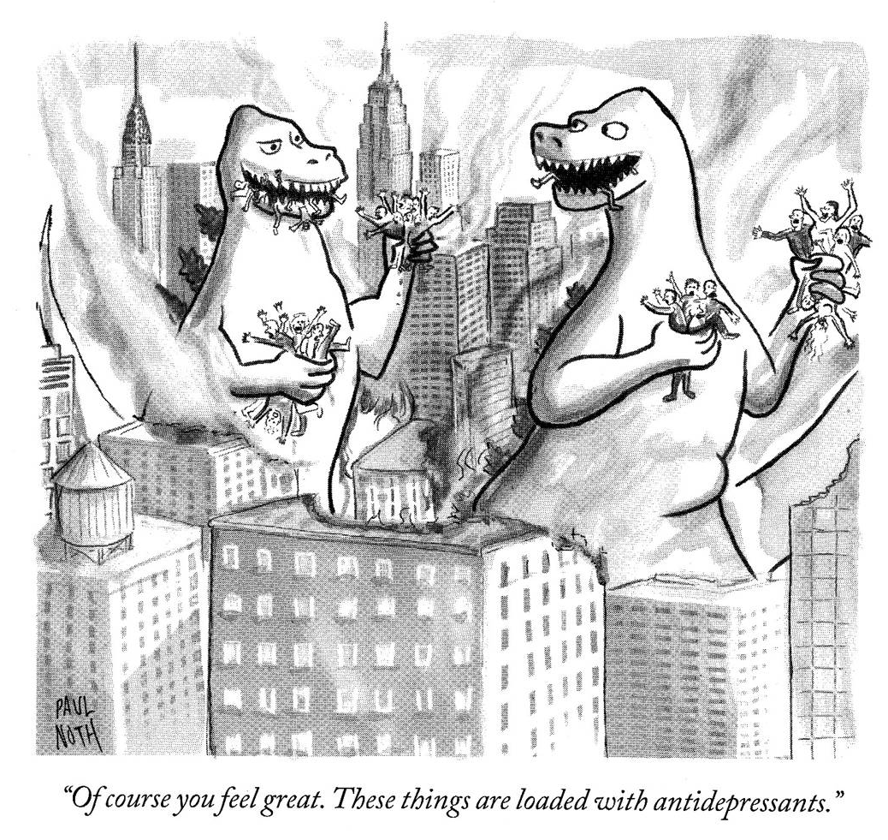
How good is current care?
Fewer than 2/10 see a psychiatrist or psychologist.
5/10 receive treatment in primary care
2/3 of PCPs complain about poor access to mental health care for their patients
~ 30 million receive an antidepressant Rx in primary care
BUT only 25% improve

Slide 5
How do we close the gap?
Train more specialists?
Work harder?
Work smarter! = Integrated care.
Leverage mental health specialists more effectively
- partnerships (e.g., integrated with primary care)
- technology (e.g., telemedicine)
> 80 RCTs of collaborative care vs care as usual: collaborative care consistently more effective. (Archer et al, Cochrane Metaanalysis 2012).

Slide 6


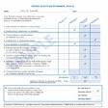



Integrated Care
Primary Care Practice with PCP, Mental Health Care Manager,
and designated Psychiatric Consultant
Outcome
Measures
Treatment
Protocols
Population
Registry
Psychiatric
Consultation

Slide 7
Collaborative Care Doubles Effectiveness of Depression Care
50% or greater improvement in depression at 12 months
%
Participating Organizations
Unützer et al., JAMA 2002; Psych Clin NA 2004
Notes:
So how well does this work? ~ 200 patients in each of 8 hc systems randomized to UC and IV. When we looked at our patients 1 year out, we found …

Slide 8
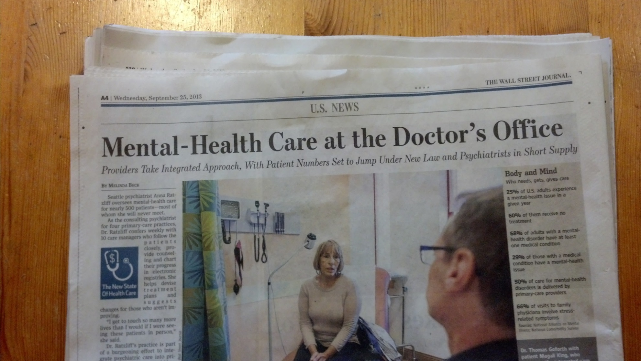
JAMA, Dec 2002 Wall Street Journal, Sept 2013

Slide 9
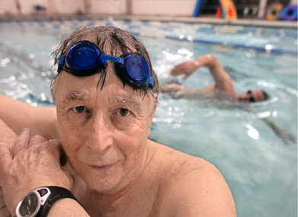
IMPACT: Summary
Improved Outcomes:
Less depression
Less physical pain
Better functioning
Higher quality of life
2) Greater patient and
provider satisfaction
3) More cost-effective
→ THE TRIPLE AIM
“I got my life back”

Slide 10

Taking effective models to scale

Slide 11
Bridging the Implementation Gap
Implementation guide supplement, "Organized, Evidence-Based Care: Behavioral Health Integration"
General outline:
The Case for Behavioral Health Integration
Integrated Behavioral Health Care: What it is and How it Works
Implementing Integrated Behavioral Health Care
Monitoring Progress
Building Integrated Care Teams
Leveraging Success: Spreading and Sustaining

Slide 12
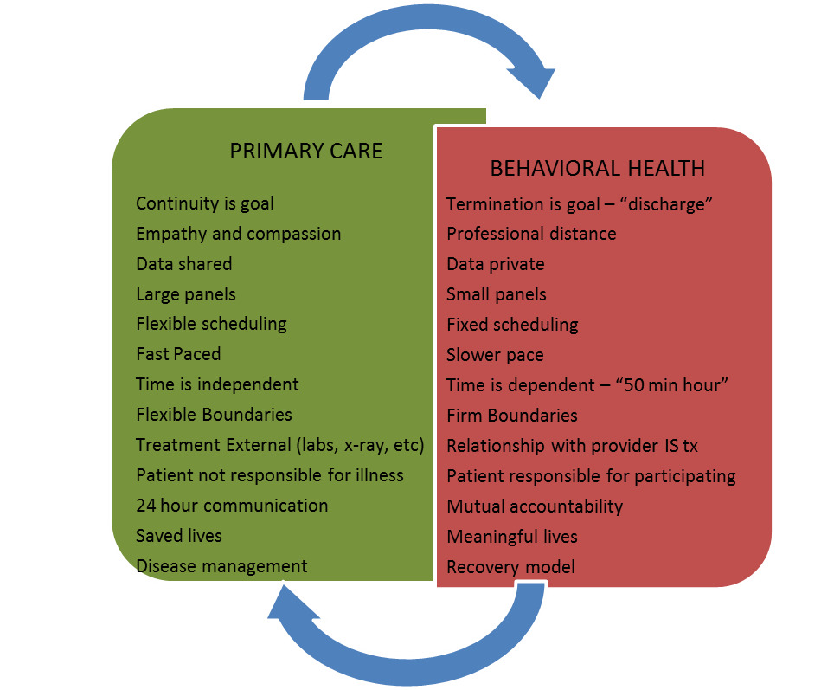
Two Cultures, One Patient

Slide 13


Slide 14
Andrea R Fox MD
Chief Medical Officer
Squirrel Hill Health Center

Slide 15
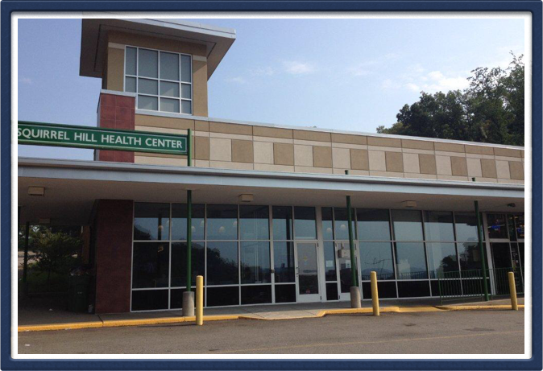
Squirrel Hill Health Center

Slide 16

Squirrel Hill Health Center
Multidisciplinary/multi-ethnic staff
15000 patients, variably insured
52 different languages
Internal medicine, pediatrics, family medicine, OB/GYN, dental
Care navigation
Electronic health record/PCMH
Mobile unit

Slide 17
Behavioral Health Services
1 day weekly psychiatrist
20 hour per week LCSW therapist
Once monthly team meeting
Approximately 35% of practice with psych diagnosis
10% seen by psych or LCSW
Central location with other clinicians

Slide 18
Behavioral Health Team
Psychiatry
LCSW/ Therapist
Primary care providers/dental staff
Care navigator
RNs
Front office staff
Medical assistants
OB/GYN
Americorp members
Administrative staff
ACA counselor

Slide 19
What are the functions of the behavioral staff?
Treat not so sick people
Treat really sick people
Be flexible
Bridge the worlds
See lots of patients really, really fast and solve all their behavioral problems so we can treat their medical problems and not be so bogged down in all their “other” problems.
Take care of us

Slide 20
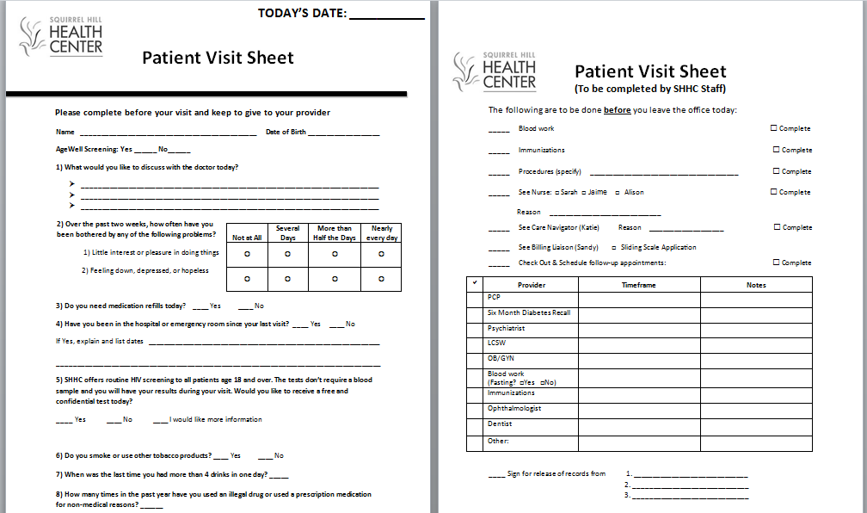

Slide 21

HRSA Grant
Increase psychiatry from 20% to 50%
Increase LCSW from 50% to 100%
Coordinator for fast intervention and tracking
Front office staff
2 FTE peers
6 hour psychologist

Slide 22

Martin Abdo, Certified Peer Specialist and Peer Bridger, Harborview Medical Center, Seattle Washington

Slide 23

www.safetynetmedicalhome.org

