Slide 1
Measuring Progress towards Accountable Care
Insight from Premier’s PACT (Partnership for Care Transformation) Collaboratives
Eugene A. Kroch, PhD
Premier Research Institute
March 14, 2013

Slide 2

The Bridge from FFS to Accountable Care
Current
FFS
System
What are the underpinning building blocks?
Accountable
Care
Accountable Care Core Components
People Centered Foundation
Health Home
ACO Leadership
High Value Network
Population Health Data Management
Payor Partnerships
Foundational Philosophy: Triple Aim™
Measurement
Notes:
What are building blocks
Triple Aim
ACO Model Components

Slide 3
Assessing the State of Readiness
Readiness assessments of 59 organizations during 2010/2011
What characteristics drive organizations to try this model?
What is the state of readiness?
Are organizations generally further ahead in certain capabilities?
What characteristics are associated with being further ahead or further behind?
Description of qualitative trends like physician relationships and market dynamics.
Other key lessons.

Slide 4
Quantitative and Qualitative Assessment
Quantitative Assessment
Qualitative Assessment
For each of the six components:
Spider chart of assessment results
Drivers for ACO development on top priority operating activities for
Readiness to negotiate ACO contract with a payer
ACO impact on the Triple Aim™ objectives
Brief summary of Readiness Assessment scoring results
Attachment – Assessment Scores
A summary of key findings from a set of key open ended questions asked of a C-level representative (CEO, COO, CMO, CNO, etc), assessing their:
Market Environment
Organization Readiness
Strategic Commitment
Clinical Integration

Slide 5
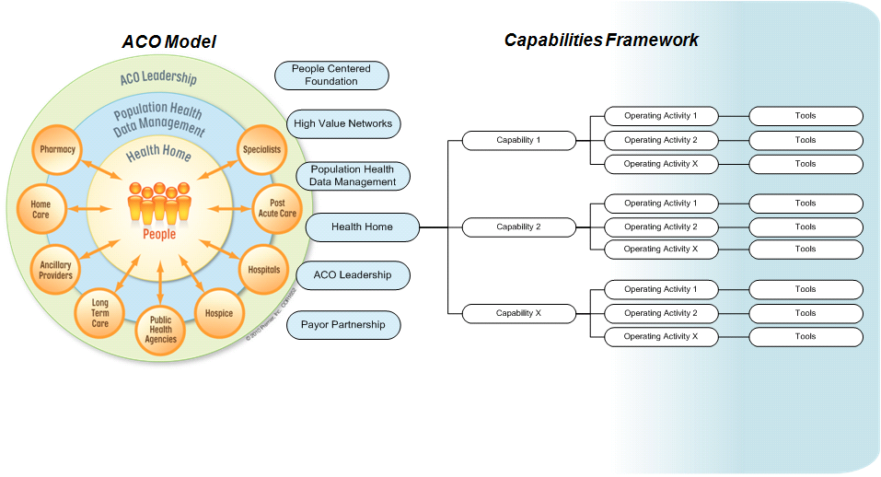
The Capabilities Framework
Notes:
Beyond our conceptual ACO model, we have developed a Capabilities Framework.
The Capabilities Framework serves to inventory all the Capabilities and Operating Activities
Across each of the six core components that an ACO could deploy.
The Framework was developed by Rick Gilfillan, MD and Lynne Rothney-Kozlak
This schematic shown here demonstrates how a single core component, Health Home, has supporting operating capabilities – and each of those capabilities are deployed through operating activities.
The framework also serves to capture tools and deliverables that need to be developed or discovered
In support of those defined operating activities “Tools and deliverables” are defined as systems, processes, methodologies, models through the Accountable Care Guidebooks;
And for the most part, this is what the Implementation collaborative is working on, defining what these tools look like.

Slide 6
Overall Assessment by Component**
Blue = Top Decile
Green = Median
Red = Bottom Decile
**Data from 59 assessments
Notes:
Hi Low Average People Centered Foundation 76% 8% 33% Health Home 64% 0% 24% High Value Network 58% 7% 23% Population Health Data Management 70% 3% 28% ACO Leadership 64% 4% 26% Payor Partnership 58% 0% 24%

Slide 7
Variation Among Organizations with High Component Scores
Scoring well in one component does not always translate to readiness in all components
Blue indicates higher scores
Red indicates lower scores
Notes:
Component Scores Among the Organizations Achieving a Weighted Score of 0.5 or Greater on One or More Components

Slide 8
Top 5 and Bottom 5 Summary
Blue = Top 5
Red = Bottom 5
Notes:
Hi Low Average People Centered Foundation 76% 8% 33% Health Home 64% 0% 24% High Value Network 58% 7% 23% Population Health Data Management 70% 3% 28% ACO Leadership 64% 4% 26% Payor Partnership 58% 0% 24%

Slide 9
Top 5 and Bottom 5 – Lessons from Comparisons
Factors That Differentiate Organizations with High ACO Readiness
Full or partial ownership of a health plan with pop health mgt capabilities Existing collaboration with other health systems in the community Existing risk-based contracts with payers including bundled payments A sophisticated EHR and HIE implementation strategy across the continuum of care Clinical integration across the continuum of care Patient-centered medical home with employed or community providers Positive relationships with primary care and specialty care providers in the market Active governance structures that include physician leadership (e.g. PHOs)
Factors That Do NOT Differentiate
Market share Number of employed physicians Disproportion of the market with government financed health services Financial strength (strong for the entire group) Medicare spending level – low cost areas are not further along High proportion of commercially insured patients Already in active execution of a clinical integration strategy across the system

Slide 10
Collaborative Learning Summary
Managing populations, not just patients, requires fundamental change within most healthcare systems
Fundamental transformation will be clinical, with financial and legal changes to support clinical change
Physician leadership is pivotal and significant culture shifts need to occur within organizations
Care models to define evidence-based standards of care delivery and coordination across the continuum of care are critical building blocks to an ACO
Executive leadership within C-Suite and Board are vital
Keys to success include a primary care foundation, plus strong informatics and IT
Variability of models is a given…flexibility and innovation is market driven
Shared learning collaborative is both a motivator and supportive structure
Private payor readiness to alter reimbursement and share data to support ACO model varies widely
Unknowns are plentiful…public and private sector have a lot to learn to effectively transform health care
10

Slide 11
The Team
Eugene Kroch
Danielle Lloyd
Joe Damore
Amanda Forster
Diane Shannon
Blair Childs
Lynne Rothney-Kozlak
Seth Edwards
Marla Kugel
Parker Marsh

