Slide 1
Birth center deliveries have grown since 2004 but still account for less than
1 percent of all U.S. births.
EXHIBIT 1
Percentage of all U.S. births that occur in birth centers
1989
0.35%
14,273 births
2004
0.23%
9,620 births
170% increase
from 2004 to 2024 in
proportion of birth center births
2024
0.62%
22,635 births
Data: Centers for Disease Control and Prevention, National Center for Health Statistics, National Vital Statistics System Birth Data, and CDC WONDER Natality Information.

Slide 2
The percentage of birth center births varies widely across U.S. states.
EXHIBIT 2
Percentage of a state's births that occurred in a birth center in 2023–2024
Note: Four states — Alabama, Hawaii, North Dakota, and Rhode Island — had fewer than 10 births that occurred in birth centers.
Data: Centers for Disease Control and Prevention, CDC WONDER Natality Information.

Slide 3
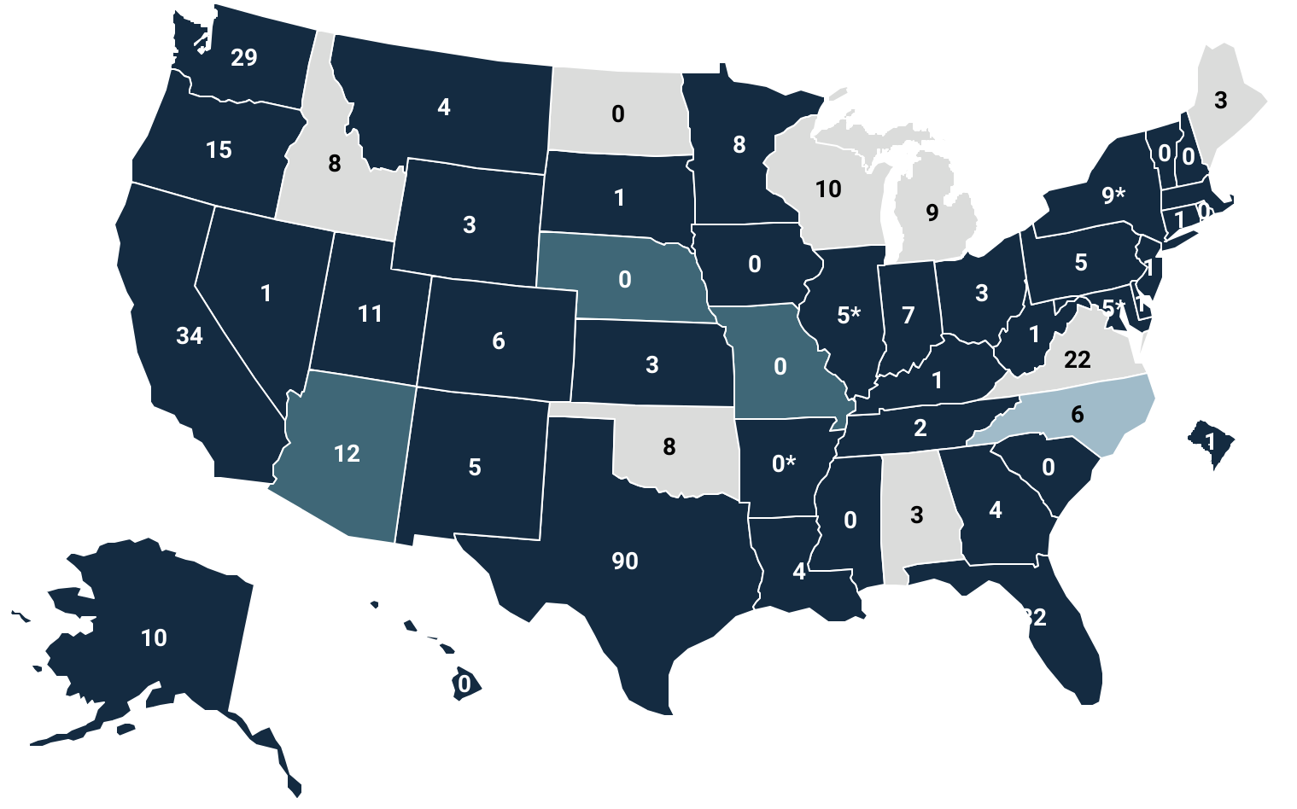
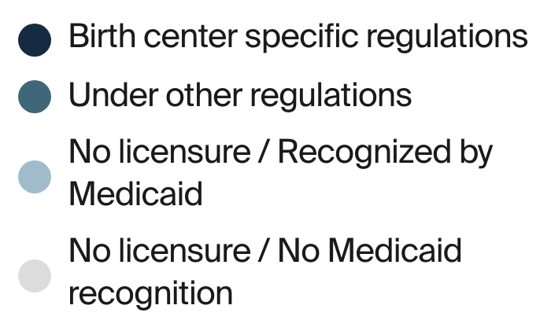
Texas has the most birth centers of any U.S. state.
EXHIBIT 3
Number of birth centers, by state and licensure/Medicaid recognition
*Certificate of Need required by for birth center.
Data: American Association of Birth Centers, Oct. 2025.

Slide 4
Birth center births are concentrated among non-Hispanic white women.
EXHIBIT 4
Percentage of all birth center births by race/ethnicity
Data: Centers for Disease Control and Prevention, CDC WONDER Natality Information.

Slide 5
Compared to hospital births, birth-center births are more often self-paid and involving people with fewer clinical risk factors and higher college attainment.
EXHIBIT 5a
Percentage of U.S. births, 2024
Data: Centers for Disease Control and Prevention, CDC WONDER Natality Information.

Slide 6
Compared to hospital births, birth-center births are more often self-paid and involving people with fewer clinical risk factors and higher college attainment.
EXHIBIT 5b
Percentage of U.S. births, 2024
* Chronic or gestational.
Note: BMI = body mass index.
Data: Centers for Disease Control and Prevention, CDC WONDER Natality Information.

Slide 7
Compared to hospital births, birth-center births are more often self-paid and involving people with fewer clinical risk factors and higher college attainment.
EXHIBIT 5c
Percentage of U.S. births, 2024
Data: Centers for Disease Control and Prevention, CDC WONDER Natality Information.

Slide 8
Certified nurse-midwives attended nearly half of all birth center births.
EXHIBIT 6
Number of U.S. birth center births, by medical profession
2024
22,635 births
Certified
Nurse-Midwives and Certified Midwives
2004
9,620 births
Certified professionals
Other
MDs and DOs
Notes: DOs = doctors of osteopathic medicine. “Other” could involve partners or fathers in some cases, as well as instances with ambiguity around the official attendant reported on the birth certificate.
Data: Centers for Disease Control and Prevention, CDC WONDER Natality Information.

