Slide 1
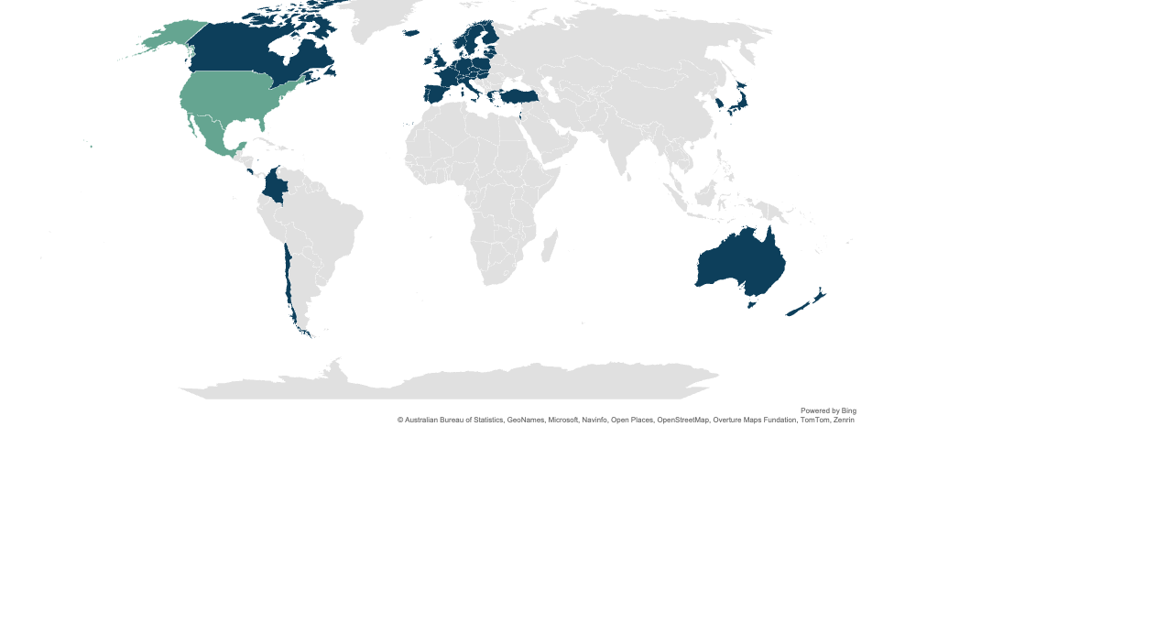
The U.S. and Mexico are the only countries in the analysis that have yet to achieve universal coverage.
Has achieved universal coverage
Has not achieved universal coverage
Data: OECD Health Statistics 2026.

Slide 2
U.S. life expectancy at birth is nearly three years lower than the OECD average.
Life expectancy at birth, 1990–2024*
Notes: * Where 2024 data are available. 2024 data: CHL, MEX, US; 2023 data: AUS, CAN, DNK, FRA, GER, ISR, ITA, JPN, KOR, NETH, NZ, NOR, ESP, SWE, SWIZ, UK; 2022 data: TUR. Total population at birth. OECD average reflects the average of 38 OECD member countries, including ones not shown here. Because of methodological differences, JPN and UK data points are estimates. Time-series break for ISR. ** Average among countries with available data in 2023.
Data: OECD Health Statistics 2026. US data come from: Jiaquan Xu et al., Mortality in the United States, 2024 (National Center for Health Statistics, Jan. 2026).

Slide 3
Avoidable deaths in the U.S. are above the average rate for OECD countries.
Avoidable deaths per 100,000 population (standardized rates), 2000–2023*
Notes: Avoidable mortality includes deaths which are preventable and treatable. * Where 2023 data are available. 2023 data: AUS, NETH, ESP, SWE, SWIZ, TUR; 2022 data: CAN, CHL, DNK, FRA, ISR, ITA, KOR, MEX, US; 2021 data: JPN, UK; 2020 data: GER; 2018 data: NZ; 2016 data: NOR. OECD average reflects the average of 38 OECD member countries, including ones not shown here. ** Average among countries with available data in 2023.
Data: OECD Health Statistics 2026.

Slide 4
The U.S. is a global outlier when it comes to health care spending.
Percent of GDP spent on health, 1990–2024
Notes: 2024 data for all countries. Annual expenditures on health for all functions by all providers for all financing schemes. Data points reflect share of gross domestic product. Based on System of Health Accounts methodology, with some differences between country methodologies. GDP = gross domestic product. Data for AUS, JPN, MEX, NOR, ESP, TUR are estimated; data for CAN, CHL, DNK, FRA, GER, ITA, KOR, NETH, NZ, SWE, SWIZ, UK are provisional; definition for ISR differs compared to other countries. OECD average reflects the average of 38 OECD member countries, including ones not shown here.
Data: OECD Health Statistics 2026. US data come from Centers for Medicare and Medicaid Services, “NHE Fact Sheet,” last updated Jan. 14, 2026.

Slide 5
The U.S. spends far more on health care per person than other countries spend.
Dollars (USD) per capita spent on health
Notes: Data reflect annual constant prices for all financing schemes on all functions of expenditures on health by all providers from 2024 for all countries. Data for AUS, ISR (voluntary schemes), JPN, MEX, NOR, ESP, TUR, US are estimated; data for CAN, CHL, DNK, FRA, GER, ITA, KOR, NETH, NZ, SWE, SWIZ, UK are provisional. Definition for government/compulsory scheme for Israel is different compared to other countries. Government health insurance refers to public benefit basket covering a minimum set of health services. Voluntary health insurance refers to payments for private insurance premiums, which grant coverage for services from private providers. In the US, “government/compulsory health insurance” includes Medicaid, State Children’s Health Insurance Program, state-sponsored or other government sponsored health plans, including Medicare, disability, military plans, and a number of other very small public health coverage programs. See more information on definitions here.
Data: OECD Health Statistics 2026.

Slide 6
Americans spend more on pharmaceuticals than people in other countries — nearly double the OECD average.
Annual household out-of-pocket payments on pharmaceuticals and other medical nondurable goods, per person (USD)
OECD average: $244
Notes: Annual expenditure spent on household out-of-pocket payments for pharmaceuticals and other medical nondurable goods, US dollars per person, PPP converted, constant prices 2020. 2024 data: CAN, DNK, ITA, KOR; NETH; 2023 data: CHL, FRA, GER, JPN, ESP, SWE, SWIZ, UK, US; 2022 data: AUS, MEX, NOR. Data for CAN, DNK, ITA, JPN, KOR, NETH are provisional. OECD average reflects the average of the most recent data available within the past six years of 34 OECD member countries, including ones not shown here.
Data: OECD Health Statistics 2026.

Slide 7
Patients in the U.S. are the most likely to skip needed care because of costs.
Percent of population
Notes: Prescribed medicines skipped due to costs — 2024 data: AUS, KOR, NETH; 2023 data: CAN; 2021 data: ISR; 2020 data: FRA, GER, NZ, NOR, ESP, SWE, SWIZ, UK, US. Medical tests, treatment, or follow-up skipped due to costs — 2024 data: KOR, NETH; 2023 data: CAN, ITA; 2021 data: ISR; 2020 data: AUS, FRA, GER, NZ, NOR, SWE, SWIZ, UK, US. Consultation skipped due to costs — 2024 data: AUS, KOR, NETH; 2023 data: CAN, ITA; 2021 data: ISR; 2020 data: FRA, GER, NZ, NOR, ESP, SWE, SWIZ, UK, US.
Data: OECD Health Statistics 2026.

Slide 8
The U.S. produces new physicians at one of the lowest rates.
Health physician graduates, per 100,000 inhabitants
OECD average: 14.5
Notes: 2024 data: CHL, JPN, NZ; 2023 data: AUS, DNK, FRA, GER, ISR, ITA, KOR, MEX, NETH, NOR, ESP, SWE, SWIZ, TUR, US; 2022 data: CAN, UK. Definition for FRA differs from other countries. Data for MEX are estimated. OECD average reflects the average of the most recent data available within the past six years of 36 OECD member countries, including ones not shown here.
Data: OECD Health Statistics 2026.

Slide 9
The U.S. has the fewest number of primary care providers per 1,000 people.
General medical practitioners (primary care providers) per 1,000 people
OECD average: 1.1
Notes: 2024 data: CHL, NZ; 2023 data: AUS, CAN, DNK, FRA, GER, ISR, ITA, KOR, MEX, NETH, NOR, ESP, SWIZ, TUR, UK; 2022 data: SWE, US. Data for AUS, NZ, UK are estimated; data for ITA are provisional; definition for ESP is different compared to other countries. OECD average reflects the average of the most recent data available within the past six years of 35 OECD member countries, including ones not shown here.
Data: OECD Health Statistics 2026.

Slide 10
The total number of hospital beds in the U.S. is lower than the OECD average.
Number of hospital beds per 1,000 population
OECD average: 4.3
Notes: 2024 data: CHL, DNK, ISR, NZ; 2023 data: CAN, FRA, GER, ITA, JPN, KOR, MEX, NETH, NOR, ESP, SWE, SWIZ, TUR; 2022 data: US. OECD average reflects the average of the most recent data available within the past six years of 36 OECD member countries, including ones not shown here.
Data: OECD Health Statistics 2026.

Slide 11
Most patients in the U.S. report having a positive relationship with their regular doctor.
Percent of patients age 16 years and older who said “yes”
Notes: 2024 data: NETH, ESP; 2023 data: CAN; 2021 data: ISR; 2020 data: AUS, FRA, GER, NZ, NOR, SWE, SWIZ, UK, US.
Data: OECD Health Statistics 2026.

Slide 12
Potential years of life lost are highest in the U.S. and Mexico.
Potential years of life lost, at 75 years of age, per 100,000 people
OECD average: 4,762
Notes: 2023 data: AUS, NETH, ESP, SWE, SWIZ, TUR; 2022 data: CAN, CHL, DNK, FRA, ISR, ITA, KOR, MEX, US; 2021 data: JPN, UK; 2020 data: GER. OECD average reflects the average of the most recent data available within the past six years of 36 OECD member countries, including ones not shown here Potential years of life lost is a summary measure of premature mortality, providing an explicit way of weighting deaths occurring at younger ages, which may be preventable. The calculation involves totaling deaths occurring at each age and multiplying this with the number of remaining years to live up to a selected age limit (75 years of age is used in OECD Health Statistics). In order to assure cross-country and trend comparison, the potential years of life lost are standardized, for each country and each year. The total OECD population in 2015 is taken as the reference population for age standardization. This indicator is measured as a total number of years lost per 100,000 inhabitants ages 0–74, by gender.
Data: OECD Health Statistics 2026.

Slide 13
In all countries, women live longer than men. Differences in life expectancy between men and women are widest in Mexico, Japan, and Korea.
Life expectancy in years by gender, sorted by the largest to smallest gender gap
Notes: 2024 data: CHL, MEX, US; 2023 data: AUS, CAN, DNK, FRA, GER, ISR, ITA, JPN, KOR, NETH, NZ, NOR, ESP, SWE, SWIZ, UK; 2022 data: TUR. Time break series for ISR. OECD average reflects the average of the most recent data available within the past six years of 38 OECD member countries, including ones not shown here.
Data: OECD Health Statistics 2026. US data come from: Jiaquan Xu et al., Mortality in the United States, 2024 (National Center for Health Statistics, Jan. 2026).

Slide 14
In all countries, men are more likely than women to die from an avoidable cause. Differences are widest in Mexico and the U.S.
Avoidable deaths per 100,000 inhabitants, by gender, sorted by the largest to smallest gender gap
Notes: 2023 data: AUS, NETH, ESP, SWE, SWIZ, TUR; 2022 data: CAN, CHL, DNK, FRA, ISR, ITA, KOR, MEX, US; 2021 data: JPN, UK; 2020 data: GER. OECD average reflects the average of the most recent data available within the past six years of 36 OECD member countries, including ones not shown here.
Data: OECD Health Statistics 2026.

Slide 15
Black women in the U.S. have the highest maternal death rate in the OECD.
Maternal mortality, deaths per 100,000 live births
OECD average: 9.5
Notes: 2024 data: CHL; 2023 data: CAN, GER, JPN, KOR, MEX, NETH, NOR, ESP, SWE, SWIZ, TUR, US; 2022 data: AUS, DNK, ISR, ITA; 2020 data: NZ. Data for CHL are provisional; definitions for AUS and DNK differ from other countries; data for NETH and NZ are estimated. OECD average reflects the average of the most recent data available within the past six years of 36 OECD member countries, including ones not shown here.
Data: OECD Health Statistics 2026. US race and ethnicity data come from: Donna L. Hoyert, “Health E-Stat 100: Maternal Mortality Rates in the United States, 2023,” National Center for Health Statistics, Centers for Disease Control and Prevention, Feb. 2025.

Slide 16
The U.S. has one of the highest suicide rates.
Intentional self-harm (standardized rates), deaths per 100,000 inhabitants
OECD average: 10.7
Notes: 2023 data: AUS, NETH, ESP, SWE, SWIZ, TUR; 2022 data: CAN, CHL, DNK, FRA, ISR, ITA, KOR, MEX, US; 2021 data: JPN, UK; 2020 data: GER. OECD average reflects the average of the most recent data available within the past six years of 36 OECD member countries, including ones not shown here. Urban and rural US data are from 2022.
Data: OECD Health Statistics 2026. Urban and rural US data come from: Alison L. Cammack et al., “Vital Signs: Suicide Rates and Selected County-Level Factors — United States, 2022,” Morbidity and Mortality Weekly Report 73, no. 37 (Sept. 19, 2024): 810–18.

