Slide 1


A New Era in Telemedicine: Opportunities, Challenges, and What Comes Next
Webinar: January 31, 2023
Thank you for joining us today, the webinar will begin in a moment.

Slide 2
Panelists
Francesca Colombo, M.Sc., Head, Health Division, OECD
Tiago Hashiguchi, M.Sc., Ph.D., Lead Author of OECD Report on Telemedicine
Niki O’Brien, M.Sc., Policy Fellow in Global Health, Centre for Health Policy, Institute of Global Health Innovation, Imperial College London
Ana Luisa Neves, M.D., M.Sc., Ph.D., Clinical Senior Lecturer in Digital Health, Director of the Global Digital Health Unit, Department of Primary Care and Public Health, Imperial College London
Dimitra Panteli, M.D., M.Sc.P.H., Dr.P.H., Programme Manager, European Observatory
Ann Mond Johnson, M.B.A., M.H.A., CEO, American Telemedicine Association
Jelena Malinina, M.Sc., Patient Data Director, EURORDIS
Moderated by Reginald D. Williams II, Vice President of International Health Policy and Practice Innovations at the Commonwealth Fund

Slide 3
The COVID-19 Pandemic and the Future of Telemedicine
A new era in telemedicine: opportunities, challenges, and what comes next
Tiago Cravo Oliveira Hashiguchi
Lead Author of the OECD Report
Webinar, 31 January 2023

Slide 4
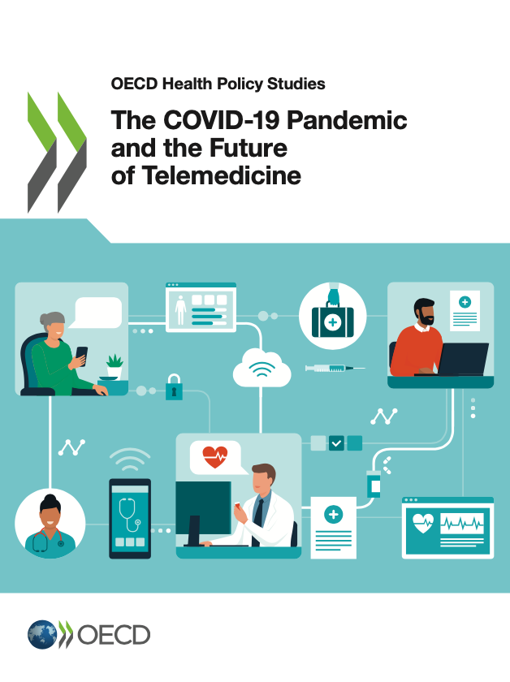
In early 2020, the use of telemedicine was very limited Then the COVID-19 pandemic changed everything
In January 2020:
Telemedicine services still represented only a small fraction of all health care activity and spending
Providers and patients faced barriers to telemedicine use, like lack of reimbursement, unclear liability, and privacy concerns
Just a few weeks later:
The COVID-19 pandemic massively disrupted in-person care.
Governments acted decisively and broadly to promote the use of telemedicine.
https://doi.org/10.1787/ac8b0a27-en

Slide 5
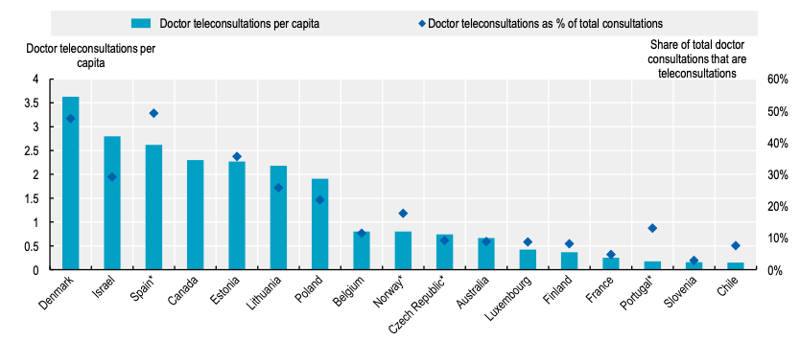
The use of telemedicine skyrocketed, partly compensating for reduced in-person care
Doctor teleconsultations per capita and as a share of total doctor consultations, in 2020
Note: All values are provisional; * Norway excludes teleconsultations by medical specialists, Spain covers consultations to generalist and paediatricians who work in primary health care centres of the National Health System; values for the Czech Republic are estimates. Data for Portugal are from the “Portal da transparência”, a data website of the National Health Service. Source: OECD Health Statistics (2022); OECD ad-hoc data collection on teleconsultations (2022).

Slide 6



Positive impact on access and patient experience, More analysis needed on equity and efficiency
Telemedicine has been crucial in maintaining access to care during the pandemic, but inequalities in access remain a key concern
Patient experiences with telemedicine are positive and satisfaction is very high
Some physicians expect to reduce their use of telemedicine services or even stop using them altogether following a period of increased use in 2020.
Quick scale up of telemedicine may have led to unnecessary and substandard care
A key underlying uncertainty is whether telemedicine services substitute for or complement in-person care, and whether remote care is good value for money.
Lack of data collection in OECD countries hinders better understanding.

Slide 7


Policy priorities for telemedicine use in the near future
Promoting high-quality person-centred telemedicine services:
Learn more about which patients are using remote care services, why they are using these services and what happens after they use them
Investigate whether telemedicine payment and prices, are creating economic signals and incentives that promote value for money
Foster integration between remote and in-person care services so that these are fully coordinated and part of a seamless care pathway

Slide 8
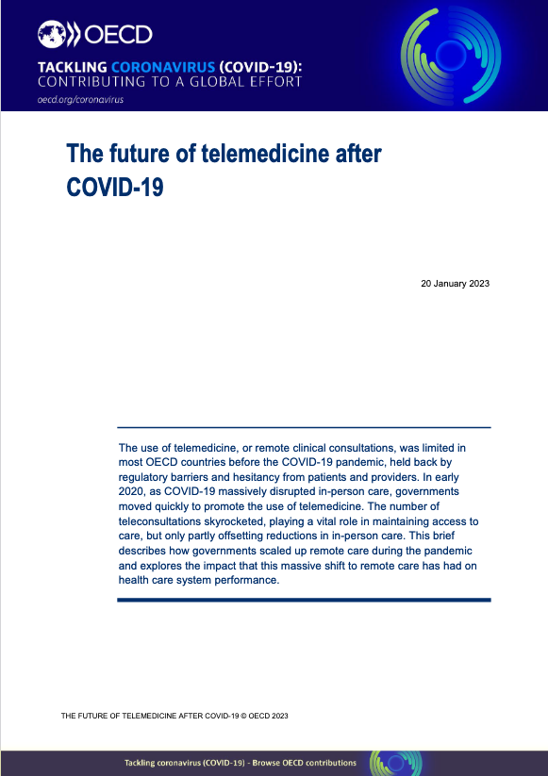
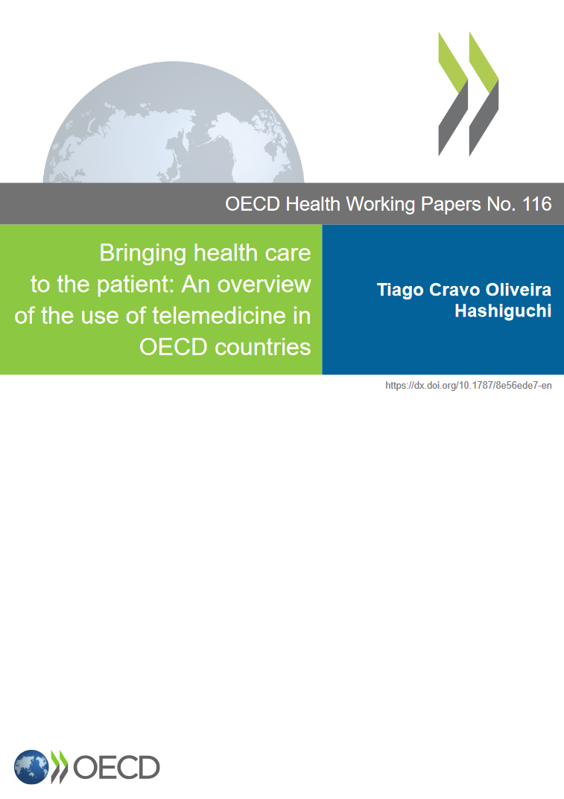
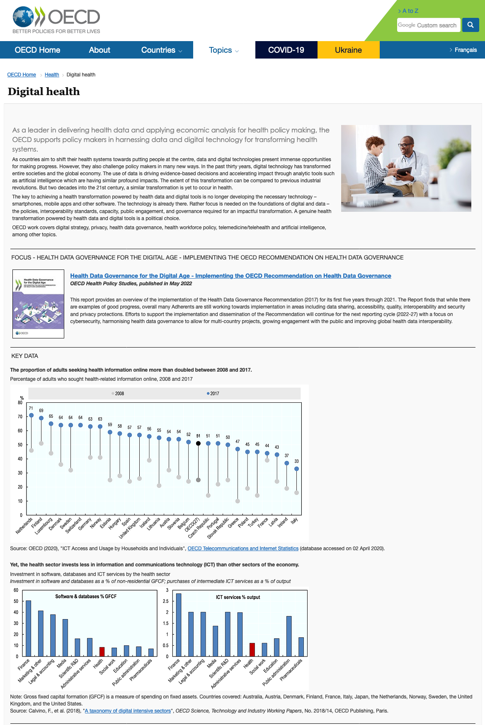

Read more @ www.oecd.org/health & www.oecd.org/coronavirus
Follow us on Twitter
@OECD_social
Email us
luca.lorenzoni@oecd.org

