Slide 1
MEDICARE DATA HUB Prescription & Outpatient Drugs
October 2022

Slide 2
Enrollment in Medicare stand-alone prescription drug plans dropped slightly between 2020 and 2021.
PRESCRIPTION & OUTPATIENT DRUGS: ENROLLMENT
Prescription Drug Plan (PDP) Enrollment in Millions
Percent of All Medicare Beneficiaries
Source: CMS PDP State/County Penetration File, March 2021.
Note: Enrollment estimates do not include records denoted as pending state or county designation. This file contains data for the following organization types (where there are active contracts): PDP; employer/union-only direct-contract PDP.
Notes:
A total of approximately 24.3 million Medicare beneficiaries enrolled in a Medicare stand-alone prescription drug plan in 2021. Relative to 2020, this represents a drop of nearly 4 percent.
The proportion of Medicare beneficiaries enrolled in stand-alone prescription drug plan remained relatively unchanged over the past decade. Between 2013 and 2019, approximately 44 percent of Medicare beneficiaries enrolled in a stand-along prescription drug plan. The proportion of beneficiaries enrolled in a stand-alone Part D plan fell modestly – from 43 percent to 39 percent - between 2019 and 2021.
Recent trends in PDP enrollment may partly reflect beneficiaries switching to Medicare Advantage plans that offer a Part D benefit (MA-PD).

Slide 3
Rates of enrollment in Medicare stand-alone prescription drug plans (PDPs) is highest in rural states with low Medicare Advantage enrollment rates.
PRESCRIPTION & OUTPATIENT DRUGS: ENROLLMENT
Medicare Beneficiaries Enrolled in PDP Plan (%)
National % enrolled in PDP Plan: 38.7%
National PDP enrollment: Approx. 24.3 million
Source: CMS Monthly Enrollment by State, March 2021.
Notes:
Overall, more than 24 million beneficiaries, or nearly 39 percent of all beneficiaries, enrolled in a stand-alone prescription drug plan in 2021.
Substantial variation in rates of PDP enrollment are observed across the U.S. Rates of enrollment in PDPs ranged from 30 percent or less in the state of Alabama (28 percent), Hawaii (25 percent), and Oregon (30 percent) to more than 60 percent in several states with large rural populations and lower Medicare Advantage penetration. These included the states of Alaska (65 percent), North Dakota (66 percent), South Dakota (61 percent), and Wyoming (63 percent).

Slide 4
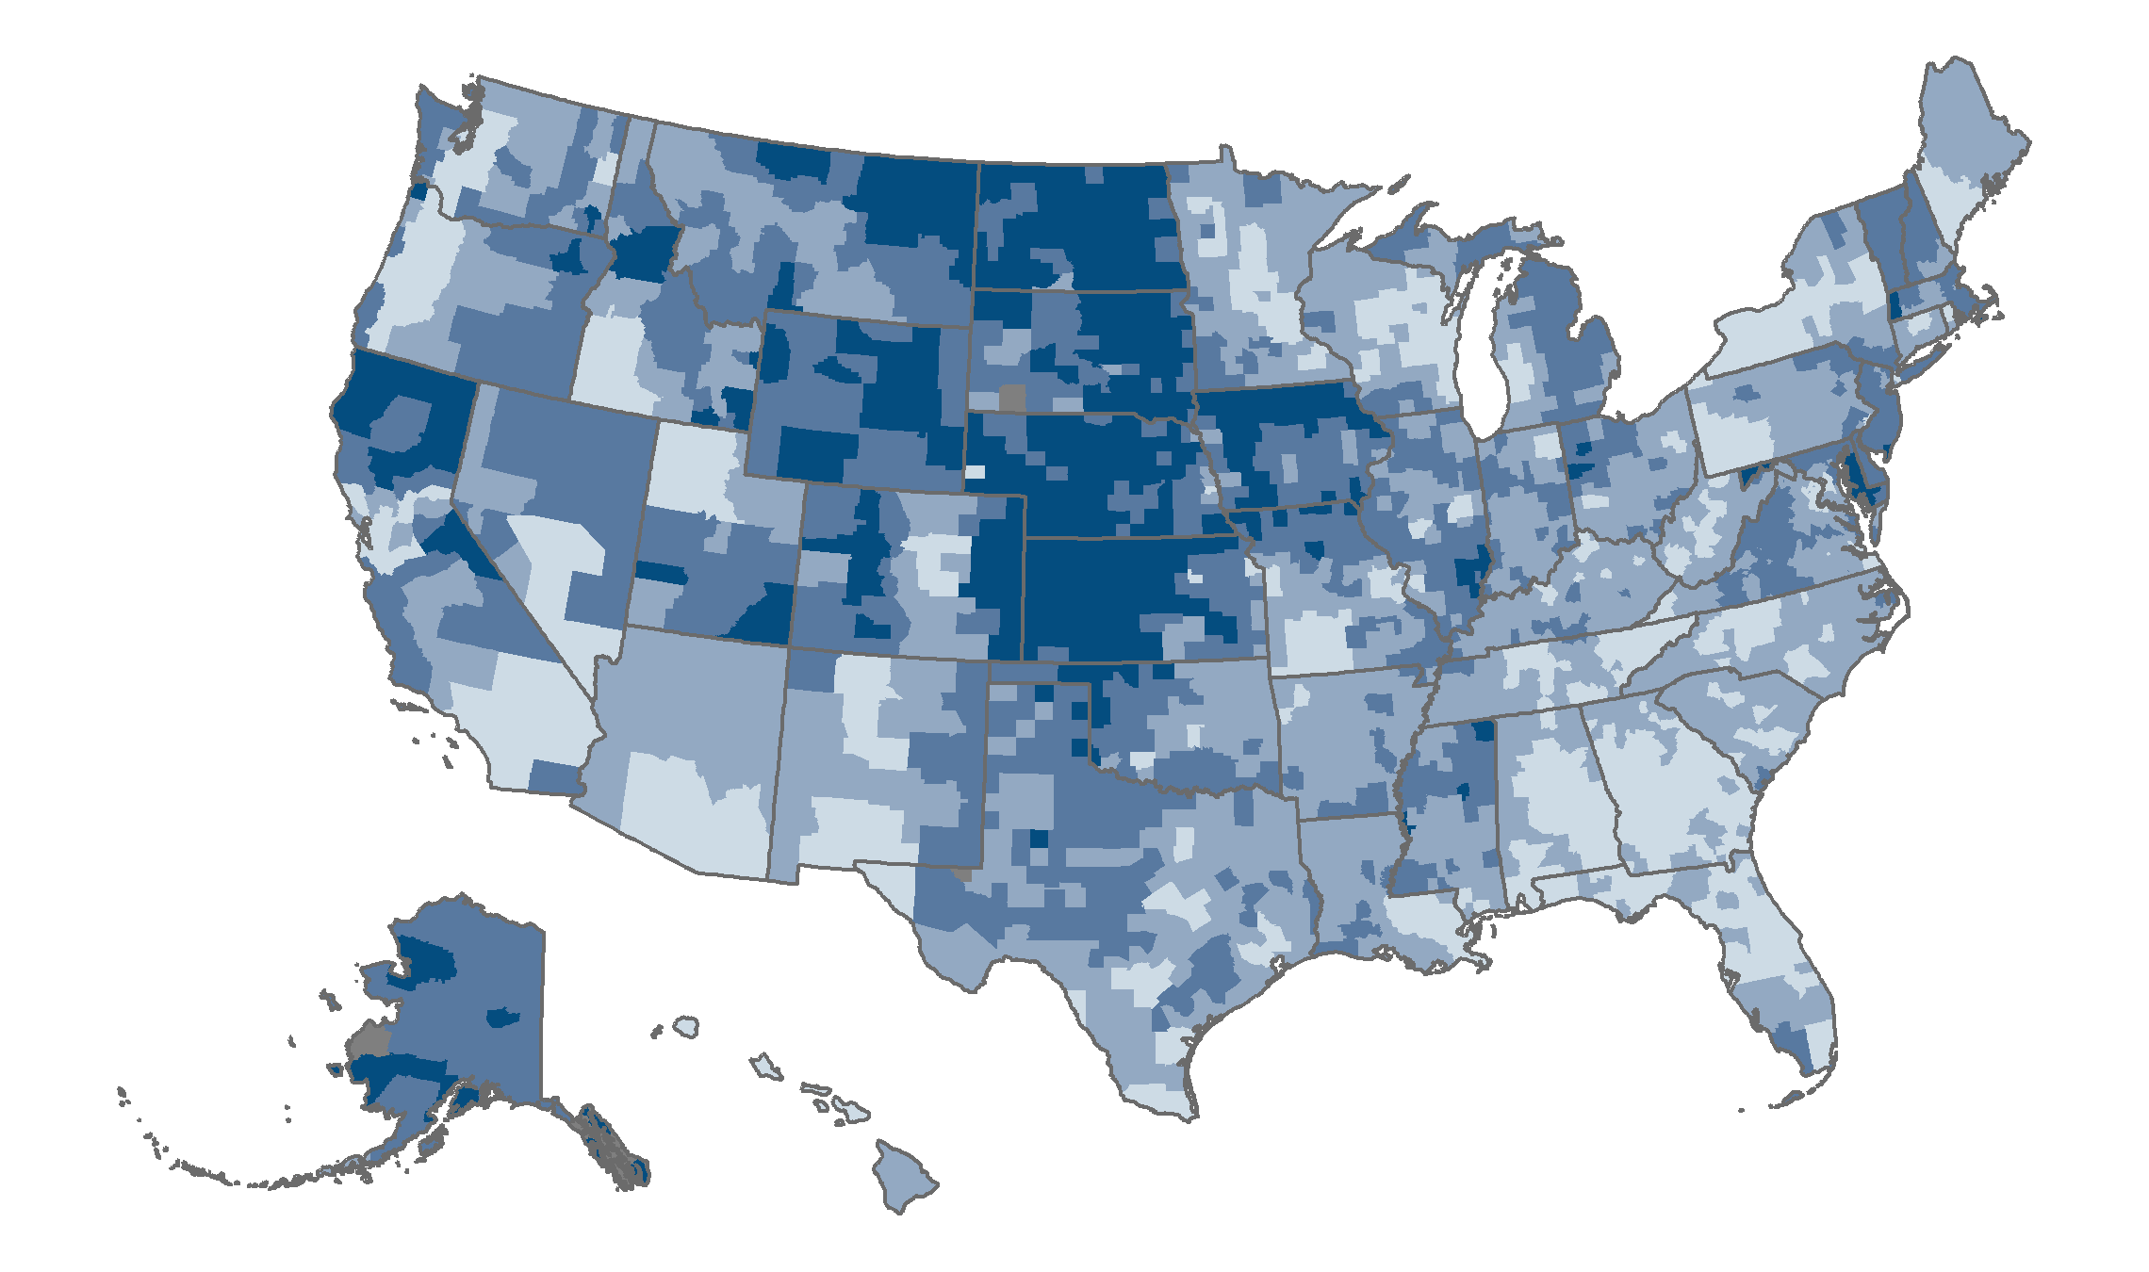
Across counties, enrollment in stand-alone prescription drug plans (PDPs) ranges from less than 1 percent to 78 percent of Medicare beneficiaries.
PRESCRIPTION & OUTPATIENT DRUGS: ENROLLMENT
<1%–34%
35%–49%
50%–64%
65%–90%
No PDP enrollment or missing data
Source: CMS PDP State/County Penetration File, March 2021.
Note: Enrollment estimates do not include records denoted as pending state or county designation.
Notes:
Excluding U.S. territories, rates of enrollment in stand-alone prescription drug plans (PDPs) varies from a high of almost 91 percent in the small communities of McCone County, Montana, and Wheeler County, Nebraska, to less than 17 percent in El Paso County, Texas, and Liberty County, Georgia.
Approximately two-thirds of all counties have PDP enrollment rates of 40 percent or higher. Among the most populous counties in the country, PDP enrollment rates are as follows:
Cook County, Illinois, 44 percent;
Kings County, New York, 37 percent
Maricopa County, Arizona, 34 percent;
Los Angeles County, California, 34 percent;
Orange County, California, 32 percent;
Harris County, Texas, 31 percent;
Clark County, Nevada, 27 percent;
San Diego, California, 26 percent;
Riverside County, California, 24 percent;
Miami-Dade County, 17 percent.

Slide 5
Between 2021 and 2022, the average number of stand-alone prescription drug plans fell by almost one-quarter.
PRESCRIPTION & OUTPATIENT DRUGS: AVAILABILITY
Source: CMS State/County Penetration, and PDP Landscape Source Files, 2010–2022.
Note: Data represent the average number of plans operating in counties across the U.S., weighted by the number of Medicare beneficiaries in each year. (Data for 2021 are weighted by September 2020 beneficiaries.) Employer-sponsored plans and plans under sanction are excluded. Estimates do not include records denoted as pending state or county designation.
Notes:
The average number of stand-along prescription drug plans available to Medicare beneficiaries has fluctuated over the past decade. Following a period of decline between 2014 and 2017 in which the average number of stand-alone prescription drug plans fell from 33 to 20, the number of available plans grew steadily, averaging 30 in 2021. Between 2021 and 2022, however, the average number of stand-alone prescription drug plans feel by almost one-quarter, to 23.

Slide 6
Average premiums for stand-alone prescription drug plans (PDP) in 2022 are $48 per month, on average.
PRESCRIPTION & OUTPATIENT DRUGS: BENEFITS
Range
Source: CMS Plan and Premium Information for Plans Offering Part D Coverage, 2022.
Notes: Amounts represent total Part D premiums, which are the sum of the Basic and Supplemental Premiums. Total premium may be lower than the sum of the basic and supplemental premiums because of negative basic or supplemental premiums. MA-PD average excludes employer-sponsored plans, Part B–only plans, demonstration, cost plans, and plans not offering Part D benefits.
Notes:
Monthly premiums for stand-alone prescription drug plans (PDP) averaged $48 in 2022. Stand-alone PDP premiums are about 2.8 times higher than premiums for the prescription drug component of MA plans, which averaged $17 a month.
Average premiums for enhanced plans are approximately $5 more per month than for basic PDPs ($50 vs. $45), a difference of about 11 percent.

Slide 7
Between 2021 and 2022, premiums for Part D stand-alone prescription drug plans increased by 16 percent.
PRESCRIPTION & OUTPATIENT DRUGS: BENEFITS
Weighted by plan enrollment
Source: CMS Plan and Premium Information for Plans Offering Part D Coverage, 2011–2022.
Notes: Data represent average plan premiums weighted by plan enrollment and are not adjusted for inflation. Amounts represent total Part D premiums, which are the sum of the basic and supplemental premiums. Total premium may be lower than the sum of the basic and supplemental premiums because of negative basic or supplemental premiums. Employer-sponsored plans and plans under sanction are excluded.
Notes:
Despite slight annual fluctuation, Part D stand-alone prescription drug plan (PDP) premiums remained relatively unchanged between 2011 and 2021. Between 2021 and 2022, however, average PDP premiums increased by approximately $6, a difference of about 16 percent.

Slide 8
Beginning in 2021, more beneficiaries receiving a Part D low-income subsidy (LIS) are in Medicare Advantage plans than stand-alone prescription drug plans.
PRESCRIPTION & OUTPATIENT DRUGS: LOW INCOME SUBSIDY
MA-PD = Medicare Advantage prescription drug plan; PDP = Stand-alone prescription drug plan.
Source: CMS Low Income Subsidy Enrollment by Plan, 2010-2021.
Note: Enrollment estimates do not include plan records suppressed because of a value of 10 or less. Only includes Medicare Advantage plans with Part D coverage.
Notes:
The Medicare low-income subsidy (LIS) program provides financial assistance to Medicare beneficiaries with low income for out-of-pocket costs associated with prescription drugs, like deductibles and premiums. In 2021, nearly 13 million Medicare beneficiaries enrolled in either a Medicare Advantage prescription drug (MA-PD) plan or a stand-alone PDP receive a low-income subsidy. Although the total number of beneficiaries receiving a LIS remained unchanged between 2020 and 2021, over the past decade, the total number of beneficiaries receiving a LIS increased by over 20 percent.
Of the 13 million Medicare beneficiaries that receive a LIS in 2021, about 6.8 million are enrolled in MA-PDs and 6.0 million are enrolled in a stand-alone PDP. Over the past decade, the number of beneficiaries in MA-PD plans who received a LIS declined from around 8.3 million to 6.0 million in 2021, a reduction of more than one quarter. At the same time, the number of Medicare beneficiaries in stand-alone PDPs that received LIS increased from 2.5 million in 2012 to 6.8 million in 2021, a close to three-fold increase.

Slide 9
Between 2019 and 2021, drug spending in Medicare Part D rose twice as fast as drug spending in Part B.
PRESCRIPTION & OUTPATIENT DRUGS: SPENDING
Part B Drug Spending
Per Capita
Change, 2019–2021: +5%
Part D Drug Spending
Per Capita
Change, 2019–2021: +10%
Data: Analysis of Medicare claims data for 2019 to 2021.
Note: Part B spending (for drugs provided in doctors’ offices and hospital outpatient departments) only includes beneficiaries in traditional Medicare. Part D spending (for retail prescription drugs) includes all Medicare beneficiaries enrolled in Part D, including those in Medicare Advantage plans.

Slide 10
Medicare Part D drug spending among people dually eligible for Medicare and Medicaid increased by 16 percent from 2019 to 2021.
PRESCRIPTION & OUTPATIENT DRUGS: SPENDING
$ billions
Change, 2019–2021: +16%
Data: Analysis of Medicare claims data for 2019 to 2021. Part D spending includes all Medicare beneficiaries with Part D (including those in Medicare Advantage plans).

Slide 11
Five drugs accounted for 40 percent of Part B drug spending in 2021, while the top five drugs comprised only 15 percent of Part D spending.
PRESCRIPTION & OUTPATIENT DRUGS: SPENDING
Part B
Part D
Total Medicare Part B drug spending in traditional Medicare, 2021: $20 billion
Total Medicare Part D drug spending, 2021: $216 billion
Notes: Top five Part B drugs are all administered as injections. Part D drugs are listed by brand name. * Administered under the direct supervision of a physician.
Data: Analysis of Medicare claims data. Part B spending only includes beneficiaries in traditional Medicare. Part D spending includes all Medicare beneficiaries with Part D, including those in Medicare Advantage plans.

Slide 12
Treatments for hypertension and mental health conditions accounted for nearly half of Medicare Part B and Part D drug spending in 2021.
PRESCRIPTION & OUTPATIENT DRUGS: SPENDING
Distribution of Medicare Part B and Part D Drug Spending, by Condition, 2021
Part B
Part D
Total Medicare Part B drug spending in traditional Medicare, 2021: $20 billion
Total Medicare Part D drug spending, 2021: $216 billion
Data: Analysis of Medicare claims data.
Note: Part B drug spending amount is calculated from the total amount of allowed charges for the line-item service on a noninstitutional claim in traditional Medicare. This charge is used to compute pay to providers or reimbursement to beneficiaries. Data on Part B drug spending by Medicare Advantage enrollees is not available. Part D drug spending is calculated from the total cost of a prescription drug event, the sum of the ingredient cost, dispensing fee, sales tax (if any), and vaccine administration fee (if any); it includes spending for beneficiaries in traditional Medicare and Medicare Advantage enrollees.

Slide 13
Five pharmacy chains accounted for 45 percent of all Medicare Part D spending in 2021.
PRESCRIPTION & OUTPATIENT DRUGS: SPENDING
Medicare Part D spending, by pharmacy chain, 2021
Data: Analysis of Medicare Part D data, including Part D enrollees in traditional Medicare and Medicare Advantage plans. Data include both pharmacy provided and mail-order prescriptions.

