Slide 1
MEDICARE DATA HUB COVID-19: Spending
Commonwealth Fund Analysis of CareJourney Claims Data for Traditional Medicare Beneficiaries

Slide 2
Total spending in traditional Medicare dipped in 2020 but was back to prepandemic levels by 2021.
COVID-19: SPENDING
Total traditional Medicare spending, 2019–2021
$ billions
Net change in spending
2019–2020: −4.93%
2020–2021: +4.91%
2019–2021: –<1%
Commonwealth Fund analysis of CareJourney traditional Medicare claims data.
Note: Spending is aggregate, not per capita.
Notes:
Compared with spending in 2019, traditional Medicare spending was 5% lower in 2020. However, in 2021, spending increased 5% to establish an overall net negative change of about 1% over the two-year period from 2019-2021.

Slide 3
Traditional Medicare spending declined at the start of the COVID-19 pandemic and at the beginning of 2021 but was relatively stable during other periods in the past two years.
COVID-19: SPENDING
Total traditional Medicare spending, by month
$ billions
Data: Commonwealth Fund analysis of CareJourney traditional Medicare claims data.
Note: Spending is aggregate, not per capita.
Notes:
The largest decline in traditional Medicare spending occurred in April 2020, before rebounding in June.
Spending between June and October 2020 did not rise higher than the pre-pandemic levels in January 2020.
While traditional Medicare spending dipped in Winter 2021 as COVID rates rose around the U.S., it increased again to meet pre-pandemic levels through the end of 2021.

Slide 4
Between 2020 and 2021, the largest declines in traditional Medicare spending were among beneficiaries who were Black or under age 65.
COVID-19: SPENDING
Total traditional Medicare spending by dual eligibility, age, and race/ethnicity, 2020 vs. 2021 (in $ billions)
Net change in spending, 2020–2021:
Not dually eligible: +10%
Dually eligible: –3%
Black: –6%
White: +5%
Other: +4%
Age <65: –6%
Ages 65–74: +6%
Ages 75–84: +9%
Age 85+: +3%
Data: Commonwealth Fund analysis of CareJourney traditional Medicare claims data.
Note: Spending is aggregate, not per capita. Other race/ethnicity includes spending on beneficiaries categorized as Asian, Hispanic, Native American, or other race/ethnicity.
Notes:
Traditional Medicare spending increased across most demographic groups from 2020 to 2021.
Compared to 2020, traditional Medicare spending in 2021 decreased among black beneficiaries, beneficiaries under the age of 65 and beneficiaries on Medicaid, while spending increased in every other beneficiary group.
Compared to 2020, traditional Medicare spending in 2021 grew most among beneficiaries not on Medicaid, at a 10% growth rate, and beneficiaries between the ages of 75-84, at a 9% growth rate.

Slide 5
Spending for most age groups in traditional Medicare declined at the end of 2020 but then increased for the rest of 2021, particularly for beneficiaries ages 65 to 84.
COVID-19: SPENDING
Total traditional Medicare spending, by age, 2020–2021
$ billions
Data: Commonwealth Fund analysis of CareJourney traditional Medicare claims data.
Note: Spending is aggregate, not per capita.
Notes:
Traditional Medicare spending rebounded for beneficiaries ages 65-74 in June to levels above pre-pandemic spending for the remainder of the year. Spending declined again during the Winter of 2021 when COVID rates rose across the U.S.
For the oldest and youngest traditional Medicare beneficiaries, spending declined only slightly during the early months of the pandemic. That trend continued during 2021.

Slide 6
Medicare spending for dually eligible beneficiaries in traditional Medicare remained stable throughout 2020 and 2021, while spending for other traditional Medicare beneficiaries dropped in March 2020 before rising to prepandemic levels throughout 2021.
COVID-19: SPENDING
Total traditional Medicare spending, by dual eligibility, 2020–2021
$ billions
Data: Commonwealth Fund analysis of CareJourney traditional Medicare claims data.
Note: Spending is aggregate, not per capita.
Notes:
Traditional Medicare spending for beneficiaries not dually eligible for Medicaid fell by more than 50 percent between February and April 2020. Spending than returned to pre-pandemic levels by the summer of 2020.

Slide 7
Medicare spending for traditional Medicare beneficiaries in urban areas decreased sharply at the start of the COVID-19 pandemic and at the start of 2021, while spending in rural areas was more stable throughout 2020 and 2021.
COVID-19: SPENDING
Total traditional Medicare spending, by rural/urban area, 2020–2021
$ billions
Data: Commonwealth Fund analysis of CareJourney traditional Medicare claims data.
Note: Spending is aggregate, not per capita.
Notes:
Traditional Medicare spending on Part B, inpatient, and outpatient care decreased between March and April before rebounding to earlier levels. Spending declined again from December through February, but rebounded by the end of 2021.
Traditional Medicare spending on Part D increased during the first month of the pandemic, then declined until May, when spending returned to pre-pandemic levels.

Slide 8
Medicare Part D drug spending remained relatively stable throughout 2020 and 2021, while Medicare spending on other services dropped at the beginning of the COVID-19 pandemic before leveling off in 2021.
COVID-19: SPENDING
Total traditional Medicare spending, by service, 2020–2021
$ billions
Data: Commonwealth Fund analysis of CareJourney traditional Medicare claims data.
Note: Spending is aggregate, not per capita.
Notes:
Traditional Medicare spending on Part B, inpatient, and outpatient care decreased between March and April before rebounding to earlier levels. Spending declined again from December through February, but rebounded by the end of 2021.
Traditional Medicare spending on Part D increased during the first month of the pandemic, then declined until May, when spending returned to pre-pandemic levels.

Slide 9
Traditional Medicare spending on home health services and hospice care has remained stable throughout the COVID-19 pandemic, while spending on skilled nursing facilities rose in late 2020 before dropping back to earlier spending levels.
COVID-19: SPENDING
Total traditional Medicare spending, by service, 2020–2021
$ billions
Data: Commonwealth Fund analysis of CareJourney traditional Medicare claims data.
Note: Spending is aggregate, not per capita.
Notes:
Unlike spending on Part B, inpatient, and outpatient care, traditional Medicare spending for skilled nursing facilities increased in the Winter for 2021 when COVID-19 infection rates rose.
Traditional Medicare spending for home health experienced smaller fluctuations throughout the pandemic.
Traditional Medicare spending on hospice remained relatively steady throughout the pandemic.

Slide 10
Traditional Medicare spending for beneficiaries with some chronic conditions had not recovered to prepandemic levels by the end of 2021.
COVID-19: SPENDING
Total traditional Medicare spending, by chronic condition, 2020–2021
$ billions
Data: Commonwealth Fund analysis of CareJourney traditional Medicare claims data.
Note: Spending is aggregate, not per capita.
Notes:
Spending in traditional Medicare declined among many chronic conditions during the first few months of the pandemic before rebounding in June 2020. Spending declined again in the Winter of 2021 when COVID rates rose across the U.S. before rising again to meet pre-pandemic levels through the end of the year.
Traditional Medicare spending decreased more substantially for hypertension, mental health, and diabetes during the early months of pandemic than for other chronic conditions.

Slide 11
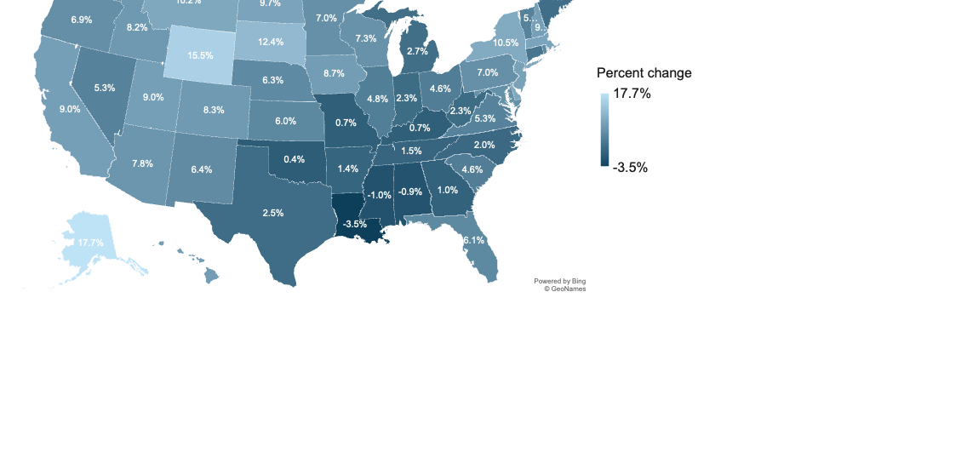
Traditional Medicare spending in most states increased between 2020 and 2021, as beneficiaries resumed seeking care after pandemic lockdown measures eased in mid-2020.
COVID-19: SPENDING
Percent change in traditional Medicare spending 2020–2021, by state
Data: Commonwealth Fund analysis of CareJourney traditional Medicare claims data.
Notes:
Nearly all states saw increases in Medicare spending between 2020 and 2021, however declines in spending were seen in Louisiana, Mississippi and Alabama.

