Slide 1
SURPRISE MEDICAL BILLS
Latest Court Challenges and What Consumers Can Expect
March 24, 2022

Slide 2

SURPRISE MEDICAL BILLS: Latest Court Challenges and What Consumers Can Expect
Rachel Nuzum
Vice President, Federal and State Health Policy
The Commonwealth Fund
Follow @
raenuzum
rachelnuzum
Learn more
Commonwealthfund.org

Slide 3
Surprise Medical Bills: Latest Court Challenges and What Consumers Can Expect
Speakers:
Jack Hoadley, Ph.D. Research Professor Emeritus, Georgetown University, McCourt School of Public Policy, Center on Health Insurance Reforms
Katie Keith, J.D., M.P.H. Associate Research Professor, Georgetown University, McCourt School of Public Policy, Center on Health Insurance Reforms; Principal at Keith Policy Solutions, LLC
Jane Beyer, J.D. Senior Health Policy Advisor, Washington State Office of the Insurance Commissioner

Slide 4
Resources and Housekeeping
Please use the Q&A box to ask your questions.
Once the webinar has commenced, the slides and recording will be available for reference on the Commonwealth Fund website and will be emailed to participants.
Ideas for other briefings or topics? Please reach out to sfederman@cmwf.org.

Slide 5
Introduction
During this webinar we will:
Review the protections extended under the No Surprises Act (NSA)
Discuss the federal and state roles in implementation of the No Surprises Act
Understand the status of litigation over NSA enforcement
Explore impact of implementation decisions and litigation for both consumers and providers

Slide 6

Implementing the No Surprises Act: Federal-State Collaboration
Commonwealth Fund Virtual Webinar
March 24, 2022
Jack Hoadley

Slide 7
No Surprises Act: An Overview
Public Law 116-260, signed December 27, 2020
Included in the Consolidated Appropriations Act, 2021
Most provisions are effective for plan years beginning on or after January 1, 2022
Bars out-of-network bills in emergency and certain non-emergency situations and by air (but not ground) ambulances
Patients responsible for in-network cost sharing only
Cost sharing payments count toward the in-network deductible and out-of-pocket limit
Protections apply both to state-regulated insurance and self-funded employer group health plans
For payment amount, relies on voluntary negotiations between insurers and providers, backed up by independent dispute resolution (i.e., arbitration) if negotiations fail.

Slide 8
Enforcement and Complaint Process
States have primary enforcement responsibility for surprise billing protections against insurers, providers, and facilities
Federal government steps in where states fail to substantially enforce the law
Most states opted to share responsibilities with the federal government, often with collaborative enforcement agreements
Consolidated complaints process for patients and others
Successful implementation starts with education of providers, insurers, and consumers

Slide 9
Enforcement Strategy
Federal
State
WA
NH
MT
ND
VT
ME
Shared
MN
OR
MA
Shared (Collaborative)
.
ID
SD
WI
WY
NY
MI
RI
Detail Not Yet Available
IA
PA
CT
NV
NE
OH
NJ
UT
IL
IN
DE
CA
CO
KS
WV
MD
MO
VA
KY
DC
TN
NC
AZ
NM
OK
AR
SC
MS
AL
GA
AK
TX
LA
HI
FL
Notes: Coding on this map reflects the state’s enforcement strategy across issuers, providers, and air ambulance providers. The scope includes provisions of the law that are narrowly relevant to surprise medical billing, not other related provisions of the No Surprises Act. Sections of the law included are 2799A-1(a) and 2799A-1(b) (both relating to requirements on issuers), 2799B-1 and 2799B-2 (both relating to requirements on providers), and 2799A-2(a) and 2799B-5 (both relating to air ambulances).
Source: Center on Health Insurance Reforms, Georgetown University Health Policy Institute; Commonwealth Fund analysis.
Notes:
9

Slide 10
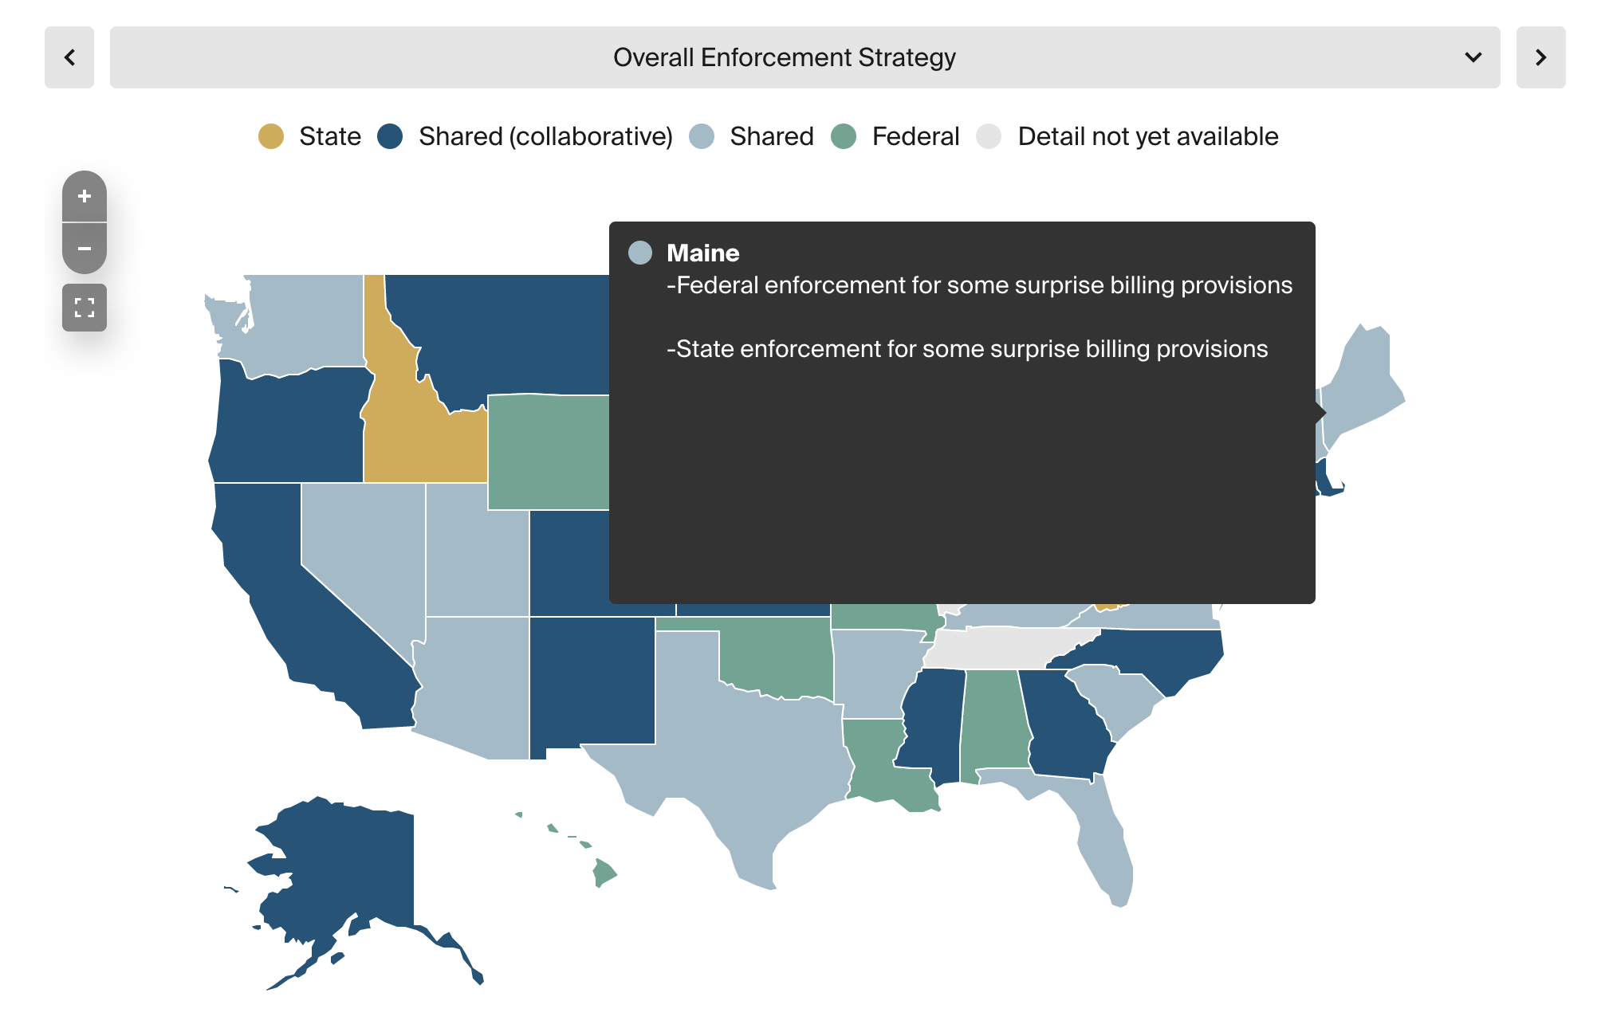
Interactive Map Displays

Slide 11
Processes for Determining Payments to Out-of-Network Providers
“Specified state law” is one that provides for a method for determining the amount of payment to an out-of-network provider (whether payment standard or arbitration)
State method used to determine payments for health plans regulated by the state and services to which state law applies
Also used to determine cost-sharing amounts
If state law does not apply, the No Surprises Act applies
Payment disputes will be resolved under the federal independent dispute resolution (IDR) process
Cost sharing will be based on the lesser of the qualifying payment amount (QPA) or a provider’s billed charges

Slide 12
Specified State Laws to Determine Payments
Yes, Where State Law Applies
No
WA
NH
MT
ND
VT
ME
Detail Not Yet Available
OR
MN
ID
WI
MA
.
SD
NY
WY
MI
RI
IA
PA
CT
NV
NE
OH
NJ
UT
IL
IN
DE
CA
CO
KS
WV
MD
MO
VA
KY
DC
TN
NC
AZ
NM
OK
AR
SC
MS
AL
GA
AK
TX
LA
HI
FL
Notes: Coding on this map reflects whether the state has a specified state law and the circumstance to which that law applies if narrower than all state-regulated insurance. It also displays which government will enforce the outcomes of IDR proceedings.
Source: Center on Health Insurance Reforms, Georgetown University Health Policy Institute; Commonwealth Fund analysis.
Notes:
12

Slide 13
Determining Payments under Federal Law
Health plan or insurer can, within certain timeframes, negotiate the payment amount with the provider or facility
Failing that, either party can request arbitration through an independent dispute resolution (IDR) entity
IDR features include:
Submission of cases through a federal portal; parties pay administrative fee of $50
Multiple items and services may be batched for a single arbitration
Parties submit amounts and supporting information
Arbitrator must select one amount or the other; decision is binding
Losing party pays the cost of arbitration ($200-$500 for a single case; $268-$670 for batched cases)

Slide 14
Factors for IDR Entity’s Consideration
Qualifying payment amount (QPA), defined as insurer’s median in-network rate
Provider’s level of training, experience and quality of care
Market share of the non-participating provider or facility
Acuity of the patient or complexity of the services provided
Prior contracted rates
Good faith efforts to enter network agreements
Barred from considering:
Provider’s billed charges
Usual or customary rates
Rates paid under government programs (Medicare, Medicaid)

Slide 15
What Should a Consumer Do?
What can covered consumers expect?
Law should be self-enforcing
But consumers should know their rights
When consumers receive a bill, how do they know what they are legally bound to pay?
Distinguishing bills that fall under the No Surprises Act from bills that are high or unexpected for other reasons
Where should consumers go for help?
Federal consumer complaint website or phone line
State processes

Slide 16
Litigation Over the NSA: The Issue
Arbitration is especially important for out-of-network specialty providers
History of private equity ownership and high charges that have led to higher patient out-of-pocket costs and overall health care costs
Providers argue:
Arbitration rule’s guardrails will make it harder to obtain higher rates
Arbitration rule creates a de facto payment standard that will disadvantage providers and is inconsistent with the No Surprises Act
Biden administration and amici argue:
Arbitration rule is consistent with the No Surprises Act and Congress’ intent
Arbitration rule’s guardrails are key to holding down health care costs

Slide 17
Aggressive Litigation by Providers
Lead Challenger | Court | Provisions Challenged | Current Status
Texas Medical Association | TX | Parts of arbitration rule | Decision issued in Feb. 2022
Association of Air Medical Services | DC | Parts of arbitration rule; Methodology to calculate QPA | Hearing on Mar. 21, 2022
American Medical Association | DC | Parts of arbitration rule | Hearing on Mar. 21, 2022
American Society of Anesthesiologists | IL | Parts of arbitration rule | On hold til May
Georgia College of Emergency Physicians | GA | Parts of arbitration rule | On hold til May
Dr. Daniel Haller | NY | Parts of arbitration rule; Statutory arbitration process; Statutory patient protections | Proceeding but slowly

Slide 18

Impact and What to Expect Next
Decision in Texas Medical Association invalidated parts of the arbitration rule on a nationwide basis; no appeal yet
Arbitration can proceed but decision eliminates key guardrails designed to keep costs down
Core consumer protections remain in place
Other lawsuits are generally on hold and a DC court indicated this week that a decision seems unlikely
May 2022: Biden administration will issue a final rule that could rescind, replace, or readopt the challenged parts of the arbitration rule
Source: https://www.commonwealthfund.org/blog/2022/health-care-providers-fight-arbitration-rule-no-surprises-act

Slide 19
Surprise Billing in Washington State
Commonwealth Fund
Jane Beyer, Senior Health Policy Advisor

Slide 20
Washington State BBPA & the NSA
Balance Billing Protection Act (2019)
Effective January 1, 2020
Comprehensive – “specified state law”
E2SHB 1688 (2022)
Aligns the BBPA and NSA, but retains key BBPA consumer protections
Awaiting Governor’s signature
Commonwealth Fund
March 24, 2022
20

Slide 21
From the consumer’s perspective
If a consumer receives a surprise bill:
Don’t pay it right away…
Contact their health plan – is deductible satisfied? What would in-network cost-sharing be for this service?
Contact the provider – is this a balance bill?
If the provider won’t waive the bill, call our consumer advocates.
Under the BBPA
OIC will contact provider. Give them an “opportunity to cure”.
If pattern of “unresolved violations” refer to state medical commission or applicable disciplinary authority.
If provider is out-of-state, we refer the complaint to CMS.
If plan is self-funded and not participating in BBPA, we refer the complaint to CMS or DOL.
Commonwealth Fund

Slide 22
From the consumer’s perspective
Key vulnerabilities and Washington’s response:
Provide greater protection than NSA under state law
Include prohibition on providers/facilities asking consumers to waive their balance billing protections
Require providers to refund excess consumer payments with interest
Address language access, i.e. OIC’s Notice of Consumer Rights translated into 11 languages and available on our website

Slide 23
From a state regulator’s perspective
For states with their own balance billing laws, consider:
Consumer, provider, and issuer confusion regarding which law applies to a particular emergency room visit or planned procedure
Align state law with the NSA?
Repeal the state law?
If no action, potentially two parallel statutes addressing the same ER visit or planned procedure
Commonwealth Fund

Slide 24
From a state regulator’s perspective
For states with network adequacy standards to ensure adequate provider networks:
Will issuer’s try to use the balance billing statute to meet network adequacy standards?
In Washington state — Yes, but OIC said no.
Providers aren’t used to hearing from state insurance regulators – use connections with their associations
Outreach and education: separate webinars for consumers, providers, and issuers
Take advantage of federal NSA resources
Commonwealth Fund

Slide 25
Lessons for other states
Keep consumers at the center
Prohibition on asking consumers to waive their rights
Notice of consumer rights at meaningful times
Dispute resolution
BBPA uses arbitration.
Fewer requests than anticipated and fewer matters went to full arbitration
Enforcement:
Provider response to insurance regulator/coordination with disciplinary authority
This is a nonpartisan issue – it can happen to anyone.
Commonwealth Fund

Slide 26
Appendix
Commonwealth Fund

Slide 27
E2SHB 1688 (as passed by Legislature) – Aligning the No Surprises Act & the Balance Billing Protection Act
Issue | Washington Balance Billing Protection Act (BBPA) | E2SHB 1688 as passed Legislature
Applicable plans | State regulated private health insurance, PEBB/SEBB and self-funded health plans that “opt-in”. | Sec. 7: State regulated private health insurance, PEBB/SEBB and self-funded health plans that “opt-in” (396 plans as of 3/1/22). Retains opportunity for self-funded group health plans to opt-in to state BBPA.
Coverage of emergency services | Emergency services provided in a hospital up to point of stabilization must be covered without prior authorization and whether in or out of network. RCW 48.43.093 | Sec. 2, amending RCW 48.43.003 and Sec. 3, amending RCW 48.43.093 Emergency services must be covered whether provider is in or out of network and without prior authorization. Emergency services, including behavioral health crisis services: screening, stabilization, and post-stabilization, including observation or an inpatient and outpatient stay with respect to the visit during which screening and stabilization services were provided.

Slide 28
E2SHB 1688 (as passed by Legislature) – Aligning the No Surprises Act & the Balance Billing Protection Act
Issue | Washington Balance Billing Protection Act (BBPA) | E2SHB 1688 as passed Legislature
Scope of balance billing protections | Emergency medical services and non-emergency “surgical and ancillary services” at in-network facilities. | Sec. 7, amending RCW 48.49.020 Align to NSA: Emergency services. Non-emergency health care services performed by nonparticipating providers at certain participating facilities includes covered items or services other than emergency services with respect to a visit at a participating health care facility, as provided in the NSA. Ground ambulance: OIC to study and report on how balance billing for ground ambulance services can be prevented and whether ground ambulance services should be added to the BBPA. Due October 2023.
Consumer cost-sharing | Same as if services had been received from an in-network provider. | Sec. 8, amending RCW 48.49.030: Same as if services had been received from an in-network provider. Uses NSA method for calculating consumer cost-sharing (aka “qualified payment amount”).

Slide 29
E2SHB 1688 (as passed by Legislature) – Aligning the No Surprises Act & the Balance Billing Protection Act
Issue | Washington Balance Billing Protection Act (BBPA) | E2SHB 1688 as passed Legislature
Waiver of rights | Consumers cannot be asked to waive their balance billing protections. | Sec. 10(2) & Sec. 7(2)(b) Consumers cannot be asked to waive their balance billing protections.
Consumer notice of rights | State template for notice. State determines when and how notice is provided to consumers. | Sec. 13, amending RCW 48.49.060 OIC must develop a template for a notice of consumer rights that applies to both the BBPA and the NSA. OIC determines through rulemaking when and how the notice must be provided to consumers.
Out of network claim payment standard | Payment is “commercially reasonable amount.” | Sec. 9 “Commercially reasonable amount” until July 1, 2023 or later date determined by the Commissioner. At that point, transition to NSA payment standard.

Slide 30
E2SHB 1688 (as passed by Legislature) – Aligning the No Surprises Act & the Balance Billing Protection Act
Issue | Washington Balance Billing Protection Act (BBPA) | E2SHB 1688 as passed Legislature
Dispute resolution | Resolved through arbitration if no agreement on payment between the carrier and an out-of-network provider. | Sec. 11, amending RCW 48.49.040 BBPA arbitration until July 1, 2023 or later date determined by the Commissioner. At that point, transition to NSA “independent dispute resolution” (IDR) system if out-of-network provider and carrier cannot agree on a commercially reasonable payment. Revisions are made to BBPA arbitration provisions, some to more closely align with the NSA. Air ambulance payment disputes use the NSA IDR system.
Network adequacy | OIC must consider whether carrier’s proposed provider network includes a sufficient number of contracted emergency & surgical or ancillary services providers at in-network hospitals or ambulatory surgical facilities. | Sec. 18, amending RCW 48.49.150 (as recodified by this act) OIC must review the network to determine whether it includes a sufficient number of facility-based providers at the carrier’s in-network hospitals and ambulatory surgical facilities. For services subject to the balance billing prohibition, a carrier cannot treat their payment of out-of-network providers or facilities under the BBPA or NSA to satisfy OIC’s network access standards.
Commonwealth Fund

Slide 31
E2SHB 1688 (as passed by Legislature) – Aligning the No Surprises Act & the Balance Billing Protection Act
Issue | Washington Balance Billing Protection Act (BBPA) | E2SHB 1688 as passed Legislature
Enforcement | Washington State Office of the Insurance Commissioner (carriers) Washington State Department of Health | New Secs. 5 & 19 OIC will enforce all BBPA and NSA requirements on carriers. DOH will enforce BBPA and NSA requirements on health care providers, and defer enforcement of requirements applicable to health care facilities and air ambulance providers to the federal gov’t (CMS) (Per OIC/DOH/CMS enforcement agreement).
Effective date | January 1, 2020 | Sec. 25: Emergency clause – effective upon Governor’s signature
Commonwealth Fund

