Slide 1
Premium contributions and deductibles added up to more than 11 percent of U.S. median income in 2020.
EXHIBIT 1
Share of median income (%)
Combined premium contribution + deductible
Premium contribution
Deductible
Note: Combined estimates of single and family premium contributions and deductibles are weighted for the distribution of single-person and family households in the state.
Data: Premium contributions and deductibles — Medical Expenditure Panel Survey–Insurance Component (MEPS–IC), 2010–2020; Median household income and household distribution type — analysis of Current Population Survey (CPS), 2010–2021, by Mikaela Springsteen and Sherry Glied of New York University for the Commonwealth Fund.

Slide 2
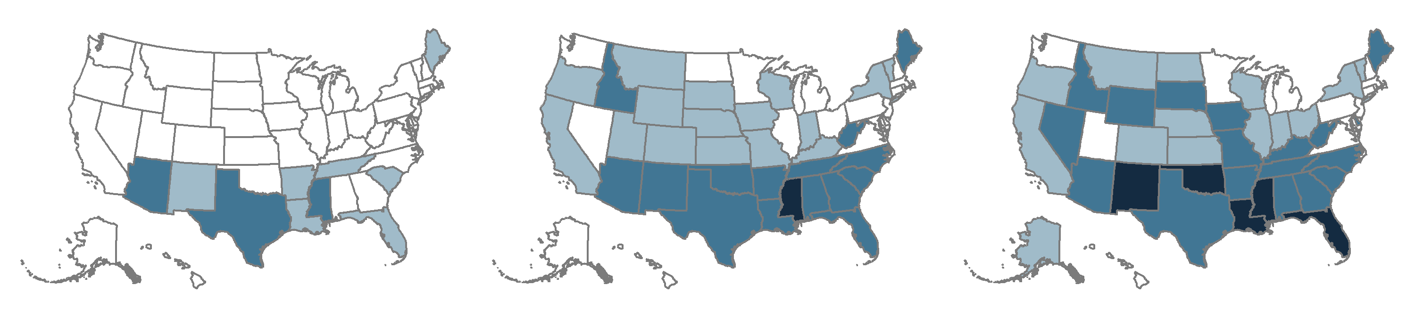
In a growing number of states, worker insurance premium contributions and deductibles make up 10 percent or more of median income.
EXHIBIT 2
2010
2015
2020
Average employee share of premium plus average deductible as percent of median state income
<10.0% (40 states + D.C.)
<10.0% (18 states + D.C.)
<10.0% (13 states + D.C.)
10.0%–11.9% (7 states)
10.0%–11.9% (16 states)
10.0%–11.9% (14 states)
12.0%–13.2% (3 states)
12.0%–14.9% (15 states)
12.0%–14.9% (18 states)
15.0%–15.6% (1 state)
15.0%–19.0% (5 states)
Note: Combined estimates of single and family premium contributions and deductibles are weighted for the distribution of single-person and family households in the state.
Data: Premium contributions and deductibles — Medical Expenditure Panel Survey–Insurance Component (MEPS–IC), 2010–2020; Median household income and household distribution type — analysis of Current Population Survey (CPS), 2010–2021, by Mikaela Springsteen and Sherry Glied of New York University for the Commonwealth Fund.

Slide 3
Premium contributions for single coverage ranged from $852 in Hawaii to $1,895 in South Carolina.
EXHIBIT 3
Employee premium contribution for single-person coverage ($)
$1,895
U.S. average = $1,532
$852
Note: Employee premium contributions are for insurance policies offered by private-sector employers in the U.S.
Data: Medical Expenditure Panel Survey–Insurance Component (MEPS–IC), 2020.

Slide 4
Premium contributions for family coverage ranged from $4,610 in Washington to $7,674 in Florida.
EXHIBIT 4
Employee premium contribution for family coverage ($)
$7,674
U.S. average = $5,978
$4,610
Note: Employee premium contributions are for insurance policies offered by private-sector employers in the U.S.
Data: Medical Expenditure Panel Survey–Insurance Component (MEPS–IC), 2020.

Slide 5
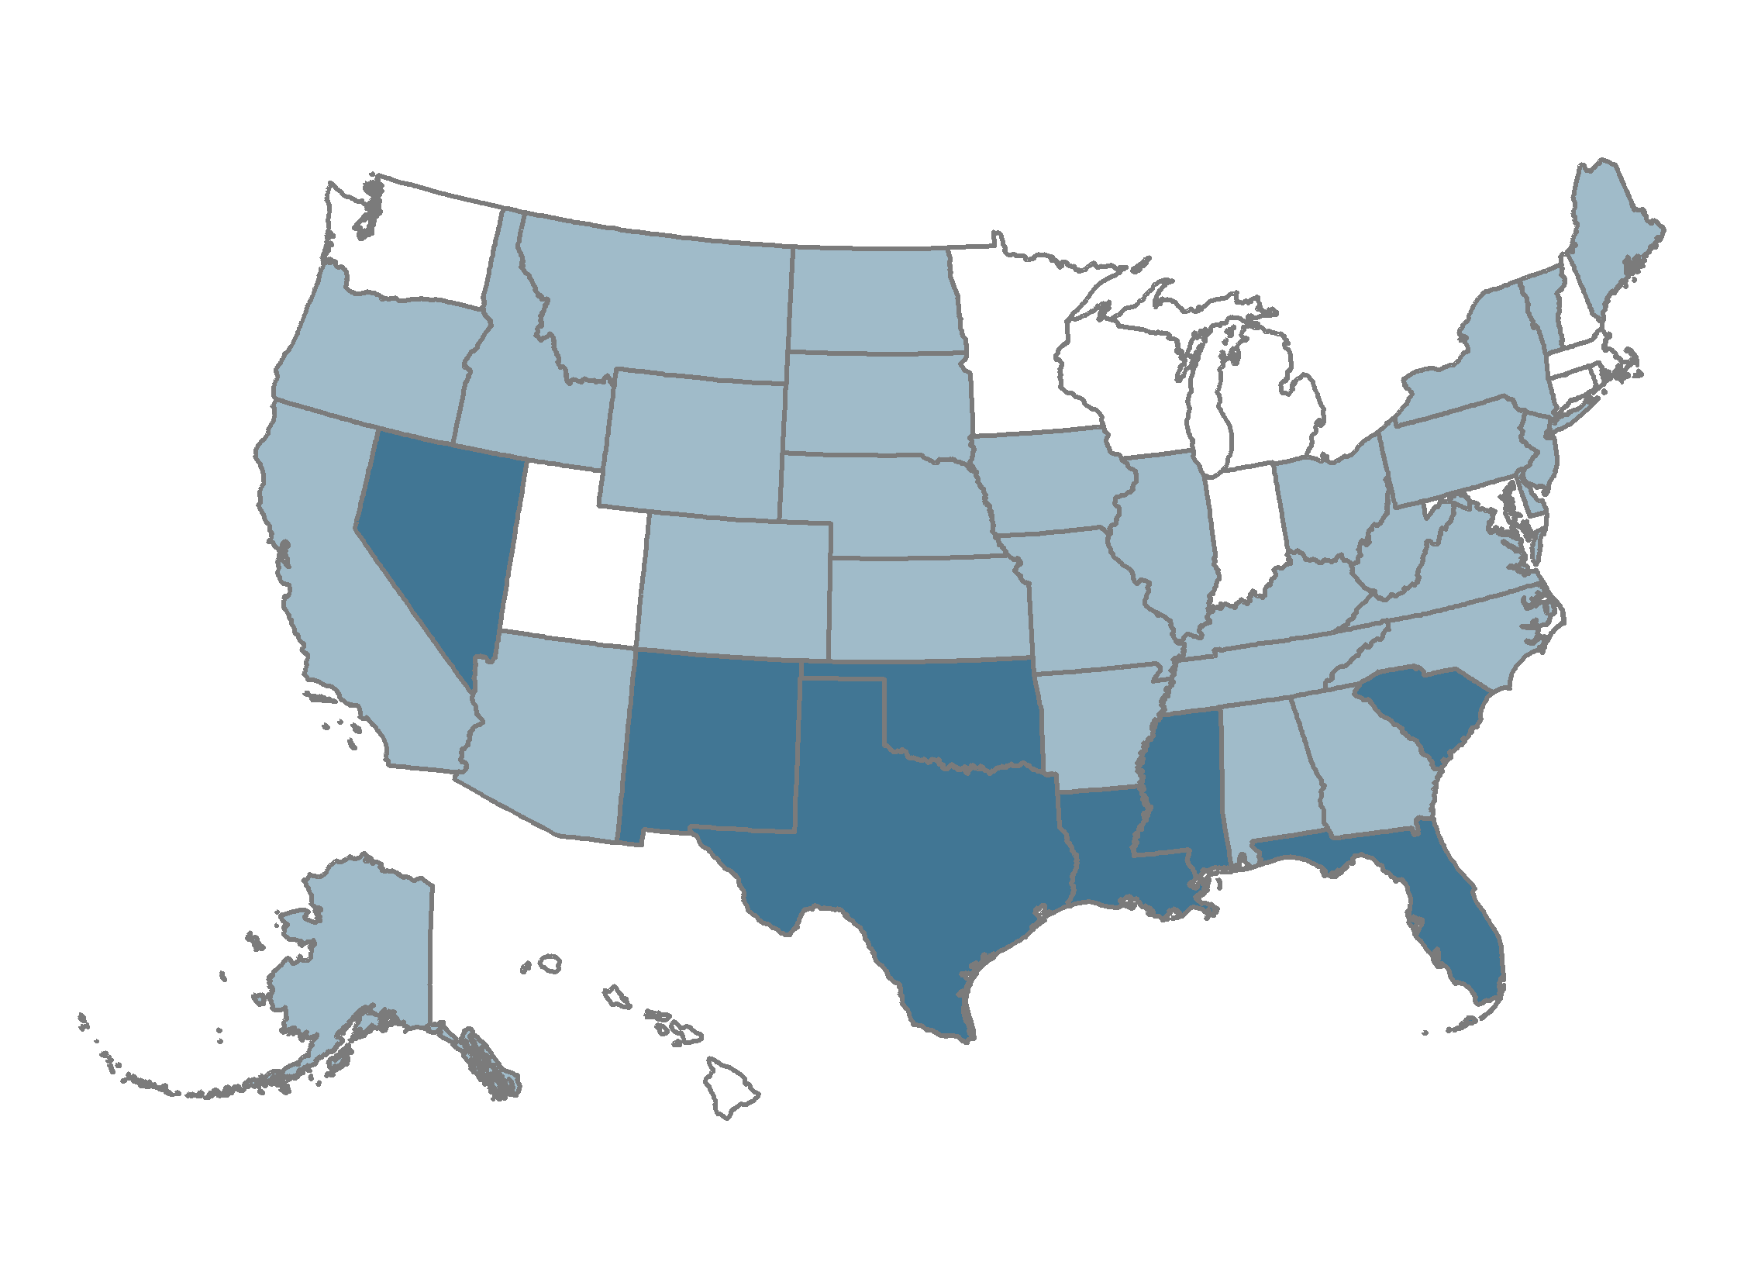
Premium contributions were more than 8.5 percent of median income in eight states.
EXHIBIT 5
Average employee share of premium as percent of median state income
4.3%–5.9% (12 states + D.C.)
6.0%–8.5% (30 states)
8.6%–12.7% (8 states)
Note: Single and family premium contributions are weighted for the distribution of single-person and family households in the state.
Data: Premium contributions — Medical Expenditure Panel Survey–Insurance Component (MEPS–IC), 2020; Median household income and household distribution type — analysis of Current Population Survey (CPS), 2020–2021, by Mikaela Springsteen and Sherry Glied of New York University for the Commonwealth Fund.

Slide 6
Family premium contributions by workers in lower-wage firms were higher than those for workers in higher-wage firms.
EXHIBIT 6
Average employee premium contribution paid for family coverage, by average wage of employer ($)
Note: To form wage quartiles, MEPS-IC places employers in order from lowest to highest average payroll per employee. Quartile 1 starts with the firm with the lowest average wage and extends until it includes 25% of total employment. Quartiles 2 through 4 follow the same procedure.
Data: Medical Expenditure Panel Survey–Insurance Component (MEPS–IC), 2020.

Slide 7
Deductibles for single coverage ranged from $1,346 in Hawaii to $2,517 in Montana.
EXHIBIT 7
Single-person deductible ($)
$2,517
U.S. average = $1,945
$1,346
Note: Deductibles are for insurance policies offered by private-sector employers in the U.S. that had a deductible.
Data: Medical Expenditure Panel Survey–Insurance Component (MEPS–IC), 2020.

Slide 8
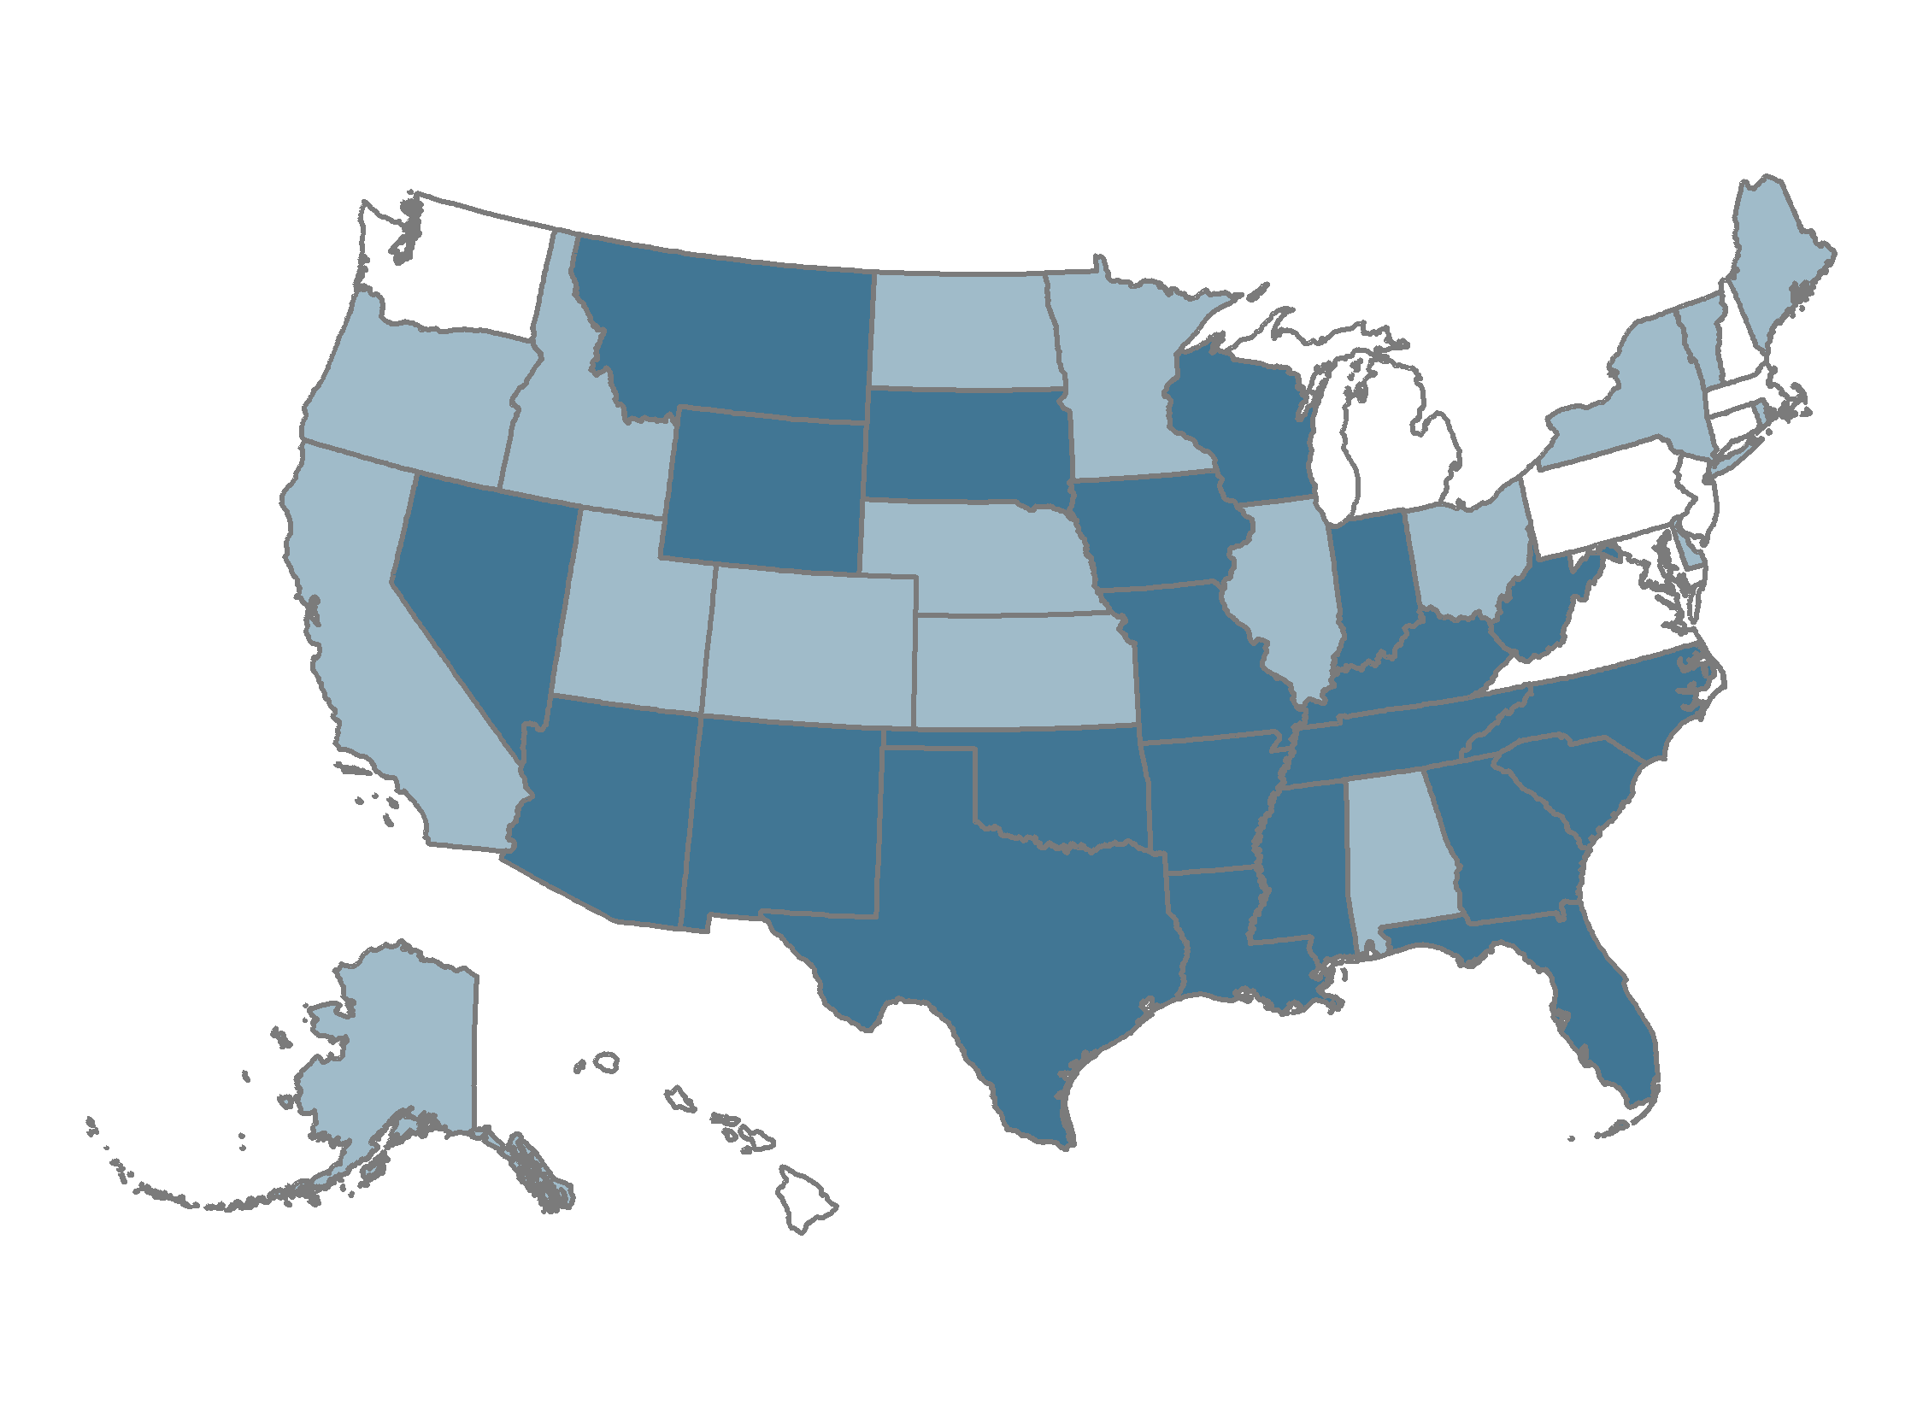
Average deductibles amounted to 5 percent or more of median income in 22 states.
EXHIBIT 8
Average deductible as percent of median state income
2.6%–3.9% (10 states + D.C.)
4.0%–4.9% (18 states)
5.0%–7.4% (22 states)
Note: Single and family deductibles are weighted for the distribution of single-person and family households in the state.
Data: Deductibles — Medical Expenditure Panel Survey–Insurance Component (MEPS–IC), 2020; Median household income and household distribution type — analysis of Current Population Survey (CPS), 2020–2021, by Mikaela Springsteen and Sherry Glied of New York University for the Commonwealth Fund.

