Slide 1
Lessons in Resilience:
International Health Systems & COVID-19
December 1, 2021

Slide 2
Lessons in Resilience:
International Health Systems & COVID-19
Speakers:
Caroline Pearson, B.A., Senior Vice President, NORC at the University of Chicago
Hugh Alderwick, Head of Policy, the Health Foundation
Jennifer Zelmer, M.A., Ph.D., President and CEO, Healthcare Excellence Canada
Ewout van Ginneken M.Sc., Ph.D., Coordinator of the Berlin Hub of the European Observatory on Health Systems and Policies at the Berlin University of Technology

Slide 3
Introduction
Context: The speed, scope, and duration of the COVID-19 pandemic has challenged health care delivery systems around the world
Goals: Understand how international delivery systems adapted to respond to the pandemic and identify lessons learned for the U.S.
Approach:
  Convene an advisory board of U.S. experts to inform priority research topics and countries
  Interview international experts in five countries to understand COVID-19 delivery system response
  Assess relevance of international innovations for the U.S.

Slide 4
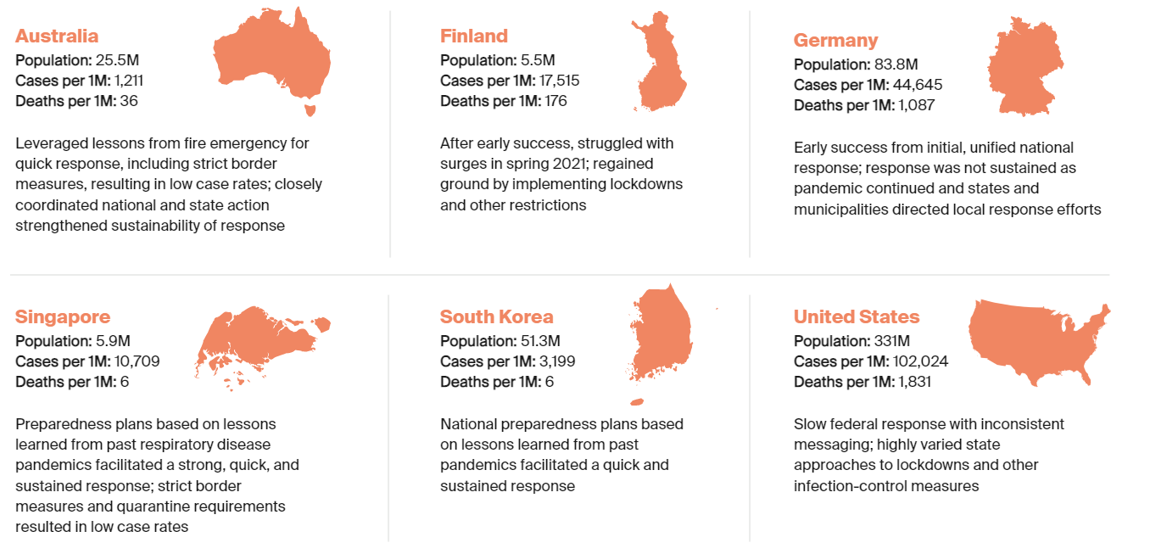
Explored Lessons Learned from Five Countries
NORC reviewed literature and conducted in-depth interviews of health system and government leaders in five countries

Slide 5
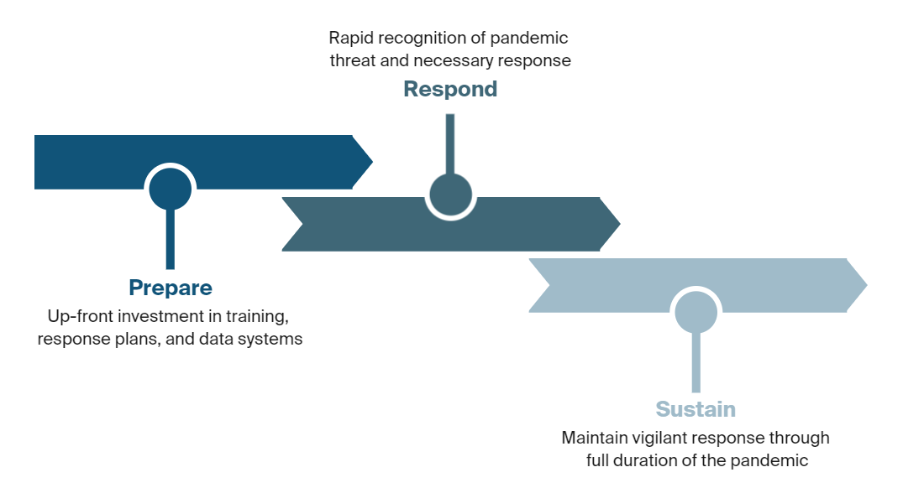
Identified Phases of COVID-19 Response

Slide 6
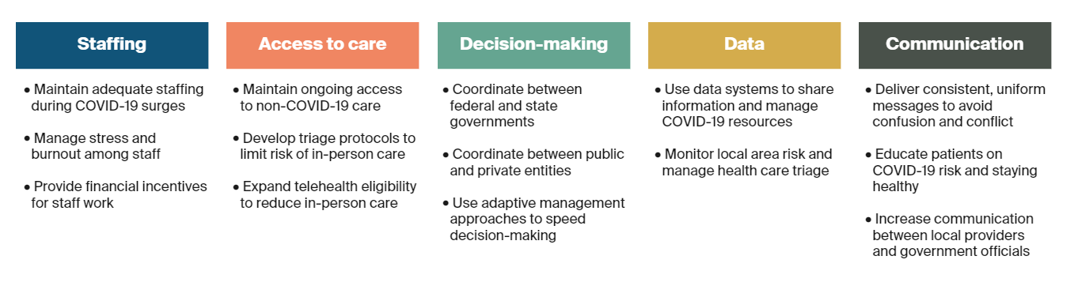
Examined Five Areas of Focus for Delivery Systems

Slide 7

COVID-19 Health Care Delivery Challenges & Lessons Learned: Staffing
 | Limited staff training and few established safety protocols for a pandemic | Staffing shortages in COVID-19 hot-spots | Duration of pandemic resulted in workforce stress and burnout
 | International Innovations
 | Contractual agreements between institutions to allow physicians, including researchers, to practice where clinical need was greatest Non-clinical workers from other industries (e.g., transportation) reassigned to health care settings to support operations Government-funded mental health programs for hospital staff
Prepare
Respond
Sustain

Slide 8

COVID-19 Health Care Delivery Challenges & Lessons Learned: Access to Care
 | Few systems to support COVID-19 patient triage between health care settings | Disruption of non-COVID-19 care Financial losses from delayed / canceled services | Rapid expansion of telehealth use Long-term health effects of foregone care and prevention
 | International Innovations
 | Centralized triage system by COVID-19 patient severity and facility Government payments to health care facilities and staff to replace revenue during shutdowns Full public funding for all COVID-19-related care for all patients Higher reimbursement for telehealth visits than in-person visits
Prepare
Respond
Sustain

Slide 9

COVID-19 Health Care Delivery Challenges & Lessons Learned: Decision-Making
 | Fragmented decision- making processes across delivery system, states, and federal government | Lack of effective decision-making reduced timely and cohesive response | Stuck in cycles of crisis management, rather than anticipating longer-term pandemic challenges
 | International Innovations
 | Prior to pandemic, government developed national preparedness plan specifying crisis management strategies across levels of government Clearly designated decision-making authority between the national government, regional/state governments, and individual health systems Formed advisory committees with representation from government officials, clinicians, researchers, community leaders, and diverse groups Local coordinating committees developed recommendations for hospital districts
Prepare
Respond
Sustain

Slide 10

COVID-19 Health Care Delivery Challenges & Lessons Learned: Data
 | Existing data systems were not coordinated and interoperable | Difficulty monitoring local area delivery needs in real-time | Struggled to share information between government and delivery systems
 | International Innovations
 | Government created central dashboard to help officials triage patients to hospitals based on available ICU beds and ventilators Used existing partnership with researchers / universities to analyze COVID-19 data and predict possible scenarios Hospitals shared status of patient and staff cases on internal board and on hospital website to support awareness
Prepare
Respond
Sustain

Slide 11

COVID-19 Health Care Delivery Challenges & Lessons Learned: Communication
 | Limited education on COVID-19 risk and safety procedures | Communication and information dissemination was fragmented | Public confusion on COVID-19 policy and regulations
 | International Innovations
 | National government centralized communication to provide timely, accurate, and inclusive public health information Government coordinated multi-media campaign to share updates about COVID-19 cases, community prevalence, safety guidelines and regulations National government held regular information sessions for clinicians to answer questions and provide guidance
Prepare
Respond
Sustain

Slide 12
It’s Not Over…
As the world continues to face challenges with vaccine roll-out, surging caseloads, and new variants, the time is now to implement lessons learned

