Slide 1
1: Profound racial and ethnic inequities in health and health care exist across and within states.
Health system performance scores, by state and race/ethnicity
Higher health system performance
ALL- GROUP MEDIAN
Lower health system performance
Notes: Scores are based on the percentile distribution of each group’s final composite z-score across all indicators/dimensions; rank-ordered by highest state performance for AANHPI population. Grey dots represent the highest score achieved in each state by any of the five groups (if no grey dot is visible, the highlighted group has the top score). The 50th percentile represents the median health performance score among all the groups measured. Summary performance scores not available for all racial and ethnic groups in all states; missing dots for a particular group indicate that there are insufficient data for that state. AANHPI = Asian American, Native Hawaiian, and Pacific Islander.
Data: Commonwealth Fund 2021 Health System Performance Scores.

Slide 2
1: Profound racial and ethnic inequities in health and health care exist across and within states.
Health system performance scores, by state and race/ethnicity
Higher health system performance
ALL- GROUP MEDIAN
Lower health system performance
Notes: Scores are based on the percentile distribution of each group’s final composite z-score across all indicators/dimensions; rank-ordered by highest state performance for AIAN population. Grey dots represent the highest score achieved in each state by any of the five groups (if no grey dot is visible, the highlighted group has the top score). The 50th percentile represents the median health performance score among all the groups measured. Summary performance scores not available for all racial and ethnic groups in all states; missing dots for a particular group indicate that there are insufficient data for that state. AIAN = American Indian/Alaska Native.
Data: Commonwealth Fund 2021 Health System Performance Scores.

Slide 3
1: Profound racial and ethnic inequities in health and health care exist across and within states.
Health system performance scores, by state and race/ethnicity
Higher health system performance
ALL- GROUP MEDIAN
Lower health system performance
Notes: Scores are based on the percentile distribution of each group’s final composite z-score across all indicators/dimensions; rank-ordered by highest state performance for Black population. Grey dots represent the highest score achieved in each state by any of the five groups (if no grey dot is visible, the highlighted group has the top score). The 50th percentile represents the median health performance score among all the groups measured. Summary performance scores not available for all racial and ethnic groups in all states; missing dots for a particular group indicate that there are insufficient data for that state.
Data: Commonwealth Fund 2021 Health System Performance Scores.

Slide 4
1: Profound racial and ethnic inequities in health and health care exist across and within states.
Health system performance scores, by state and race/ethnicity
Higher health system performance
ALL- GROUP MEDIAN
Lower health system performance
Notes: Scores are based on the percentile distribution of each group’s final composite z-score across all indicators/dimensions; rank-ordered by highest state performance for Latinx/Hispanic population. Grey dots represent the highest score achieved in each state by any of the five groups (if no grey dot is visible, the highlighted group has the top score). The 50th percentile represents the median health performance score among all the groups measured. Summary performance scores not available for all racial and ethnic groups in all states; missing dots for a particular group indicate that there are insufficient data for that state.
Data: Commonwealth Fund 2021 Health System Performance Scores.

Slide 5
1: Profound racial and ethnic inequities in health and health care exist across and within states.
Health system performance scores, by state and race/ethnicity
Higher health system performance
ALL- GROUP MEDIAN
Lower health system performance
Notes: Scores are based on the percentile distribution of each group’s final composite z-score across all indicators/dimensions; rank-ordered by highest state performance for white population. Grey dots represent the highest score achieved in each state by any of the five groups (if no grey dot is visible, the highlighted group has the top score). The 50th percentile represents the median health performance score among all the groups measured. Summary performance scores not available for all racial and ethnic groups in all states; missing dots for a particular group indicate that there are insufficient data for that state.
Data: Commonwealth Fund 2021 Health System Performance Scores.

Slide 6
2: In most states where data are available, Black people and AIAN people are more likely than white people to die early in life from conditions that are treatable with timely access to high-quality health care.
Mortality amenable to health care, deaths per 100,000 population, by state and race/ethnicity
Notes: States arranged in rank order based on highest rate in each state. Missing dots for a particular group indicate that there are insufficient data for that state. Data for AANHPI and Latinx/Hispanic populations available in online exhibit and state profile documents. AIAN = American Indian/Alaska Native.
Data: CDC, 2018 and 2019 National Vital Statistics System (NVSS), All-County Micro Data, Restricted Use Files.

Slide 7
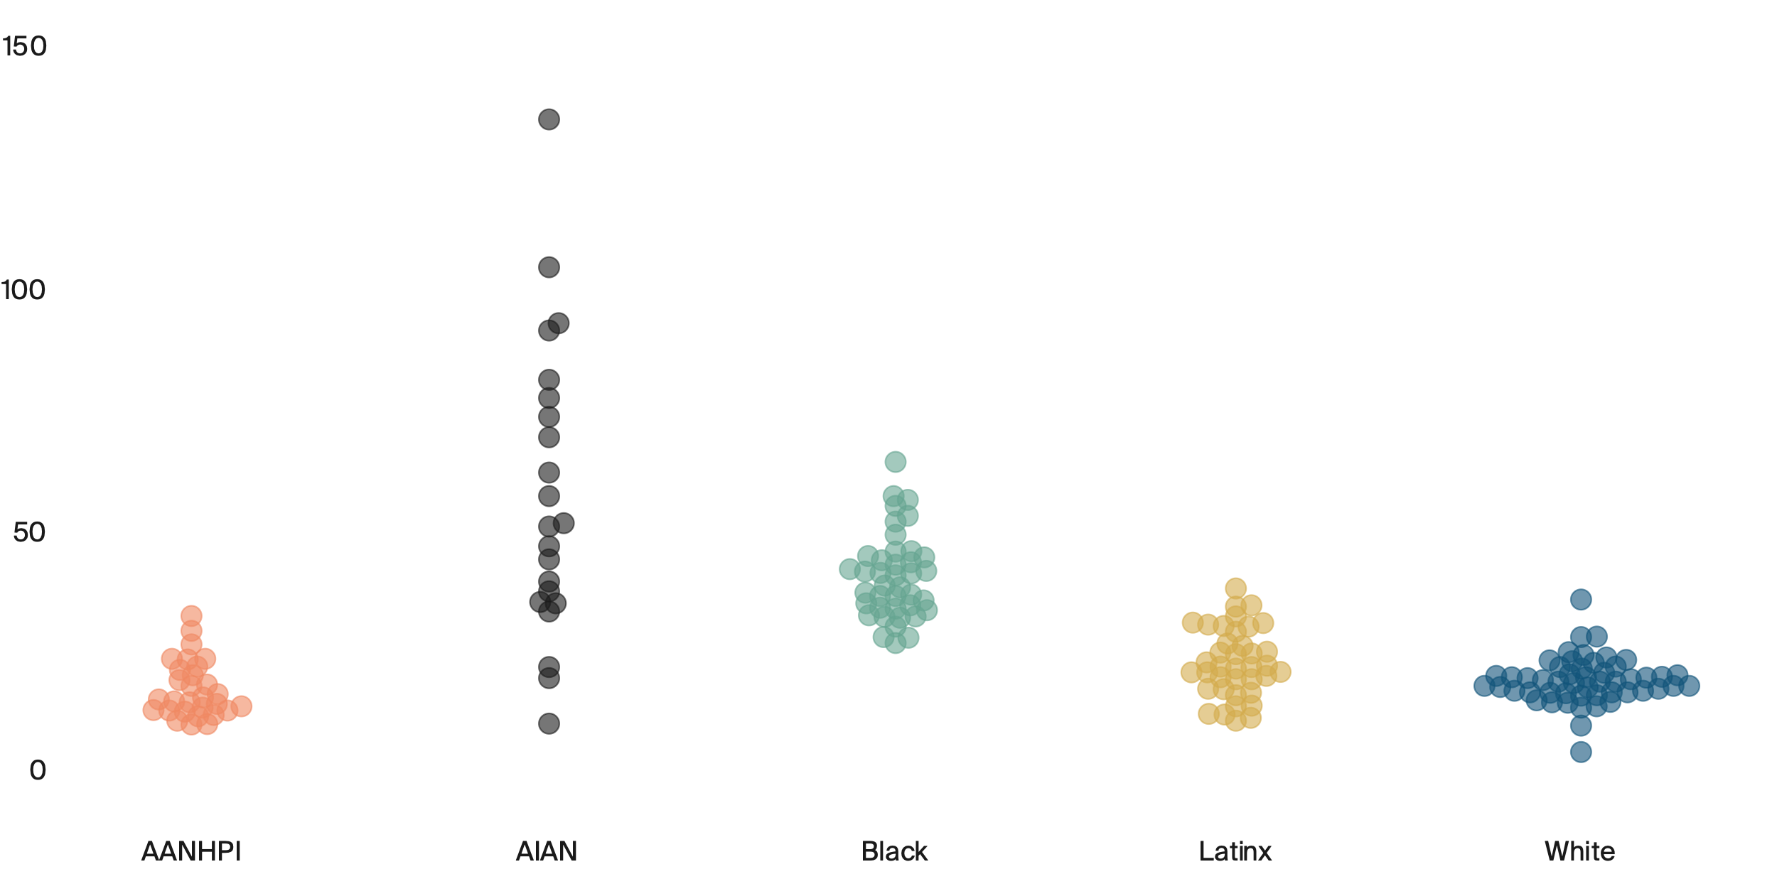
3: In nearly all the states where data are available, Black people and AIAN people are more likely than AANHPI, Latinx/Hispanic, and white people to die from complications of diabetes.
Diabetes-related age-adjusted deaths per 100,000 population, by state and race/ethnicity
Dots represent states
See online graphic for state detail
South Dakota
135.3
West Virginia
64.4
Utah
32.5
Wyoming
38.2
West Virginia
35.9
Connecticut
26.9
Michigan
10
Texas
10.2
Maryland
10.8
District of Columbia
4.3
Notes: Missing dots for a particular group indicate that there are insufficient data for that state. AANHPI = Asian American, Native Hawaiian, and Pacific Islander; AIAN = American Indian/Alaska Native.
Data: CDC, 2018 and 2019 National Vital Statistics System (NVSS).

Slide 8
4: Black women are more likely than white women to be diagnosed with breast cancer at later stages and to die, even though the disease is often considered treatable when detected early.
Breast cancer age-adjusted deaths per 100,000 female population, by state and race/ethnicity
Notes: States arranged in rank order based on highest rate in each state. Missing dots for a particular group indicates that there are insufficient data for that state. Data for AIAN, AANHPI and Latinx/Hispanic populations available in online exhibit and state profile documents.
Data: CDC, 2018 and 2019 National Vital Statistics System (NVSS).

Slide 9
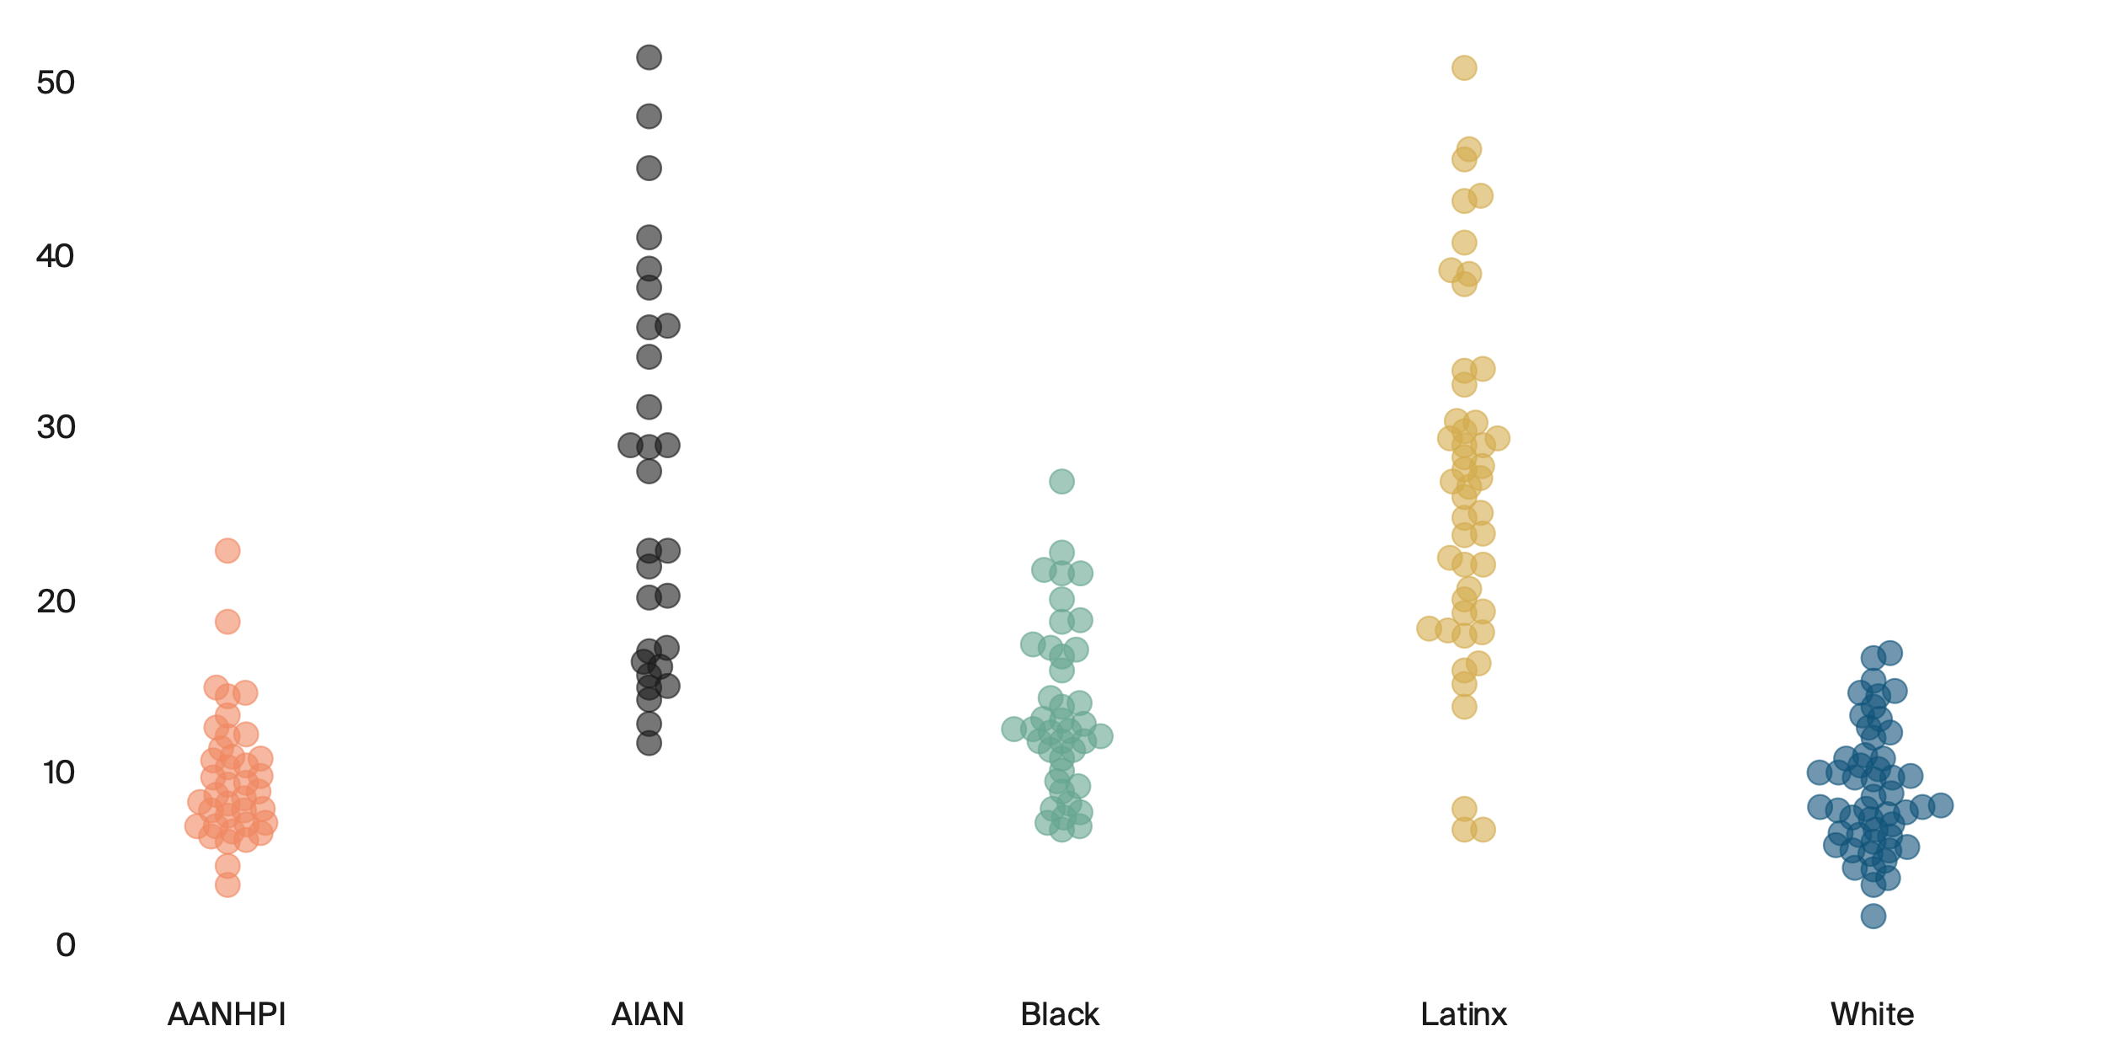
5: Although the ACA’s coverage expansion improved inequities, state uninsured rates are generally higher and more variable for Black, Latinx/Hispanic, and AIAN adults compared to AANHPI and white adults.
Percent of adults ages 19–64 who are uninsured, by state and race/ethnicity
Dots represent states
See online graphic for state detail
Wyoming
51.3
Tennessee
50.7
Utah
26.8
Mississippi
22.8
Oklahoma
16.9
South Carolina
11.7
District of Columbia
6.7
District of Columbia
6.7
Massachusetts
3.5
District of Columbia
1.7
Notes: Missing dots for a particular group indicate that there are insufficient data for that state. AANHPI = Asian American, Native Hawaiian, and Pacific Islander; AIAN = American Indian/Alaska Native. ACA = Affordable Care Act.
Data: American Community Survey Public Use Micro Sample (ACS-PUMS) 2019 1-year file.

Slide 10
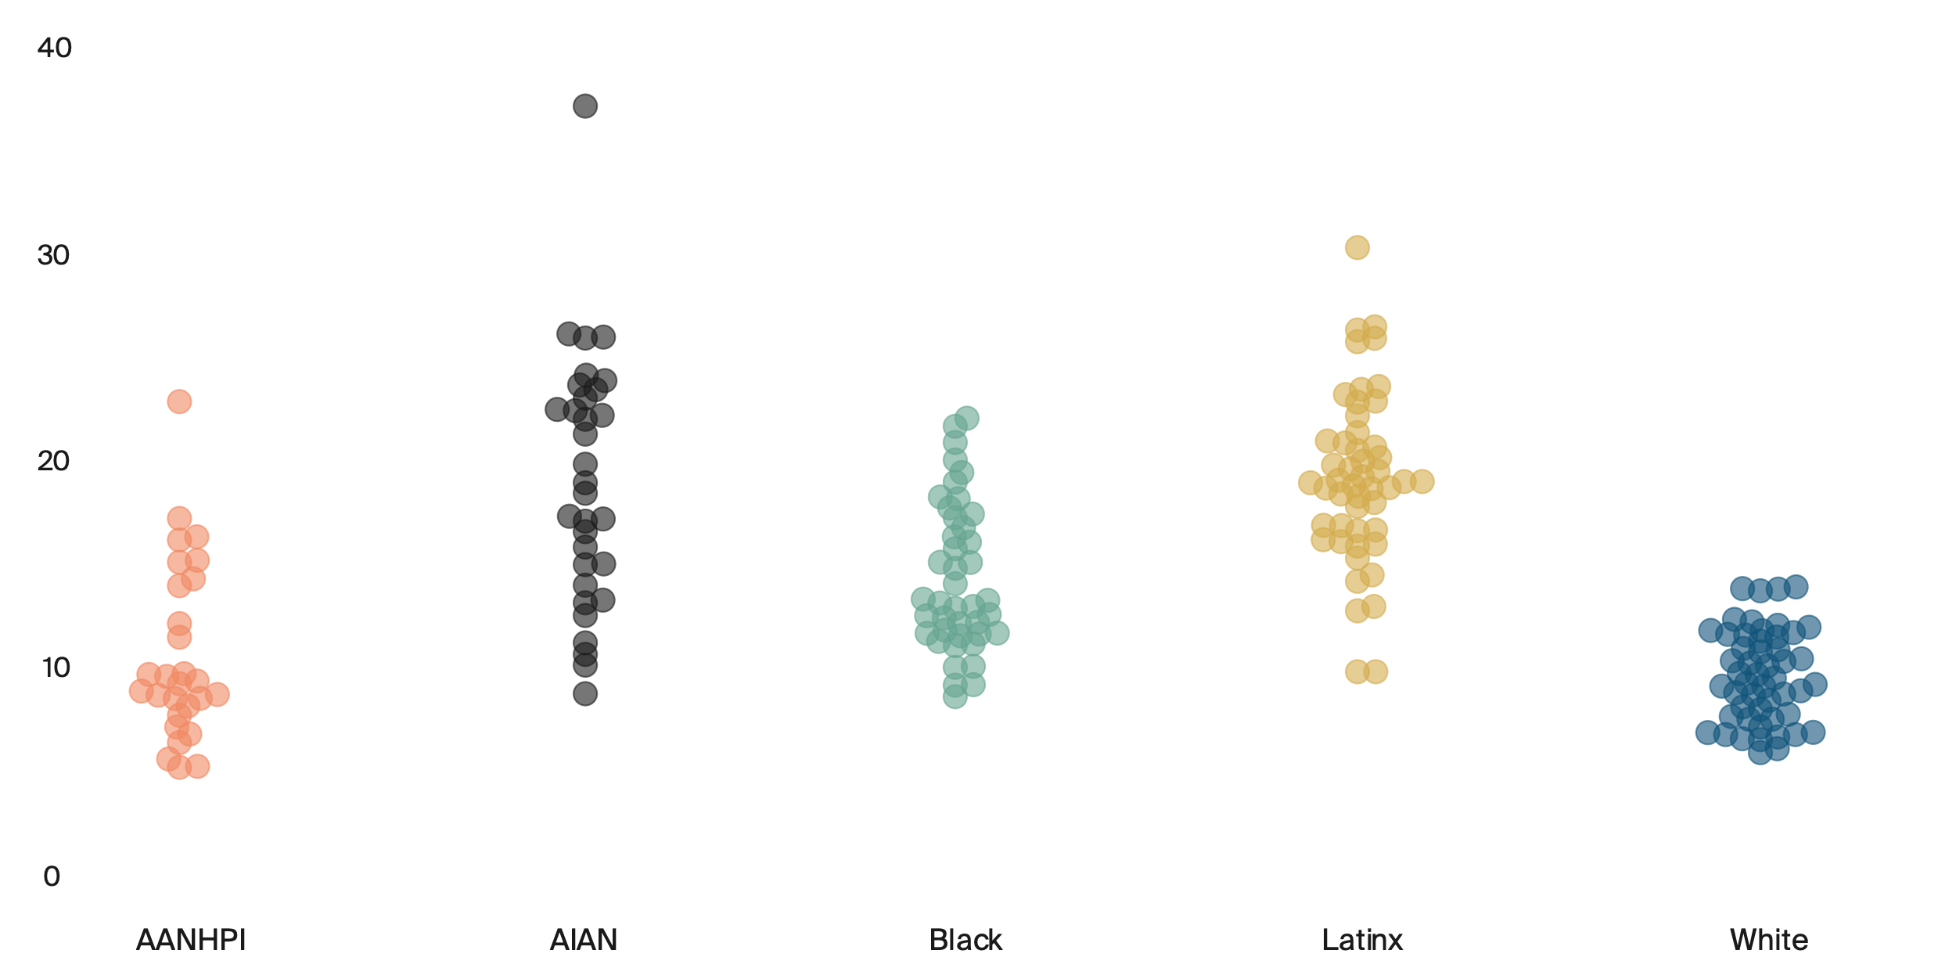
6: White people are less likely than other population groups to face cost-related barriers in most states.
Percent of adults age 18 and older who went without care because of cost in the past year, by state and race/ethnicity
Dots represent states
See online graphic for state detail
New Hampshire
37.1
Tennessee
30.3
South Carolina
22.9
Missouri
22.1
Mississippi
13.9
Alaska
8.8
Hawaii
9.8
California
8.6
Arizona
5.2
Hawaii
5.9
Notes: Missing dots for a particular group indicate that there are insufficient data for that state. AANHPI = Asian American, Native Hawaiian, and Pacific Islander; AIAN = American Indian/Alaska Native.
Data: Behavioral Risk Factor Surveillance System (BRFSS), 2019–20.

Slide 11
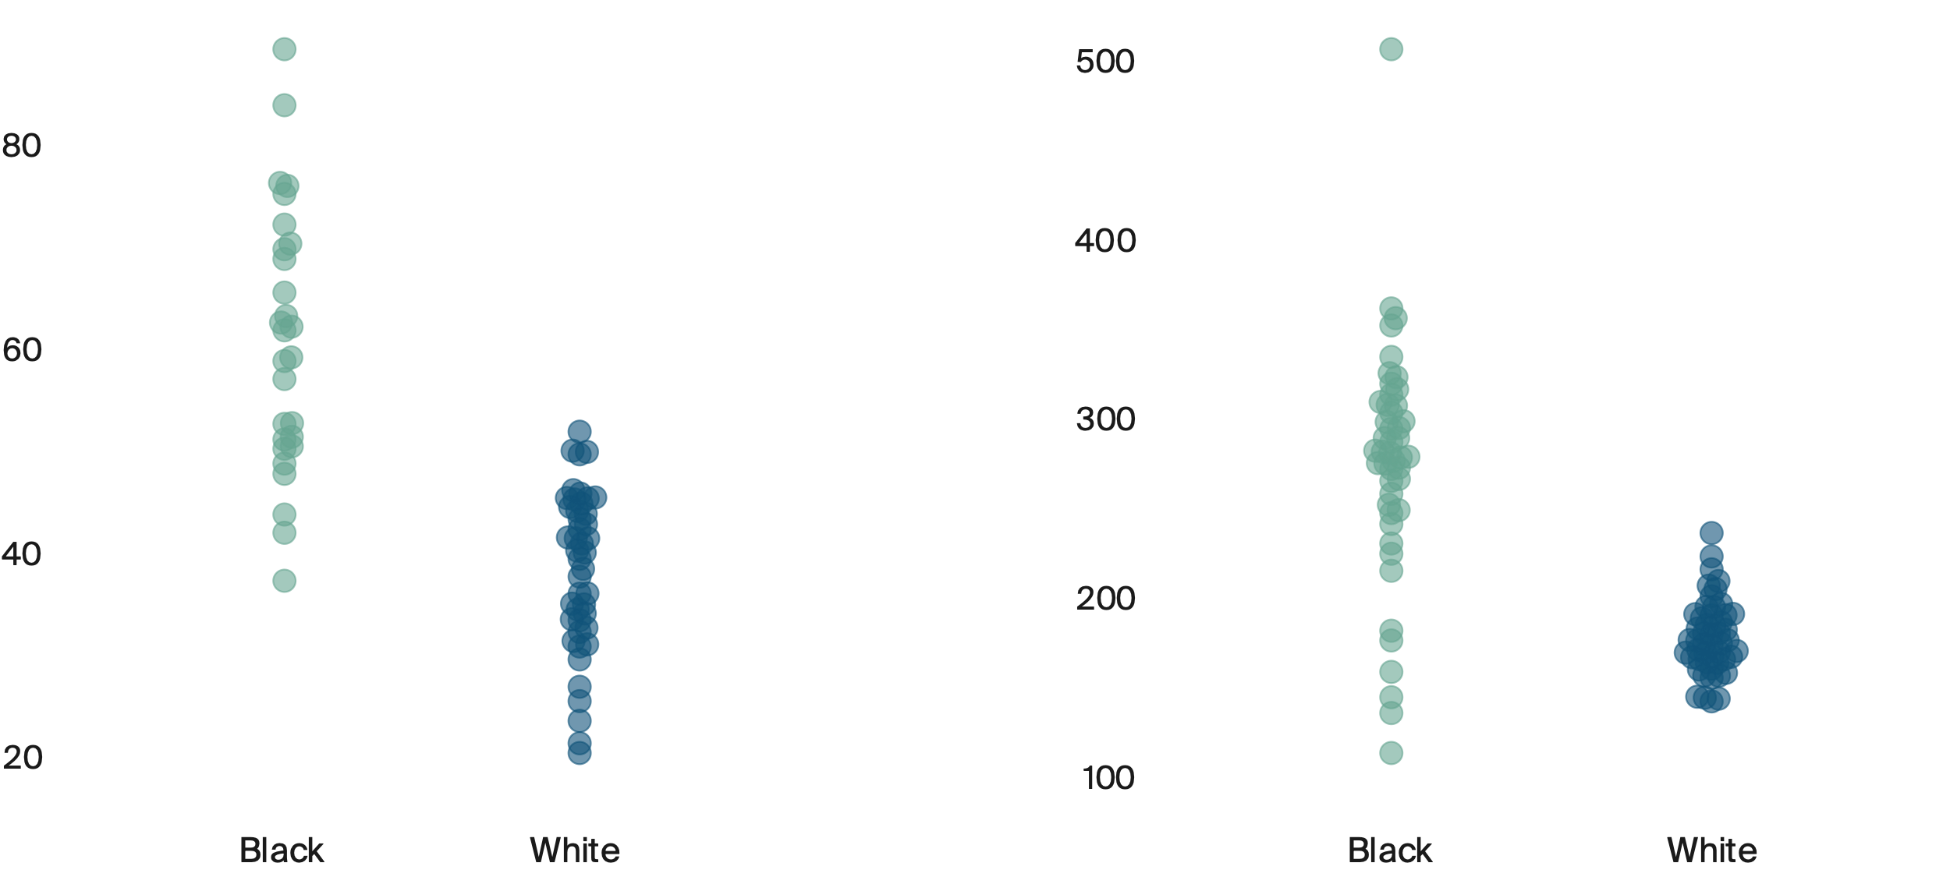
7: Black Medicare beneficiaries are more likely than white beneficiaries to be admitted to a hospital or to seek care in an emergency department for conditions typically manageable through good primary care.
Admissions for ambulatory care–sensitive conditions,
per 1,000 Medicare beneficiaries
Avoidable emergency department visits,
per 1,000 Medicare beneficiaries
Missouri
89.4
Vermont
505.1
Kentucky
51.8
West Virginia
236.1
Arkansas
37.2
Colorado
20.2
Nebraska
142.5
Hawaii
113.9
Notes: Dots represent states. Missing dots for a particular group indicates that there are insufficient data for that state. Race data only available for Black and white populations—ethnicity is unknown.
Data: Centers for Medicare and Medicaid Services, 2019 Limited Data Set (LDS) 5% sample. Analysis by Westat.

Slide 12
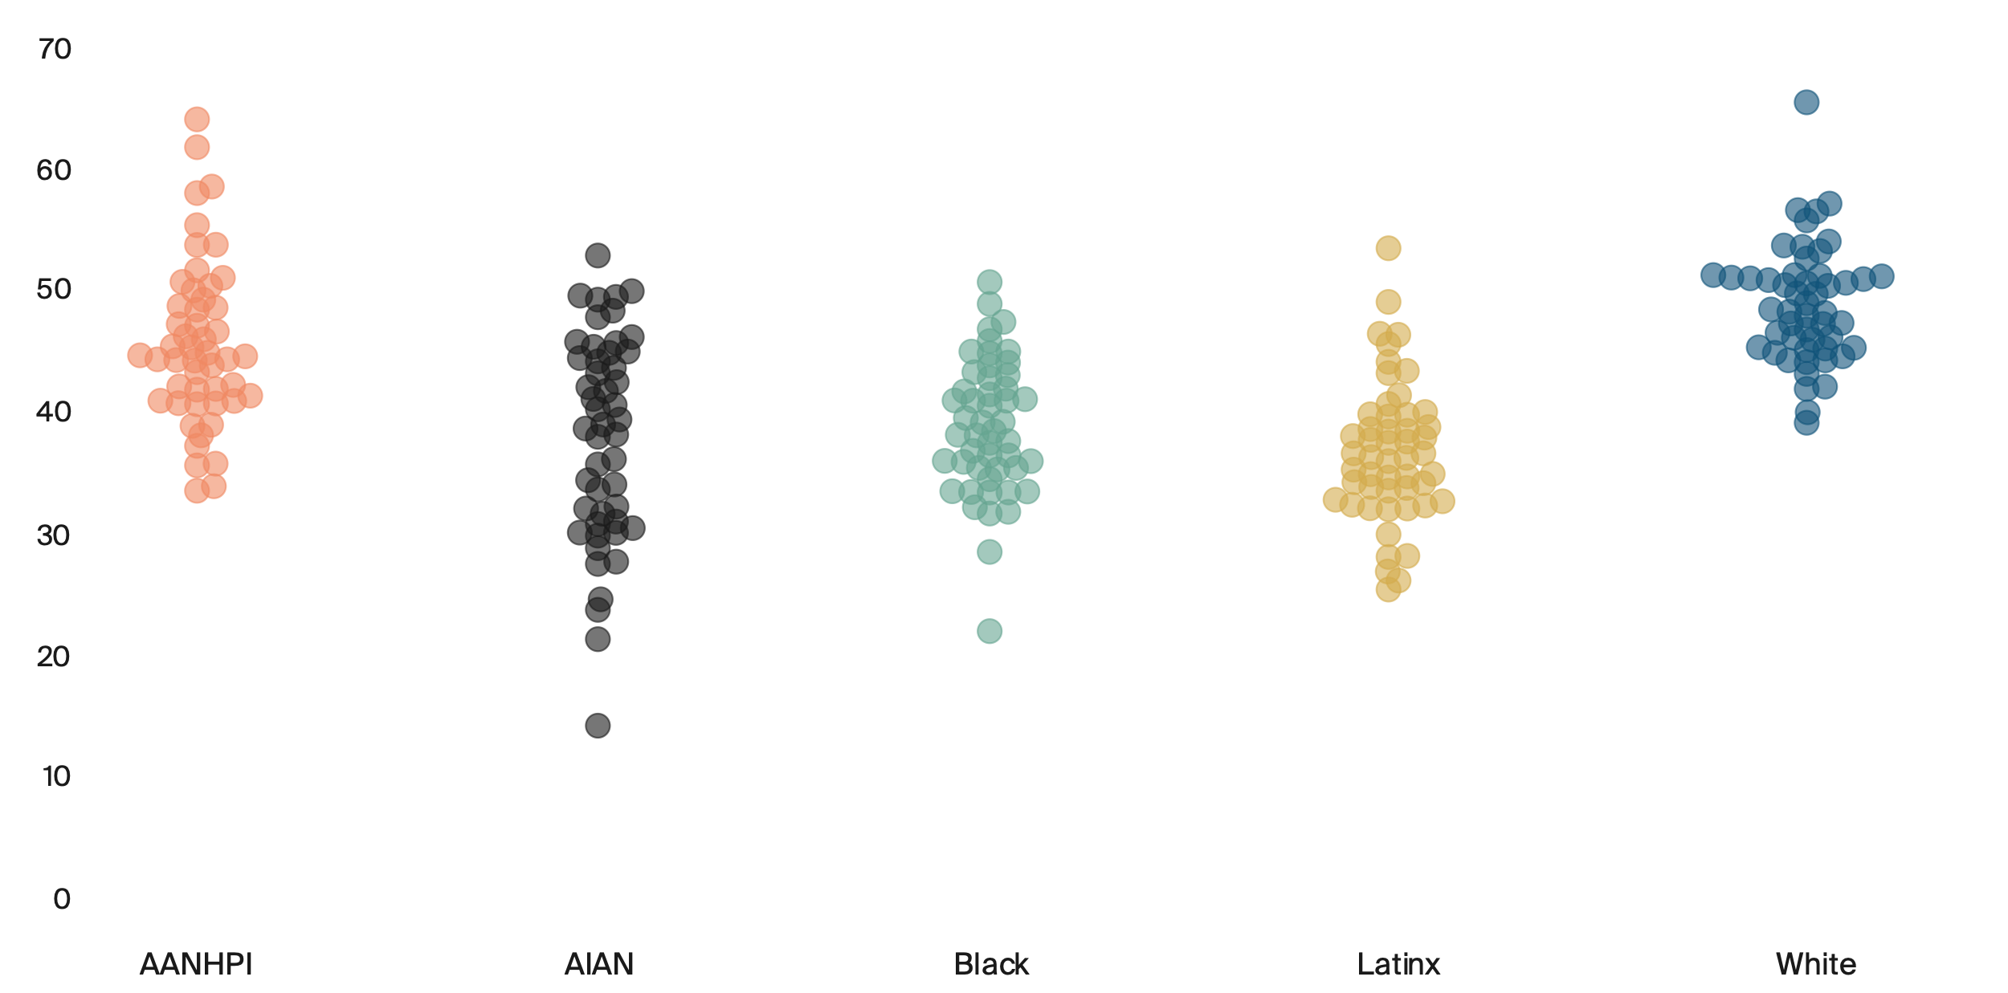
8: Black, AIAN, and Latinx/Hispanic adults are less likely than AANHPI and white adults to receive an annual flu shot.
Percent of adults age 18 and older with a seasonal flu shot in the past year
Dots represent states
See online graphic for state detail
Vermont
64.0
District of Columbia
65.3
Rhode Island
52.8
Mississippi
53.4
Rhode Island
50.6
Wyoming
39.1
Alaska
33.5
Nevada
22.0
Georgia
25.4
South Carolina
14.3
Notes: Missing dots for a particular group indicate that there are insufficient data for that state. AANHPI = Asian American, Native Hawaiian, and Pacific Islander; AIAN = American Indian/Alaska Native.
Data: Behavioral Risk Factor Surveillance System (BRFSS), 2019–20.

