Slide 1
ADVANCING HEALTH EQUITY
Federal and State Policy Solutions
November 18, 2021

Slide 2

ADVANCING HEALTH EQUITY: Federal and State Policy Solutions
Rachel Nuzum
Vice President, Federal and State Health Policy
The Commonwealth Fund
Follow @
raenuzum rachelnuzum
Learn more
commonwealthfund.org
Notes:
Goals for today’s briefing:
Share new state-by-state data on measures of health care access, quality, and outcomes by race and ethnicity
Discuss federal and state policy options and solutions around ensuring access to equitable coverage, addressing structural barriers and social drivers of health and the need to modernize race and ethnicity data
Highlight federal and state policy opportunities to advance more equitable care and outcomes

Slide 3
Advancing Health Equity: Federal and State Policy Solutions
Modernizing Race and Ethnicity Data
Ensuring universal, affordable, and equitable health coverage
Strengthening primary care and improving delivery of services
Reducing inequitable administrative burdens affecting patients and providers
Investing in social services
Notes:
Ensuring universal, affordable, and equitable health coverage
Marketplace premium subsidies and close Medicaid gap (in reconciliation bill)
Reduce deductibles and OOP costs for marketplace insurance plans
Subsidized mktplace plans
Targeted outreach and enrollment (tracking low enrollment by demographic group, like CA)
Population specific interventions such as the Postpartum extension under consideration in the build back better act and the mediciad re-entry act that would disproportionately impact communities of color
Address immigration-related barriers to coverage
Promote more equitable treatment of enrollees in commercial insurance plans
Strengthening primary care and improving delivery of services
Incentivize primary care (e.g. NC prospective Medicaid payment model, OR, WA)
Telemedicine (telematernity care)
Modernize medical licensing
Develop community-based health care workforces focused on team care
Reducing inequitable administrative burdens affecting patients and providers
Auto-enrollment
Get rid of red tape in public and private insurers
Investing in social services – the need for measures – see blog
Economic support for lower income families
Worker benefits and protections
Housing, transport, early childhood, education
Modernizing race and ethnicity data – central to advancing solutiosn in all of these buckets.

Slide 4
Advancing Health Equity: Federal and State Policy Solutions
Speakers:
David Radley, Ph.D., M.P.H. Senior Scientist, Tracking Health System Performance, The Commonwealth Fund
Laurie Zephyrin, M.D., M.P.H., M.B.A. Vice President, Advancing Health Equity, The Commonwealth Fund
Taylor Priestley, M.S.W., M.P.H. Health Equity Officer and Deputy Director of Health Equity & Quality Transformation, Covered California

Slide 5
Resources and Housekeeping
Please use the Q&A box to ask your questions.
All resources can be found here: https://www.commonwealthfund.org/event/2021/webinar-federal-and-state-policy-solutions-advance-health-equity and slides will be added.
Ideas for other briefings or topics? Please reach out to sfederman@cmwf.org.

Slide 6

Results from the 2021 Scorecard on Racial and Ethnic State Health System Equity
www.commonwealthfund.org
Commonwealth Fund Policy Briefing
November 18, 2021
Report Authors:
David Radley, Ph.D.
Jesse Baumgartner, M.P.H.
Sara Collins, Ph.D.
Laurie Zephyrin, M.D., M.P.H., M.B.A
Eric Schneider, M.D., M.Sc.

Slide 7
Introduction
Exhibit 7
Racial and ethnic inequities in health and health care are longstanding, are rooted in the structural racism embedded in U.S. policies, and have been exacerbated during the pandemic
The Commonwealth Fund’s State Scorecard on Health System Performance series has long tracked the functioning of each state’s health care system, but state averages can mask profound underlying inequities among different people
This tool will allow policy makers to understand the magnitude of health inequities and establish attainable benchmarks for reducing disparities

Slide 8
How We Created the State Equity Scorecard Report
Exhibit 8
The report uses 24 data indicators drawn from our State Scorecard representing aspects of health system performance that can be stratified by race/ethnicity
Report features measures for 5 racial and ethnic groups: Black, white, American Indian/Alaska Native (AIAN), Asian American, Native Hawaiian, and Pacific Islander (AANHPI), and Latinx/Hispanic
Data from 2019 and 2020
Measures are grouped into 3 dimensions: Health Outcomes, Health Care Access, Quality and Use of Health Care Services
Composite summary scores calculated for each group within each state (e.g. Black residents in TX) by aggregating performance measure data

Slide 9
Key Findings
Exhibit 9
Health equity does not exist in any state within the U.S., even those with stronger health systems
In every state, health system performance is markedly worse for many people of color, particularly Black, Latinx, and AIAN populations, when compared to white people
Only 6 states had above average performance for all racial and ethnic groups (for which data were available): Massachusetts, Connecticut, Rhode Island, New York, Hawaii, and Oregon
Some Midwest states like Minnesota and Wisconsin have historically performed strongly in the State Scorecard series, but they report some of the largest racial inequities between groups
Others like Mississippi and Oklahoma show substandard performance for all groups, but still report sizable inequities within the state

Slide 10
Health system performance for white people is above average in most states
Summary Findings
Exhibit 10
Higher performance
Average
Performance (all groups)
White populations
Lower performance
Best score achieved in state
Notes: States are rank-ordered by highest state performance for white population. Grey dots represent the highest score achieved in each state by any of the five groups (if no grey dot is visible, the highlighted group has the top score). Height of the point represents state performance on a 1-100 point scale, with the centerline marking average performance (equivalent to the all-group median at the 50th percentile) among all the groups measured. Summary performance scores not available for all racial and ethnic groups in all states; missing dots for a particular group indicate that there are insufficient data for that state.
Data: Commonwealth Fund 2021 Health System Performance Scores

Slide 11
Health system performance among Black people is below average in most states and much worse than the best achieved in all states
Summary Findings
Exhibit 11
Black populations
Higher performance
Best score achieved in state
Average Performance (all groups)
Lower performance
Notes: States are rank-ordered by highest state performance for Black population. Grey dots represent the highest score achieved in each state by any of the five groups (if no grey dot is visible, the highlighted group has the top score). Height of the point represents state performance on a 1-100 point scale, with the centerline marking average performance (equivalent to the all-group median at the 50th percentile) among all the groups measured. Summary performance scores not available for all racial and ethnic groups in all states; missing dots for a particular group indicate that there are insufficient data for that state.
Data: Commonwealth Fund 2021 Health System Performance Scores

Slide 12
Summary Findings
Exhibit 12
Health system performance among Latinx/Hispanic people is below average in most states and much worse than the best achieved in all states
Higher performance
Average Performance (all groups)
Latinx populations
Lower performance
Best score achieved in state
Notes: States are rank-ordered by highest state performance for Latinx/Hispanic population. Grey dots represent the highest score achieved in each state by any of the five groups (if no grey dot is visible, the highlighted group has the top score). Height of the point represents state performance on a 1-100 point scale, with the centerline marking average performance (equivalent to the all-group median at the 50th percentile) among all the groups measured. Summary performance scores not available for all racial and ethnic groups in all states; missing dots for a particular group indicate that there are insufficient data for that state.
Data: Commonwealth Fund 2021 Health System Performance Scores

Slide 13
Six states with better-than-average & three states with below average health system performance for all groups; within state disparities exist in each
Summary Findings
Exhibit 13
AANHPI populations
Higher performance
AIAN populations
Black populations
Latinx/Hispanic populations
White populations
Average
Performance (all groups)
Lower performance
better-than-average
below average
Notes: Only states with sufficient data for at least two racial and ethnic groups included. Height of the point represents state performance on a 1-100 point scale, with the centerline marking average performance (equivalent to the all-group median at the 50th percentile) among all the groups measured. Summary performance scores not available for all racial and ethnic groups in all states; missing dots for a particular group indicate that there are insufficient data for that state. AANHPI = Asian American, Native Hawaiian, and Pacific Islander; AIAN = American Indian/Alaska Native.
Data: Commonwealth Fund 2021 Health System Performance Scores

Slide 14
Many states have strong performance for some racial and ethnic groups, but still face large disparities (six examples)
Summary Findings
Exhibit 14
Higher performance
AANHPI populations
AIAN populations
Average Performance (all groups)
Black populations
Latinx/Hispanic populations
Lower performance
White populations
Notes: Only states with sufficient data for at least two racial and ethnic groups included. Height of the point represents state performance on a 1-100 point scale, with the centerline marking average performance (equivalent to the all-group median at the 50th percentile) among all the groups measured. Summary performance scores not available for all racial and ethnic groups in all states; missing dots for a particular group indicate that there are insufficient data for that state. AANHPI = Asian American, Native Hawaiian, and Pacific Islander; AIAN = American Indian/Alaska Native.
Data: Commonwealth Fund 2021 Health System Performance Scores

Slide 15
health outcomes

Slide 16
Black people are more likely, in most states, to die early in life from conditions that are treatable with timely access to high-quality health care
Health Outcomes
Exhibit 16
Mortality amenable to health care, deaths per 100,000 population
Black populations
Higher mortality
Lowest group mortality observed in state
U.S. rate
(all groups)
84 per 100,000
Lower mortality
Notes: Grey dots represent the lowest mortality rate achieved in each state by any of the five groups (if no grey dot is visible, the highlighted group has the lowest rate). The centerline marks the U.S. premature mortality rate for all people. Data not available for all racial and ethnic groups in all states; missing dots for a particular group indicate that there are insufficient data for that state.
Data: CDC, 2018 and 2019 National Vital Statistics System (NVSS), All-County Micro Data, Restricted Use Files.

Slide 17
AIAN people are more likely, in most states, to die early in life from conditions that are treatable with timely access to high-quality health care
Health Outcomes
Exhibit 17
Mortality amenable to health care, deaths per 100,000 population
Higher mortality
AIAN populations
Lowest group mortality observed in state
U.S. rate
(all groups)
84 per 100,000
Lower mortality
Notes: Grey dots represent the lowest mortality rate achieved in each state by any of the five groups (if no grey dot is visible, the highlighted group has the lowest rate). The centerline marks the U.S. premature mortality rate for all people. Data not available for all racial and ethnic groups in all states; missing dots for a particular group indicate that there are insufficient data for that state. AIAN = American Indian/Alaska Native.
Data: CDC, 2018 and 2019 National Vital Statistics System (NVSS), All-County Micro Data, Restricted Use Files.

Slide 18
health care access

Slide 19
Although the ACA’s coverage expansion improved inequities, state uninsured rates are generally higher for Latinx/Hispanic adults
Health Care Access
Exhibit 19
Uninsured adults ages 19-64 (%)
Higher uninsured
rate
Latinx populations
Lowest group uninsured rate observed in state
U.S. rate
(all groups)
12.9%
Lower uninsured rate
Notes: Grey dots represent the lowest uninsured rate achieved in each state by any of the five groups (if no grey dot is visible, the highlighted group has the lowest rate). The centerline marks the U.S. uninsured rate for all people. Data not available for all racial and ethnic groups in all states; missing dots for a particular group indicate that there are insufficient data for that state.
Data: American Community Survey Public Use Micro Sample (ACS-PUMS) 2019 1-year file.

Slide 20
Although the ACA’s coverage expansion improved inequities, state uninsured rates are generally higher for Black adults
Health Care Access
Exhibit 20
Uninsured adults ages 19-64 (%)
Higher uninsured
rate
Black populations
Lowest group uninsured rate observed in state
U.S. rate
(all groups)
12.9%
Lower uninsured rate
Notes: Grey dots represent the lowest uninsured rate achieved in each state by any of the five groups (if no grey dot is visible, the highlighted group has the lowest rate). The centerline marks the U.S. uninsured rate for all people. Data not available for all racial and ethnic groups in all states; missing dots for a particular group indicate that there are insufficient data for that state.
Data: American Community Survey Public Use Micro Sample (ACS-PUMS) 2019 1-year file.

Slide 21
Summary
Exhibit 21
State health systems are not working for many people of color
Racial and ethnic disparities in health and health care are evident in every state, even those with stronger health systems
Health system performance is markedly worse for many people of color, particularly Black, Latinx, and AIAN populations, when compared to white people

Slide 22

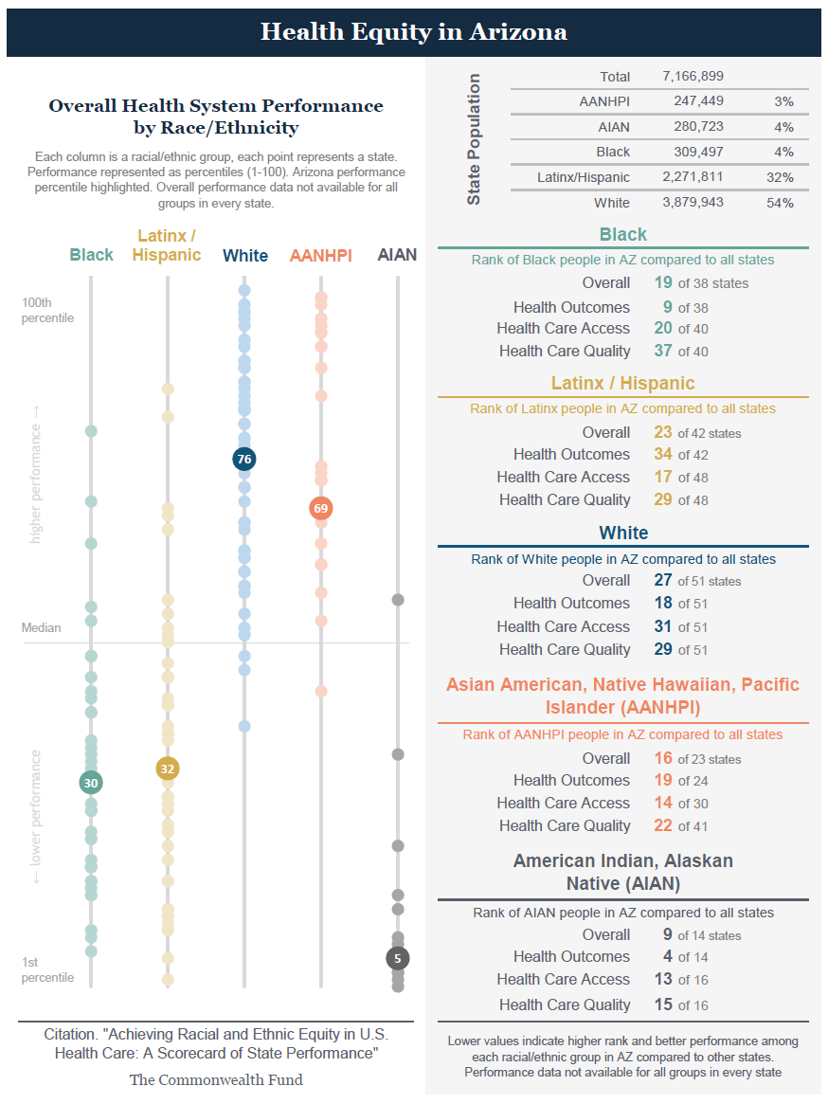
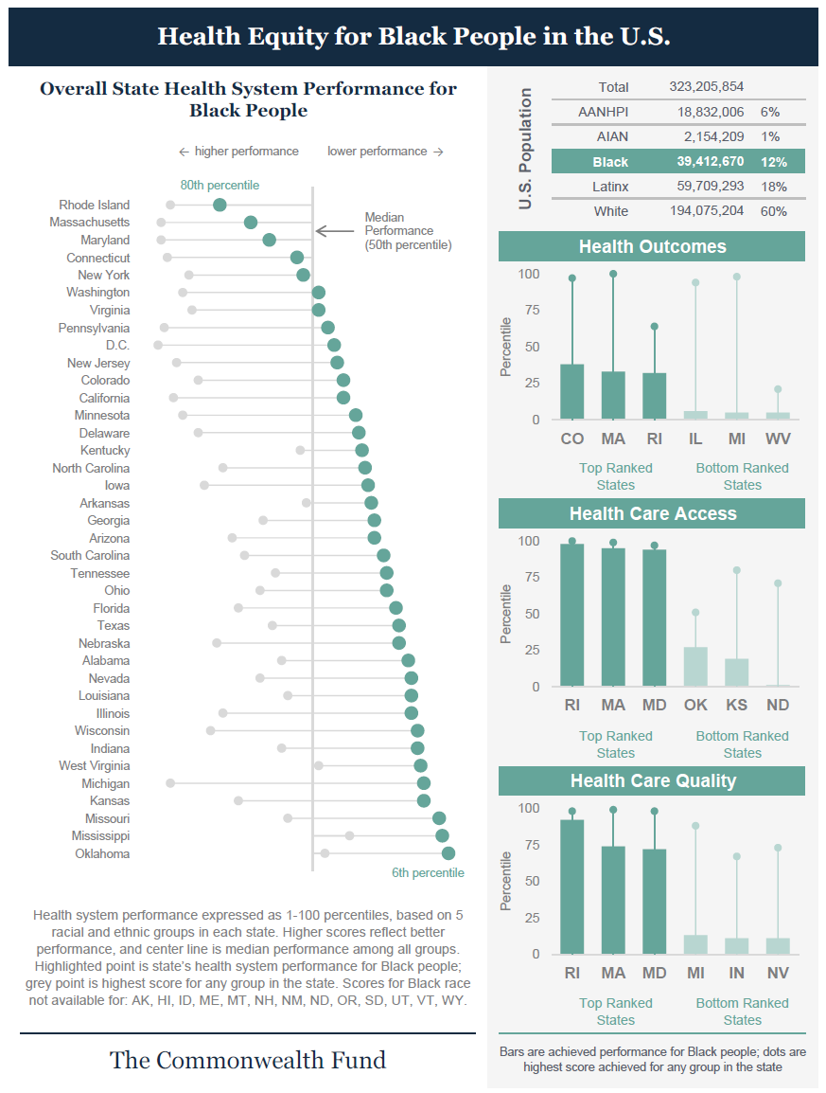
Using the Scorecard, more than just a report…
Exhibit 22
A new tool that identifies differential health system performance between racial and ethnic groups
Provides insight across & within states
State & racial and ethnic group profiles provide focused detail with summary information and data points for all 24 indicators
Online interactive content + Printable PDF +
State & Group Profiles

Slide 23
Opportunities for Advancing Health Equity
Laurie Zephyrin, MD, MBA, MPH
Vice President, Advancing Health Equity
The Commonwealth Fund
Health Equity Scorecard Report Webinar
November 18, 2021

Slide 24
Structural Barriers to Health Care Access, Coverage, and Quality
Opportunities for Advancing Health Equity
Staggering disparities persist across socioeconomic, racial, and educational backgrounds due to structural barriers in place
Factors that Impact Optimal Healthcare Access and Outcomes
High Costs
Language Barriers
Lack of Transportation
Restricted Access to Healthy Foods
Inadequate Insurance Coverage
Low Availability of Healthcare Providers
People of color are less likely to receive preventive health services irrespective of income, neighborhood, comorbid illness, or insurance type, and often receive lower-quality care

Slide 25
Enhancing Social Drivers of Health Is Critical to Advancing Health Equity
Opportunities for Advancing Health Equity
Education
Access to Providers
We must invest strategically into drivers of health to reduce inequities in health care and outcomes
Housing
Advancing Health Equity
Drivers of health account for 80 percent of health outcomes and have a disproportionate impact on communities of color.
These include stable, affordable housing; healthy food; reliable income; and interpersonal safety, among others.
Addressing systemic racism and structural barriers is key
Economic Opportunity
Community and Social Services
Addressing Systemic Racism
November 18, 2021

Slide 26
Staggering Racial/Ethnic and Socioeconomic Inequities/Disparities
Opportunities for Advancing Health Equity
40% higher breast cancer mortality rates for Black women
More likely to be served by poorly resourced and underfunded health systems
10-year lower life expectancy for lowest income women
Unequal Access
Unequal Treatment
Unequal Outcomes
Lower access to preventive services
2-3x higher maternal mortality rate higher for Black and Native American women
Lower rates of cancer screenings in uninsured women
November 18, 2021
Notes:
She’s not alone. One-quarter of Black women report disrespect and abuse in the hospital after giving birth. Numerous studies show that medical professionals spend less time with Black patients, ignore their symptoms, dismiss their complaints, and undertreat their pain.
That’s why it’s so important that the work we do as OB/GYNs doesn’t just take into account the role that gender plays in women’s health care experience but also incorporates strategies to care for low-income people and eliminate racial/ethnic disparities. To achieve this, we have to adopt health equity approaches that ensure that care practices acknowledge intersectionality.

Slide 27
Racial Equity in Maternal Health
Addressing Unequal Treatment
Black serving hospitals are more likely to perform worse on 12 of 15 delivery indicators and have higher severe maternal morbidity rates than white serving hospitals
Black birthing people are less likely to be screened postpartum for depression and access mental health treatment and less likely to receive health guidance on core maternal health concerns
Addressing Unequal Experience
Black birthing people compared to white birthing people are more likely to report:
Being treated unfairly and with disrespect by providers because of their race
Not having decision autonomy during labor and delivery
Feeling pressured to have a cesarean
Addressing Unequal Outcomes
A Black person with a college education is at 60 percent greater risk for a maternal death than a white or Hispanic person with less than a high school education
Even within the same hospital Black and Latina birthing people are more likely to suffer from severe maternal morbidity than white birthing people, regardless of insurance
Sources: Eugene Declercq and Laurie Zephyrin, Maternal Mortality in the United States: A Primer, Commonwealth Fund. Dec, 2020; Laura Attanasio and Katy Kozhimannil, Patient-reported Communication Quality and Perceived Discrimination in Maternity Care, Med Care. Oct 2016; Carol Sakala, et al., Listening to Mothers in California, National Partnerships Women & Families. Sept 2018; Abbey Sidebottom, et al., Perinatal Depression Screening Practices in a Large Health System: Identifying Current State and Assessing Opportunities to Provide more Equitable Care, Archives of Women’s Mental Health. May 2020; Saraswathi Vedam, et al., The Giving Voice to Mothers study: inequity and mistreatment during pregnancy and childbirth in the United States, Reproductive Health. Jun 2019; Elizabeth Howell, et al., Black-White Differences in Severe Maternal Morbidity and Site of Care, Am J Obstet Gynecol, Jan 1.

Slide 28
These inequities are costing all of us…
Opportunities for Advancing Health Equity
The high costs associated with maternal morbidity showcase the importance of investing in health equity
$32.3B
Maternal morbidity encompasses physical and psychological conditions resulting from, or aggravated by, pregnancy. These conditions do not necessarily lead to death, but they can have a negative impact on quality of life that lasts for months, even years
Opportunities to Improve Maternal Outcomes
nine common maternal morbidity conditions associated with births in a given year (2019) cost society $32.3 billion from the beginning of pregnancy through five years postpartum
Increased Medicaid Coverage 12 months post partum and increased coverage overall
Integrate access to mental health services and primary health care
Investments in community-based models
Diversifying health care providers
November 18, 2021

Slide 29






Potential Solutions for Reducing Inequities
Opportunities for Advancing Health Equity
Addressing Racism and Discrimination in Health Systems
Increasing Insurance Coverage Nationally
Systemically Address Inequitable Access to Social Drivers of Health and Invest in Social Services
Develop Local and State-Specific Strategies for Addressing Disparities Amongst Communities
Identify Opportunities to Improve Data Collection to Better Understand How Inequities Manifest
Develop Accountability Mechanisms to Ensure Prioritization of Equity

Slide 30


Learn more
commonwealthfund.org
Follow @
LaurieZephyrin lauriezephyrin
advancinghealthequity

Slide 31
Covered California Health Equity Initiatives
Taylor Priestley, Health Equity Officer
Deputy Director, Health Equity & Quality Transformation
November 18, 2021

Slide 32
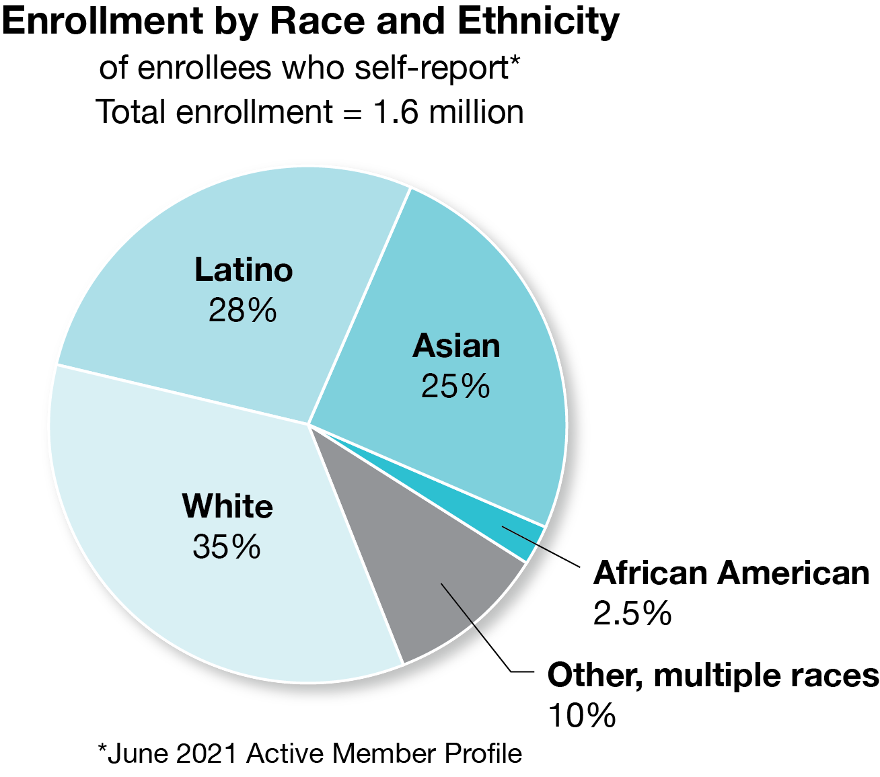
Covered California Strategies to address health equity
Enrollment and Outreach Efforts
Marketing and promotional efforts focus on health insurance literacy, racial and cultural diversity, LGBTQ communities, and rural locales.
Culturally and linguistically tailored materials and strategies, in-language marketing in nine languages, media channels specific to Latino, African American, Asian American, and LGBTQ+ communities.
In-language consumer support through racially/ethnically diverse agents, navigators, Covered California service center representatives
Patient-Centered Benefit Design
Focus on “health insurance literacy” and income, attention to impact of cost sharing at each income level
Designed to prevent “gotcha” insurance experiences, e.g., standard benefit designs, emphasis on copays over co-insurance
Where possible, primary, urgent, and other outpatient care not subject to deductible
June 2021 Active Member Profile

Slide 33
Covered California health disparities reduction
Covered California’s multi-year disparities reduction initiatives have been in place since 2017 and seek to achieve the following goals:
Goal 1: Improve disparity data capture to support measurement, and
Goal 2: Improve structure and rigor for disparities intervention development, in order to
Goal 3: Systematically measure and reduce disparities
Demographic Data Collection & Disparities Measurement
2017-2022
2022 Performance Standard
Disparities Reduction Interventions
2017-2022
Learning & Engagement
2021-2022
NCQA Health Equity Accreditation
Incorporating Equity in QTI
2023-2025
2022-2025
achieve by 2023
2022 Performance Standard
Centering Equity in Health Plan Performance

Slide 34
federal policy changes to support health equity
Accurate and adequate demographic data is critical to identification and reduction of health disparities.
Update the “OMB 15” – the Office of Management and Budget (OMB) 1997 Statistical Policy Directive on Standards for Maintaining, Collecting, and Presenting Federal Data on Race and Ethnicity to support accurate and standard collection and use of race and ethnicity data
Adopt framework recommended by Census Bureau in 2017
Implement uniform requirements for stratified reporting and facilitate demographic data sharing across federal programs
Review and update as needed laws and regulations to facilitate efficient and appropriate collection, sharing, and use of demographic data
Remove prohibitions and perceived prohibitions to collecting demographic data

