Slide 1

Results from the 2021 Scorecard on Racial and Ethnic State Health System Equity
www.commonwealthfund.org
Media teleconference: November 17, 2021
Embargoed
until 12:01 am,
November 18, 2021

Slide 2
Introduction
Exhibit 2
Racial and ethnic inequities in health and health care are longstanding, are rooted in the structural racism embedded in U.S. policies, and have been exacerbated during the pandemic
The Commonwealth Fund’s State Scorecard on Health System Performance series has long tracked the functioning of each state’s health care system, but state averages can mask profound underlying inequities among different people
This tool will allow policy makers to understand the magnitude of health inequities and establish attainable benchmarks for reducing disparities

Slide 3
How We Created the State Equity Scorecard Report
Exhibit 3
The report uses 24 data indicators drawn from our State Scorecard representing aspects of health system performance that can be stratified by race/ethnicity
Report features measures for 5 racial and ethnic groups: Black, white, American Indian/Alaska Native (AIAN), Asian American, Native Hawaiian, and Pacific Islander (AANHPI), and Latinx/Hispanic
Data from 2019 and 2020
Measures are grouped into 3 dimensions: Health Outcomes, Health Care Access, Quality and Use of Health Care Services
Composite summary scores calculated for each group within each state (e.g. Black residents in TX) by aggregating performance measure data

Slide 4
Key Findings
Exhibit 4
Health equity does not exist in any state within the U.S., even those with stronger health systems
In every state, health system performance is markedly worse for many people of color, particularly Black, Latinx, and AIAN populations, when compared to white people
Only 6 states had above average performance for all racial and ethnic groups (for which data were available): Massachusetts, Connecticut, Rhode Island, New York, Hawaii, and Oregon
Some Midwest states like Minnesota and Wisconsin have historically performed strongly in the State Scorecard series, but they report some of the largest racial inequities between groups
Others like Mississippi and Oklahoma show substandard performance for all groups, but still report sizable inequities within the state

Slide 5
Health system performance for white people is above average in most states
Summary Findings
Exhibit 5
Higher performance
Average
Performance (all groups)
White populations
Lower performance
Best score achieved in state
Notes: States are rank-ordered by highest state performance for white population. Grey dots represent the highest score achieved in each state by any of the five groups (if no grey dot is visible, the highlighted group has the top score). Height of the point represents state performance on a 1-100 point scale, with the centerline marking average performance (equivalent to the all-group median at the 50th percentile) among all the groups measured. Summary performance scores not available for all racial and ethnic groups in all states; missing dots for a particular group indicate that there are insufficient data for that state.
Data: Commonwealth Fund 2021 Health System Performance Scores

Slide 6
Health system performance among Black people is below average in most states and much worse than the best achieved in all states
Summary Findings
Exhibit 6
Black populations
Higher performance
Best score achieved in state
Average Performance (all groups)
Lower performance
Notes: States are rank-ordered by highest state performance for Black population. Grey dots represent the highest score achieved in each state by any of the five groups (if no grey dot is visible, the highlighted group has the top score). Height of the point represents state performance on a 1-100 point scale, with the centerline marking average performance (equivalent to the all-group median at the 50th percentile) among all the groups measured. Summary performance scores not available for all racial and ethnic groups in all states; missing dots for a particular group indicate that there are insufficient data for that state.
Data: Commonwealth Fund 2021 Health System Performance Scores

Slide 7
Summary Findings
Exhibit 7
Health system performance among Latinx/Hispanic people is below average in most states and much worse than the best achieved in all states
Higher performance
Average Performance (all groups)
Latinx populations
Lower performance
Best score achieved in state
Notes: States are rank-ordered by highest state performance for Latinx/Hispanic population. Grey dots represent the highest score achieved in each state by any of the five groups (if no grey dot is visible, the highlighted group has the top score). Height of the point represents state performance on a 1-100 point scale, with the centerline marking average performance (equivalent to the all-group median at the 50th percentile) among all the groups measured. Summary performance scores not available for all racial and ethnic groups in all states; missing dots for a particular group indicate that there are insufficient data for that state.
Data: Commonwealth Fund 2021 Health System Performance Scores

Slide 8
Six states with better-than-average & three states with below average health system performance for all groups; within state disparities exist in each
Summary Findings
Exhibit 8
AANHPI populations
Higher performance
AIAN populations
Black populations
Latinx/Hispanic populations
White populations
Average
Performance (all groups)
Lower performance
better-than-average
below average
Notes: Only states with sufficient data for at least two racial and ethnic groups included. Height of the point represents state performance on a 1-100 point scale, with the centerline marking average performance (equivalent to the all-group median at the 50th percentile) among all the groups measured. Summary performance scores not available for all racial and ethnic groups in all states; missing dots for a particular group indicate that there are insufficient data for that state. AANHPI = Asian American, Native Hawaiian, and Pacific Islander; AIAN = American Indian/Alaska Native.
Data: Commonwealth Fund 2021 Health System Performance Scores

Slide 9
Many states have strong performance for some racial and ethnic groups, but still face large disparities (six examples)
Summary Findings
Exhibit 9
Higher performance
AANHPI populations
AIAN populations
Average Performance (all groups)
Black populations
Latinx/Hispanic populations
Lower performance
White populations
Notes: Only states with sufficient data for at least two racial and ethnic groups included. Height of the point represents state performance on a 1-100 point scale, with the centerline marking average performance (equivalent to the all-group median at the 50th percentile) among all the groups measured. Summary performance scores not available for all racial and ethnic groups in all states; missing dots for a particular group indicate that there are insufficient data for that state. AANHPI = Asian American, Native Hawaiian, and Pacific Islander; AIAN = American Indian/Alaska Native.
Data: Commonwealth Fund 2021 Health System Performance Scores

Slide 10
health outcomes

Slide 11
Black people are more likely, in most states, to die early in life from conditions that are treatable with timely access to high-quality health care
Health Outcomes
Exhibit 11
Mortality amenable to health care, deaths per 100,000 population
Black populations
Higher mortality
Lowest group mortality observed in state
U.S. rate
(all groups)
84 per 100,000
Lower mortality
Notes: Grey dots represent the lowest mortality rate achieved in each state by any of the five groups (if no grey dot is visible, the highlighted group has the lowest rate). The centerline marks the U.S. premature mortality rate for all people. Data not available for all racial and ethnic groups in all states; missing dots for a particular group indicate that there are insufficient data for that state.
Data: CDC, 2018 and 2019 National Vital Statistics System (NVSS), All-County Micro Data, Restricted Use Files.

Slide 12
AIAN people are more likely, in most states, to die early in life from conditions that are treatable with timely access to high-quality health care
Health Outcomes
Exhibit 12
Mortality amenable to health care, deaths per 100,000 population
Higher mortality
AIAN populations
Lowest group mortality observed in state
U.S. rate
(all groups)
84 per 100,000
Lower mortality
Notes: Grey dots represent the lowest mortality rate achieved in each state by any of the five groups (if no grey dot is visible, the highlighted group has the lowest rate). The centerline marks the U.S. premature mortality rate for all people. Data not available for all racial and ethnic groups in all states; missing dots for a particular group indicate that there are insufficient data for that state. AIAN = American Indian/Alaska Native.
Data: CDC, 2018 and 2019 National Vital Statistics System (NVSS), All-County Micro Data, Restricted Use Files.

Slide 13
health care access

Slide 14
Although the ACA’s coverage expansion improved inequities, state uninsured rates are generally higher for Latinx/Hispanic adults
Health Care Access
Exhibit 14
Uninsured adults ages 19-64 (%)
Higher uninsured
rate
Latinx populations
Lowest group uninsured rate observed in state
U.S. rate
(all groups)
12.9%
Lower uninsured rate
Notes: Grey dots represent the lowest uninsured rate achieved in each state by any of the five groups (if no grey dot is visible, the highlighted group has the lowest rate). The centerline marks the U.S. uninsured rate for all people. Data not available for all racial and ethnic groups in all states; missing dots for a particular group indicate that there are insufficient data for that state.
Data: American Community Survey Public Use Micro Sample (ACS-PUMS) 2019 1-year file.

Slide 15
Although the ACA’s coverage expansion improved inequities, state uninsured rates are generally higher for Black adults
Health Care Access
Exhibit 15
Uninsured adults ages 19-64 (%)
Higher uninsured
rate
Black populations
Lowest group uninsured rate observed in state
U.S. rate
(all groups)
12.9%
Lower uninsured rate
Notes: Grey dots represent the lowest uninsured rate achieved in each state by any of the five groups (if no grey dot is visible, the highlighted group has the lowest rate). The centerline marks the U.S. uninsured rate for all people. Data not available for all racial and ethnic groups in all states; missing dots for a particular group indicate that there are insufficient data for that state.
Data: American Community Survey Public Use Micro Sample (ACS-PUMS) 2019 1-year file.

Slide 16
Summary
Exhibit 16
State health systems are not working for many people of color
Racial and ethnic disparities in health and health care are evident in every state, even those with stronger health systems
Health system performance is markedly worse for many people of color, particularly Black, Latinx, and AIAN populations, when compared to white people

Slide 17

Using the Scorecard, more than just a report…
Exhibit 17
Online interactive content + Printable PDF
A new tool that identifies differential health system performance between racial and ethnic groups
Provides insight across & within states
State & racial and ethnic group profiles provide focused detail with summary information and data points for all 24 indicators

Slide 18
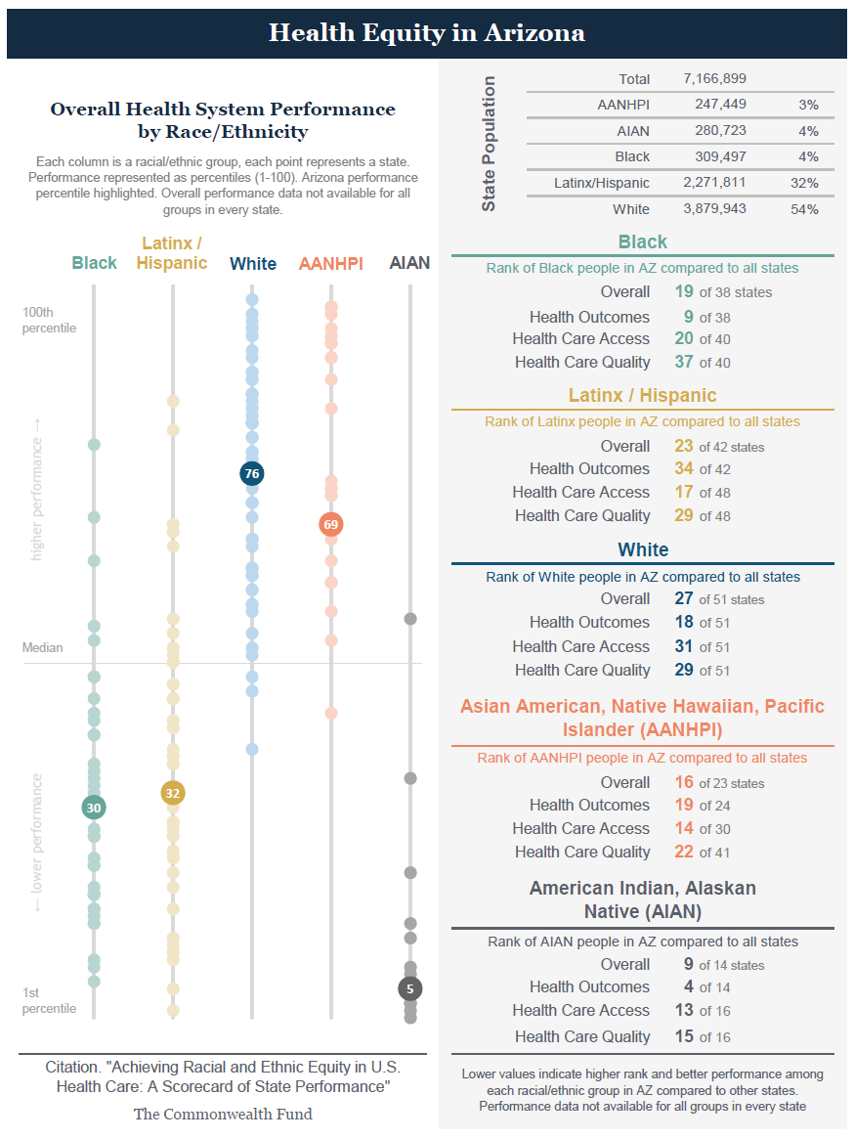
State Profiles
Exhibit 18
Performance scores and group-specific ranks for each of the 5 racial and ethnic groups
Performance scores on each of the 3 dimensions to help target areas of relative strength or weakness
State-specific data for each indicator

Slide 19
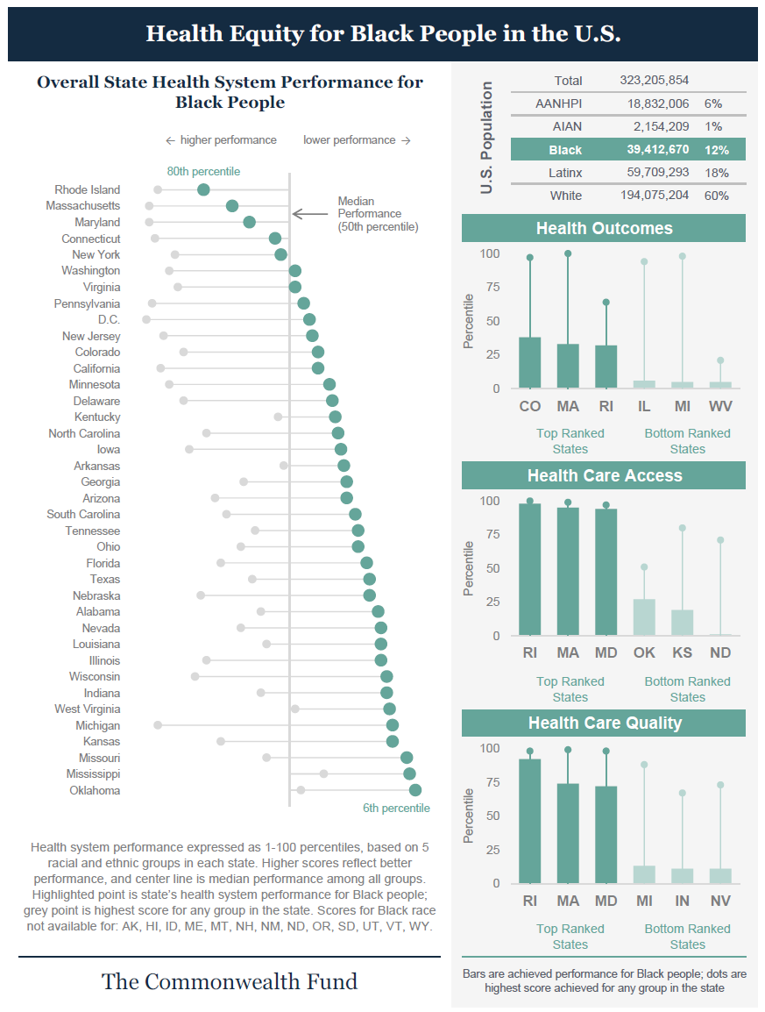
Racial and Ethnic Group Profiles
Exhibit 19
Performance detail for each of 5 racial and ethnic groups featured in the report
State rankings
Top- and bottom-performing states
Data tables for benchmarking

