Slide 1
More than half of the population under age 65 has coverage through an employer; there has been little change since the ACA became law.
Exhibit 1
Employer-sponsored insurance (ESI) coverage (%), 0-to-64-year-olds, 2012–2020
Note: Employer-sponsored insurance (ESI) estimates include single employer-sponsored insurance and dependent employer-sponsored insurance.
Data: Current Population Survey (CPS), 2013–2021.
Source: Analysis of the Current Population Survey, 2013–2021, by Sherry Glied of New York University for the Commonwealth Fund.

Slide 2
While nearly all large firms offer health benefits to at least some workers, smaller firms are significantly less likely to do so.
Exhibit 2
Percentage of firms offering health benefits, by firm size, 2011–2020
*
*
*
*
*
* Estimate is statistically different from estimate for the previous year shown (p < .05).
Note: Estimates are based on the sample of both firms that completed the entire survey and those that answered just one question about whether they offer health benefits.
Data: Kaiser Family Foundation Employer Health Benefits Survey, 2018–2020; Kaiser/HRET Survey of Employer-Sponsored Health Benefits, 2011–2017.
Source: Gary Claxton et al., Employer Health Benefits: 2020 Annual Survey (Henry J. Kaiser Family Foundation, 2020).

Slide 3
Workers in industries hardest hit by the pandemic were the least likely to have coverage through their own jobs.
Exhibit 3
Percentage of workers with employer sponsored insurance (ESI) coverage in own name, by industry, 2020
Data: Authors’ analysis of state-level unemployment insurance claims, U.S. Department of Labor, Employment and Training Administration; and the 2019 Annual Social and Economic Supplement to the Current Population Survey.
Source: Paul Fronstin and Stephen A. Woodbury, How Many Americans Have Lost Jobs with Employer Health Coverage During the Pandemic? (Commonwealth Fund, Oct. 2020).

Slide 4
Six percent of adults reported that they lost employer coverage because of job loss related to the pandemic; 67 percent gained other coverage.
Exhibit 4
Percentage of adults ages 19–64 who lost coverage through their own lost
or furloughed job, or through a spouse’s, partner’s, or parent’s lost or furloughed job
Adults ages 19–64
* Includes respondents who lost coverage through their own lost or furloughed job, or through a spouse’s, partner’s, or parent's lost or furloughed job.
Note: Pie may not sum to 100% because of rounding and unknown respondents.
Data: Commonwealth Fund Health Care Coverage and COVID-19 Survey, March–June 2021.
Source: Sara R. Collins, Gabriella N. Aboulafia, and Munira Z. Gunja, As the Pandemic Eases, What Is the State of Health Care Coverage and Affordability in the U.S.? Findings from the Commonwealth Fund Health Care Coverage and COVID-19 Survey, March–June 2021 (Commonwealth Fund, July 2021).

Slide 5
For a majority of adults who lost employer health insurance during the pandemic, coverage gaps were brief.
Exhibit 5
Percentage of adults ages 19–64 who lost coverage through their own lost or furloughed job, or through a spouse’s, partner’s, or parent’s lost or furloughed job, did not get coverage through COBRA
Data: Commonwealth Fund Health Care Coverage and COVID-19 Survey, March–June 2021.
Source: Sara R. Collins, Gabriella N. Aboulafia, and Munira Z. Gunja, As the Pandemic Eases, What Is the State of Health Care Coverage and Affordability in the U.S.? Findings from the Commonwealth Fund Health Care Coverage and COVID-19 Survey, March–June 2021 (Commonwealth Fund, July 2021).

Slide 6
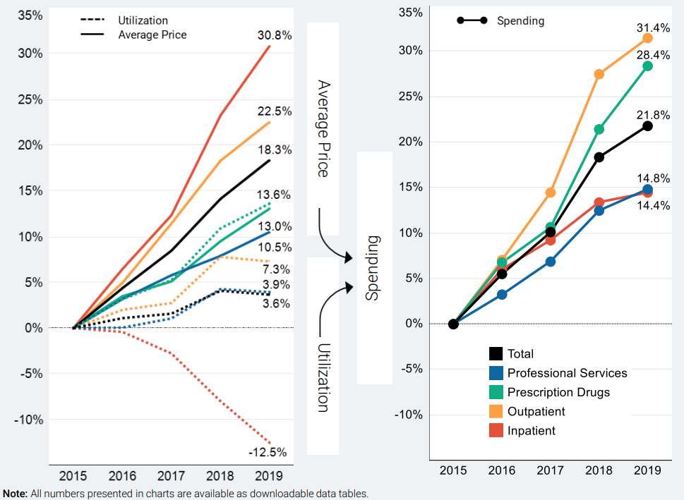
Prices accounted for nearly two-thirds of per-person spending growth in employer plans, 2015–2019.
Exhibit 6
Cumulative change in utilization, average price, and per-person spending, 2015–2019
Notes: Utilization and average prices account for changes in the type or intensity of services used, with the exception of prescription drugs. Prescription drug spending is the amount paid on the pharmacy claim, which reflects discounts from the wholesale price, but not manufacturer rebates.
Source: Health Care Cost Institute, 2019 Health Care Cost and Utilization Report (HCCI, Oct. 2021).

Slide 7
Higher prices are associated with higher employer premiums.
Exhibit 7
State values
State median
Average premiums for employer coverage
Average commercial prices paid for health care services (employer coverage)
Source: David C. Radley, Sara R. Collins, and Jesse C. Baumgartner, 2020 Scorecard on State Health System Performance (Commonwealth Fund, Sept. 2020).

Slide 8
Workers’ premium contributions and deductibles increase with overall spending growth, adding up to 11.6 percent of median income in 2020.
Exhibit 8
Share of median income (%)
Combined premium contribution + deductible
Premium contribution
Deductible
Note: Combined estimates of single and family premium contributions and deductibles are weighted for the distribution of single-person and family households in the state.
Data: Premium contributions and deductibles — Medical Expenditure Panel Survey–Insurance Component (MEPS–IC), 2010–2020; Median household income and household distribution type — analysis of the Current Population Survey (CPS), 2010–2021, by Mikaela Springsteen and Sherry Glied of New York University for the Commonwealth Fund.
Source: Sara R. Collins, David C. Radley, and Jesse C. Baumgartner, Trends in Employer Health Care Coverage, 2010–2020 (Commonwealth Fund, forthcoming, Dec. 2021).

Slide 9
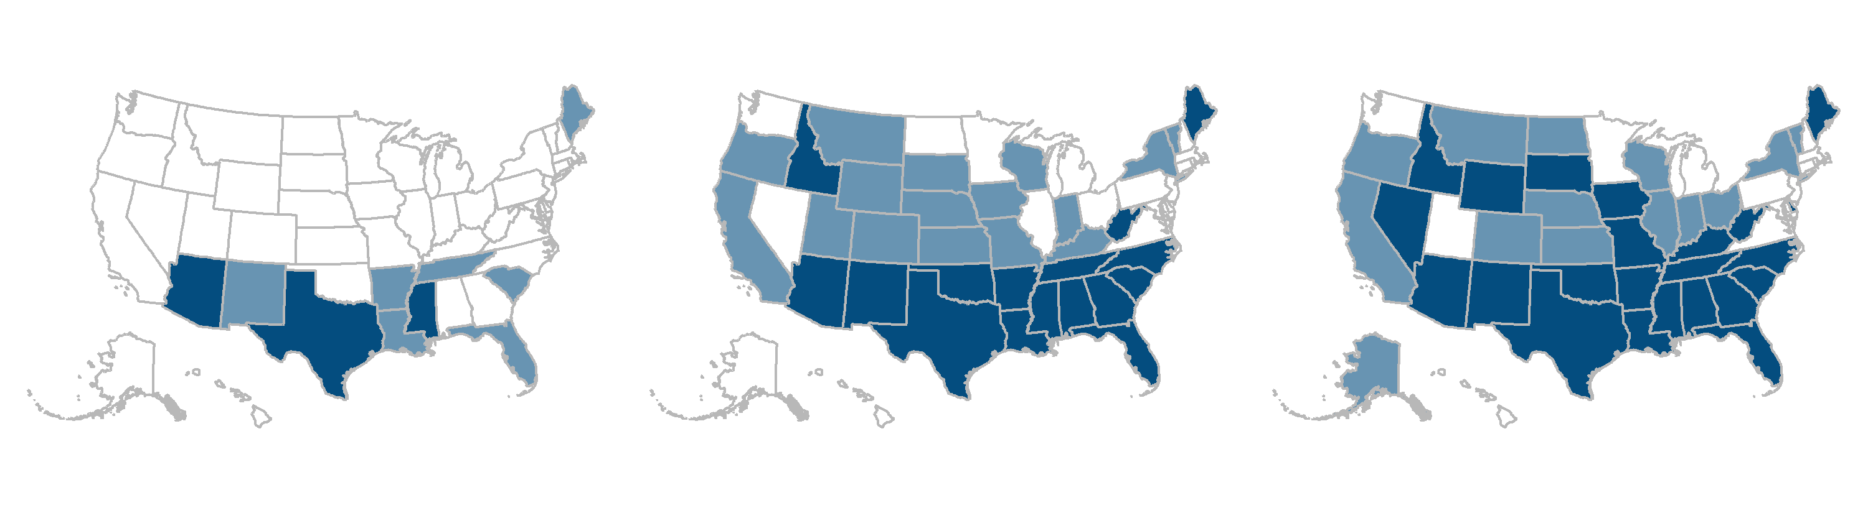
The number of states where workers spend 10 percent or more of median income on premiums and deductibles has grown over the decade.
Exhibit 9
2010
2015
2020
Average employee share of premium plus average deductible as a percentage of median state incomes
6.1%–9.9% (40 states + D.C.)
7.6%–9.9% (18 states + D.C.)
7.7%–9.9% (13 states + D.C.)
10.0%–11.0% (7 states)
10.0%–11.9% (16 states)
10.0%–11.9% (14 states)
12.0%–13.2% (3 states)
12.0%–15.6% (16 states)
12.0%–19.0% (23 states)
Note: Combined estimates of single and family premium contributions and deductibles are weighted for the distribution of single-person and family households in the state.
Data: Premium contributions and deductibles — Medical Expenditure Panel Survey–Insurance Component (MEPS–IC), 2010–2020; Median household income and household distribution type — analysis of the Current Population Survey (CPS), 2010–2021, by Mikaela Springsteen and Sherry Glied of New York University for the Commonwealth Fund.
Source: Sara R. Collins, David C. Radley, and Jesse C. Baumgartner, Trends in Employer Health Care Coverage, 2010–2020 (Commonwealth Fund, forthcoming, Dec. 2021).

Slide 10
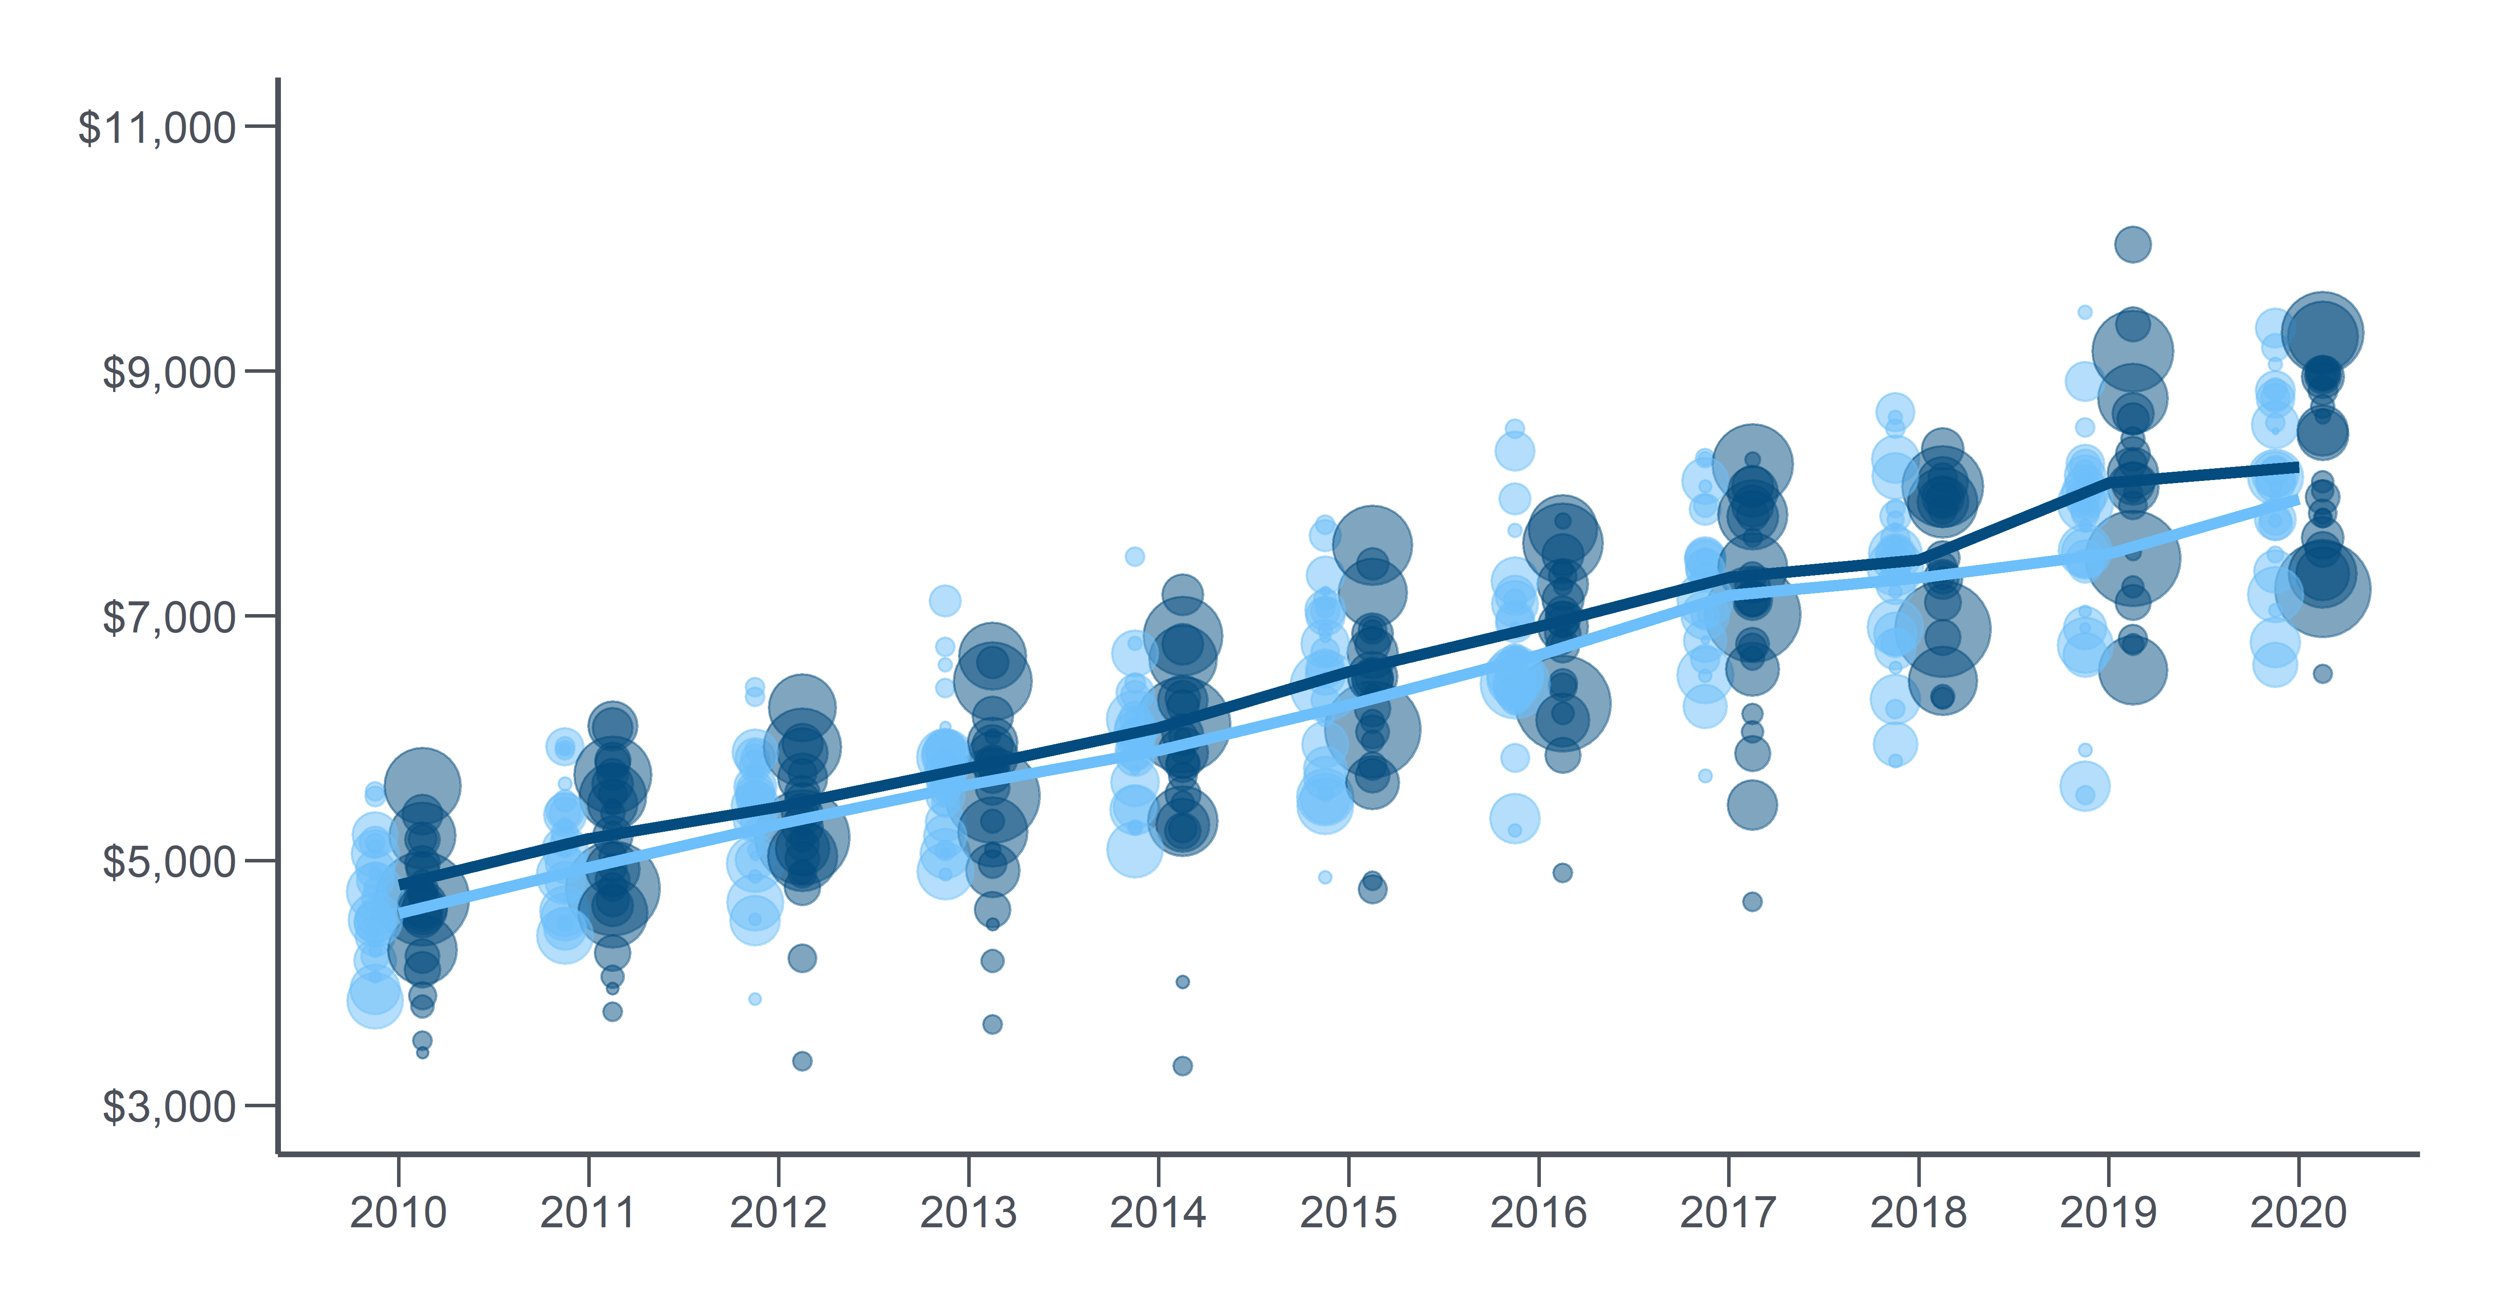
Workers in states with lower median incomes face higher combined premium contributions and deductibles.
Exhibit 10
Combined premium contribution + deductible ($)
States with lower than U.S. median incomes
States with higher than U.S. median incomes
Note: Bubbles are proportionate to the States’ population. Lines represent the average among the associated group of states, weighted by population.
Data: Premium contributions and deductibles — Medical Expenditure Panel Survey–Insurance Component (MEPS–IC), 2010–2020; Median household income and household distribution type — analysis of the Current Population Survey (CPS), 2010–2021, by Mikaela Springsteen and Sherry Glied of New York University for the Commonwealth Fund.

Slide 11
Covered workers in firms with many lower-wage workers contribute more toward their premium than workers in firms with few lower-wage workers.
Exhibit 11
Average percentage of family premium paid by covered workers, by firm characteristics, 2020
Note: Small firms have 3–199 workers and large firms have 200+ workers. Firms with many lower-wage workers are those where at least 35% earn the 25th percentile or less of national earnings ($26,000 in 2020). Firms with many higher-wage workers are those where at least 35% earn the 75th percentile or more of national earnings ($64,000 in 2020). Firms with older workers are those where at least 35% of the workers are age 50 or older. Firms with many younger workers are those where at least 35% of workers are age 26 or younger.
Data: Kaiser Family Foundation Employer Health Benefits Survey, 2020.
Source: Gary Claxton et al., Employer Health Benefits: 2020 Annual Survey (Henry J. Kaiser Family Foundation, 2020).

Slide 12
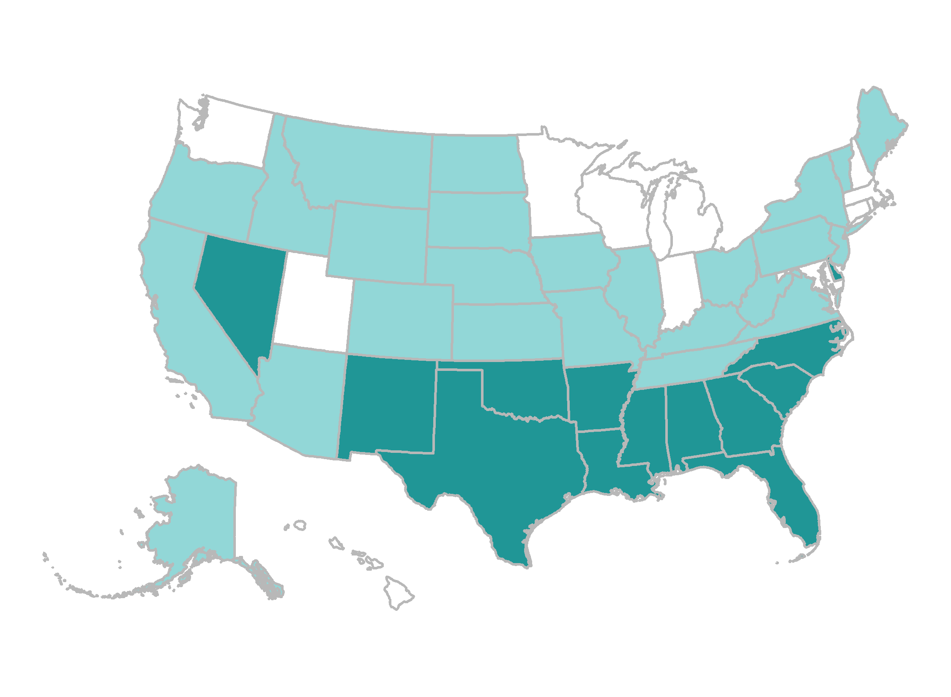
Workers spent 8 percent or more of median income on premium contributions in 13 states.
Exhibit 12
Average employee share of premium as a percentage of median state incomes
4.3%–5.9% (12 states + D.C.)
6.0%–7.9% (25 states)
8.0%–12.7% (13 states)
Note: Single and family premium contributions are weighted for the distribution of single-person and family households in the state.
Data: Premium contributions and deductibles — Medical Expenditure Panel Survey–Insurance Component (MEPS–IC), 2020; Median household income and household distribution type — analysis of the Current Population Survey (CPS), 2020–2021, by Mikaela Springsteen and Sherry Glied of New York University for the Commonwealth Fund.
Source: Sara R. Collins, David C. Radley, and Jesse C. Baumgartner, Trends in Employer Health Care Coverage, 2010–2020 (Commonwealth Fund, forthcoming, Dec. 2021).

Slide 13
One-quarter of adults in employer plans are underinsured; the individual market continues to be challenging.
Exhibit 13
Percentage of adults ages 19–64 insured all year who were underinsured
Notes: “Underinsured” refers to adults who were insured all year but experienced one of the following: out-of-pocket costs, excluding premiums, equaled 10% or more of income; out-of-pocket costs, excluding premiums, equaled 5% or more of income if low-income (<200% of poverty); or deductibles equaled 5% or more of income. Respondents may have had another type of coverage at some point during the year but had coverage for the entire previous 12 months. ^ For 2014–2020, individual coverage includes adults who got coverage in the individual market and the marketplaces.
Data: Commonwealth Fund Biennial Health Insurance Surveys (2010, 2012, 2014, 2016, 2018, 2020).
Source: Sara R. Collins, Munira Z. Gunja, and Gabriella N. Aboulafia, U.S. Health Insurance Coverage in 2020: A Looming Crisis in Affordability — Findings from the Commonwealth Fund Biennial Health Insurance Survey, 2020 (Commonwealth Fund, Aug. 2020).

Slide 14
Deductibles have grown faster than income, taking up larger shares of household budgets, and leaving more people underinsured.
Exhibit 14
Percentage of adults ages 19–64 with private coverage who had deductibles that were 5% or more of income | 2010 | 2012 | 2014 | 2016 | 2018 | 2020
Total | 7 | 11 | 13 | 15 | 16 | 15
Insurance source at time of survey*
Employer-provided coverage | 6 | 9 | 11 | 13 | 15 | 14
Individual and marketplace coverage^ | 18 | 29 | 22 | 24 | 23 | 27
Firm size (base: full- or part-time workers with coverage through their own employer)^^^
2–99 employees | 7 | 15 | 20 | 13 | 18 | 16
100 or more employees | 5 | 6 | 9 | 13 | 14 | 14
* Respondents may have had another type of coverage at some point during the year. ^ For 2014–2020, individual coverage includes adults who got coverage in the individual market and the marketplaces. ^^^ Does not include adults who are self-employed.
Data: Commonwealth Fund Biennial Health Insurance Surveys (2010, 2012, 2014, 2016, 2018, 2020).
Source: Sara R. Collins, Munira Z. Gunja, and Gabriella N. Aboulafia, U.S. Health Insurance Coverage in 2020: A Looming Crisis in Affordability — Findings from the Commonwealth Fund Biennial Health Insurance Survey, 2020 (Commonwealth Fund, Aug. 2020).

Slide 15
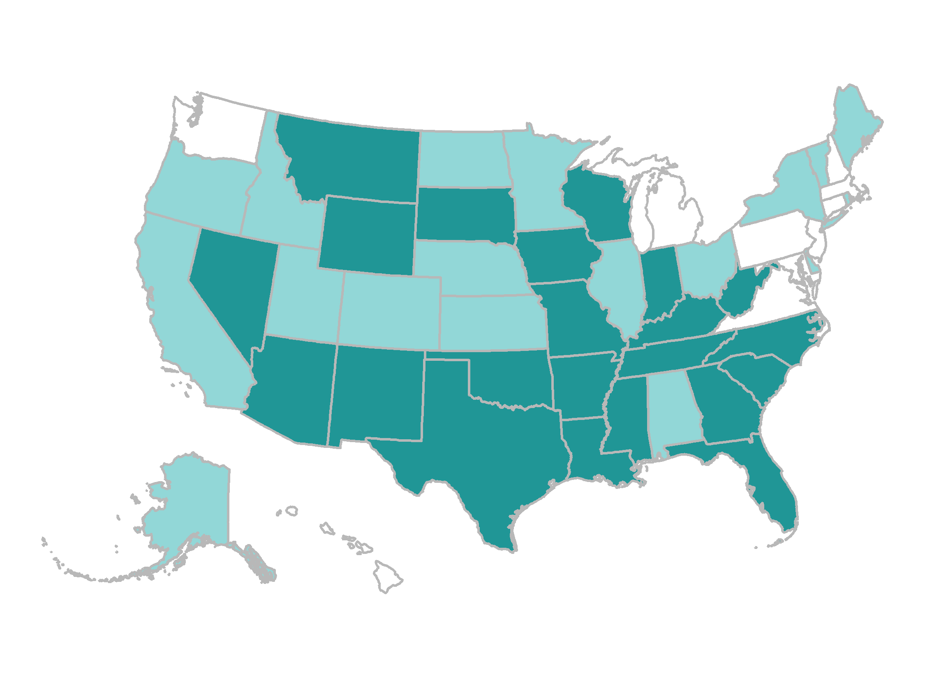
Average deductibles were 5 percent or more of median income in 22 states.
Exhibit 15
Average deductible as a percentage of median state incomes
2.6%–3.9% (10 states + D.C.)
4.0%–4.9% (18 states)
5.0%–7.4% (22 states)
Note: Single and family deductibles are weighted for the distribution of single-person and family households in the state.
Data: Premium contributions and deductibles — Medical Expenditure Panel Survey–Insurance Component (MEPS–IC), 2020; Median household income and household distribution type — analysis of the Current Population Survey (CPS), 2020–2021, by Mikaela Springsteen and Sherry Glied of New York University for the Commonwealth Fund.
Source: Sara R. Collins, David C. Radley, and Jesse C. Baumgartner, Trends in Employer Health Care Coverage, 2010–2020 (Commonwealth Fund, forthcoming, Dec. 2021).

Slide 16
About 3 of 10 workers with employer coverage are enrolled in a high-deductible health plan with a savings option, either an HRA or HSA.
Exhibit 16
Distribution of health plan enrollment for covered workers, by plan type and firm size, 2020
*
*
*
*
Note: Small firms have 3–199 workers and large firms have 200+ workers. HMO = health maintenance organization; PPO = preferred provider organization; POS = point-of-service plan; HDHP/SO = high-deductible health plan with a savings option, such as a health reimbursement arrangement (HRA) or health savings account (HSA).
Data: Kaiser Family Foundation Employer Health Benefits Survey, 2020.
Source: Gary Claxton et al., Employer Health Benefits: 2020 Annual Survey (Henry J. Kaiser Family Foundation, 2020).

Slide 17
Percentage of workers with deductibles of $1,000 or more, after adjustment for employer account contributions in HDHPs with HRAs and HSAs.
Exhibit 17
Percentage of covered workers enrolled in a plan with a general annual deductible of $1,000 or more for single coverage, by firm size, 2020
Small firms
Large firms
All firms
Note: Small firms have 3–199 workers and large firms have 200+ workers. These estimates include workers enrolled in high-deductible health plans with a savings option and other plan types. Average general annual deductibles are for in-network providers.
Data: Kaiser Family Foundation Employer Health Benefits Survey, 2020.
Source: Gary Claxton et al., Employer Health Benefits: 2020 Annual Survey (Henry J. Kaiser Family Foundation, 2020).

Slide 18
People with higher deductibles more frequently report financial problems because of medical bills or delaying care because of cost.
Exhibit 18
Percentage of adults ages 19–64 with private coverage who were insured all year and said “yes” to any of the following happening to them in the past two years*
Percentage of adults ages 19–64 with private coverage who were insured all year and said “yes” to any of the following happening to them in the past 12 months*
* Base is those with private coverage who specified their deductibles. ** Includes any of the following: had problems paying or unable to pay medical bills; contacted by collection agency for unpaid medical bills; had to change way of life to pay bills; medical bills/debt being paid over time. *** Base is limited to those who said they had a medical bill problem or debt. ^ Includes any of the following because of cost: did not fill a prescription; skipped recommended medical test, treatment, or follow-up; had a medical problem but did not visit doctor or clinic; did not see a specialist when needed. ^^ Health problems include hypertension or high blood pressure, heart failure or heart attack, diabetes, asthma, emphysema, or lung disease, high cholesterol, or depression, anxiety or other mental health problem.
Data: Commonwealth Fund Biennial Health Insurance Survey (2020).
Source: Sara R. Collins, Munira Z. Gunja, and Gabriella N. Aboulafia, U.S. Health Insurance Coverage in 2020: A Looming Crisis in Affordability — Findings from the Commonwealth Fund Biennial Health Insurance Survey, 2020 (Commonwealth Fund, Aug. 2020).

Slide 19
One-third of adults with employer coverage reported problems paying medical bills or that they were paying off medical debt over time.
Exhibit 19
Percentage of adults ages 19–64 who had medical bill or debt problems in the past year
Public
insurance
Private
insurance
Data: Commonwealth Fund Health Care Coverage and COVID-19 Survey, March–June 2021.
Source: Sara R. Collins, Gabriella N. Aboulafia, and Munira Z. Gunja, As the Pandemic Eases, What Is the State of Health Care Coverage and Affordability in the U.S.? Findings from the Commonwealth Fund Health Care Coverage and COVID-19 Survey, March–June 2021 (Commonwealth Fund, July 2021).

Slide 20
Medical bill problems lead to a number of other financial problems.
Exhibit 20
Percentage of adults ages 19–64 with employer coverage in 2021 who had the following financial problems in the past two years
because of medical bill problems or debt^
^ Base: Respondents who reported at least one of the following medical bill problems in the past 12 months: had problems paying medical bills, contacted by a collection agency for unpaid bills, had to change way of life in order to pay medical bills, or has outstanding medical debt.
Data: Commonwealth Fund Health Care Coverage and COVID-19 Survey, March–June 2021.
Source: Sara R. Collins, Gabriella N. Aboulafia, and Munira Z. Gunja, As the Pandemic Eases, What Is the State of Health Care Coverage and Affordability in the U.S.? Findings from the Commonwealth Fund Health Care Coverage and COVID-19 Survey, March–June 2021 (Commonwealth Fund, July 2021).

Slide 21
One-quarter of people with low incomes in employer plans who are not eligible for Medicaid in their states spend more than 8.5 percent of their income on premium contributions.
Exhibit 21
Percentage of people with employer coverage where more than 8.5 percent of household income goes toward after-tax
premium contributions
Notes: FPL = federal poverty level. People below 138% FPL in states that have expanded Medicaid are excluded from the analysis sample.
Data: Analysis of U.S. Census Bureau Current Population Survey, Annual Social and Economic Supplement, Sept. 2019 and 2020 data releases (2018 and 2019 data years).

