Slide 1
MEDICARE DATA HUB COVID-19: Telehealth
Commonwealth Fund Analysis of CareJourney Claims Data for Traditional Medicare Beneficiaries

Slide 2
Telehealth visits were 13 percent of total patient visits for traditional Medicare beneficiaries in 2020. Total visits in 2020 did not rebound to 2019 levels despite an increase in telehealth use.
COVID-19: TELEHEALTH
Number of visits (millions)
Telehealth visits
(13%)
Data: Commonwealth Fund analysis of CareJourney traditional Medicare claims data.
Notes:
1.0

Slide 3
Telehealth visits accounted for 13 percent of all patient visits for traditional Medicare beneficiaries from March to December 2020.
COVID-19: TELEHEALTH
Telehealth visits, Percent of total visits
In-person visits, Percent of total visits
Data: Commonwealth Fund analysis of CareJourney traditional Medicare claims data.
Note: Telehealth visits were less than 1% of total visits by Medicare beneficiaries between January 2019 and February 2020.
Notes:
1.1

Slide 4
Medicare beneficiaries under age 65 with significant disabilities had higher rates of telehealth visits than older beneficiaries in 2020.
COVID-19: TELEHEALTH
Percent of total visits for each group
Data: Commonwealth Fund analysis of CareJourney traditional Medicare claims data.
Notes:
1.2

Slide 5
Younger Medicare beneficiaries with disabilities had higher rates of telehealth visits in 2020 than other frail beneficiaries.
COVID-19: TELEHEALTH
Percent of total visits for each group
Data: Commonwealth Fund analysis of CareJourney traditional Medicare claims data.
Notes:
1.3

Slide 6
After the start of the pandemic, Medicare beneficiaries who were dually eligible for Medicaid had higher rates of telehealth visits than non-dual-eligible beneficiaries.
COVID-19: TELEHEALTH
Percent of total visits for each group
Data: Commonwealth Fund analysis of CareJourney traditional Medicare claims data.
Notes:
1.4

Slide 7
After the initial months of the pandemic, white and Black Medicare beneficiaries had similar rates of telehealth visits in 2020.
COVID-19: TELEHEALTH
Percent of total visits for each group
Data: Commonwealth Fund analysis of CareJourney traditional Medicare claims data.
Notes:
1.5

Slide 8
Medicare beneficiaries in urban areas had higher rates of telehealth visits than those in rural areas in 2020.
COVID-19: TELEHEALTH
Percent of total visits for each group
Data: Commonwealth Fund analysis of CareJourney traditional Medicare claims data.
Notes:
1.6

Slide 9
Rates of telehealth visits were similar across Medicare beneficiaries with different chronic conditions. Beneficiaries with COVID-19 were less likely to have telehealth visits in 2020.
COVID-19: TELEHEALTH
Percent of total visits for each group
Note: COPD = chronic obstructive pulmonary disease.
Data: Commonwealth Fund analysis of CareJourney traditional Medicare claims data.
Notes:
1.7

Slide 10
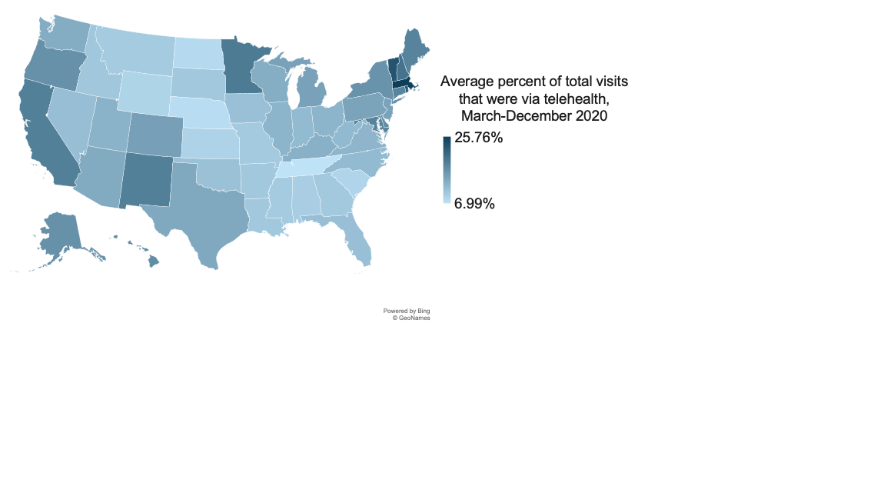
Medicare beneficiaries’ rates of telehealth visits varied across states in 2020, with the highest rates in Massachusetts, Vermont, and Rhode Island.
COVID-19: TELEHEALTH
Data: Commonwealth Fund analysis of CareJourney traditional Medicare claims data.
Notes:
1.8

Slide 11
Rates of telehealth visits among Medicare beneficiaries living in more prosperous zip codes were somewhat higher than others at the beginning of the pandemic. The gap narrowed by the end of 2020.
COVID-19: TELEHEALTH
Percent of total visits for each group
Data: Commonwealth Fund analysis of CareJourney traditional Medicare claims data.
Note: Distressed Communities Index tiers are from the Economic Innovation Group’s economic distress cohorts.
Notes:
1.9
All reports now have break-outs by the EIG economic distress cohorts (which are designated by zip code):
o eig_1 (prosperous)
o eig_2 (comfortable)
o eig_3 (mid-tier)
o eig_4 (at risk)
o eig_5 (distressed)

