Slide 1
Premium Contributions and Deductibles Added Up to More Than 11 Percent of Median Income in 2019
Exhibit 1
Share of median income (%)
Combined premium contribution + deductible
Premium contribution
Deductible
Note: Combined estimates of single and family premium contributions and deductibles are weighted for the distribution of single-person and family households in the state.
Data: Premium contributions and deductibles — Agency for Healthcare Research and Quality, Medical Expenditure Panel Survey–Insurance Component (MEPS–IC), 2010–2019; Median household income and household distribution type — U.S. Census Bureau, Current Population Survey (CPS), 2010–2020, analysis by Benjamin Zhu and Sherry Glied of New York University for the Commonwealth Fund.

Slide 2
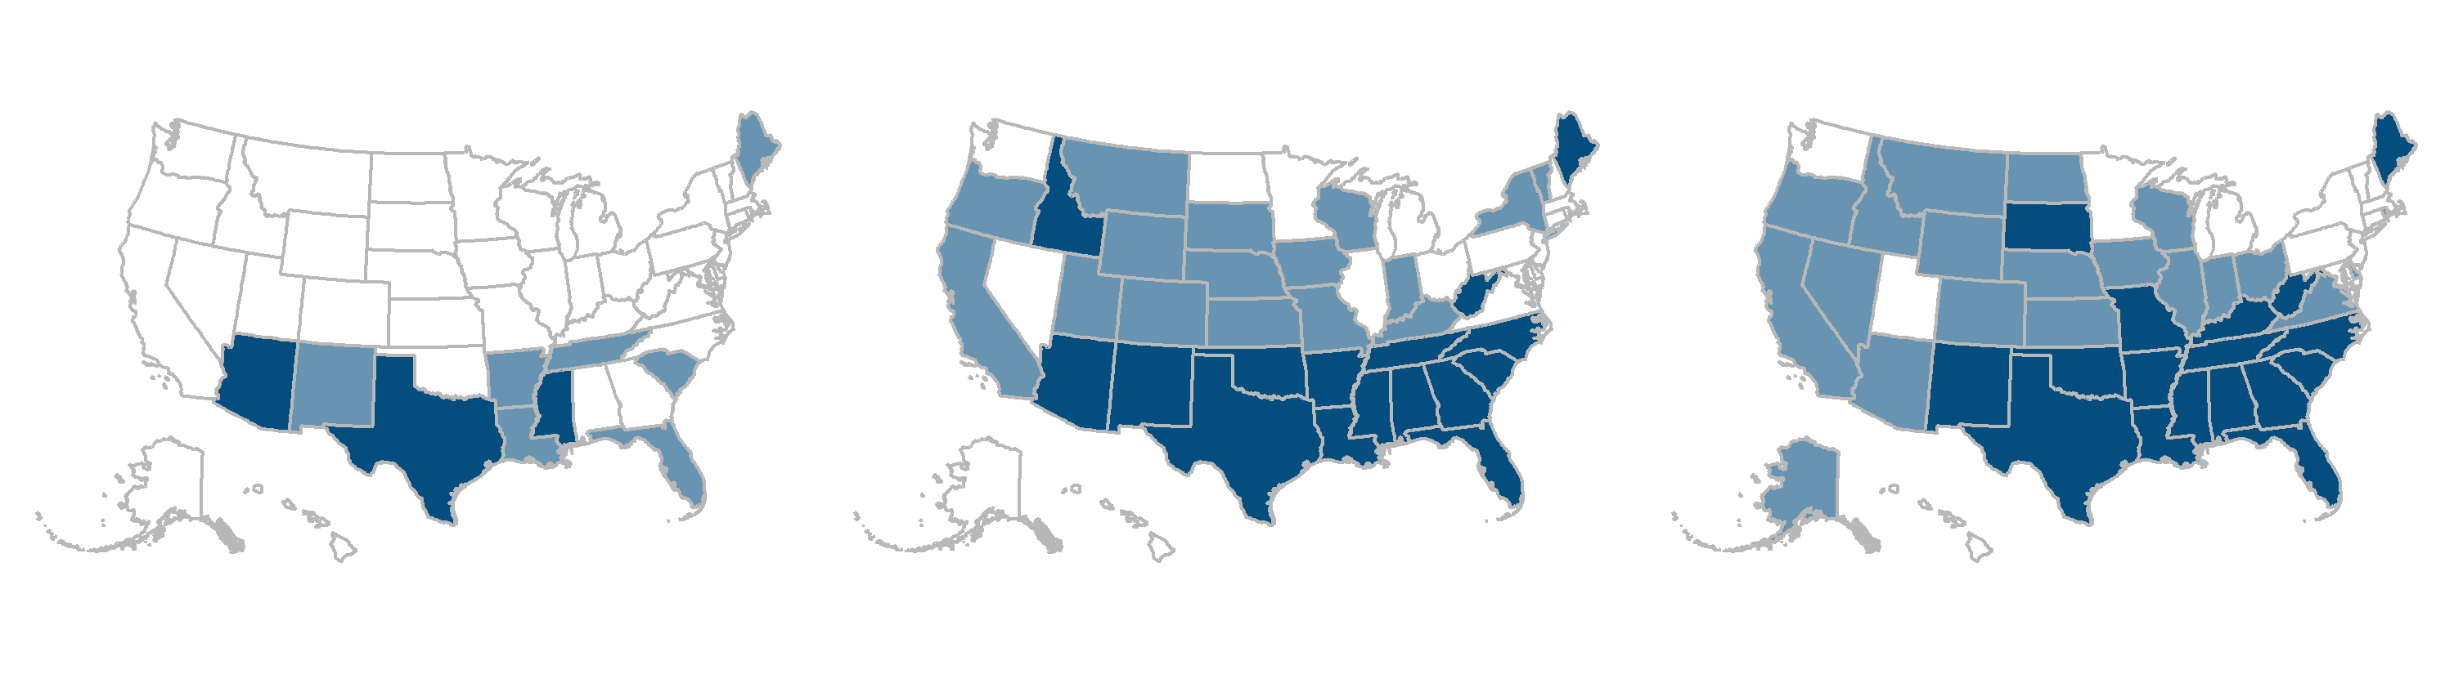
The Number of States Where Worker Premium Contributions and Deductibles Were 10 Percent or More of Median Income Grew over the Decade
Exhibit 2
2010
2015
2019
Average employee share of premium plus average deductible as percent of median state incomes
6.1% – 9.9% (40 states + D.C.)
7.6% – 9.9% (18 states + D.C.)
7.3% – 9.9% (13 states + D.C.)
10.0% – 11.9% (7 states)
10.0% – 11.9% (16 states)
10.0% – 11.9% (20 states)
12.0% – 13.2% (3 states)
12.0% – 15.6% (16 states)
12.0% – 17.4% (17 states)
Note: Combined estimates of single and family premium contributions and deductibles are weighted for the distribution of single-person and family households in the state.
Data: Premium contributions and deductibles — Agency for Healthcare Research and Quality, Medical Expenditure Panel Survey–Insurance Component (MEPS–IC), 2010–2019; Median household income and household distribution type — U.S. Census Bureau, Current Population Survey (CPS), 2010–2020, analysis by Benjamin Zhu and Sherry Glied of New York University for the Commonwealth Fund.

Slide 3
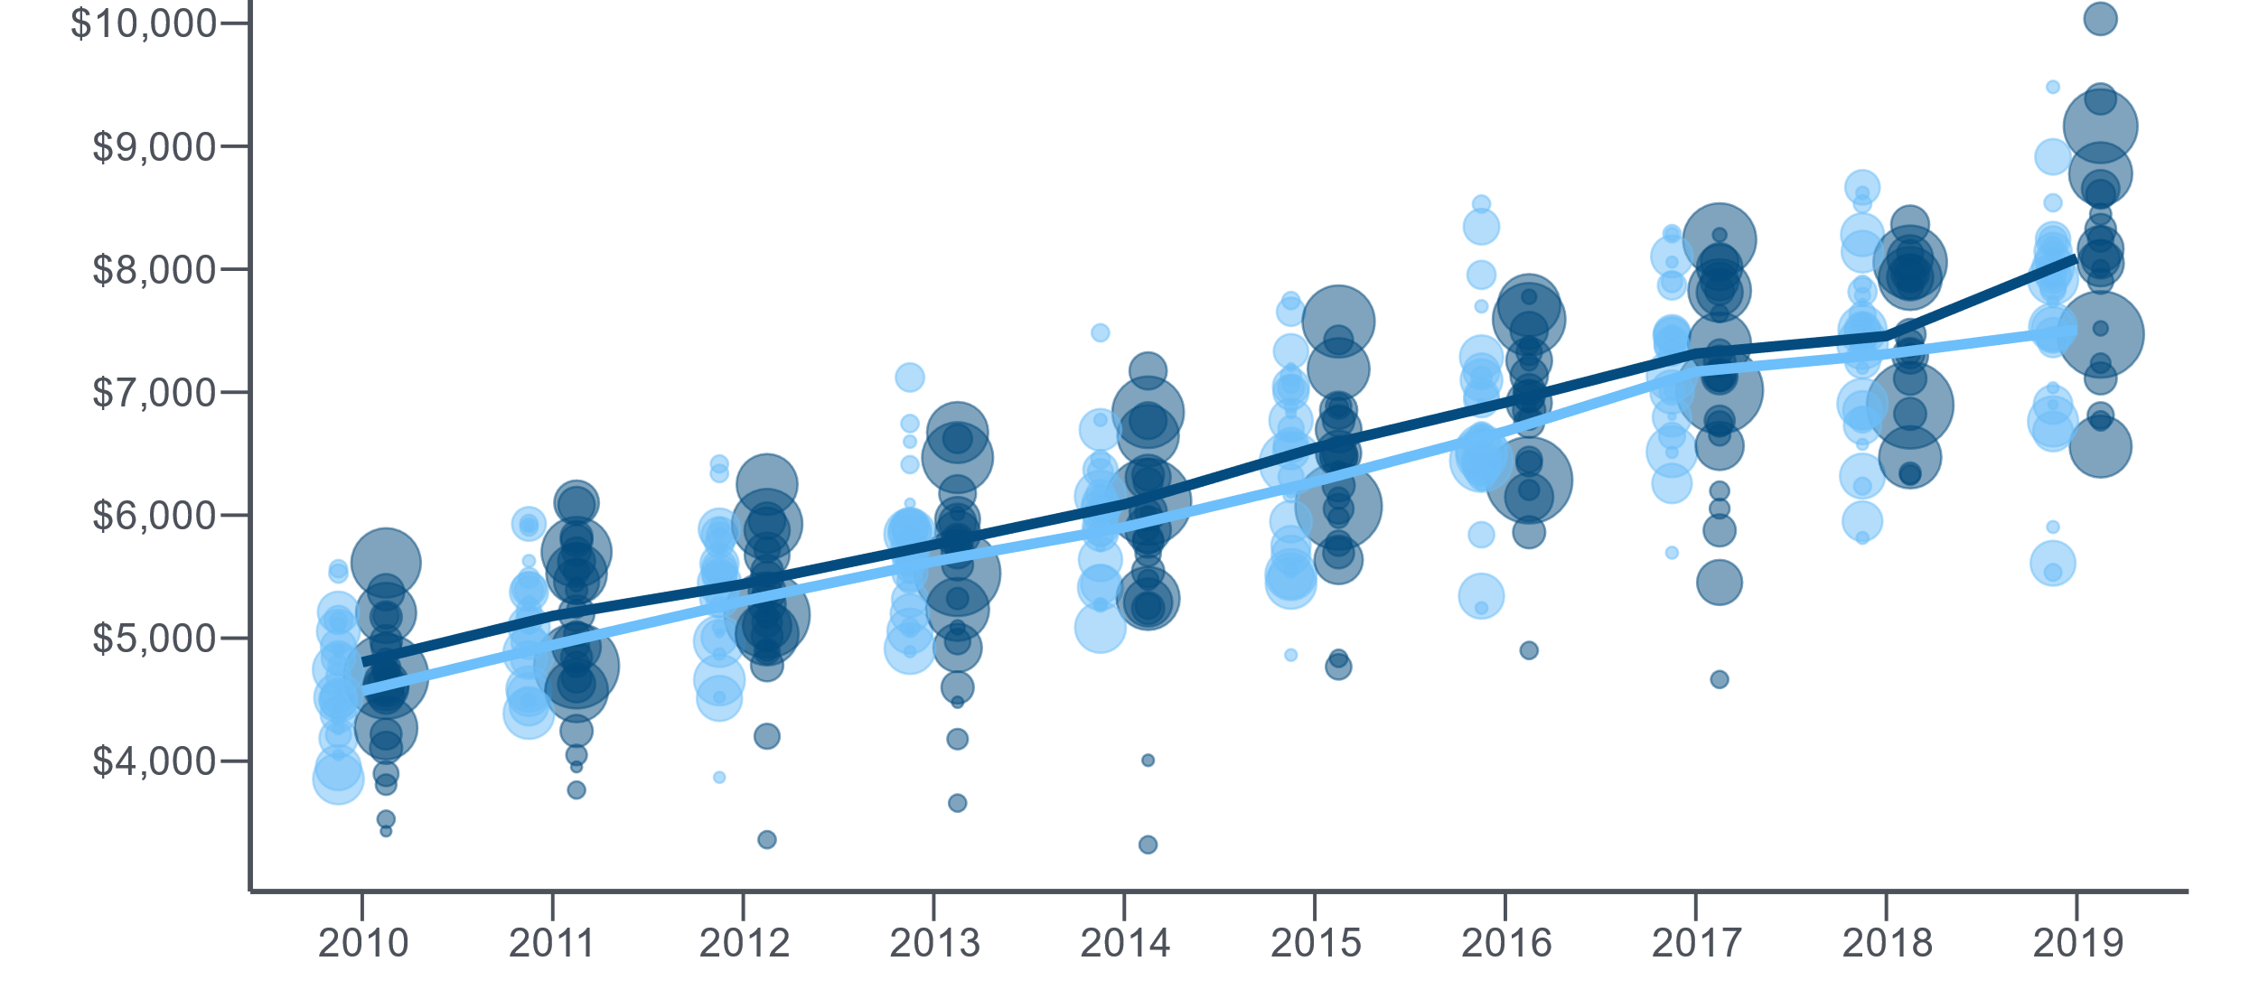
Workers in States with Lower Median Incomes Faced Higher Combined Premium Contributions and Deductibles
Exhibit 3
Combined premium contribution + deductible ($)
States with lower than U.S. median incomes
States with higher than U.S. median incomes
Note: Bubbles are proportionate to the states’ populations. Lines represent the average among the associated group of states, weighted by population.
Data: Premium contributions and deductibles — Agency for Healthcare Research and Quality, Medical Expenditure Panel Survey–Insurance Component (MEPS–IC), 2010–2019; Median household income and household distribution type — U.S. Census Bureau, Current Population Survey (CPS), 2010–2020, analysis by Benjamin Zhu and Sherry Glied of New York University for the Commonwealth Fund.

Slide 4
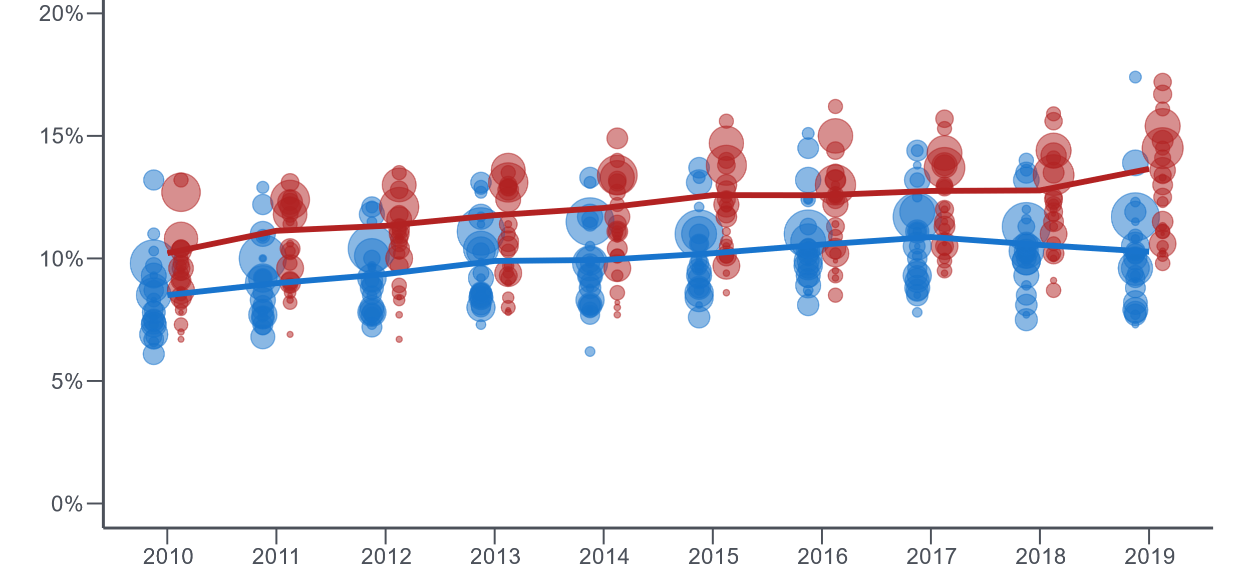
Workers in Republican-Leaning States Face Higher Insurance Cost Burdens on Average Than Those in Democratic-Leaning States
Exhibit 4
Combined premium contribution + deductible as a share of median state incomes (%)
States that voted Democratic in 2020 election
States that voted Republican 2020 election
Notes: Bubbles are proportionate to the states’ populations. Lines represent the average among the associated group of states, weighted by population. Political affiliation based on 2020 election results as of 11/13/2020 — Nebraska is considered Republican and Maine is considered Democratic despite likely split electoral votes in each state.
Data: Premium contributions and deductibles — Agency for Healthcare Research and Quality, Medical Expenditure Panel Survey–Insurance Component (MEPS–IC), 2010–2019; Median household income and household distribution type — U.S. Census Bureau, Current Population Survey (CPS), 2010–2020, analysis by Benjamin Zhu and Sherry Glied of New York University for the Commonwealth Fund.

Slide 5
Employee Premium Contributions for Single Coverage Ranged from $718 in Hawaii to $1,793 in Massachusetts in 2019
Exhibit 5
Dollars
$1,793
U.S. average = $1,489
$718
Note: Employee premium contributions are for insurance policies offered by private-sector employers in the U.S.
Data: Agency for Healthcare Research and Quality, Medical Expenditure Panel Survey–Insurance Component (MEPS–IC), 2019.

Slide 6
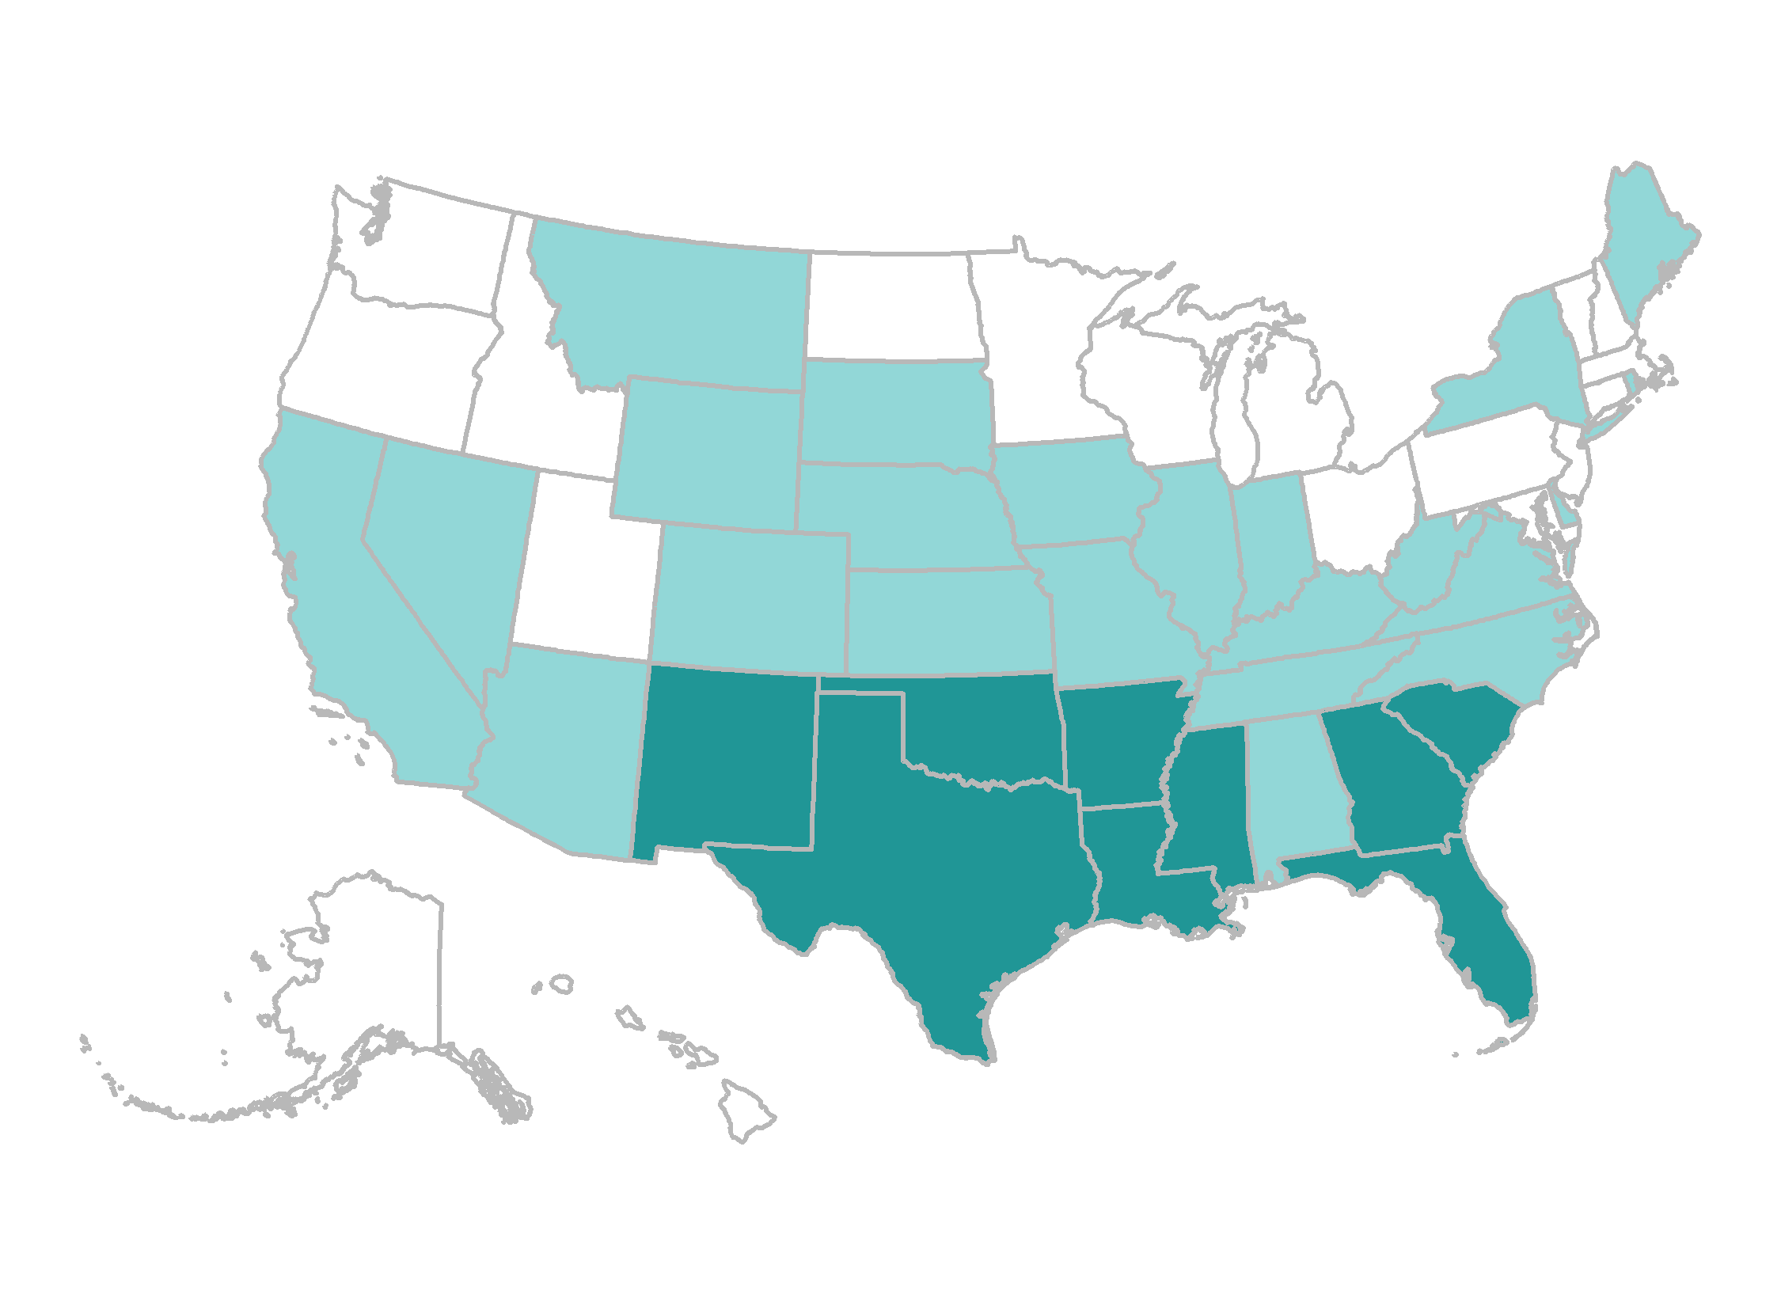
Workers’ Premium Contributions Were 8 Percent or More of Median Income in Nine States in 2019
Exhibit 6
Average employee share of premium as percent of median state incomes
4.3% – 5.9% (18 states + D.C.)
6.0% – 7.9% (23 states)
8.0% – 10.7% (9 states)
Note: Single and family premium contributions are weighted for the distribution of single-person and family households in the state.
Data: Premium contributions and deductibles — Agency for Healthcare Research and Quality, Medical Expenditure Panel Survey–Insurance Component (MEPS–IC), 2019; Median household income and household distribution type — U.S. Census Bureau, Current Population Survey (CPS), 2019–2020, analysis by Benjamin Zhu and Sherry Glied of New York University for the Commonwealth Fund.

Slide 7
Average Deductibles for Single Coverage Ranged from $1,264 in Hawaii to $2,521 in Montana in 2019
Exhibit 7
Dollars
$2,521
U.S. average = $1,931
$1,264
Note: Deductibles are for insurance policies offered by private-sector employers in the U.S.
Data: Agency for Healthcare Research and Quality, Medical Expenditure Panel Survey–Insurance Component (MEPS–IC), 2019.

Slide 8
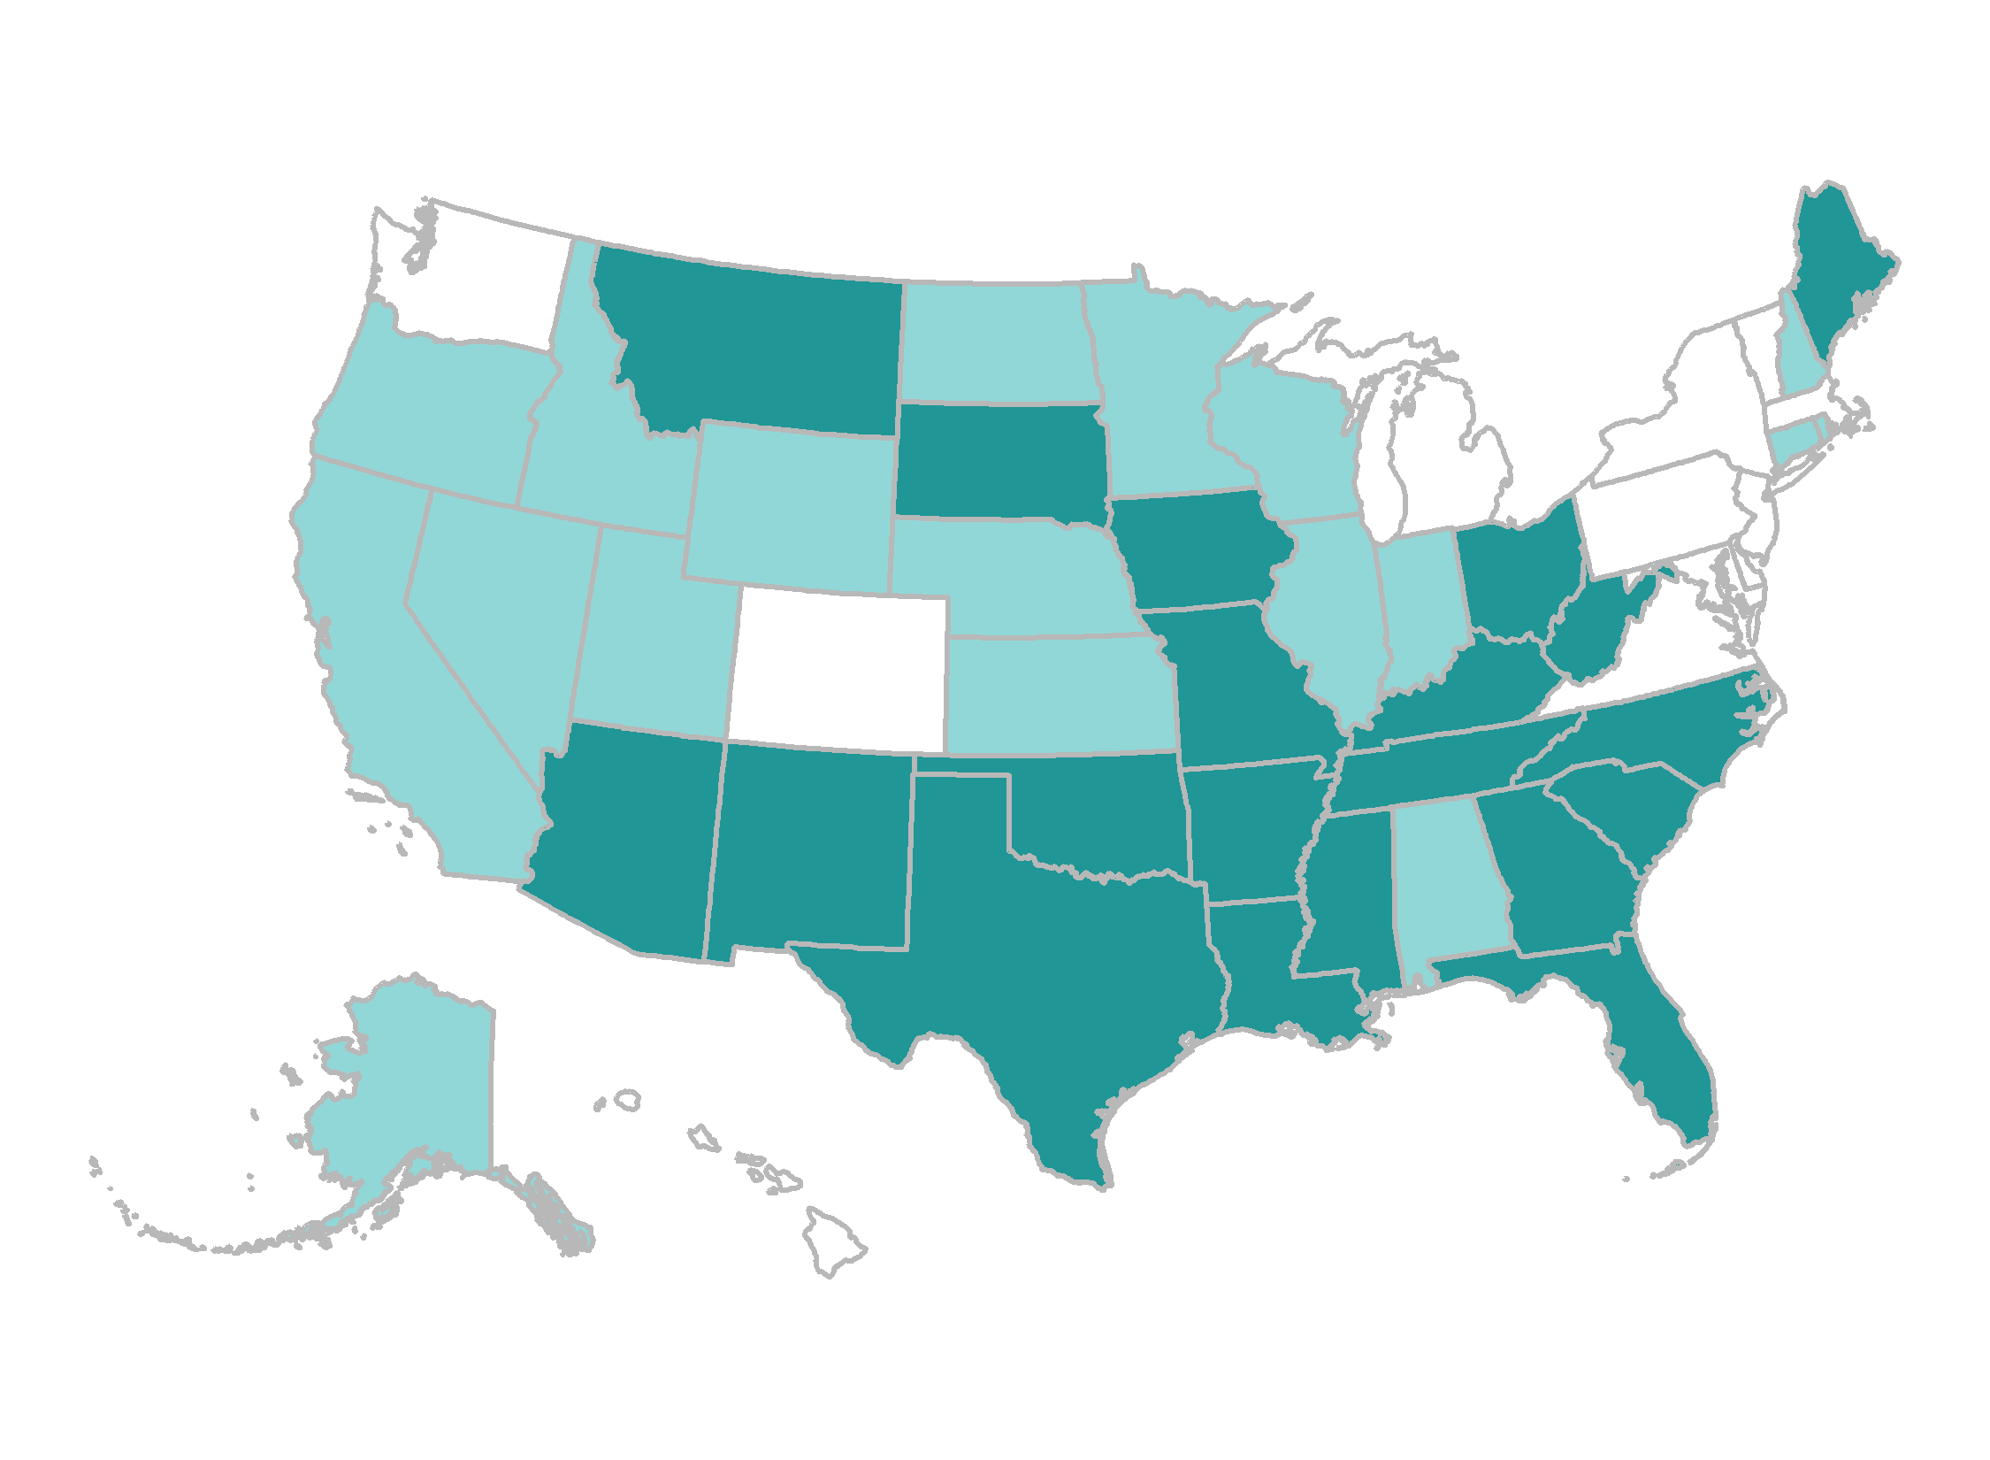
Average Deductibles Were 5 Percent or More of Median Income in 20 States in 2019
Exhibit 8
Average deductible as a percent of median state incomes
2.5% – 3.9% (12 states + D.C.)
4.0% – 4.9% (18 states)
5.0% – 7.0% (20 states)
Note: Single and family deductibles are weighted for the distribution of single-person and family households in the state.
Data: Premium contributions and deductibles — Agency for Healthcare Research and Quality, Medical Expenditure Panel Survey–Insurance Component (MEPS–IC), 2019; Median household income and household distribution type — U.S. Census Bureau, Current Population Survey (CPS), 2019–2020, analysis by Benjamin Zhu and Sherry Glied of New York University for the Commonwealth Fund.

