Slide 1
Medicare Data Hub
October 2020

Slide 2
Table of Contents
1
3
Traditional Medicare
Medicare Part D
Enrollment
Financing, Spending, and Affordability
Enrollment
Benefits
Low Income Subsidy
2
4
Medicare Advantage
International Comparisons
Enrollment
Benefits
Plan Availability
Special Needs Plans
Private Plans

Slide 3
Enrollment in Medicare is projected to increase an average of 1.5 million beneficiaries per year from 2021 to 2029.
Medicare Enrollment
Enrollment in millions
Projected
Source: Centers for Medicare and Medicaid Services, Program Statistics, 1965–2018, and Congressional Budget Office, Medicare Baseline, March 2020.

Slide 4
Medicare spending is projected to nearly double between 2019 and 2029.
Medicare Financing, Spending, and Affordability
Spending in billions
Projected
Source: National Health Expenditure Accounts, by type of service and source of funds, 1960–2018 and Congressional Budget Office, Medicare Baseline, March 2020.

Slide 5
Capitated payments to Medicare Advantage and Part D plans comprise more than two-fifths of federal spending for Medicare
Medicare Financing, Spending, and Affordability
Other Services
Other Part D Prescription Drug
Hospital Inpatient Care
19%
8%
Part D Low Income Subsidy
4%
Skilled Nursing Facilities
9%
Physician Fee Schedule
8%
Hospital Outpatient Services
35%
3%
Group Plans
(includes Medicare Advantage)
Home Health Agencies
Total Medicare Benefits, 2020: $814 Billion
Source: Congressional Budget Office, Medicare Baseline, March 2020.
Note: Benefits are net of recoveries.

Slide 6
All Medicare beneficiaries are required to pay the Part B premium, in addition to any premium for their Medicare Advantage or Part D plan.
Medicare Financing, Spending, and Affordability
Projected
Source: 2020 Medicare Trustees Report, Supplementary Medical Insurance Cost‑Sharing and Premium Amount,
1967–2029.
Note: Not adjusted for inflation.

Slide 7
Federal Medicare spending per beneficiary is projected to increase nearly 60 percent from 2019 to 2029.
Medicare Financing, Spending, and Affordability
Total cost per beneficiary
Projected
Source: 2020 Medicare Trustees Report, HI and SMI Average Per Beneficiary Costs, 1967–2029.

Slide 8
Enrollment in private Medicare Advantage plans more than doubled between 2010 and 2020.
Medicare Advantage Enrollment
Percent of Total Medicare Beneficiaries
Source: CMS Medicare Advantage State/County Penetration File, March 2020.
Note: Enrollment estimates do not include records denoted as pending state or county designation. Data include counts for local Coordinated Care Plans (CCP); Regional CCP; Medical Savings Accounts (MSA); Private Fee-for-Service (PFFS); Demonstrations; National PACE; 1976 Cost; HCPP–1933 Cost; Employer Direct PFFS.
Notes:
Medicare Advantage (MA), or Part C, plans are offered by private companies that contract with Medicare to provide Part A and Part B benefits to enrollees. Most plans also provide Part D prescription drug coverage. The most common types of MA plans are health maintenance organizations (HMOs) and preferred provider organizations (PPOs).
In 2020, approximately 37 percent of Medicare beneficiaries were enrolled in a MA plan.
Enrollment in MA plans has grown steadily since 2010. Over the past decade, the number of beneficiaries in an MA plan rose from about 11 million to nearly 25 million, a 115 percent increase.

Slide 9
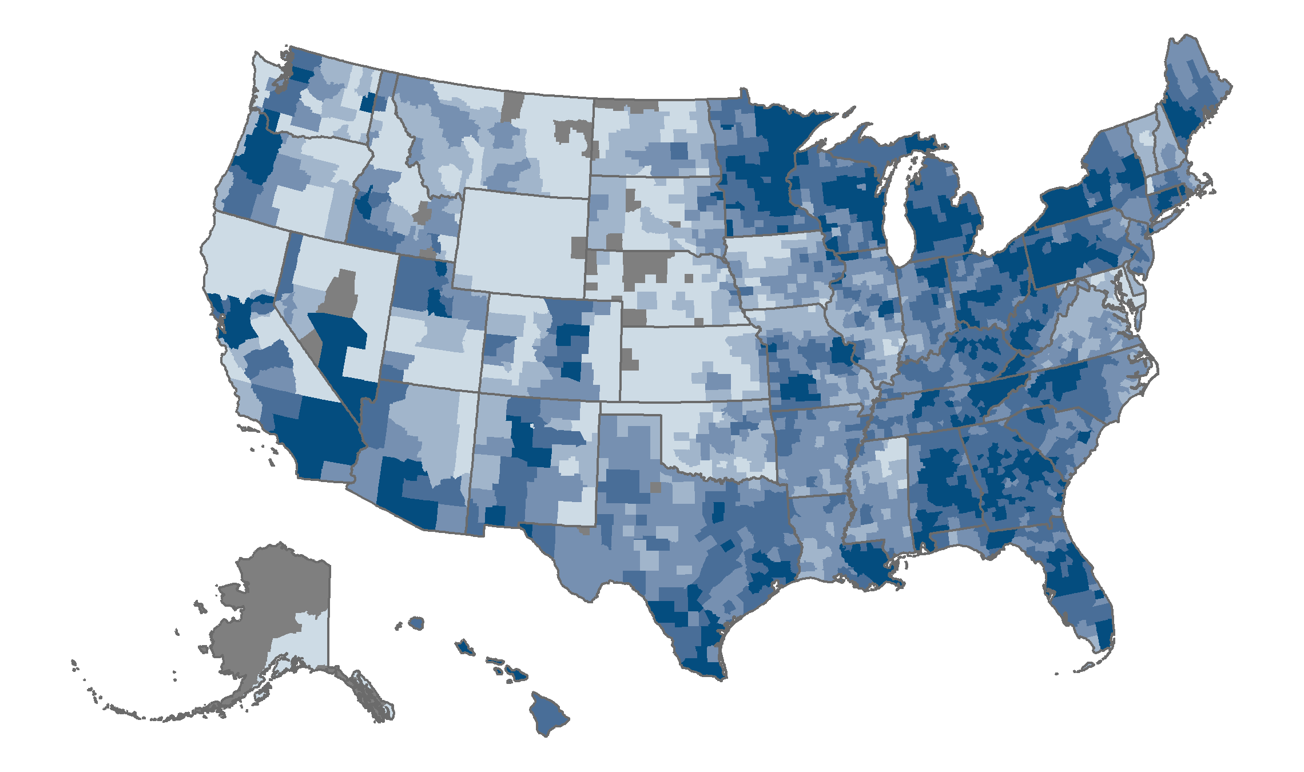
Enrollment in Medicare Advantage plans varies widely, with rates lowest in the midwestern and western counties.
Medicare Advantage Enrollment
<1%–9%
10%–19%
20%–29%
30%–39%
40%–67%
No Medicare Advantage enrollment, or missing data
Source: CMS MA State/County Penetration File, 2020.
Note: Enrollment estimates do not include records denoted as pending state or county designation.
Notes:
At the county level, enrollment rates vary from under 1 percent to about 67 percent.
The lowest county-level Medicare Advantage (MA) rates are in regions of Alaska and counties in Wyoming and Montana, with less than 1 percent of Medicare beneficiaries enrolled in a plan.
Excluding regions of Puerto Rico, where enrollment rates approach 80 percent, areas with the highest MA rates are:
Miami-Dade County, Fla., and Monroe County, N.Y. (which includes Rochester), with over two-thirds of Medicare beneficiaries enrolled
Cambria, Beaver, Westmoreland, and Armstrong counties in Pennsylvania, with between 61 and 63 percent enrolled
Meeker and McLeod counties in Minnesota, with 63 percent and 62 percent enrolled
Ottawa County, Mich., with 62 percent enrolled
El Paso County, Texas, with 61 percent enrolled.

Slide 10
The percentage of Medicare beneficiaries enrolled in a Medicare Advantage plan varies from 45 percent in Hawaii to 1 percent in Alaska.
Medicare Advantage Enrollment
Percentage enrolled in Medicare Advantage nationally: 35.3
National Medicare Advantage enrollment: 24.7 million
Source: CMS Monthly Enrollment by State, County, and Plan, March 2020.
Notes:
Rates of enrollment in Medicare Advantage vary substantially across the United States and the District of Columbia, from less than 5 percent of Medicare beneficiaries in Alaska, North Dakota, and Wyoming to more than 40 percent in Alabama, Connecticut, Florida, Hawaii, Michigan, Oregon, and Pennsylvania.

Slide 11
Enrollment in HMOs has doubled over the past decade.
Medicare Advantage Enrollment
 | 2010 | 2011 | 2012 | 2013 | 2014 | 2015 | 2016 | 2017 | 2018 | 2019 | 2020
(Enrollment in millions)
HMO | 7.3 | 7.8 | 8.5 | 9.4 | 10.1 | 11.1 | 11.8 | 12.4 | 13.1 | 14.0 | 15.2
PPO | 1.3 | 2.2 | 2.8 | 3.2 | 3.7 | 4.1 | 4.2 | 5.0 | 5.7 | 6.9 | 8.0
Private Fee-for Service | 1.7 | 0.6 | 0.5 | 0.4 | 0.3 | 0.3 | 0.2 | 0.2 | 0.2 | 0.1 | 0.1
Regional PPO | 0.8 | 1.1 | 0.9 | 1.1 | 1.2 | 1.2 | 1.3 | 1.4 | 1.3 | 1.3 | 1.2
Total | 11.0 | 11.7 | 12.8 | 14.1 | 15.4 | 16.7 | 17.5 | 18.9 | 20.3 | 22.3 | 24.4
Source: CMS Monthly Contract and Summary Enrollment Reports, March 2009–2020.
Note: Enrollment estimates do not include records denoted as pending state or county designation; totals include beneficiaries enrolled in employer/union-only group plans. Total does not include all Medicare Advantage plan types; actual enrollment is higher than shown in this table.
Notes:
Local coordinated care plans (HMOs and PPOs) often serve different markets or regions than regional PPO plans. Local plans typically provide services to Medicare beneficiaries in one county or multiple counties. Regional plans are required to provide services to beneficiaries in a single state or in multiple states, with the benefit package and premiums uniform across the state or states served.
The majority of Medicare beneficiaries, more than 23 million, are enrolled in a local coordinated care plan, either an HMO or PPO.
Enrollment in local coordinated care plans increased substantially throughout the past decade, with enrollment in HMOs rising more than twofold (from 7.3 million to 15.2 million) and enrollment in local PPOs rising sixfold (from 1.3 million to 8.0 million) between 2010 and 2020.
Reductions in private-fee-for-service enrollment (PFFS) over the past decade reflect changes to plan network requirements that took effect in 2011 following enactment of the Medicare Improvement for Patients and Providers Act of 2008. These changes led to significant reductions in the number of Medicare PFFS plans.

Slide 12
Average Medicare Advantage premiums fell by approximately 40 percent between 2010 and 2020.
Medicare Advantage Benefits
Weighted by plan enrollment
Source: CMS Plan and Premium Information for Medicare Plans Offering Part D Coverage, 2010–2020.
Notes: Data represent average plan premiums weighted by plan enrollment and are not adjusted by inflation. Data do not include Special Needs Plans, employer-sponsored plans, Part B–only plans, or plans not offering a Part D drug benefit. The Part C premium covers Medicare medical and hospital care; the Part D premium is a total (basic and supplemental) premium.
Notes:
Most Medicare Advantage (MA) plans provide prescription drug coverage.
Average total MA plan premiums – which cover costs associated with both Part C and Part D components – decreased by $4 between 2019 and 2020, a 14 percent reduction.
Despite fluctuation over the past decade, average MA total plan premiums declined by 40 percent between 2010 and 2020.

Slide 13
Among Medicare Advantage plan types, average 2021 premiums are lowest for HMOs and Special Needs Plans.
Medicare Advantage Benefits
Range
Source: CMS Plan and Premium Information for Medicare Plans Offering Part D Coverage, 2021.
Notes: PACE, Part B–only plans, employer-sponsored plans, and plans under sanction are excluded. Special Needs Plans are excluded from the “All Medicare Advantage Plans” average.
Notes:
Ranging from $0 per month to $351 per month, premiums for Medicare Advantage plans average $28 per month in 2021.
Average premiums vary substantially by type of plan, with HMOs ($23) and Special Needs Plans ($25) having the lowest average monthly premiums.
Monthly premiums for regional PPOs, which average $73, and private fee-for-service plans, which average $78, are approximately three times higher than for either HMOs or Special Needs Plans.

Slide 14
HMOs’ average in-network maximum out-of-pocket (MOOP) amount is about one-third less than the Medicare limit for 2021.
Medicare Advantage Benefits
Source: CMS Medicare Advantage Landscape File, 2021.
Notes: PACE, Special Needs Plans, Part B–only plans, employer-sponsored plans, and plans under sanction are excluded.
Notes:
Each year, the Centers for Medicare and Medicaid Services (CMS) sets a Medicare Advantage (MA) maximum out-of-pocket (MOOP) limit to reduce beneficiary financial risk. Beneficiary cost-sharing for Part A and Part B services is waived once a beneficiary reaches the MOOP amount. The CMS-allowed MOOP limit provides a ceiling for MA plans’ MOOP limits, and plans may choose to set a lower limit. CMS has set the in-network, maximum out-of-pocket limit at $7,550 per year, up from the $6,700 limit set for 2010 to 2020.
Across all MA plans, the in-network MOOP limit averages $5,343, about 30 percent lower than the CMS-allowed MOOP limit.
MOOP amounts vary by plan type. Average annual MOOP among HMOs ($4,982) is about one-third lower, and average MOOP among local PPOs ($6,086) is about one-fifth lower than the CMS-allowed MOOP limit for 2021.

Slide 15
In 2021, more Special Needs Plans than other Medicare Advantage plans offer popular supplemental benefits, such as eye exams, hearing exams, over-the-counter drugs, and transportation.
Medicare Advantage Benefits
Source: CMS Plan Benefit Package, 2021 (Updated as of October 1, 2020).
Notes:
Medicare Advantage plans are required to provide coverage that is comparable to that provided under traditional Medicare Part A and Part B. Additionally, Medicare Advantage plans have the option of providing coverage for primarily health-related services that are not presently covered under Medicare fee-for-service. Comparing Special Needs Plans (SNPs) to all other Medicare Advantage plans, a substantially greater proportion of SNPs than other Medicare Advantage plans offer the more popular supplemental benefits, most significantly:
Eye and hearing exams are each offered by nine in ten SNPs, but only three quarters of other Medicare Advantage plans;
Over 91 percent of SNPs offer access to over-the-counter drugs, compared to 61 percent of other Medicare Advantage plans;
Non-medical emergency transportation services is offered by nearly 85 percent of SNPs, but only 36 percent of other Medicare Advantage plans;
Over 64 percent of SNPs provide access to limited meal benefits compared to slightly more than 44 percent of other Medicare Advantage plans.
Supplemental benefits may also include enhancements to traditional inpatient and outpatient services. Among the more popular of these, approximately 93 percent of SNPs and 75 percent of other Medicare Advantage plans waive the rule requiring hospitalization for 3 days for coverage of post-acute care at a skilled nursing facility (3-day SNF rule).

Slide 16
Fewer than one in ten Medicare Advantage plans offer support for caregivers, in-home safety assessments, or other services that help people live independently in their homes.
Medicare Advantage Benefits
Source: CMS Plan Benefit Package, 2021 (Updated as of October 1, 2020).
Notes:
In 2019, CMS expanded the definition of a “primarily health-related” supplemental benefit to include services or items that may be used to “diagnose, compensate for physical impairments, ameliorate the functional/psychological impact of injuries or health conditions, or reduce avoidable emergency and healthcare utilization.” This expanded definition opened the door for Medicare Advantage plans to provide benefits that, among others, included adult day health services, home-based palliative care, support for caregivers of enrollees, non-opioid pain management or therapeutic massages, and home and bathroom safety devices.
Among the expanded benefits that are offered by the greatest number of Medicare Advantage plans:
Over 19 percent of SNPs and 7 percent of other Medicare Advantage plans provide some coverage for in-home support services;
Bathroom safety devices are offered by 12 percent of SNPs and almost 7 percent of other Medicare Advantage plans; and
Telemonitoring services are offered by 11 percent of SNPs and 5 percent of other Medicare Advantage;
Benefits offered by the fewest plans include post-discharge medication reconciliation, in-home palliative care services, and support for caregivers. Each of these services are offered by fewer than 2 percent of SNPs and other Medicare Advantage plans.

Slide 17
The number of Medicare Advantage plans available to Medicare beneficiaries has increased over the past decade, with 33 plans available, on average, in 2021.
Medicare Advantage Plan Availability
All Medicare Advantage Plans
HMO
Local PPO
Private
Fee-for-Service
Regional PPO
Source: CMS MA Landscape Source Files, 2010–2021.
Note: Data represent the average number of plans operating in counties across the U.S. and Puerto Rico, weighted by the number of Medicare beneficiaries in each year. (Data for 2021 are weighted by September 2020 beneficiaries.) PACE, Special Needs Plans, Part B–only plans, employer-sponsored plans, plans under sanction, and records denoted as pending state or county designation are excluded.
Notes:
From 2016 to 2021, the average number of Medicare Advantage (MA) plans available to Medicare beneficiaries increased from 19 to 33, or 74 percent.
Growth in the number of available MA plans has been driven by greater availability of HMOs and local PPOs. Between 2016 and 2021:
The average number of HMOs available to beneficiaries rose 58 percent, from 12 to 19 plans
The average number of local PPOs available increased nearly threefold, from four to 11 plans.
Compared to 2020, the average number of MA plans available to beneficiaries in 2021 increased by 18 percent (from 28 to 33 plans); the average number of HMOs available increased by 12 percent (from 17 to 19 plans); and the average number of local PPOs increased by 37 percent (from eight to 11 plans).
The availability of private fee-for-service plans and regional PPO plans remained unchanged throughout this same period.

Slide 18
Nearly all Medicare beneficiaries have access to at least one Medicare Advantage plan for 2021, typically an HMO or local PPO.
Medicare Advantage Plan Availability
Sources: CMS MA Landscape Source File, 2010–2021.
Notes: Data for the following organization types are included: local Coordinated Care Plans (CCP); Regional CCP; Medical Savings Accounts (MSA); Private Fee-for-Service (PFFS); Demonstrations; National PACE; 1976 Cost; HCPP - 1933 Cost; Employer Direct PFFS.
Notes:
Throughout the past decade, nearly all Medicare beneficiaries have had access to at least one Medicare Advantage plan. In 2021, less than 1 percent of the U.S. population resided in an area without access to a plan.
Access to HMOs and local PPOs has increased over the past decade. In 2021, all but 4 percent of Medicare beneficiaries have access to at least one HMO, and only 6 percent lack access to a local PPO.
Access to regional PPOs and private fee-for-service plans declined substantially over the last decade. In 2021, more than one-quarter of the Medicare population does not have access to a regional PPO, and more than two-thirds do not have access to a private fee-for-service plan.

Slide 19
The number of Special Needs Plans (SNPs) has increased steadily in the past six years, totaling 1,019 in 2021.
Medicare Advantage Special Needs Plans
Source: CMS SNP Landscape Source File, 2010–2021.
Note: Employer-sponsored plans, demonstrations, and plans under sanction are excluded from SNP counts.
Notes:
The Medicare Modernization Act of 2003 established Medicare Special Needs Plans (SNPs) to provide coordinated care services to Medicare beneficiaries who are dually eligible for Medicare and Medicaid, require an institutional-level of care, and/or have a chronic and disabling condition.
Between 2010 and 2015, the number of SNPs fluctuated, but the number of SNPs increased steadily between 2016 and 2021. During these last six years, the number of SNPs nearly doubled, from 534 to 1,019 plans.
Of the more than 1,000 SNPs operating in 2021, nearly two-thirds target care to beneficiaries dually eligible for Medicare and Medicaid. Only one in five SNPs target care to beneficiaries with chronic and disabling conditions, and slightly less target care to beneficiaries requiring an institutional-level of care.

Slide 20
Enrollment in Special Needs Plans (SNPs) has more than doubled in the past decade.
Medicare Advantage Special Needs Plans
Most growth occurred in Dual Eligible SNPs
Source: CMS SNP Comprehensive Report, 2020 (March version).
Note: Dual eligibles describes individuals who receive both Medicare and Medicaid benefits. Medicare acts as the primary payer for most services, while Medicaid may help pay for premiums, cost-sharing, and benefits not covered by Medicare. Beneficiaries must be dually eligible for Medicare and Medicaid to enroll in a dual SNP (D-SNP).
Notes:
The Medicare Modernization Act of 2003 established Medicare Special Needs Plans (SNPs) to provide coordinated care services to Medicare beneficiaries who are dually eligible for Medicare and Medicaid, require an institutional-level of care, and/or have a chronic and disabling condition.
SNP enrollment increased more than 2.5 times (164%) over the past decade. SNPs enrolled approximately 1.3 million beneficiaries in 2010 compared to 3.4 million in 2020.
The majority of beneficiaries – nearly 2.9 million, or 86 percent of those in a Special Needs Plan – are enrolled in a dual-eligible SNP (D-SNP). Approximately 11 percent and 3 percent of beneficiaries, respectively, are enrolled in a chronic condition SNP (C-SNP) and institutional SNP (I-SNP).

Slide 21
Ninety-six percent of Medicare beneficiaries have access to Special Needs Plans (SNPs) in 2021.
Medicare Advantage Special Needs Plans
Source: CMS State/County Penetration, and SNP Landscape Source File, 2010–2021.
Note: Estimates do not include records denoted as pending state or county designation.
Notes:
Regardless of whether they meet enrollment criteria, including eligibility for both Medicare and Medicaid, need for institutional care, and presence of selected chronic conditions, approximately 96 percent of Medicare beneficiaries have access to a Special Needs Plan (SNP) in 2021.
Access to SNPs varies by type of plan:
In 2021, 92 percent of Medicare beneficiaries have access to a dual-eligible SNP if they meet eligibility criteria. This represents a 13 percentage-point increase from 2010.
The percentage of Medicare beneficiaries who could potentially access an institutional SNP increased by 26 points, from 48 percent in 2010 to 74 percent in 2021.
Access to chronic condition SNPs modestly declined over the past decade. In 2010, about 60 percent of the Medicare population could potentially enroll in a chronic condition SNP, compared to 58 percent in 2021.

Slide 22
Few Chronic Condition Special Needs Plans focus on mental health conditions, HIV/AIDS, dementia, or end-stage renal disease.
Medicare Advantage Special Needs Plans
Conditions targeted by Special Needs Plans (SNPs)*
1% Mental health
2% HIV/AIDS
3% Dementia
4% End-stage renal disease
11% Respiratory disease
62% Cardiovascular/ congestive heart failure
78% Either heart conditions or diabetes
69% Diabetes
*Numbers total more than 100 percent, as plans may target multiple conditions.
Total SNPs in 2021: 1,019
Source: CMS SNP Landscape Source File, 2021.
Note: Employer-sponsored plans, demonstrations, and plans under sanction are excluded from SNP counts.
Notes:
Chronic Condition Special Needs Plans (SNPs) provide care to Medicare beneficiaries who are medically complex or have been diagnosed with one or more disabling or potentially life-threatening conditions, have a high risk of hospitalization or poor health outcome, and require specialized delivery systems.
CMS has identified 15 conditions or sets of conditions that meet these criteria, including: chronic alcohol or drug dependence, autoimmune disorders, cancer, cardiovascular disorders, chronic heart failure, dementia, diabetes, end-stage liver disease, end-stage renal disease, hematologic disorders, HIV/AIDS, chronic and disabling mental health conditions, chronic lung disorders, neurologic conditions, and stroke.
A total of 214 Chronic Condition SNPs are available to Medicare beneficiaries in 2021.
Approximately 78 percent of Chronic Condition SNPs focus care on Medicare beneficiaries with heart disease or diabetes (62% target heart conditions and 69% target diabetes). One-half focus care on beneficiaries with both diabetes and heart disease. Few plans target end-stage renal disease (4%), dementia (3%), HIV/AIDS (2%), or mental health conditions (1%).

Slide 23
Average monthly premiums for Chronic Condition Special Needs Plans (SNPs) are one-fourth that of Dual Eligible SNPs in 2021.
Medicare Advantage Special Needs Plans
Source: CMS SNP Landscape Source Files, 2021.
Notes: Employer-sponsored plans and plans under sanction are excluded.
Notes:
Most Special Needs Plans (SNPs) operate as HMOs, which, on average, tend to have lower premiums than other types of Medicare Advantage plans.
Monthly premiums average $33 across the 1,019 SNPs, though wide variation is noted by type of SNP.
With an average monthly premium of $33, premiums for institutional SNPs are 18 percent higher than that of Dual Eligible SNPs, for which premiums average $28.
At only $7 per month, average 2021 premiums across Chronic Condition SNPs are about one-fifth of those for Institutional SNPs and one-fourth that of Dual Eligible SNPs.

Slide 24
Enrollment in Medicare stand-alone prescription drug plans has changed relatively little since 2015.
Medicare Part D Enrollment
Prescription Drug Plan (PDP) Enrollment in Millions
Percent of All Medicare Beneficiaries
Source: CMS PDP State/County Penetration File, March 2020.
Note: Enrollment estimates do not include records denoted as pending state or county designation. This file contains data for the following organization types (where there are active contracts): PDP; employer/union-only direct-contract PDP.
Notes:
Between 2010 and 2015, enrollment in Part D stand-alone prescription drug plans increased nearly 32 percent, from 17.7 million to 24.0 million Medicare beneficiaries.
Between 2016 and 2020, the number of Medicare beneficiaries enrolled in a PDP was relatively steady, although the percentage of all beneficiaries enrolled in PDPs declined from 45 percent to 37 percent.
Recent trends in PDP enrollment may partly reflect beneficiaries switching to Medicare Advantage plans that offer a Part D benefit (MA-PD).

Slide 25
Enrollment in Medicare stand-alone prescription drug plans (PDPs) is highest in rural states with low Medicare Advantage enrollment rates.
Medicare Part D Enrollment
Medicare Beneficiaries Enrolled in PDP Plan (%)
National % enrolled in PDP Plan: 37%
National PDP enrollment: Approx. 25.2 million
Source: CMS PDP State, County, Plan Enrollment, March 2020.
Note: Includes data for Medicare PDP and employer/union-only direct-contract PDPs. Enrollment estimates do not include records denoted as pending state or county designation.
Notes:
Overall, more than 25 million beneficiaries, or 37 percent, are enrolled in a PDP in 2020.
Across the U.S., rates of enrollment in PDPs varies twofold. PDP enrollment ranges from less than 30 percent in Alabama, Florida, Hawaii, Nevada, and Oregon to a high of approximately 60 percent in states that are rural and/or have low Medicare Advantage enrollment, including Alaska, Delaware, North Dakota, Vermont, and Wyoming.

Slide 26
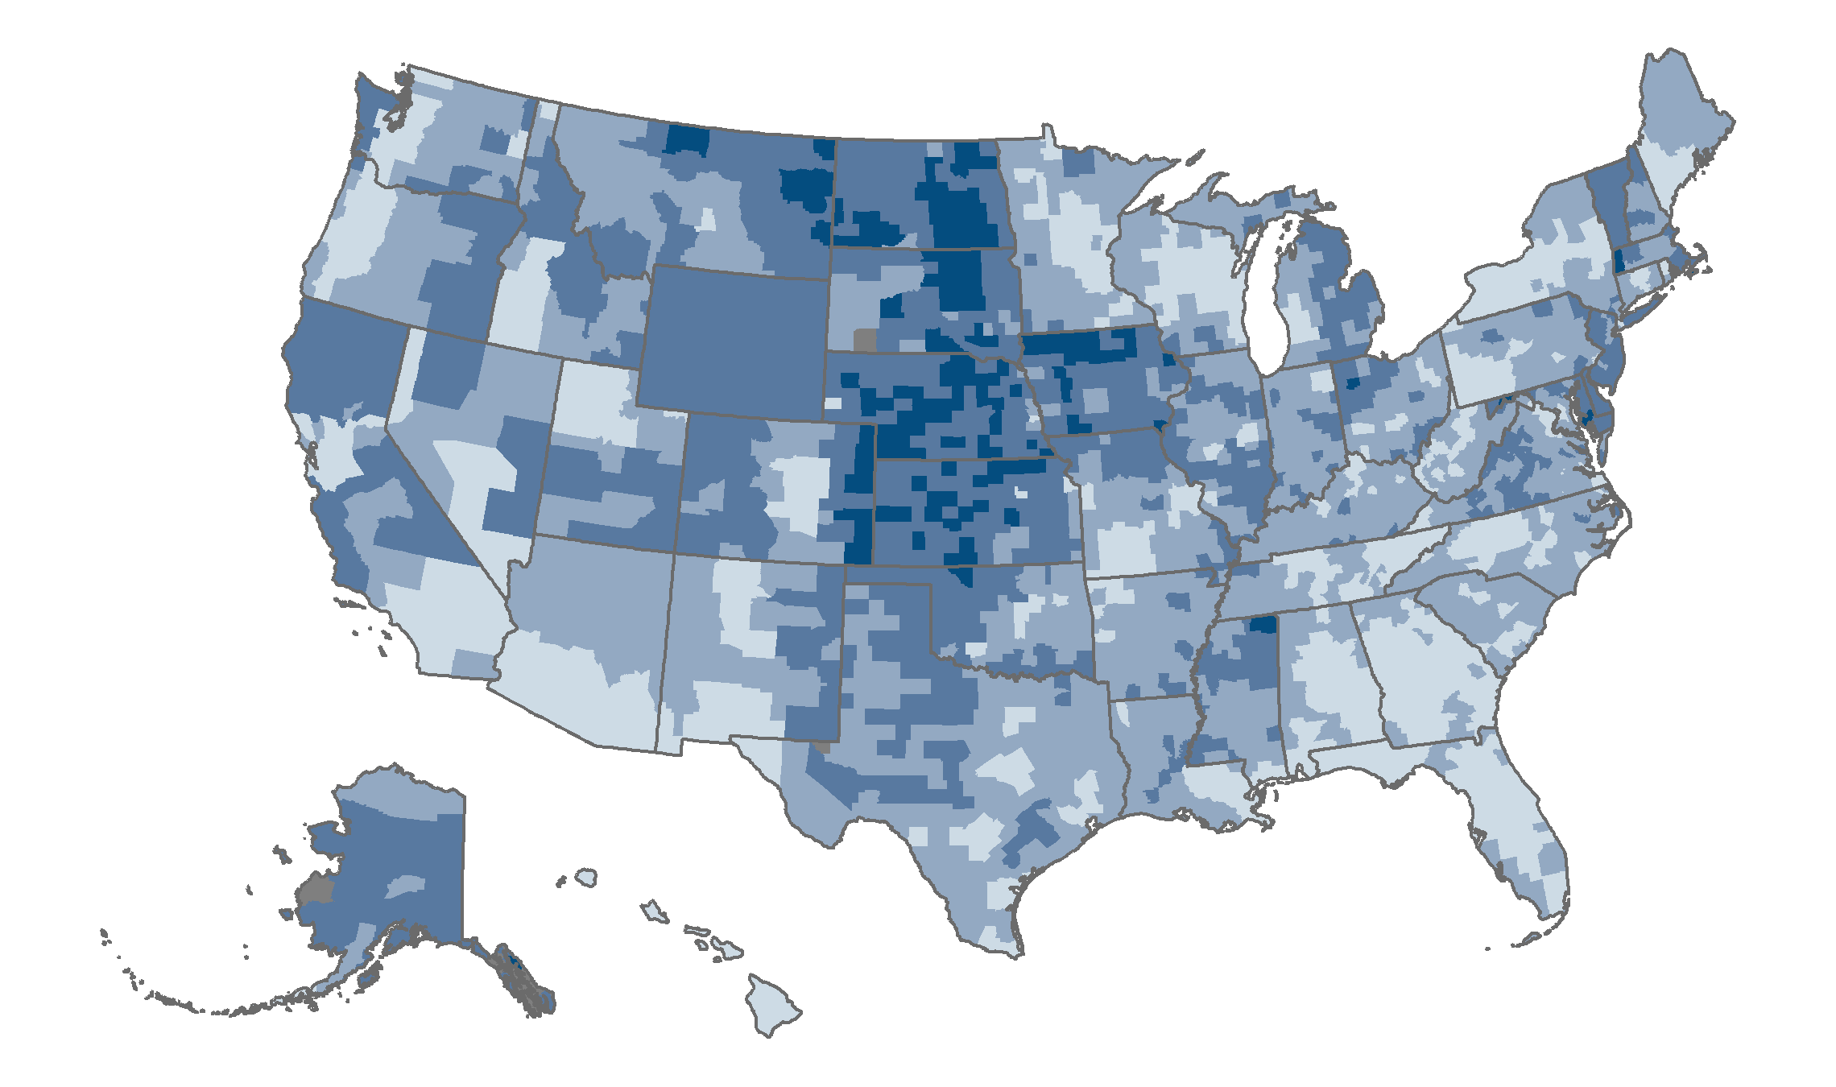
Across counties, enrollment in stand-alone prescription drug plans (PDPs) ranges from less than 1 percent to 78 percent of Medicare beneficiaries.
Medicare Part D Enrollment
<1%–34%
35%–49%
50%–64%
65%–78%
No PDP enrollment or missing data
Source: CMS PDP State/County Penetration File, March 2020.
Note: Enrollment estimates do not include records denoted as pending state or county designation.
Notes:
Across the U.S., county rates of enrollment in stand-alone prescription drug plans (PDPs) varies substantially, from a high of almost 78 percent in Dubuque County, Iowa, to a low of nearly 16 percent in Osceola County, Fla.
A total of 28 counties have PDP enrollment rates greater than 70 percent.
Twelve of these counties are located in two states, Kansas (six counties) and North Dakota (six counties)
Five counties are located in Nebraska
Four counties with high PDP enrollment rates are in Iowa, and another four are in South Dakota.
Two counties with the highest PDP enrollment are in Colorado; one county is in western Maryland.
Several counties with high Medicare Advantage penetration rates have low rates of PDP enrollment: Miami-Dade, Fla.; Monroe, N.Y.; and El Paso, Texas. Each of these counties has PDP enrollment of approximately 17 percent.

Slide 27
Many stand-alone prescription drug plans (PDPs) are available to Medicare beneficiaries, with the average number of plans on the rise since 2017.
Medicare Part D Availability
Source: CMS State/County Penetration, and PDP Landscape Source Files, 2010–2021.
Note: Data represent the average number of plans operating in counties across the U.S., weighted by the number of Medicare beneficiaries in each year. (Data for 2021 are weighted by September 2020 beneficiaries.) Employer-sponsored plans and plans under sanction are excluded. Estimates do not include records denoted as pending state or county designation.
Notes:
There has been substantial fluctuation in the average number of stand-along prescription drug plans (PDPs) available to Medicare beneficiaries over the past decade:
Since 2017, PDP availability has been on the rise. In the five years between 2017 and 2021, the average number of PDPs available increased by 50 percent, from 20 to 30 plans.
Between 2010 and 2013, the average number of PDPs available fell from 47 to 26 plans, and, following an increase in plan availability in 2014, the number fell from an average of 33 plans to 24 plans between 2014 and 2016.
Since 2010, the average number of stand-alone prescription drug plans (PDPs) available to Medicare beneficiaries has decreased from 47 plans to 30 plans in 2021, a reduction of about 36 percent.

Slide 28
Average premiums for stand-alone prescription drug plans (PDP) in 2021 are nearly 2.5 times those for Medicare Advantage prescription drug plans (MA-PDs).
Medicare Part D Benefits
Range
Source: CMS Plan and Premium Information for Plans Offering Part D Coverage, 2021.
Notes: Amounts represent total Part D premiums, which are the sum of the Basic and Supplemental Premiums. Total premium may be lower than the sum of the basic and supplemental premiums because of negative basic or supplemental premiums. MA-PD average excludes employer-sponsored plans, Part B–only plans, demonstration, cost plans, and plans not offering Part D benefits.
Notes:
Approximately 91 percent of Medicare Advantage (MA) plans offer prescription drug (Part D) benefits in 2021.
In 2021, average monthly premiums for stand-alone prescription drug plans ($41) are about 2.6 times higher than average premiums for the prescription drug component of MA plans ($17).
Average premiums for enhanced plans are approximately $3 more per month than for basic PDPs ($43 vs. $40), a difference of about 8 percent.

Slide 29
During the past decade, premiums for Part D stand-alone prescription drug plans declined modestly.
Medicare Part D Benefits
Weighted by plan enrollment
Source: CMS Plan and Premium Information for Plans Offering Part D Coverage, 2011–2020.
Notes: Data represent average plan premiums weighted by plan enrollment and are not adjusted for inflation. Amounts represent total Part D premiums, which are the sum of the basic and supplemental premiums. Total premium may be lower than the sum of the basic and supplemental premiums because of negative basic or supplemental premiums. Employer-sponsored plans and plans under sanction are excluded.
Notes:
Despite slight annual fluctuation, Part D stand-alone prescription drug plan (PDP) premiums remained relatively unchanged over the past decade, with plan premiums averaging $38 in 2011 and 2020.
Average PDP premiums fell by about $3 from 2019 to 2020, a difference of less than 8 percent.

Slide 30
The number of Medicare Advantage enrollees receiving a low income subsidy (LIS) tripled in the past decade.
Medicare Part D Low Income Subsidy
MA-PD = Medicare Advantage prescription drug plan; PDP = Stand-alone prescription drug plan.
Source: CMS Low Income Subsidy Enrollment by Plan, 2010-2020.
Note: Enrollment estimates do not include plan records suppressed because of a value of 10 or less. Only includes Medicare Advantage plans with Part D coverage.
Notes:
The Medicare low income subsidy (LIS) program provides financial assistance to Medicare beneficiaries with low income for out-of-pocket costs associated with prescription drugs, like deductibles and premiums.
In 2020, nearly 13 million Medicare beneficiaries enrolled in either a Medicare Advantage prescription drug (MA-PD) plan or a stand-alone PDP receive an LIS, an increase of nearly 30 percent from 2010.
Among Medicare beneficiaries enrolled in MA-PDs, more than 6.1 million (approximately one-quarter of those enrolled in an MA-PD) receive LIS benefits in 2020. This is a threefold increase since 2010, when 2.2 million beneficiaries received LIS benefits.
During the past decade, the number of beneficiaries in a stand-alone PDP who received LIS benefits declined by 16 percent, from 8.0 million to 6.7 million.

Slide 31







In the U.S. Medicare program, private plans offer primary, supplemental, and prescription drug–only coverage, similar to models of private plans in other countries.
International Comparisons
United States
Germany
Netherlands
Switzerland
Primary
United States
Australia
France
Netherlands
Supplemental
Coverage
Type
Prescription Drug
United States
Canada
Source: The Commonwealth Fund/London School of Economics 2020 International Profiles of Health Care Systems, June 2020.
Notes:
Private health insurance plans serve diverse roles in nations’ health care systems. In Germany, Netherlands, and Switzerland, private plans are the primary source of insurance and cover essential health benefits. In Australia, Netherlands, and France, people can purchase private plans that provide coverage supplemental to the primary insurance source for such things as adult dental or vision care, physical therapy, private hospital rooms, or greater choice of private providers. In Canada, people can purchase private plans that provide only outpatient prescription drug coverage.
In the United States, private health insurance plans play a pivotal role. Private plans provide primary coverage through Medicare Advantage plans, the Affordable Care Act (ACA) marketplaces, employer-sponsored plans, and some Medicaid managed care organizations. Examples of supplemental or wrap-around coverage provided by private plans include Medigap (for Medicare beneficiaries), critical illness insurance, and indemnity insurance plans. Medicare Part D stand-alone prescription drug plans (PDPs) are an example of private plans that offer only prescription drug coverage.
For more information, see https://www.commonwealthfund.org/international-health-policy-center/system-profiles.

