Slide 1
Transforming Primary Health Care for Women
The Commonwealth Fund and Manatt Health
July 16, 2020

Slide 2

Housekeeping
TRANSFORMING PRIMARY HEALTH CARE FOR WOMEN
The slides and a recording of this webinar will be available after the webinar and will be sent to all participants.
All participant lines are muted.
Please submit your questions throughout the webinar in the Q&A box (usually located at the bottom of your screen).

Slide 3
Agenda
TRANSFORMING PRIMARY HEALTH CARE FOR WOMEN
Introduction
Overview of Key Findings
Panel Discussion

Slide 4
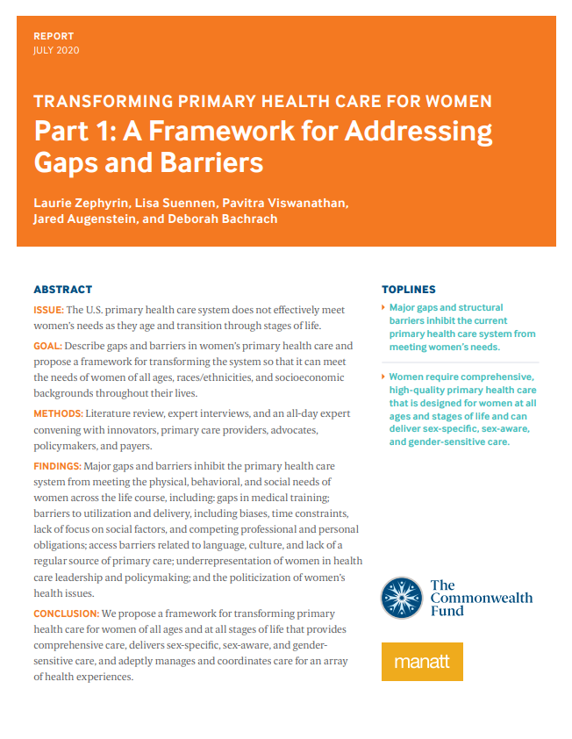
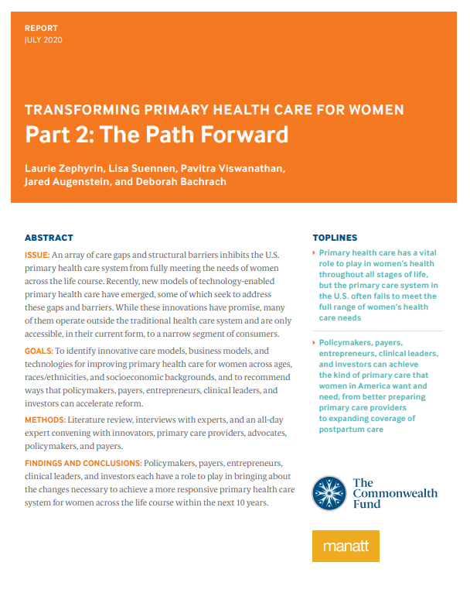
Two New Reports Released Today
TRANSFORMING PRIMARY HEALTH CARE FOR WOMEN

Slide 5
Introduction
TRANSFORMING PRIMARY HEALTH CARE FOR WOMEN

Slide 6
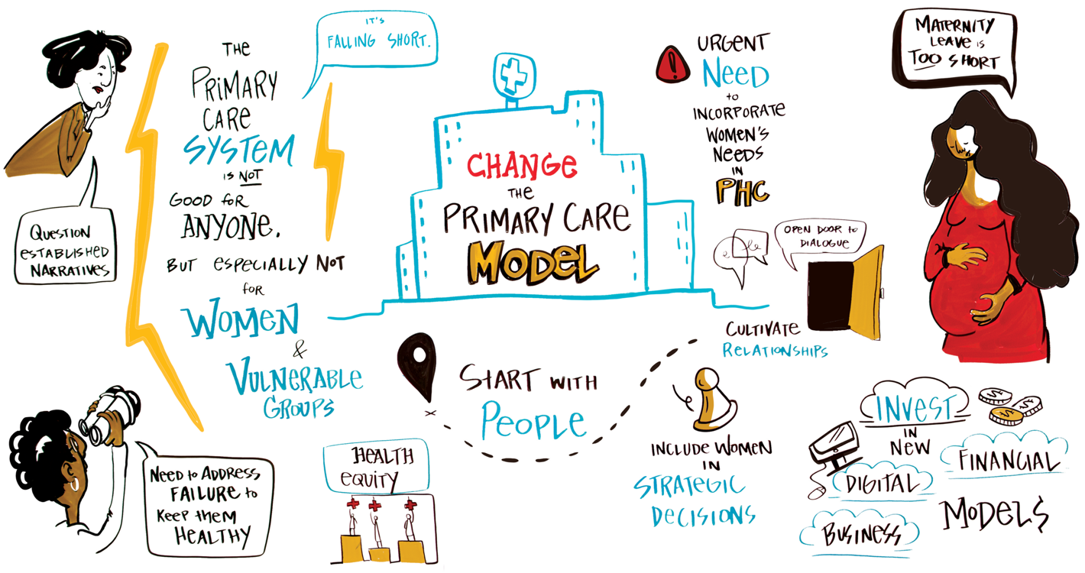
Perspectives from the Field
TRANSFORMING PRIMARY HEALTH CARE FOR WOMEN
In its current form, the U.S. primary health care system does not effectively meet the needs of all women across the life course.

Slide 7
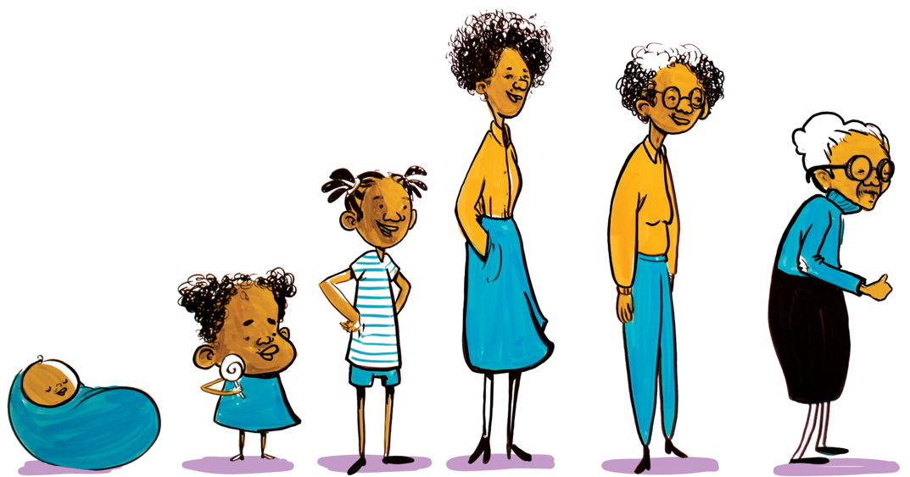
Objectives
TRANSFORMING PRIMARY HEALTH CARE FOR WOMEN
Recognize and describe gaps in and barriers to primary health care for women
Describe gaps in primary health care exacerbated by the COVID-19 pandemic
Propose a framework for transforming the primary health care system to meet the needs across all ages, races, and socioeconomic backgrounds throughout life transitions

Slide 8
Staggering Racial/Ethnic and Socioeconomic Disparities Persist
TRANSFORMING PRIMARY HEALTH CARE FOR WOMEN
40% higher breast cancer mortality rates for black women
More likely to be served by poorly resourced and underfunded practices
10-year lower life expectancy for lowest income women
Lower utilization of preventive services
2-3x higher maternal mortality rate higher for black woman
Lower rates of cancer screenings in uninsured women
It is paramount that an effective primary health care system incorporates strategies to care for low-income people and eliminate racial/ethnic disparities.

Slide 9
Overview of Key Findings
TRANSFORMING PRIMARY HEALTH CARE FOR WOMEN

Slide 10
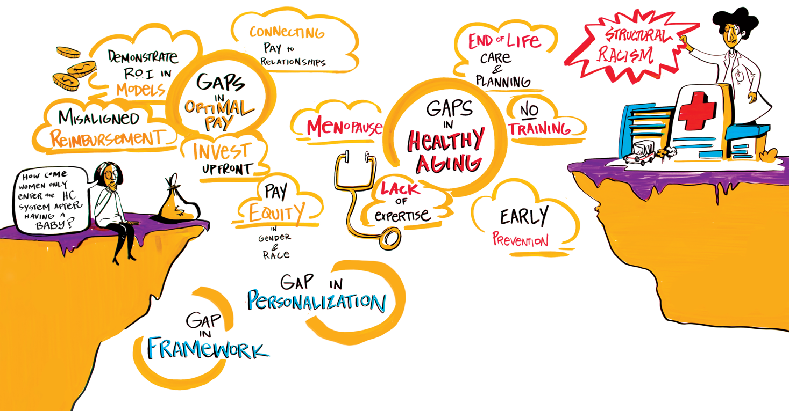
Gaps and Barriers in the Primary Health Care System for Women
TRANSFORMING PRIMARY HEALTH CARE FOR WOMEN
The COVID-19 pandemic has revealed and, in some cases, further exacerbated existing gaps in the primary health care system

Slide 11
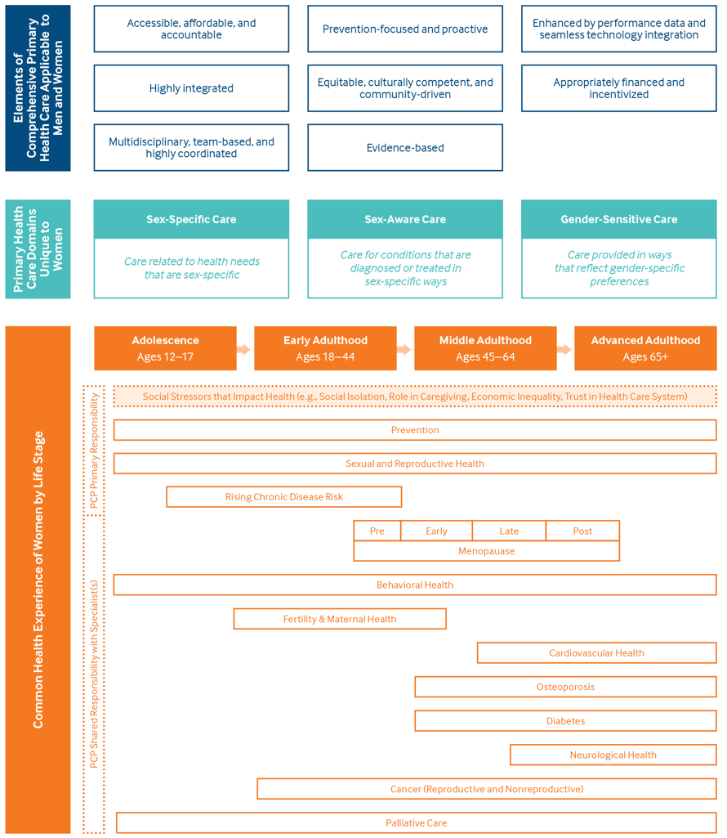
Framework
TRANSFORMING PRIMARY HEALTH CARE FOR WOMEN
To address existing gaps and barriers
To optimally serve women of all ages and at all stages of life

Slide 12
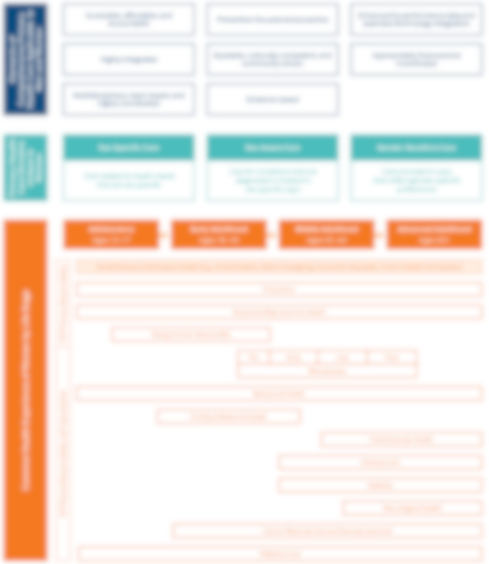
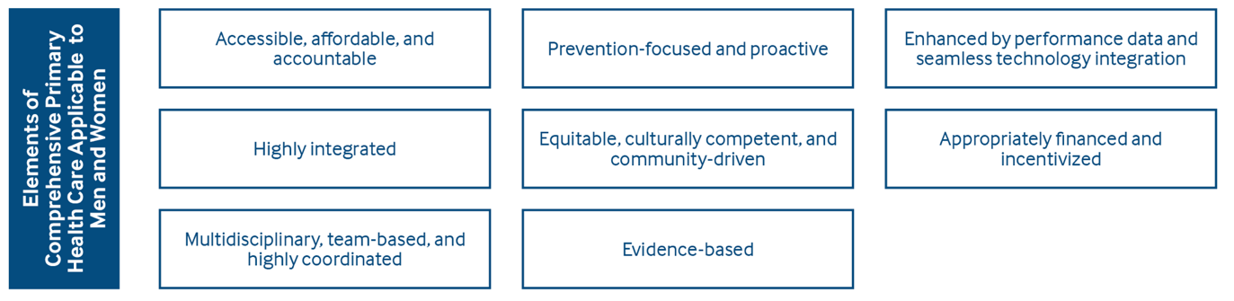
The Primary Health Care System Must Be Comprehensive
TRANSFORMING PRIMARY HEALTH CARE FOR WOMEN

Slide 13
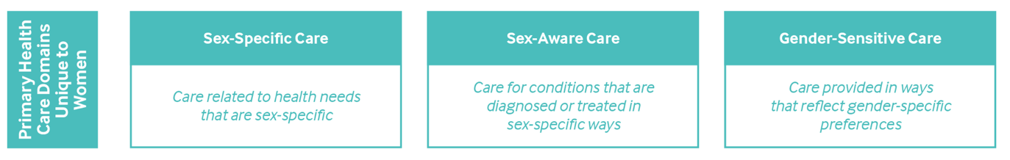
The Primary Health Care System Must Be Prepared to Deliver Sex-Specific, Sex-Aware, and Gender-Sensitive Care
TRANSFORMING PRIMARY HEALTH CARE FOR WOMEN

Slide 14
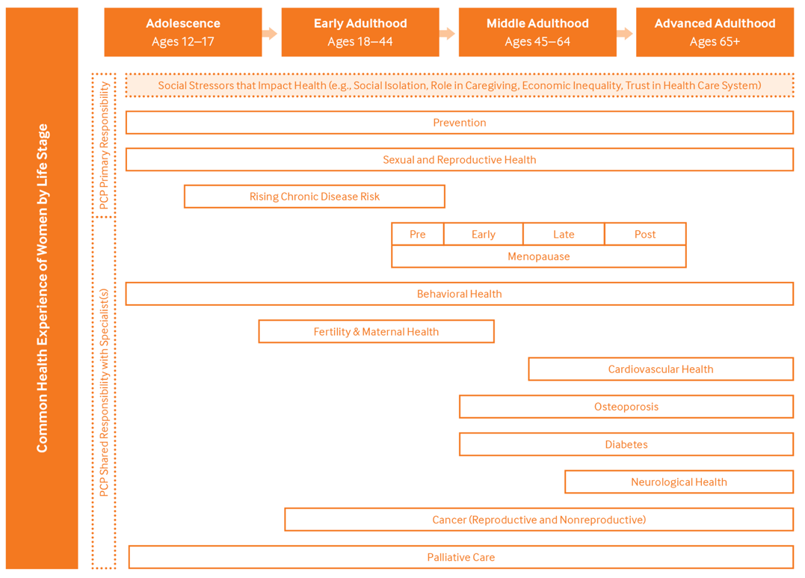
The Primary Health Care System Must Be Adept at Coordinating Care across Life Transitions
TRANSFORMING PRIMARY HEALTH CARE FOR WOMEN

Slide 15
Role of Digital Innovations in Primary Health Care
TRANSFORMING PRIMARY HEALTH CARE FOR WOMEN
In response to the COVID-19 pandemic, the adoption of digital tools that facilitate telehealth consultations, remote monitoring, and patient engagement increased significantly and is expected to continue growing.

Slide 16
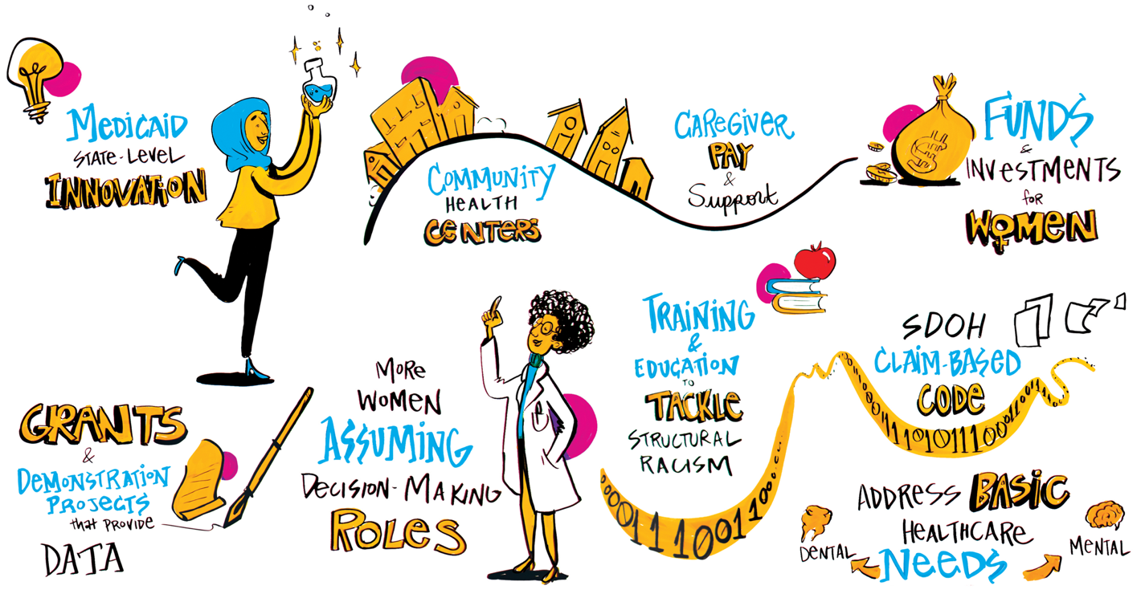
Policymakers, Payers, Entrepreneurs, Clinical Leaders, and Investors All Have Roles to Play
TRANSFORMING PRIMARY HEALTH CARE FOR WOMEN

Slide 17







Achieving a Comprehensive Primary Health Care System for Women
TRANSFORMING PRIMARY HEALTH CARE FOR WOMEN
Recognize the gaps and commit to addressing them.
Train primary health care providers
Integrate into primary health care teams.
Reimagine annual visits
Invest in diversity in leadership and providers
Adopt care models and digital health innovations

Slide 18
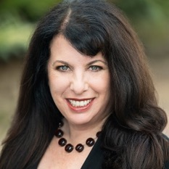

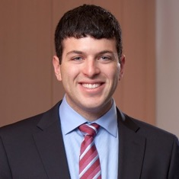
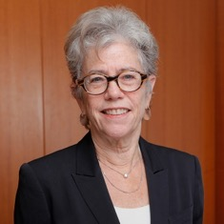
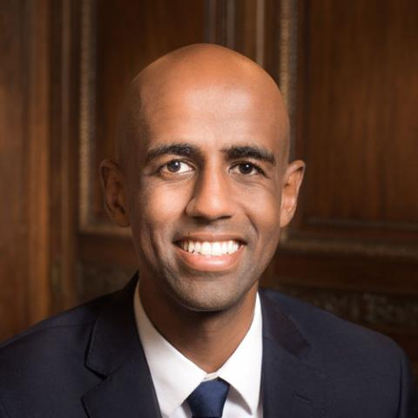
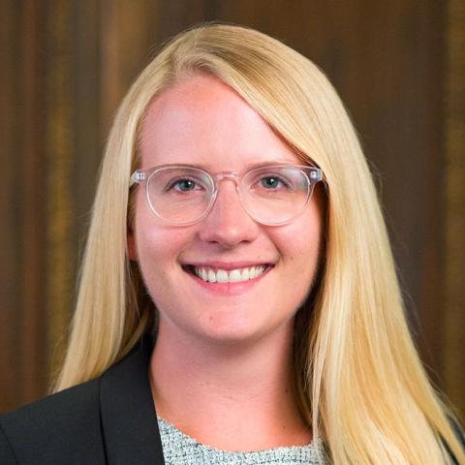
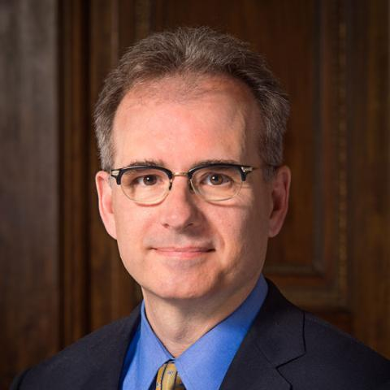
Thank You!
TRANSFORMING PRIMARY HEALTH CARE FOR WOMEN
MANATT HEALTH
Lisa Suennen
Manatt Health
Pavitra Viswanathan
Manatt Health
Jared Augenstein
Manatt Health
Deborah Bachrach
Manatt Health
THE COMMONWEALTH FUND
Yaphet
Getachew
Corinne
Lewis
Eric
Schneider

Slide 19
Thank You!
TRANSFORMING PRIMARY HEALTH CARE FOR WOMEN
Convening Participants
Adimika Arthur, HealthTech for Medicaid
Sydney Etheredge, Planned Parenthood Federation of America
Seth Feuerstein, Yale School of Medicine
Ann Garnier, Lisa Health
Margaret Laws, HopeLab
Debra Ness, National Partnership for Women and Families
Neil Patel, Iora Health
Ileana L. Piña, Wayne State University/American Heart Association
Christine Ritchie, Massachusetts General Hospital
Evan Schnur, Walmart
Lisa Simpson, AcademyHealth
Leah Sparks, Wildflower Health
Emily Stewart, Community Catalyst
Deneen Vojta, UnitedHealth Group
Jane Weldon, CommonSpirit Health
Stakeholder Interview Participants
Molly Coye, Executive in Residence, AVIA
Joia Crear Perry, National Birth Equity Collaborative
Susan Edgman-Levitan, Executive Director, John D. Stoeckle Center for Primary Care Innovation, Massachusetts General Hospital
Mary Langowski, Founder and CEO, Rising Tide
Emily Maxson, Chief Medical Officer, Aledade, Inc.
Sharon Vitti, Senior Vice President and Executive Director, CVS Health/MinuteClinic
Jeanette Waxmonsky, Vice President Integrated Care, Product Development at New Directions Behavioral Health
Elizabeth Yano, Director, VA Center for the Study of Healthcare Innovation, Implementation & Policy
Manatt Health Subject Matter Experts
Jocelyn Guyer, Managing Director, Manatt Health
Brenda Pawlak, Managing Director, Manatt Health
Carol Raphael, Senior Advisor, Manatt Health
Edith Coakley Stowe, Director, Manatt Health
Sharon Woda, Managing Director, Manatt Health

Slide 20
Panel Discussion
TRANSFORMING PRIMARY HEALTH CARE FOR WOMEN

Slide 21
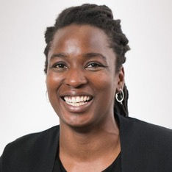
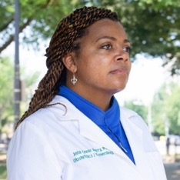
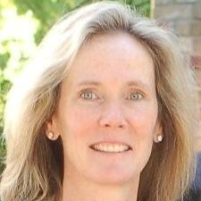
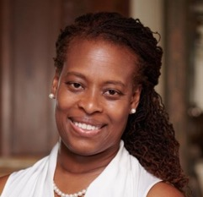
Meet the Panelists
TRANSFORMING PRIMARY HEALTH CARE FOR WOMEN
MODERATOR
PANELISTS
Lisa Suennen
Group Lead of the Digital & Technology Practice and Managing Director
Manatt Health
Toyin Ajayi
Chief Health Officer & Co-Founder
Cityblock Health
Joia Crear-Perry
Founder & President
National Birth Equity Collaborative
Deneen Vojta
Executive Vice President, Research & Development
UnitedHealth Group
Laurie Zephyrin
Vice President, Health Care Delivery System Reform
The Commonwealth Fund

Slide 22
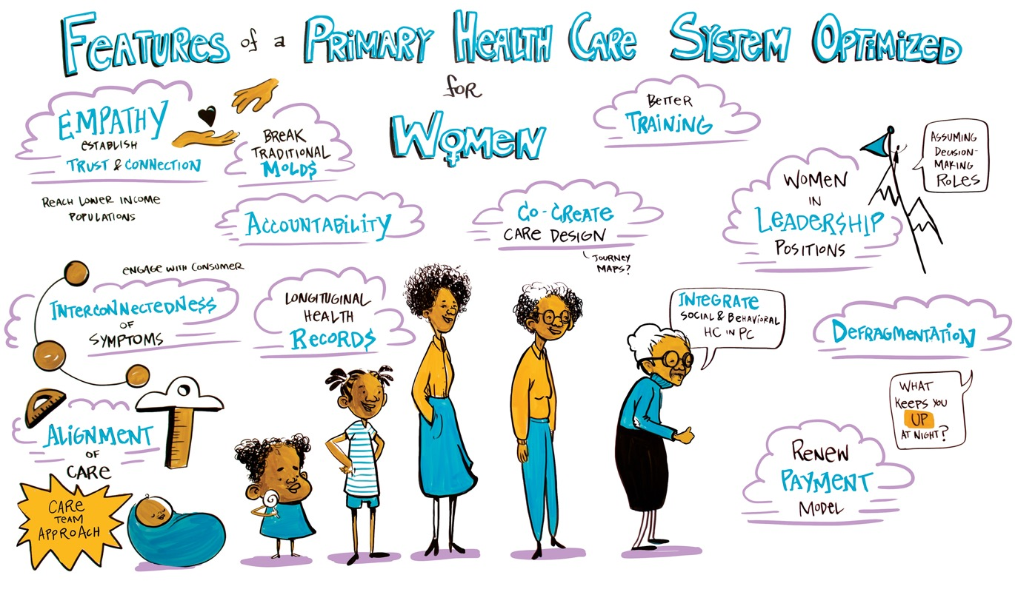
Panel Discussion
TRANSFORMING PRIMARY HEALTH CARE FOR WOMEN
How can we achieve a primary health care system that is optimized for women of all ages and at all stages of life?

Slide 23
Thank You!
TRANSFORMING PRIMARY HEALTH CARE FOR WOMEN
To learn more, please see the two-part report:
Transforming Primary Health Care for Women — Part 1: A Framework for Addressing Gaps and Barriers
https://www.commonwealthfund.org/publications/fund-reports/2020/jul/transforming-primary-health-care-women-part-1-framework
Transforming Primary Health Care for Women — Part 2: The Path Forward https://www.commonwealthfund.org/publications/fund-reports/2020/jul/transforming-primary-health-care-women-part-2-path-forward
AUTHORS
Laurie Zephyrin
The Commonwealth Fund
Lisa Suennen
Manatt Health
Pavitra Viswanathan
Manatt Health
Jared Augenstein
Manatt Health
Deborah Bachrach
Manatt Health

Slide 24


Questions
TRANSFORMING PRIMARY HEALTH CARE FOR WOMEN
Please submit your questions throughout the webinar in the Q&A box (usually located at the bottom of your screen).

