Slide 1

State Health Care Capacity & the COVID-19 Pandemic
April 3, 2020
David Radley, Ph.D. – Senior Scientist, Commonwealth Fund
Co-Authors on Accompanying Brief:
Jesse Baumgartner
Eric Schneider, M.D.
Sara Collins, Ph.D.
Melinda Abrams, M.S.

Slide 2
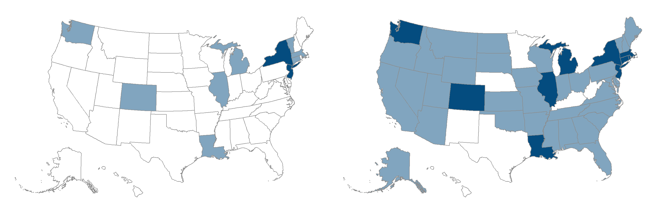
Confirmed COVID-19 Cases per 100,000 adults
March 26, 2020
April 2, 2020
Less than 25 confirmed cases per 100,000 adults
25 per 100,000 to 74 per 100,000 adults
75+ confirmed cases per 100,000 adults
Data: Johns Hopkins University Center for Systems Science and Engineering (JHU CSSE). Obtained on April 2, 2020.

Slide 3
Assessing state level risk, physician supply & hospital capacity
High Risk Population
Age 65 and older
Age 18-64 with a chronic Illness
  COPD or Asthma, Diabetes, Heart disease, severe obesity
State rates: 36%-53%
≈107 million adults
Hospital Capacity
Acute care bed capacity
Intensive Care Unit (ICU) bed capacity
Ventilator supply
Physician Supply
Current and surge scenarios
Ambulatory capacity for triage and management
Hospital-based physicians familiar with admitting and managing patients in inpatient settings
Data available for download in excel format @ CommonwealthFund.org

Slide 4
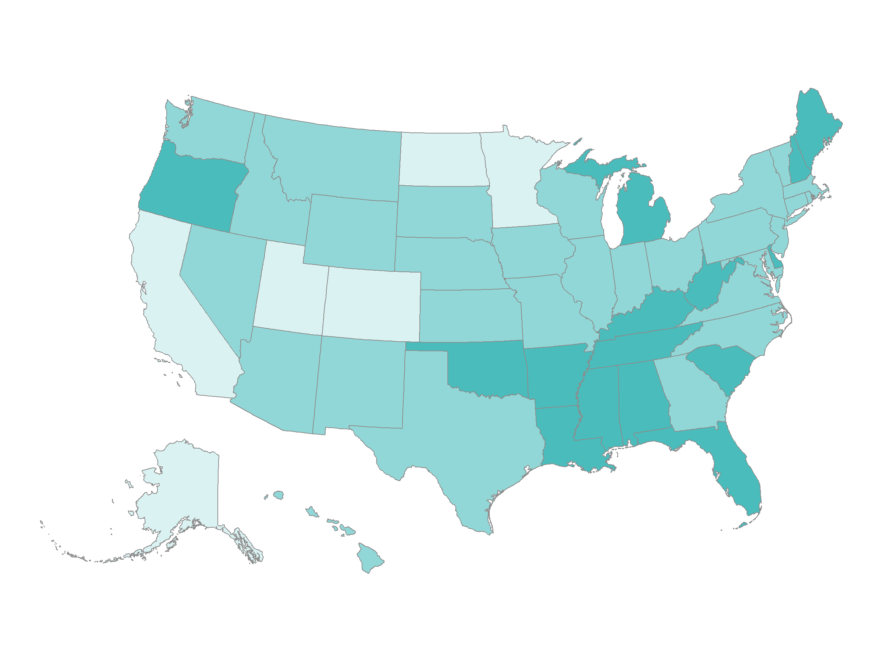
High Risk Populations
Share of State Population Age 65+ or Age 18-64 with a Chronic Illness
36% - 40% (7 states)
40% - 44% (29 states)
45% - 53% (15 states)
Note: Chronic illness include COPD, Asthma, Diabetes, Severe Obesity (BMI >= 40)
Data: Behavioral Risk Factor Surveillance System (BRFSS), CDC, 2020

Slide 5
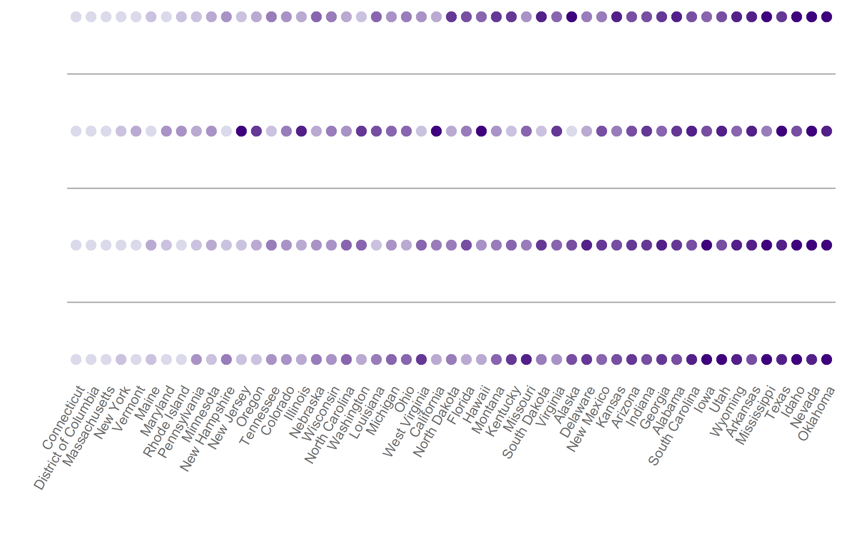
Current and Surge Physician Capacity
Additional physician capacity under surge scenario
Current Physician Assistant & Nurse Practitioner
Current Hospital/ICU Management
Current Ambulatory Triage and Management
Higher Supply
Lower Supply
Notes: Ambulatory includes General Practice, Family Medicine, and Medical Specialty who work in ambulatory settings; current hospital/ICU includes General Practice, Family Medicine, Medical Specialty, Anesthesiology, Emergency Medicine, and Surgical specialists who work in a hospital setting; Surge scenario includes physicians in categories above who currently work primarily in research, teaching, or administrative roles Data: Area Health Resource File, HRSA, 2018-19 release

Slide 6
Physician Surge Capacity Explained
Additional Surge Capacity
10.8 per 100,000
(about 2,100 physicians)
Current Hospital/ICU Management 149.0 per 100,000
Physicians per 100,000 residents
Current Ambulatory Triage & Management 91.3 per 100,000
Physician Asst. & Nurse Practitioner 159.7 per 100,000
Notes: Ambulatory includes General Practice, Family Medicine, and Medical Specialty who work in ambulatory settings; current hospital/ICU includes General Practice, Family Medicine, Medical Specialty, Anesthesiology, Emergency Medicine, and Surgical specialists who work in a hospital setting; Surge scenario includes physicians in categories above who currently work primarily in research, teaching, or administrative roles Data: Area Health Resource File, HRSA, 2018-19 release

Slide 7
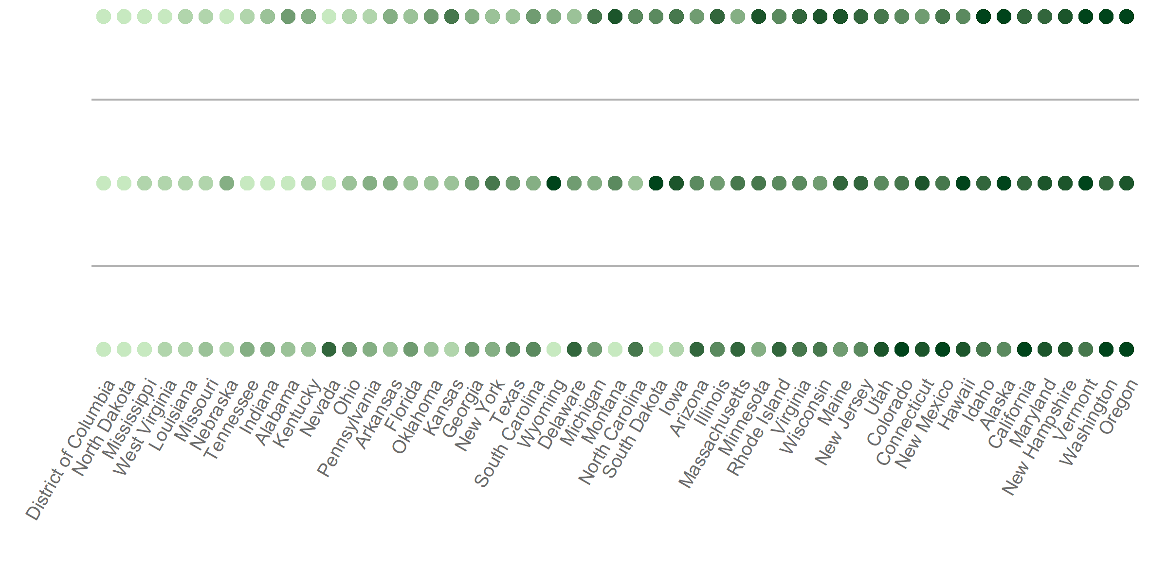
Hospital Bed and Ventilator Supply
Ventilator Supply
Intensive Care Hospital Bed Supply
Acute Care Hospital Bed Supply
Higher Supply
Lower Supply
Data: Hospital Bed Supply: Harvard Global Health Institute analysis of American Hospital Association data (2018) and American Hospital Directory (https://globalepidemics.org/our-data/hospital-capacity/); Ventilator: Estimated number of full-feature mechanical ventilators owned by acute care hospitals in each state per 100,000 residents; Lewis Rubinson et al. Mechanical ventilators in US acute care hospitals. Disaster Medicine and Public Health Preparedness 4, no. 3 (Oct 2010): 199-206.

Slide 8
Mobilizing health care resources in uncertain times
Healthcare delivery systems in all states facing unprecedented challenges
Facilities in New York, New Jersey, and Louisiana on the precipice of exceeding the capacity of their health systems and workforce
State governments have emerged as the locus of policy action to mitigate the virus’ spread
  Enacting social distancing policies,
  Mobilizing resources and infrastructure

