Slide 1
How to Reduce Health Care Costs and Improve Access: What Unions Can Teach Us
Transforming Care Webinar
July 1, 2019
1pm-2pm EDT

Slide 2
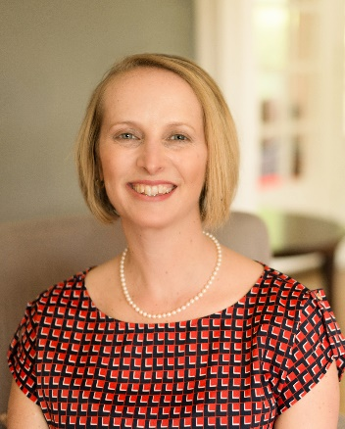
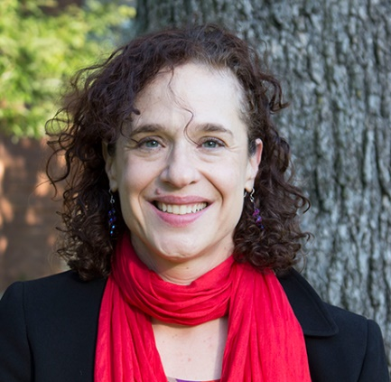
Transforming Care
A quarterly publication focused on new models of care, payment, and patient engagement for the nation's sickest and most vulnerable.
Martha Hostetter
Sarah Klein

Slide 3
Housekeeping
All lines are on mute
Please submit questions and comments in the “chat” box on your webinar screen
The slides and recording will be available and distributed after the webinar has concluded

Slide 4

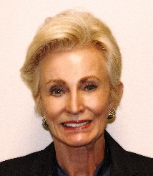
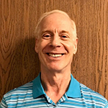
Presenters
Mark Blum, executive director of America’s Agenda, an alliance of labor unions, businesses, health care providers, insurers, and pharmaceutical companies, will describe the landscape of union–employer health care partnerships and explain how New Jersey’s public unions worked with the state to lower pharmaceutical costs by $1.5 billion.
Kathy Silver, president of the Culinary Health Fund, a Taft-Hartley plan for union members working in Las Vegas casinos, will describe how the fund set up advanced-access primary care clinics and urgent care centers for members. The Fund has also been able to negotiate capitated payments for its primary care clinicians and specialists.
Ken Stuart, former administrative manager of the health trust for the San Diego chapter of the International Brotherhood of Electrical Workers, will explain how the trust created narrow networks to steer members toward high-value providers and what tools it offers to help members choose evidence-based treatments.

Slide 5


How Unions Are a Force
for Change in Health Care
An Overview
Presented by Mark Blum
Executive Director, America’s Agenda
Commonwealth Fund Webinar
July 2019

Slide 6
Why are unions a force
for health care change?

Slide 7
Health cost growth outstrips wage growth…
1999-2015
2016-2018
2009-2018
Healthcare premiums
grew approx.
4x faster than wages
Healthcare premiums
grew approx.
2x faster than wages
Workers’ Deductible Spending Increased
8x faster than wages
Sources: Kaiser/HRET Surveys of Employer-Sponsored Health Benefits, Bureau of Labor Statistics, Consumer Price Index, U.S. City Average of Annual Inflation (April to April), 1999-2015 and Current; Bureau of Labor Statistics, Seasonally Adjusted Data from the Current Employment Statistics Survey, 1999-2015 and Current (April to April).
Rising health cost correlates directly with…
Declining
rate of real wage growth
Declining US
employer retirement contributions
Disproportionate
cost burden on lower income workers
Source: Health Care USA: A Cancer on the American Dream, Sylvester Schieber and Steven A. Nyce, Council for Affordable Health Coverage and Willis Towers Watson, Sept. 2018.

Slide 8
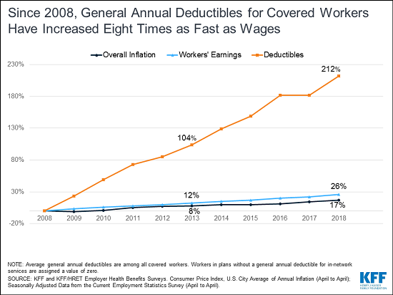
Unions are uniquely motivated to be high-value heath care innovators
Employers’ first impulse in response to rising health costs is to shift these costs onto their workers.
The fight against rising health costs is
central in unions’ efforts to:
Increase workers’ real wages
Defend workers’
health benefits
Protect workers’ retirement benefits

Slide 9
Union-represented workers have unique capacity to resist health cost-shifting…
When cost-shifting comes off the bargaining table, union & employer interests become completely aligned. Both seek:
  Better care
  Lower costs

Slide 10
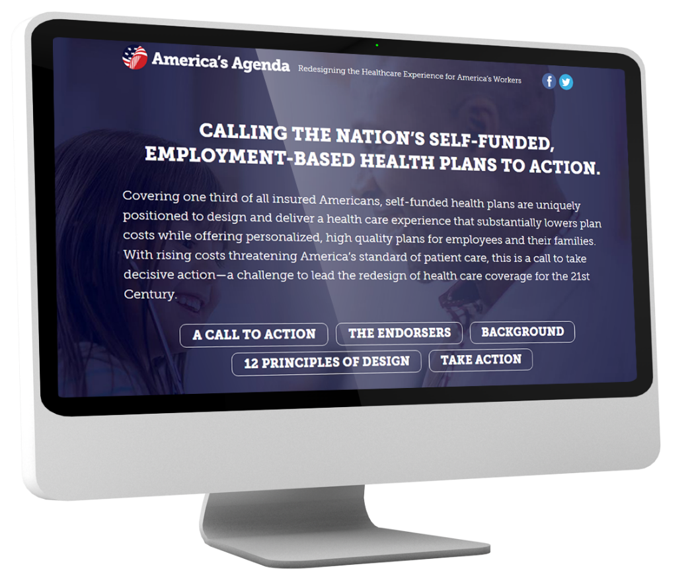
Working as partners, unions and their employers have unique flexibility and capacity to redesign care
Self-Funded Health Plans:
Union Employer Sponsored
Jointly Governed
Taft-Hartley
Total
Self-funded health plans
Approx.
lives
Approx.
lives
Approx.
lives
33 M
15M
18M
+
=

Slide 11


Key Areas of Union-Driven, High-Value Care Delivery Change
Advanced Primary Care/ Removing Barriers to Access
Redesign of high-performance,
high access primary care delivery
Examples:
Culinary Health Fund
SolidaritUS Health/UAW AeroSpace Workers
NJ Public Workers
UFCW Packinghouse Division

Slide 12

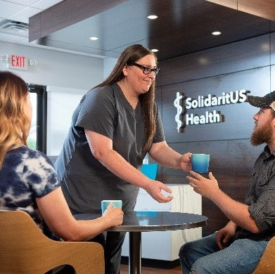
Key Areas of Union-Driven, High-Value Care Delivery Change
Transforming the Patient Experience
Culinary Health Fund
SolidaritUS
Health
NY Hotel & Motel Trades Council

Slide 13
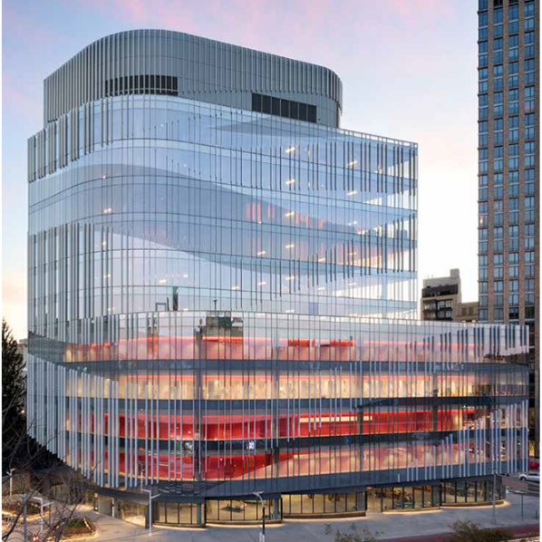
Key Areas of Union-Driven, High-Value Care Delivery Change
Moving Beyond ASO/PPO Networks
Fully Integrated Care System
NY Hotel & MotelTrades Council
Direct Pay, High-Value
Surgery Bundles Marketplace
SolidaritUS Health w/UAW AeroSpace Workers’
IBEW/San Diego
Best Doctors Narrow Specialist Network

Slide 14
Key Areas of Union-Driven, High-Value Care Delivery Change
Overcoming Fragmentation Among Union Plan Sponsors
Driving Transformation Across Whole Communities where Our Members Live and Work
Aligning Taft-Hartley & Employer-Sponsored Health Plans
Leveraging Labor Investment Dollars
  “Strategic Healthcare 1” joint union investment fund
  Currently $275 million in assets

Slide 15

Innovation in Reducing Rx Spending
Slashing Prescription Drug Spending
Without Cutting Workers’ Benefits
CASE STUDY:
Public Employee Unions’
PBM Reverse Auction
Saves New Jersey
taxpayers
over
3 years
1.6B
Automated PBM Bill review saves millions more

Slide 16

New Jersey Public Sector Union Objective:
To create a dynamically competitive, online PBM marketplace
Strategy
Write best-in-class PBM contract terms. Convert terms to a digital Participant Bidder Agreement (“PBA”).
Acquire a technology platform capable of conducting the PBM reverse auction.
Conduct the PBM reverse auction. Select the winner.
The winner’s bid will automatically populate the State’s PBM contract.
Redeploy the same technology platform to conduct real-time review and validation of PBM invoices.
“We won’t have to out-smart
the PBM. We’re going to put PBMs in a cost competition for our business and let them outsmart each other.”
- New Jersey PBM selection committee member

Slide 17

For Immediate Release:
September 17, 2018
Contact: Governor's Press Office
(609) 777- 2600
…Significant savings were derived from the rebid of the PBM contract through what is known as a “reverse auction” that the state conducted in 2017. This was something labor groups encouraged strongly. This change reduced pharmacy costs for state and local governments by over 25%. Active school employee members will see a sizable difference in their premiums for Plan Year 2019 with rates decreasing by 1.1 percent - in stark contrast to the 13% increase they saw last year…

Slide 18

Discussion
Thank you to the Commonwealth Fund for hosting this conversation!

Slide 19


Union Impact on
Healthcare in Las Vegas
Kathy Silver, President
Culinary Health Fund
July 1, 2019

Slide 20
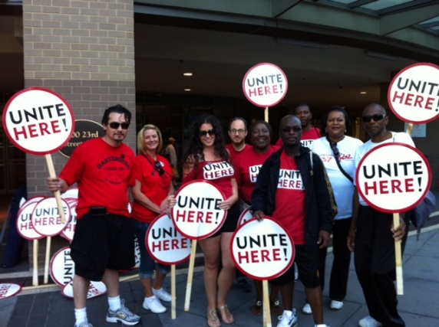
About the Culinary Health Fund
  A multi-employer Taft-Hartley fund, established in 1981
  Funded by Collective Bargaining Agreements that are negotiated by Unions and funded by Employers
  We provide health care benefits, including medical, dental, and vision, to approximately 55,000 workers and their 78,000 dependents in the Las Vegas area

Slide 21

Culinary Health Fund’s Mission
Provide health benefits that offer high quality, affordable health care to our participants at better value with better service than is otherwise available in the market.
We believe our success depends on innovation and on engaging our participants.

Slide 22
Strategies for Affordable Healthcare
1
2
3
4
5
Bundled payments
Capitation
Pay for performance
Direct hospital contracting
Medical management

Slide 23
Strategies for Affordable Healthcare
1
Services performed in a freestanding ambulatory surgery center which include charges for the:
  Facility
  Surgeons
  Anesthesia
  Implantables
Bundled payments

Slide 24
Strategies for Affordable Healthcare
2
Important factors to consider:
  Patient volume
  High quality, well-trained physicians
  Metrics
  Risks
Capitation
Payment is made on a fixed per member, per month basis

Slide 25
Strategies for Affordable Healthcare
2
Advantages of capitated contracts:
  Fixed costs
  Eliminates up-coding and unnecessary testing
  Builds partnerships
  Shared savings
  Enhanced customer service for participants
Capitation

Slide 26
Strategies for Affordable Healthcare
3
Performance-based system:
  Promotes quality improvement and accountability
  Builds partnership and collegiality
  Is more cost effective
Pay for performance
Annual escalators are contingent upon mutually determined quality and performance metrics

Slide 27
Strategies for Affordable Healthcare
4
Benefits of direct hospital contracting:
  Ability to control hospital costs
  Direct contract with all hospital systems in Las Vegas
  Direct contract for quaternary services that can’t be rendered locally
Direct hospital contracting

Slide 28
Strategies for Affordable Healthcare
5
Comprehensive in-house medical management through Nevada Health Solutions which provides:
  Utilization review / utilization management
  Clinical and non-clinical staff at all local hospitals
  Transitional care coordination
  Innovative patient care program
Medical management

Slide 29
Strategies for Affordable Healthcare
Member
Personalized
Surgical Management
ER Follow Up
Medical Case Management
5
Patient care program
Ongoing support for participants from beginning of care through treatment and recovery
Medical management

Slide 30

Participant Engagement
Continued support for participants happens through our engagement strategies:
Advocacy
Health literacy and communication
Wellness initiatives

Slide 31
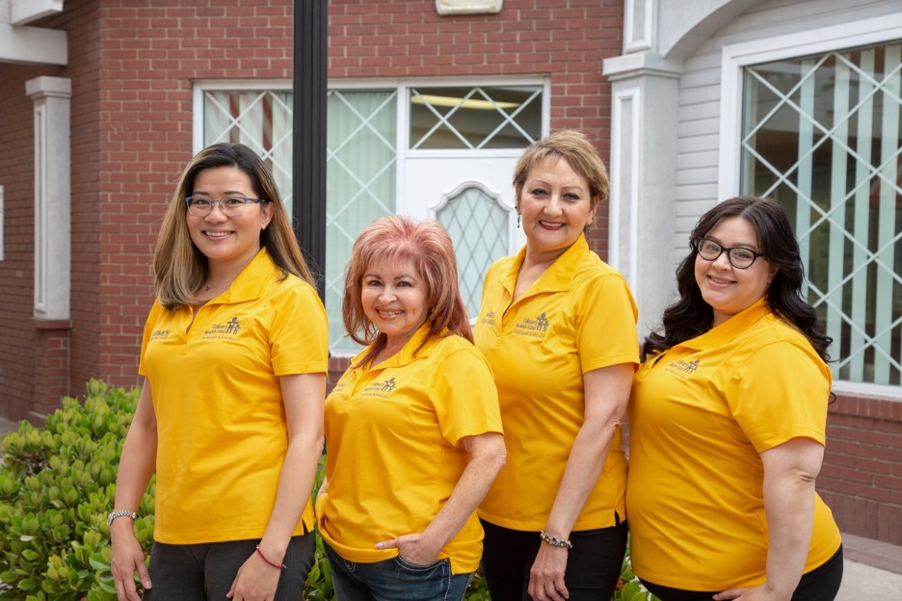
Advocacy
Advocates assist with:
Eligibility
Enrollments
Health fairs
Participant concerns
Case management
Home visits

Slide 32

Health Literacy and Communication
Health literacy
The degree to which individuals have the capacity to obtain, process, and understand basic health information and services needed to make appropriate health decisions.
Key principles
Easy to understand and use
Involve participants
Influence behavior

Slide 33
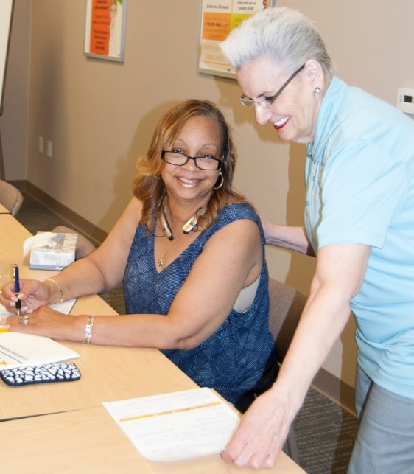
Wellness Initiatives
Classes
  Kidney Smart
  Diabetes
  High Blood Pressure
  Breastfeeding
  Healthy cooking
  Deciding Our Health Care Wishes
  Coping with Depression
Resources to manage health conditions
  Blood pressure monitors
  Breast pumps
  Glucometers
  Incentives (measuring cups, portion control plates, water bottles and more)

Slide 34
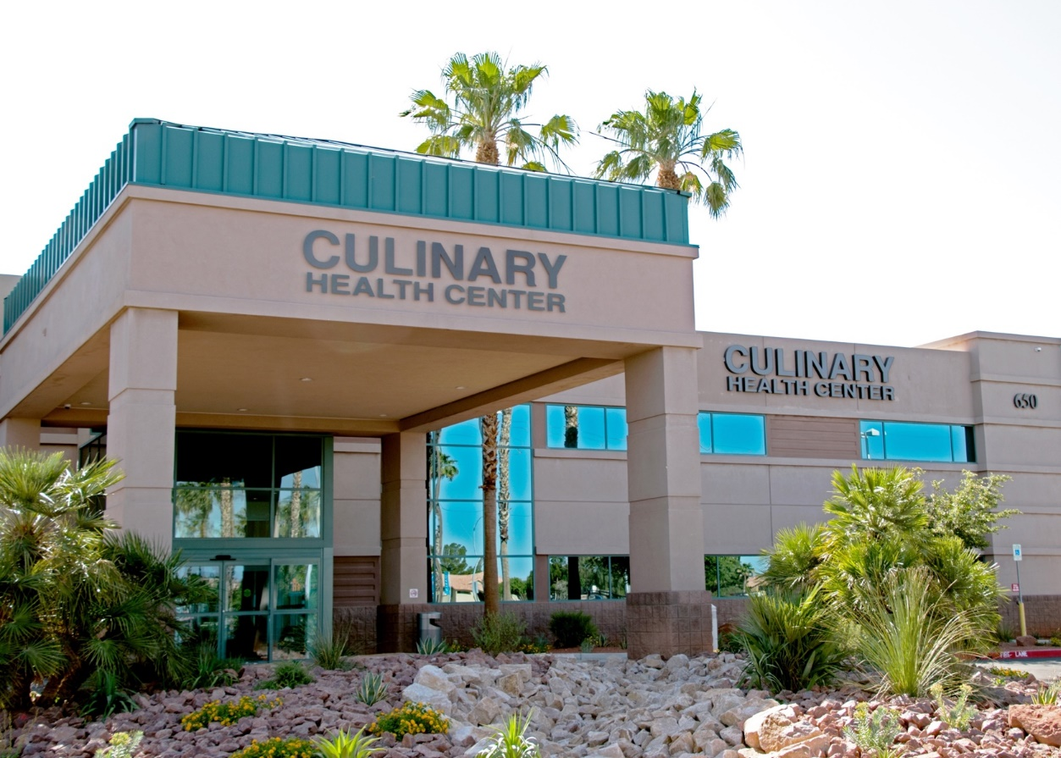
Improving Access to Healthcare
The Culinary Health Center is exclusively for participants and their dependents.
Compassion
Clinical Excellence
Communication

Slide 35







Culinary Health Center
Services offered through our partners
Urgent Care
(open 24 hours, 7 days a week)
Primary Care (adult and pediatrics)
Dental Services
Free Culinary Pharmacy
Eye Care Services
Radiology
Lab

Slide 36
Culinary Health Center
Our services | Our partners | Usage (last 12 months)
Primary Care (adult and pediatrics) | Keck Medicine of USC | 53,000 visits
Dental Care | Nevada Dental Benefits | 26,000 visits
Eye Care | The EyeCare Center | 15,500 visits
Urgent Care | U.S. Acute Care Solutions | 51,000 visits
Pharmacy | OptumRx | 254,000 prescriptions filled (552,000 total for both locations)
Laboratory | Clinical Pathology Laboratories
Radiology | Desert Radiology
145,500 visits over the last 12 months

Slide 37

Culinary Health Center
An excellent patient
experience is our goal.
98% of patients would recommend the Center.
Service | Satisfaction Rating
Primary Care | 99%
Urgent Care | 96%
Dental | 98%
Eye Care | 96%
Pharmacy | 98%

Slide 38
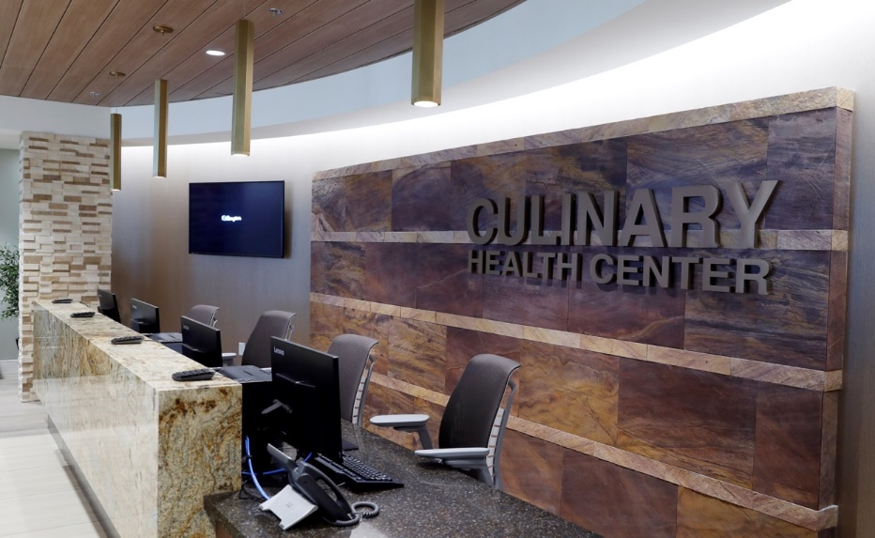

Inside the Culinary Health Center
Main entrance welcome desk
Front lobby

Slide 39
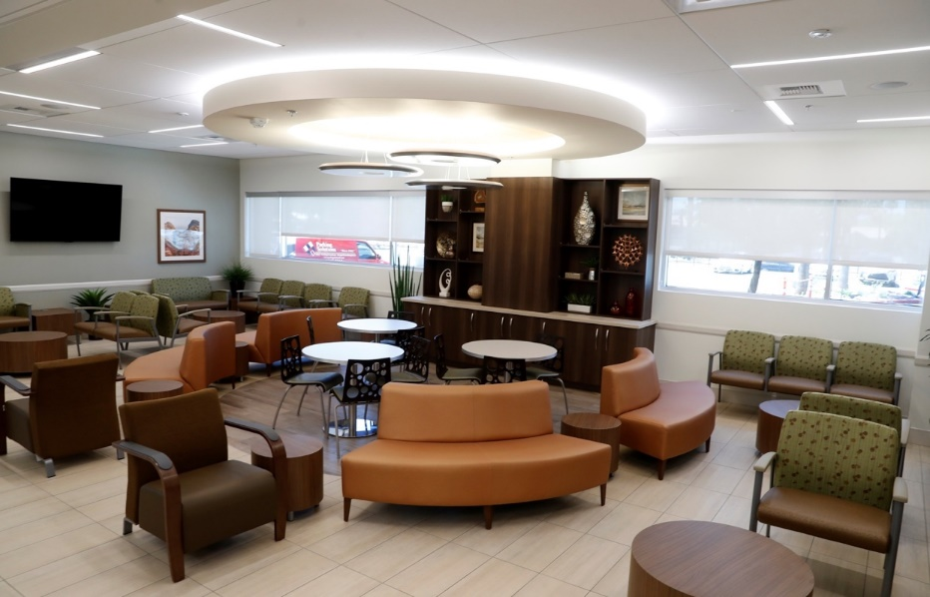

Inside the Culinary Health Center
Urgent Care waiting area
Urgent Care observation room

Slide 40
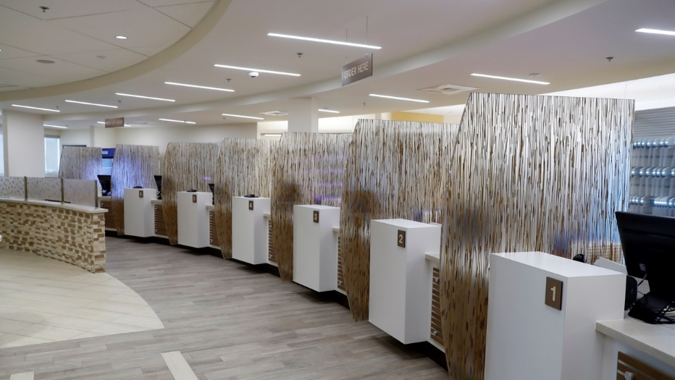
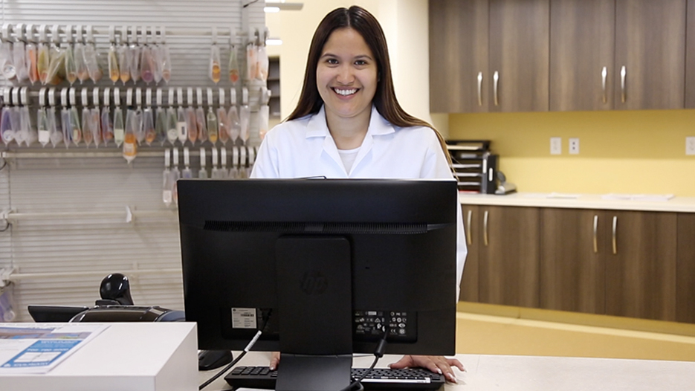
Inside the Culinary Health Center
Pharmacy lobby
Pharmacy counter

Slide 41

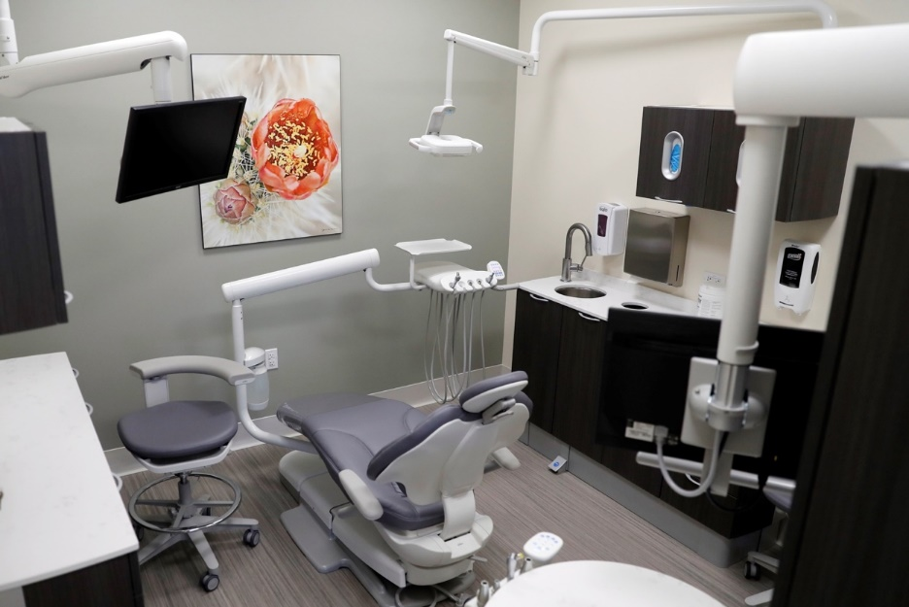
Inside the Culinary Health Center
Dental reception desk
Dental exam room

Slide 42

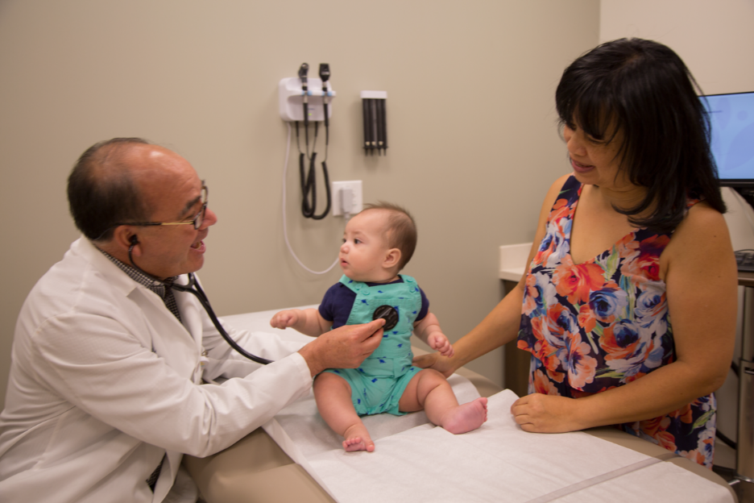
Inside the Culinary Health Center
Pediatrics waiting room
Pediatrics exam room

Slide 43
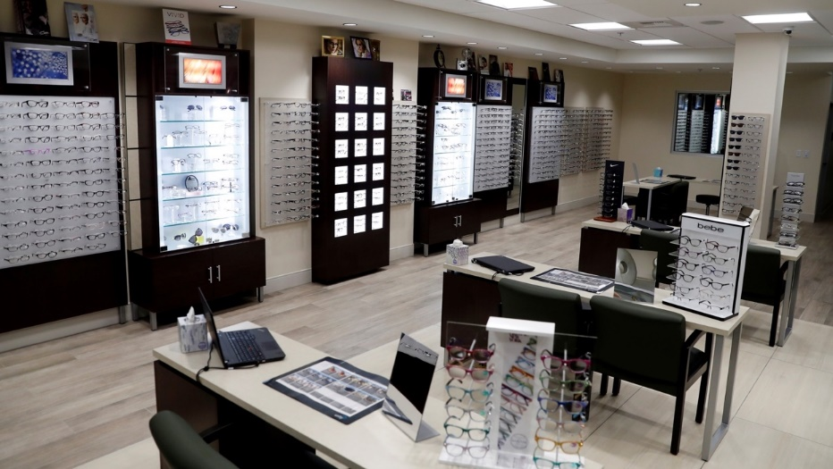

Inside the Culinary Health Center
Eye care
Radiology

Slide 44
Culinary Health Center Expansion
  Design and development is underway for the second location
  Projected size: 80,000+ sq. ft.
  Services to be offered:
    Primary Care (adult and pediatrics)
    Urgent Care
    Dental
    Lab
    Radiology
    Mental health
    Physical therapy and chiropractic care*
    Telehealth*
* New service offerings

Slide 45


Impact on Participants
Christine Ali
“I was diagnosed 8 years ago with type 2 diabetes. The new passport program that I enrolled in was such a fun and clever way to complete the updated classes on nutrition, kidneys, eyes, and feet. The teachers and fellow students were so supportive and engaging.”
Kim Robinson
“I have been smoking 35 years. I feel now that I have developed confidence and skills to remain stopped. I have not smoked for 23 days.”
Facebook Review
“THANK YOU! THANK YOU! THANK YOU! This place is the epitome of health CARE. The staff actually cares about every patient’s experience as well as the services provided. They LISTEN and involve the clients in the decisions for their care...”
Raymond Martin
“I feel that by taking classes, I will be able to improve my pre-diabetes and not let it get to where it becomes diabetes and is permanent.”
Gilberto Guereque
“Thanks to the doctors, the cardiologist, and the staff at the Culinary Health Center for the care I received. They saved my life. I’m very grateful that we have these benefits.”

Slide 46

Using Benefit Design and Incentives to Control Costs, Promote Evidence-Based Care
Ken Stuart, former Administrative Manager of the
San Diego Electrical Health & Welfare Trust
Health Trust for Local Union 569,
International Brotherhood of Electrical Workers
Notes:
Introduce yourself; explain what Electrical Health & Welfare Trust is – ie health trust for 7,000 IBEW members & dependents

Slide 47
Once Close to the Median, Contribution Rates for the San Diego Local
Are Now Among Lowest in California
LOCAL | Current rate | Effective Date | Rate as of 12/04 | Increase since 12/04
Dublin | $17.41 | 6/18 | $9.11 | 91%
San Mateo | $15.32 | 6/19 | $6.20 | 147%
San Francisco | $14.65 | 6/18 | $8.18 | 79%
San Jose | $13.98 | 6/17 | $6.30 | 122%
Contra Costa | $13.60 | 3/17 | $8.39 | 62%
Vallejo | $13.45 | 6/17 | $7.12 | 89%
Santa Rosa | $12.00 | 6/16 | $7.19 | 67%
Modesto* | $11.84 | 1/19 | $9.02 | 31%
Los Angeles | $11.74 | 2/17 | $5.84 | 101%
Castroville | $11.70 | 1/18 | $6.88 | 70%
Sacramento | $11.63 | 2/16 | $5.84 | 99%
San Luis Obispo* | $11.52 | 1/17 | $7.60 | 52%
Fresno* | $11.15 | 9/18 | $5.60 | 99%
Los Angeles | $10.61 | 2/19 | $3.84 | 176%
San Bernardino | $10.56 | 6/19 | $5.94 | 78%
Santa Barbara* | $10.08 | 1/17 | $6.78 | 49%
Bakersfield | $9.44 | 12/16 | $5.97 | 58%
Ventura* | $8.75 | 1/19 | $4.91 | 78%
Riverside* | $8.75 | 1/19 | $4.86 | 80%
Santa Ana* | $8.75 | 1/19 | $4.88 | 79%
San Diego | $7.16 | 6/19 | $6.08 | 18%
Average (all locals) | $11.62 |  | $11.54 | 94.7%
Median (all locals) | $11.63 |  | $11.52 | 79.0%
*Participating in IBEW National Family Plan; Modesto's initial rate is as of 1/11

Slide 48
Actual vs. Projected Growth in Claims
Orange = 8% projected trend Yellow = 6% projected trend Blue = claims per employee per quarter Red = ~4% Actual Trend

Slide 49

How we promote value for IBEW members
Identify providers who routinely achieve optimal medical outcomes at the most reasonable cost
Use narrow networks to reward these providers
Leverage incentives and education to influence members
Notes:
Moved this slide from below since it seemed to introduce your main points – then later slides get into the how

Slide 50
Network Plan Design
Nearly all IBEW’s 7,000 members & dependents opted into Preferred Provider Organization (PPO); clinicians selected based on quality & cost data
Premium: $899 per family per month (includes medical, dental, vision, life insurance)
Office visit co-pays steer members to higher-value clinicians:
$10 – physicians from preferred health system
$30 – for all other PPO physicians in San Diego County
$15 – for all PPO physicians outside San Diego County
Reduced copayments for special programs:
$10 – for all CVS Minute Clinics visits
$10 – for Anthem Online office visits
$5 – for Heal In-Home physician visits
Tiered benefit design led to a 40% increase in utilization of PPO physicians within 6 months.
Notes:
Could mention here that deductibles are low, and premiums less than the cost of the HMO; also may want to explain why out-of-county MDs are less. Would explain rationale for offering lower copays for non-traditional care settings

Slide 51
Cost Containment Programs & Incentives
Encouraging prevention and evidence-based care
  Free access to a 24/7 nurse line & employee assistance program
  Physicals obtained from preferred providers covered at 100%
  Basic PPO dental services covered at 100%, 90% for all others
  “Best Doctors” treatment review & recommendations
Using transparent pharmacy benefit manager (PBM)
Leveraging alternate payment models
  No cost sharing for members who use surgery centers that accept bundled payment
Reviewing claims
  Screening of claims for fraud, waste, and abuse reduced total claim costs by 2%-2.5% per year
Notes:
These are all things you can do to impact costs… Note bi-lateral contracting with service providers for additional discounts.

Slide 52

Example: Best Doctors
Basic services offered to members:
  Validation of diagnoses and recommended treatment plans
  Referrals to highly certified expert specialists
  Answers to health care-related questions
Best Doctors’ experience:
38 percent of recommended surgeries are unnecessary
45 percent of diagnoses and 79 percent of treatment plans are modified or changed after review
Incentives for completing a Best Doctors “Inter-Consultation”
  Waiving or refund of the $250 calendar-year deductible
  100% coverage for charges relating to specified elective surgeries if completed prior to the procedure
  No requirement to follow findings
Notes:
Segue: Can Use analytics to identify those at rising risk – recommend them to use Best Doctors before making decisions on next steps
Need to explain what Best Doctors is

Slide 53

What must plan sponsors be willing to do to achieve effective cost containment?
Be proactive in making plan design changes to influence both participant and provider behavior
Invest in cost-containment programs
Implement incentives to assist participants in making better health care decisions
Promote any and all programs that reduce costs before shifting costs to members

Slide 54
Questions? Comments?
Please submit them via the “chat” function on your webinar screen.
And don’t forget to sign up at Commonwealthfund.org to receive future issues of Transforming Care in your inbox.

