Slide 1

What Do New Changes for Medicare-Medicaid Enrollees Mean for Health Systems, Providers, and Patients?
Webinar
June 20, 2019

Slide 2
Housekeeping
WEBINAR
All lines are on mute
The webinar is being recorded and slides will be available afterwards
For technical assistance, please contact representative at ReadyTalk

Slide 3
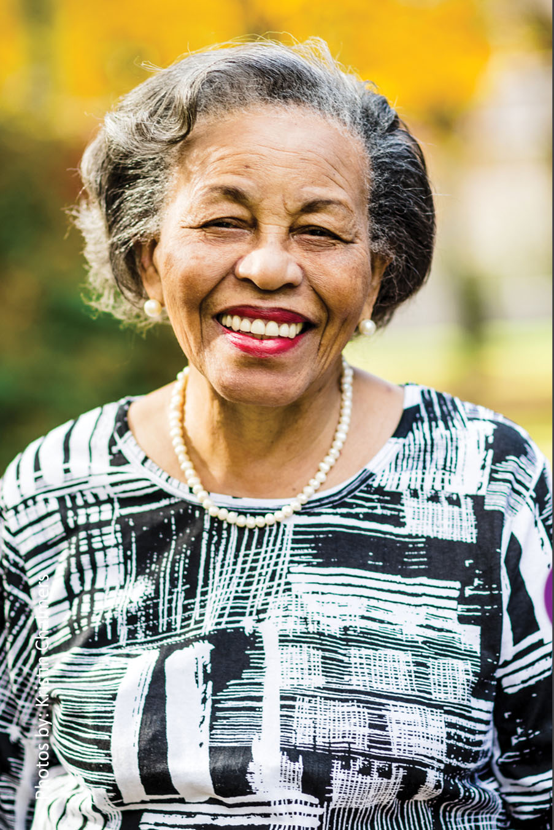




About the Center
WEBINAR
Our Mission: Bring the experience of consumers to the forefront of health innovation
Building consumer
leadership
Improving
health systems
Engaging
policymakers
Conducting research

Slide 4



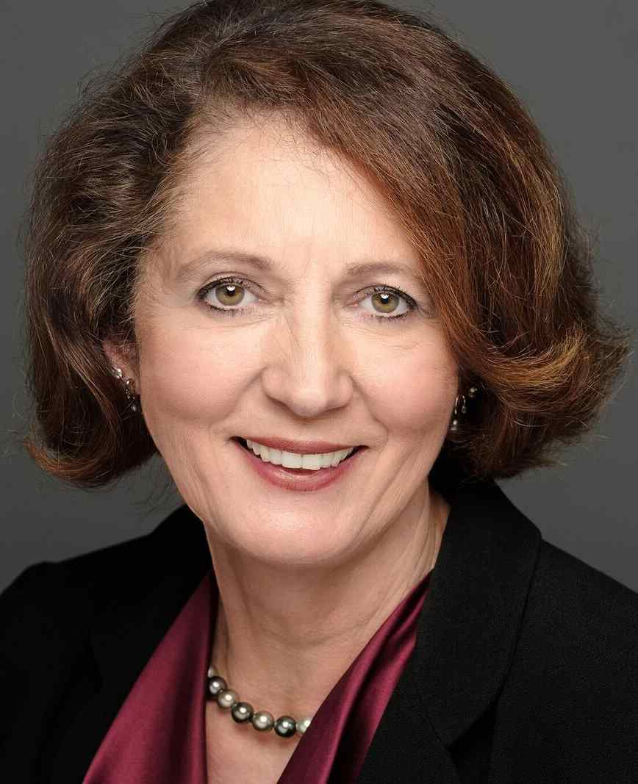
Speakers
WEBINAR
Ann Hwang, MD
Director, Center for Consumer Engagement in Health Innovation
Michelle Herman Soper
Director, Integrated Care, Center for Health Care Strategies
Melanie Bella
Chief of New Business and Policy, Cityblock Health, and Former Director, Medicare-Medicaid Coordination Office
Cheryl Phillips, M.D.
President and CEO
SNP Alliance

Slide 5

What Do New Changes for Medicare-Medicaid Enrollees Mean for Health Systems, Providers, and Patients?
Melanie Bella
June 20, 2019

Slide 6
Snapshot of Medicare-Medicaid Enrollees
In 2017, 12M there were 12M “dually eligible” individuals
  71% are full benefit, 29% are partial benefit
  Roughly 60% are age 65 and older, 40% are under age 65
Dual eligible individuals are medically, behaviorally, functionally and socially complex
  41% have at least one mental health diagnosis
  49% receive long-term care services and supports (LTSS)
  60% have multiple chronic conditions
  17% report that they have “poor” health status (vs. 6% of other Medicare beneficiaries)
Dual eligibles account for a disproportionate share of spending
  Medicare: 34%of spending, 20% percent of enrollees
  Medicaid: 32% of spending, 15% of enrollees
Dual eligible must navigate 2, sometimes 3, separate programs
  Medicare: primary, acute, post acute services and prescription drugs
  Medicaid: LTSS, behavioral health, Medicare premiums and cost sharing
Source: Medicare-Medicaid Coordination Office, Fact Sheet March 2019. https://www.cms.gov/Medicare-Medicaid-Coordination/Medicare-and-Medicaid-Coordination/Medicare-Medicaid-Coordination-Office/index.html

Slide 7
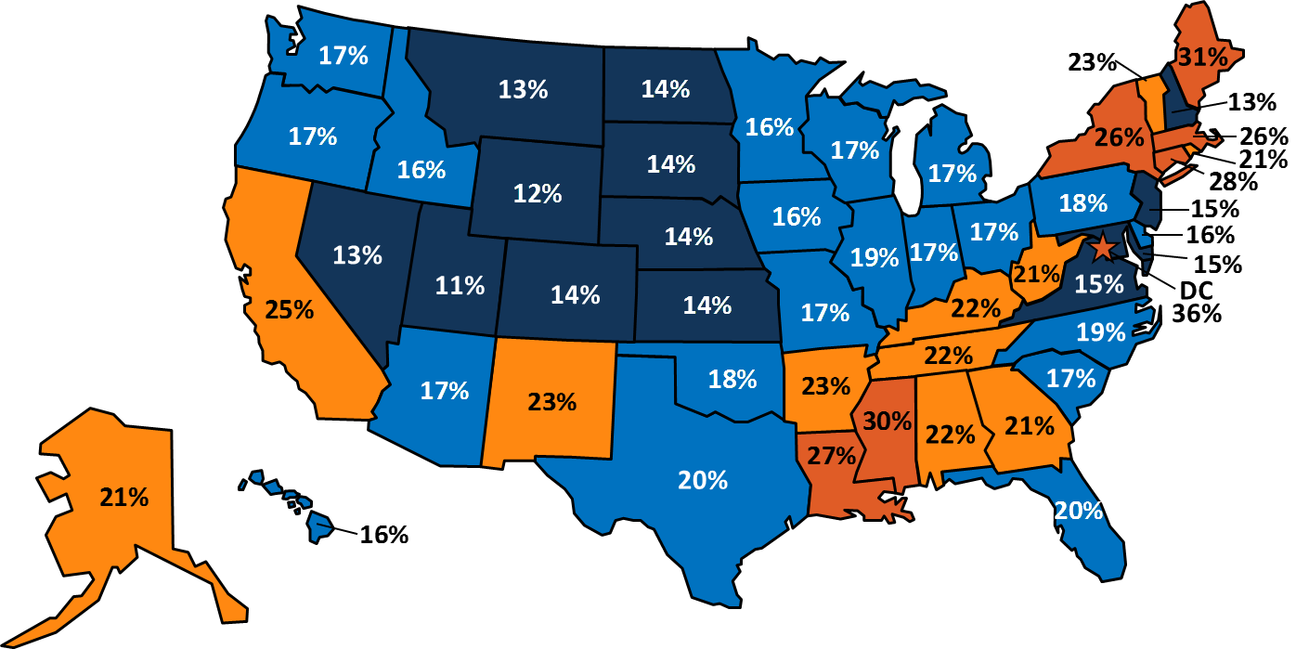

One in five people on Medicare receive assistance from Medicaid
Dual Eligible Beneficiaries as a Share of Medicare Enrollees, by State
United States, 2014 = 20%
< 15% | 16%-20% | 21%-25% | > 25%
13 states | 20 states | 11 states | 7 states and D.C.
SOURCE: Kaiser Family Foundation, “What Could a Medicaid Per Capita Cap Mean for Low-Income People on Medicare?” March 2017.

Slide 8
People on Medicare who receive assistance from Medicaid use more medical services than other people on Medicare
NOTE: Excludes Medicare beneficiaries in Medicare Advantage plans
SOURCE: Kaiser Family Foundation, “What Could a Medicaid Per Capita Cap Mean for Low-Income People on Medicare?” March 2017.

Slide 9
Challenges Created by Medicare and Medicaid Silos
Fragmentation in administration, delivery, financing
Misaligned incentives lead to cost shifting, inefficient spending, poor outcomes
Highly complex system for beneficiaries and providers to navigate and use effectively
When both payers are involved, you can’t look at one in the absence of the other

Slide 10
Promising Integration Vehicles
 | Medicare Advantage Dual Eligible Special Needs Plan (D-SNP) | Medicare-Medicaid Demonstration Plan (MMP) | Program of All-Inclusive Care for the Elderly (PACE)
Medicare A, B and D benefits | ✔ | ✔ | ✔
Medicaid LTSS benefits | May have separate Medicaid risk contract | ✔ | ✔
Rate Structure (all are risk-adjusted) | Capitated for Medicare | Blended, capitated for Medicare and Medicaid | Separate, capitated for Medicare and Medicaid
Authorization | Permanent | Through 2022 (varies by state) | Permanent
Current Enrollment | 2.5 M | 385,000 | 45,000

Slide 11
Why Is This So Hard? What Are We Learning?
Challenges
Disrupting the status quo
Making the case for integration – to both beneficiaries and policymakers
Limited state capacity/bandwidth
Locating and engaging beneficiaries
Increasing provider buy-in & appetite for financial risk
Integrating LTSS, BH and other non-medical services
Cost shifting and gaming
Scaling
Early Successes
Positive beneficiary experiences and outcomes
Critical learning about assessments, care plans and care teams
Integration of LTSS, BH and other non-medical services
Unprecedented level of investment in infrastructure, people and community supports
Meaningful risk adjustment and payment changes

Slide 12
Thank You
Melanie Bella, Chief of Partnerships & Policy
melanie@cityblock.com
55 Washington St, Unit #552
Brooklyn, NY 11201
www.cityblock.com

Slide 13
New Opportunities to Test
Integrated Care
Michelle Herman Soper
Director of Integrated Care, Center for Health Care Strategies
Webinar: What Do New Changes for Medicare-Medicaid Enrollees Mean for Health Systems, Providers, and Patients?
June 20, 2019
Notes:
Welcome and Introductory Remarks by Ann Hwang (10 minutes)
Speaker # 1 (10 minutes): Melanie Bella, Chief of New Business and Policy, Cityblock Health; former Director, Medicare-Medicaid Coordination Office
Melanie will provide a broad perspective on the current integration initiatives, key values and principles to keep in mind, challenges we need to overcome and where we go next.
Speaker #2 (10 minutes): Michelle Herman Soper, Director, Integrated Care, Center for Health Care Strategies
Michelle will provide a brief overview on the current landscape of the FAI, their work with state and federal agencies and then focus the conversation on the reopening of the FAI, what this means and what states and other stakeholders (e.g. plans and providers) should be thinking about.
Speaker #3 (10 minutes): Cheryl Phillips, President and CEO, SNP Alliance or Deborah Paone, Policy Consultant and Performance Evaluation Lead, SNP Alliance
Cheryl or Deborah will provide a brief overview of the new integration requirements for D-SNPs, what this means for health plans and the efforts it will take for plans to implement this including the challenges. She will also provide SNP Alliance’s perspective on plans who have experience with already integrating services like LTSS and behavioral health and what it takes to be successful.
Question & Answer Session Facilitated by Ann Hwang (20 minutes)
Final Thoughts by Ann Hwang (15 minutes)

Slide 14
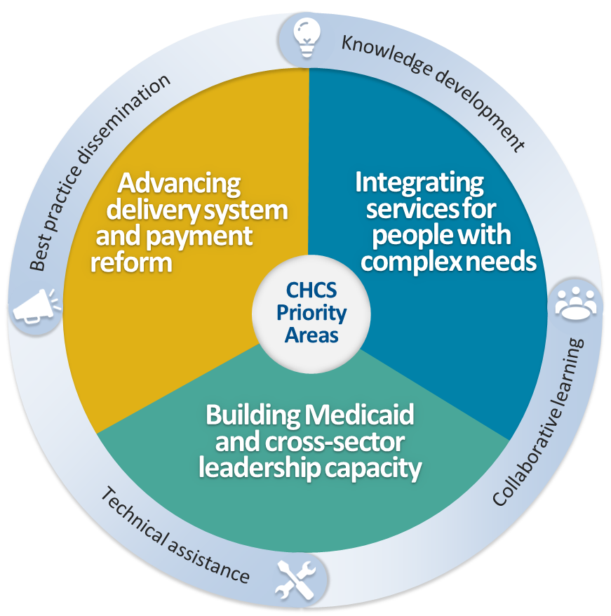
About the Center for Health Care Strategies
CHCS: A non-profit
policy center dedicated to improving
the health of
low-income Americans
Integrated Care Resource Center:* A major project, conducted in partnership with Mathematica, that supports states pursuing integrated care models
* Find ICRC resources on Medicare-Medicaid integration for states and other stakeholders at https://www.integratedcareresourcecenter.com/

Slide 15
Financial Alignment Initiative:
Impetus and Early Demonstration Activity
Sec. 2602 of the Affordable Care Act created the Medicare-Medicaid Coordination Office (MMCO) at CMS
Goals of demonstration models: to integrate primary, acute, behavioral health, and LTSS for Medicare-Medicaid enrollees, and improve quality and care experience and reduce costs
26 states submitted proposals
12 states launched a demonstration under the Financial Alignment Initiative; MN has an administrative alignment demonstration

Slide 16
Financial Alignment Initiative
Demonstration Models
Capitated
CA, IL, MA, MI, NY, OH, RI, SC, TX, VA*
Managed Fee for Service
CO*, WA
FFS providers, including Medicaid health homes or accountable care organizations
Single set of rules for marketing, appeals, etc.
Voluntary, passive enrollment with opt-out provisions
Quality thresholds and savings targets
Joint procurement of high-performing health plans (Medicare Medicaid Plans or MMPs)
Three-way contract: CMS, state, health plan
Blended payment, built-in savings
Seamless access to necessary services
* No longer operates a demonstration

Slide 17
What’s the Latest? Recent Research
Early demonstration evaluation results* from 6 states:
  Inpatient utilization: Reduction (3 states); Increase (1 state)
  Skilled nursing facility admission: Reduction (3 states); No significant change (1 state)
  Long-stay nursing facility placement: Reduction (3 states); Increase (1 state)
  Medicare costs: Reduction (3 states); No significant change (3 states)
Washington’s MFFS evaluation (3 years): Gross Medicare Parts A & B savings of 11%
High MMP enrollee satisfaction: In 2018, 90% rated health plans a 7 or higher (out of 10); 65% rated their plan as a 9 or a 10
Integrated D-SNP analysis: Minnesota Senior Health Options study found that dually eligible beneficiaries in an integrated plan, compared to non-integrated plan, were:
  48% less likely to have a hospital stay;
  6% less likely to have an emergency department visit; and
  More likely to use primary care and home-and community based services.
*Evaluations at: https://www.cms.gov/Medicare-Medicaid-Coordination/Medicare-and-Medicaid-Coordination/Medicare-Medicaid-Coordination-Office/FinancialAlignmentInitiative/Evaluations.html
Notes:
(Year 1 [CA, IL, MA, OH, TX, WA]; Year 2 [MA, WA]; Year 3 [WA (preliminary)]

Slide 18
Three New Opportunities: April 24, 2019 State Medicaid Director Letter
#1: Capitated model Financial Alignment demonstration
Current capitated states can request extensions and/or changes such as geographic scope to existing, promising models
#2: Managed fee-for-service model Financial Alignment demonstration
New states can explore a MFFS model demonstration, using an approach similar to WA’s high-intensity intervention for high-risk beneficiaries
New states can work with CMS and stakeholders to explore testing new ideas under the current framework
#3: State-specific models
  States may propose to test new state-developed models for better serving dually eligible individuals
  Interested in flexible, accountable, and person-centered concepts that:
    Address social determinants of health
    May include value-based payment reform methodologies
    Include robust stakeholder engagement
    Promote beneficiary empowerment and independence
    Increase access to coordinated and high-quality care
    Reduce expenditures
    Preserve access to all covered Medicare benefits, cost-sharing protections and choice of provider

Slide 19
Lessons from and Considerations for Implementing New Demonstrations
Upfront investments are key for program design and launch
  IT and data infrastructure or platform
  Health plan capacity and interest
  Medicare knowledge and expertise
Political, leadership and stakeholder support is best achieved through robust engagement
  Develop shared goals, address common concerns, commit to collaboration
  Ongoing efforts to maintain support over time
Demonstration parameters and care interventions should consider:
  Population-specific and possible significant unmet needs
  Person-centered care goals and oversight
  Impact of requirements on providers
Realistic expectations for shared savings potential/financial risk
Ongoing alignment barriers in some areas

Slide 20




Visit CHCS.org to…
Download practical resources
to improve the quality and cost-effectiveness of Medicaid services
Subscribe to CHCS e-mail, blog
and social media updates to learn about new programs and resources
Learn about cutting-edge efforts to improve care for Medicaid’s highest-need, highest-cost beneficiaries
Contact Information
Michelle Soper, Director of Integrated Care msoper@chcs.org

Slide 21

Advancing Integration for D-SNPs
Cheryl Phillips, M.D.
President and CEO
Special Needs Plan Alliance

Slide 22
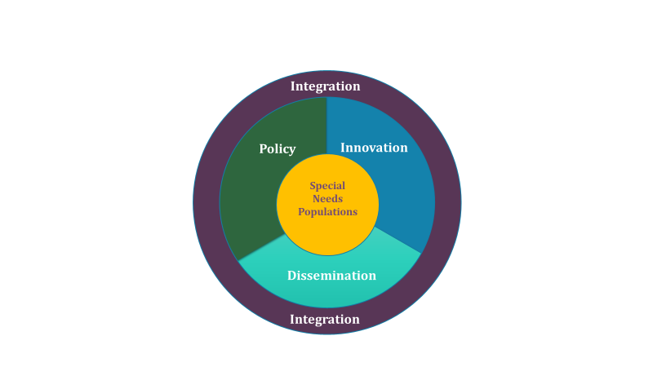
The SNP Alliance – Introduction
  SNPA a national leadership organization whose mission is to improve care and services for high-need and high-cost individuals through specialized managed care.
  Our members represent approximately 400 SNPs and Medicare-Medicaid plans, with over 1.9 million individuals enrolled (over half of the current national enrollment)

Slide 23

Special Needs Plans in the World of Medicare
4% of the total 58.9 Million Medicare Enrollees
12.3 % of the 20.4 million Medicare Advantage Enrollees
2.9 Million SNP Enrollees

Slide 24
Three Types of Targeted Managed Medicare
Special Needs Plans
Are a type of managed Medicare (MA) plans - > 2.9 million enrollees
Began enrollment in 2006 / received permanency – January, 2018
3 types:
  Chronic Condition – serving those with serious and potential life-threatening chronic conditions. (C-SNPs)
  Dually-eligible – serving those with both Medicare and Medicaid enrolled in managed care (may be aligned or not aligned). (D-SNPs)
  Institutional – serving those who are at the state definition of “institutional level of care” for at least 90 days. Most are in NHs, but not all. (I-SNPs)

Slide 25

How the SNP Types
Stack UP Nationally
D SNPs
2.5 Million 85%
Total National SNP Enrollment Feb, 2019 = 2,910,189

Slide 26
The Focus on Medicare-Medicaid Integration
Aligning services to best meet the individual’s needs
Coordinating medical and LTSS benefits – avoid redundancy / gaps / reduce confusion and system complexity
Ability to target needed additional benefits
Acute care is a significant driver of LTSS utilization (particularly long-stay NH)
Further supports longer term shift to community-based services

Slide 27
SNP Permanency 2018 and CMS Rulemaking April 1, 2019
BBA 2018 defined, and CMS codified in regulation the minimum standards for D-SNP Integration – effective 2021 Contract year. D-SNPs must meet ONE or more of the following criteria, “to the extent permitted under State Law”:
1. FIDE SNP
MCO contract inclusive of MLTSS and BH consistent with state policy
Must include 180 nursing facility days per year
2. HIDE SNP
Parent org has capitated Medicaid MLTSS and/or BH contract
3. Care Transitions
Notify state when “high-risk” full dual is admitted to hospital or SNF
States define process
May include PIHP and PAHP contracts

Slide 28
Care Coordination
CMS is clarifying and strengthening the meaning of “arranging for [Medicaid] benefits” for all DSNPs.
Examples and Requirements:
Awareness of and coordination with the other “payers” for unaligned members
Verify eligibility for LTSS, BH services and make arrangements for Medicaid service provision
Education/coaching on the roles of Medicaid and DSNP
Training plan staff and network providers on availability of LTSS and BH services in Medicaid
Notes:
PA example with critical incident and or mortality reporting for DSNPs
Medicaid eligibility redetermination

Slide 29
Appeals & Grievances Coordination
CMS is implementing a coordinated A&G process for all DSNPs in 2020 and a unified A&G process for exclusively aligned DSNPs in 2021
FIDE/HIDE with Exclusively Aligned Enrollment (2021)
Integrated organization determinations (Medicare determinations and adverse benefit determinations)
Integrated reconsiderations (MA reconsideration/ appeal of adverse org determination)
All DSNPs (2020)
Must offer to assist with obtaining Medicaid services, resolving grievances, requesting authorization of services, and navigating A&G
Integrated grievance (dispute or complaint about providers)
May coach the enrollee on how to self-advocate
Must provide enrollee reasonable assistance in completing A&G forms and taking procedural steps

Slide 30

States at the Forefront of Integration in 2019
WA
ME
MT
ND
VT
OR
MN
NY
NH
ID
SD
WI
MI
MA
WY
IA
PA
RI
NE
OH
NV
IL
IN
WV
VA
CT
CA
UT
CO
MO
KY
NJ
KS
NC
TN
SC
DE
AZ
NM
OK
AR
MD
MS
AL
GA
DC
TX
LA
HI
FL
AK
PR
KEY
* These states have at least some aligned D-SNP/MLTSS plans and/or FIDE SNPs as of 2019.
Integrated D-SNP*
Financial Alignment Demonstration
Both Financial Alignment Demonstration and Integrated D-SNPs

Slide 31
Flexibility in Supplemental Benefits
Uniform Flexibility
Special Sup Benefits for Chronically Ill (SSBCI) –CY 2020
Guidance Memo 4-27-18
CMS reinterpreted “uniformity requirement”
May target benefits, but must provide for equal tx of enrollees with the same health status or disease status
CMS also reinterpreted “primary health related”, if an item or service that is used to dx, compensate for physical impairments, addresses fxnl/psychological impact of injuries or health conditions, or reduces avoidable healthcare utilization
Guidance Memo - April 24, 2019
Defines “chronically ill”
Plans need not submit processes used to identify enrollees who qualify – waiver of uniformity requirements
BROAD discretion in developing items and services that may be offered (10 general categories listed)
If benefits may be individualized, unclear how plans will include these in their bids.

Slide 32
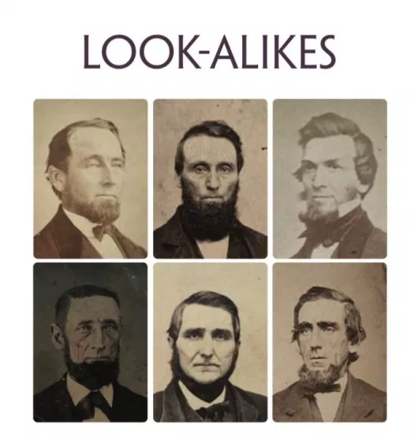
Emergence of the “Look Alikes”
General MA plans, targeted to those dually-eligible, but without any Medicaid coordination or integration.
Growth of these plans are driven by a number of market and policy forces
CMS specifically raised the issue in the CY2020 Final Call Letter. Potential ways to address:
  Require to make them meet D SNP requirements
  Further limits on marketing
  Beneficiary notification when an integrated option is available in that service area
  Possible further rule-making by CMS
CMS and States have the opportunity to make D SNPs more attractive – make it be a product of choice for duals

Slide 33

Will Medicare beneficiaries be able to navigate all this?

Slide 34

Special Needs Plans for those dually eligible for Medicare and Medicaid (D-SNPs) are an important vehicle to integrate care and services for those with complex medical issues who also have long term service and support and/or behavioral health needs.
D-SNPs will be able to continue enrollment after 2021 if they meet one of the 3 described requirement for integration, as defined in the Balanced Budget Act of 2018.
Considerable barriers exist for plan to move into “fully integrated” D SNPs – at the state and federal policy level
Consumers are facing a myriad of options and choices – most of which they do not well understand.
Helping people navigate with clear and usable information must be a priority for CMS, states and health plans.

Slide 35

Contact me:
cphillips@snpalliance.org
www.snpalliance.org
(202) 204-975

Slide 36
Questions?

Slide 37
Thank You
Visit us on the Web!
Healthinnovation.org
Follow us on Twitter!
@CCEHI

