Slide 1
Commonwealth Fund Mongan Fellowship in Minority Health Policy Informational Webinar
Thursday November 10th, 2016
2:00 p.m. EST

Slide 2

Agenda
Introduction
Pamela Riley, M.D., M.P.H, Assistant Vice President, Delivery System Reform, The Commonwealth Fund
Overview of the Commonwealth Fund Mongan Fellowship Program & Online Application Process
Joan Reede, M.D., M.P.H., M.S., M.B.A., Dean for Diversity and Community Partnership, Harvard Medical School
Perspectives on the Fellowship and the Reede Scholars
Andrew K. Sanderson II, M.D., Medical Officer at The Office of Minority Health, Office of the Director at the United States Department of Health and Human Services (HHS)
Questions

Slide 3
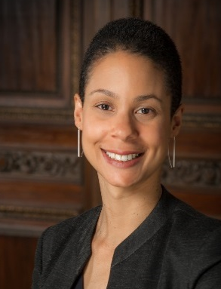
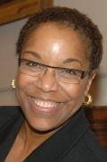
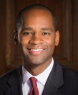
Today’s Speakers
Pamela Riley, M.D., M.P.H., Assistant Vice President, Health Care Delivery System Reform, The Commonwealth Fund
Joan Reede, M.D., M.P.H., M.S., M.B.A., Dean for Diversity and Community Partnership, Harvard Medical School
Andrew K. Sanderson II, M.D., Medical Officer at The Office of Minority Health, Office of the Director at the United States Department of Health and Human Services (HHS)

Slide 4
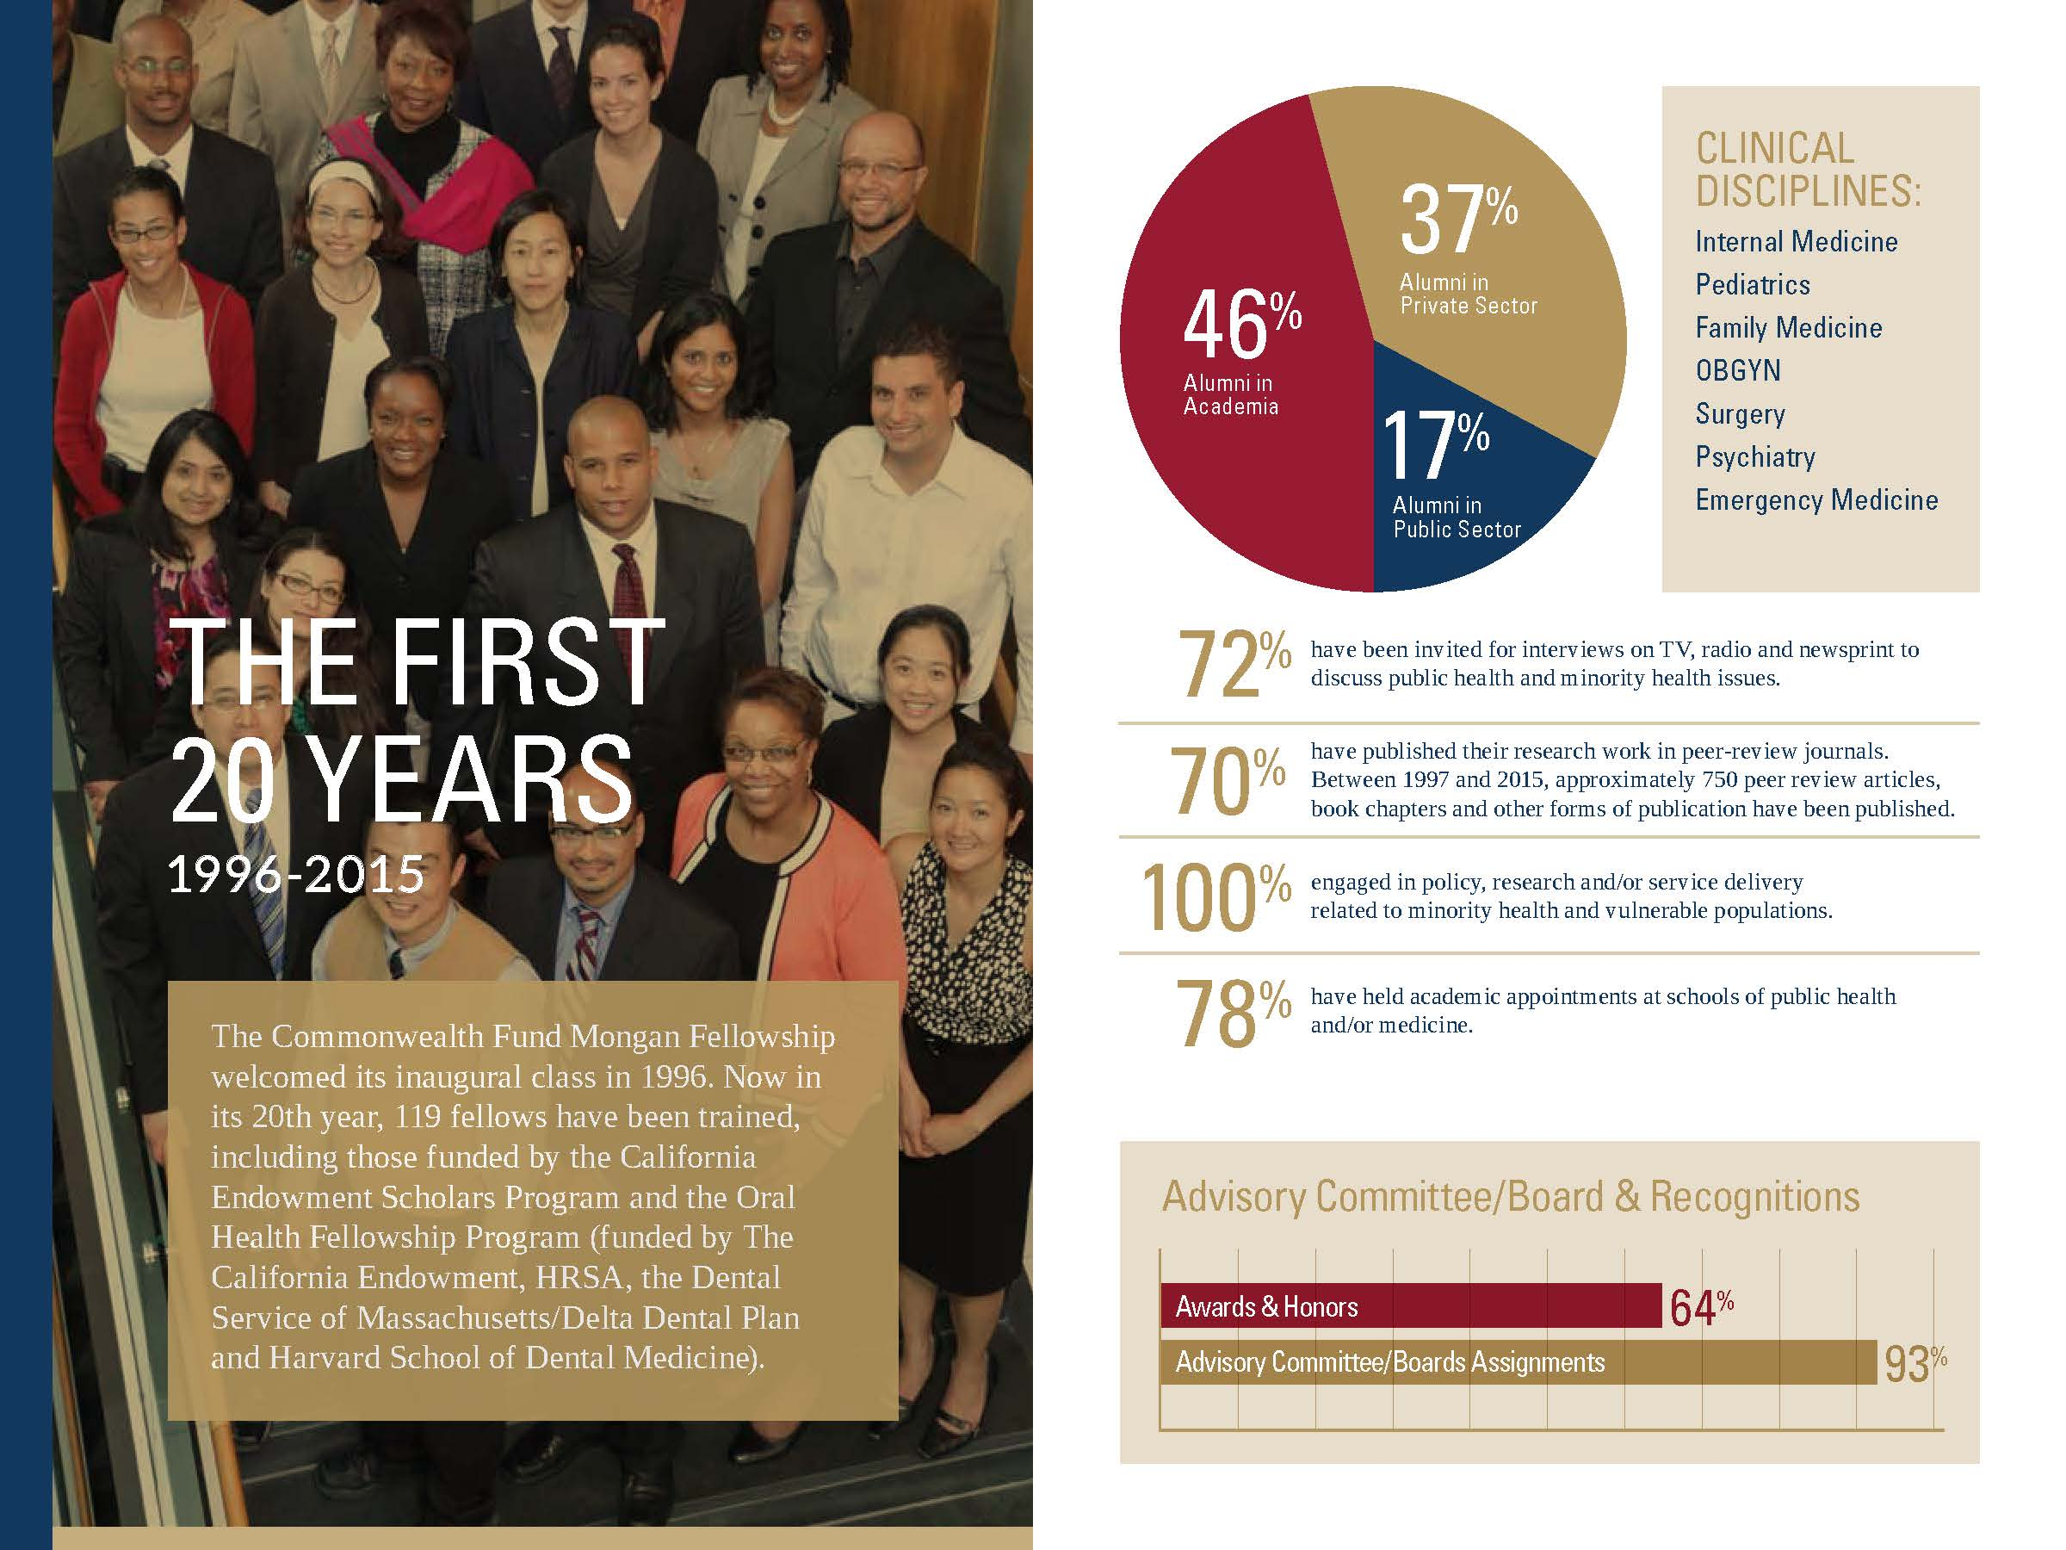
Fellowship Overview The First 20 Years (1996-2015)
Notes:
4
Joan Y. Reede, Program Plan (Draft) February 14, 2011
4

Slide 5
Fellowship Overview
Eligibility:
Physicians who have completed residency.
Additional experience beyond residency preferred.
Board certified or board eligible.
U.S. citizenship or U.S. permanent residency.
Evidence of leadership experience and potential.
Commitment to vulnerable populations.
Benefits:
$60,000 stipend, full tuition, health insurance, books, travel and related program expenses, including financial assistance for practicum project.
Network of fellows.
Notes:
5
Joan Y. Reede, Program Plan (Draft) February 14, 2011
5

Slide 6
Fellowship Overview
Degree Offerings
MPH (HCSPH)
MPA (HKSG)
Fields of Study
Healthcare management (HC)
Health policy (HP)
Class cross registration
Key course requirements (45 credits)
Biostatistics
Epidemiology
Environmental Health
Ethics
Leadership
Health Policy and Politics
Healthcare Delivery System & High Performance Health System
Economics
Finance
Seminars – Minority Health Policy
Data Analysis for Professionals
The Health Care Safety Net and Vulnerable Populations

Slide 7
Fellowship Overview: Fellowship Activities
Leadership Forums
Leadership Skills Development Series
Seminar Series
Journal Club
Practicum
Individual Practicum Project
Mentoring
Group/Individual Meetings with Program Director
National Conferences
APHA, AcademyHealth
Minority Health Policy Annual Meeting
Career Development Series
Shadowing
Site Visits
CDC, Morehouse School of Medicine, ACS
Centura in Denver, CO
Washington, DC
Notes:
7
Joan Y. Reede, Program Plan (Draft) February 14, 2011
7

Slide 8
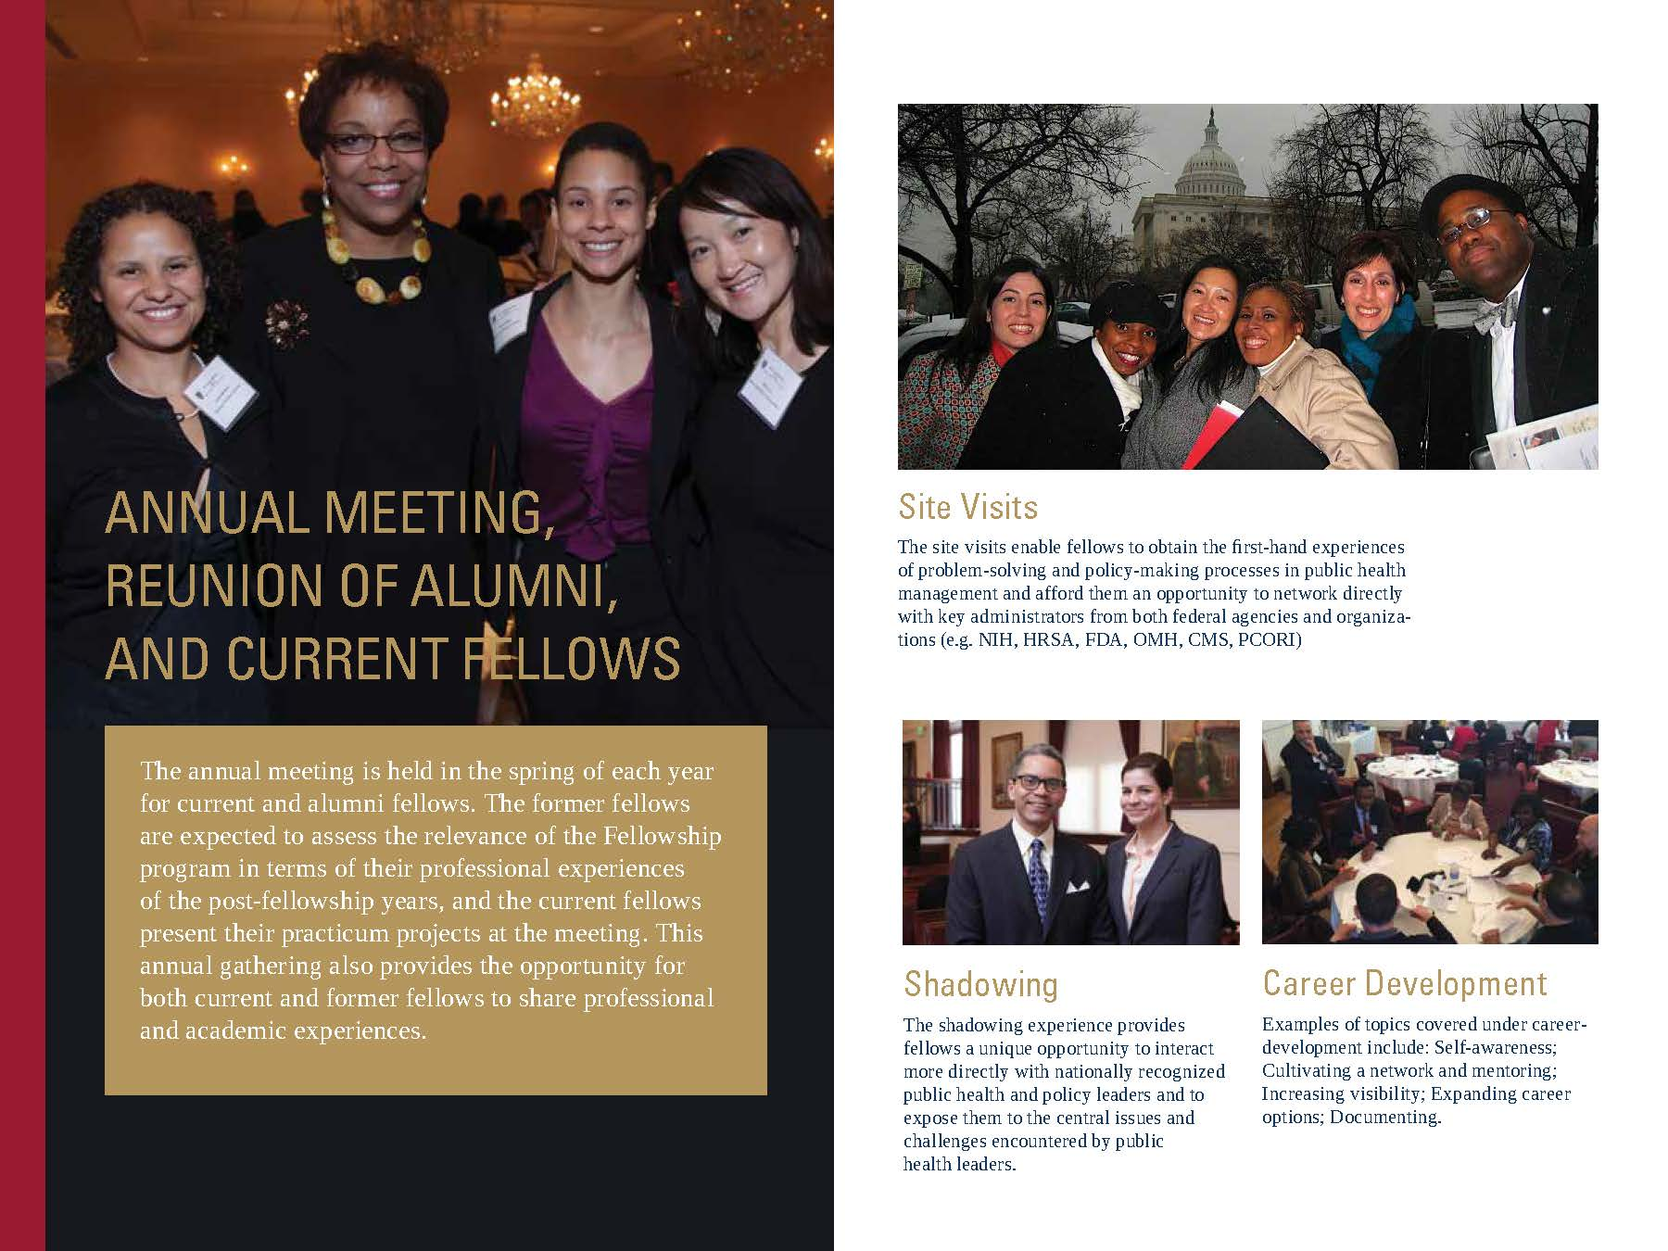
Fellowship Overview: Fellowship Activities
Notes:
8
Joan Y. Reede, Program Plan (Draft) February 14, 2011
8

Slide 9
Fellowship Overview: How to Apply
Application Deadline: December 1, 2016
Apply online: https://mfdp.med.harvard.edu/cfmf/how-apply/request-applications Applications required for both:
Commonwealth Fund Mongan Fellowship in Minority Health Policy
And either
HCSPH
Master of Public Health
HKSG
Master of Public Administration
(prior MPH)
Inquiries? Call: 617-432-2922 – Christine Colacino
Email: mfdp_cfmf@hms.harvard.edu
2
Notes:
9
Joan Y. Reede, Program Plan (Draft) February 14, 2011
9

Slide 10
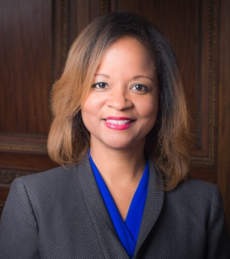

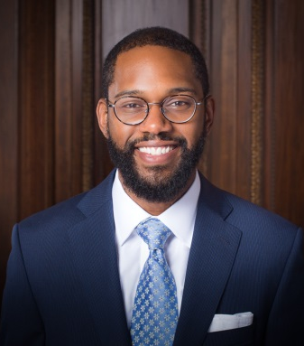
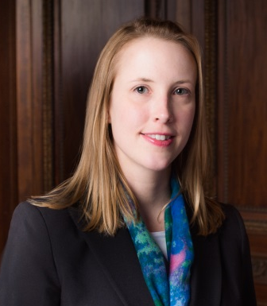
2016-2017 Fellows
Tamiko Morgan, MD,
Chief Medical Officer,
Director of Quality,
Metropolitan Health Plan/
Hennepin Health
Minneapolis, MN
(Pediatrics)
Chloe Slocum, MD
Spinal Cord Injury Medicine
Fellow,
Harvard Medical School
Department of Physical
Medicine and Rehabilitation
Spaulding Rehabilitation
Hospital/ VA Boston
Boston, MA (Physical Medicine and Rehabilitation)
Photos by Donnelly Marks
Rhea Boyd, MD,
Provider, Department of Pediatric Care,
Palo Alto Medical
Foundation
Palo Alto, CA (Pediatrics)
Phillip Murray, MD,
Child & Adolescent
Psychiatry Resident,
NY-Presbyterian Hospital,
Child & Adolescent
Residency Training
Program, Columbia and
Cornell Universities
New York, NY (Psychiatry)
17
Notes:
Joan Y. Reede, Program Plan (Draft) February 14, 2011
10

Slide 11
Fellowship Overview: Examples of Alumni Career Paths
Joseph Betancourt, MD, MPH (Fellow 98) Director, The Health Disparity Solution Center, Partners/ Massachusetts General Hospital, Associate Professor, Harvard Medical School
Resident, Internal Medicine Internship and Residency, New York Hospital-Cornell Medical Center (1994-97)
Monica Bharel, MD, MPH, (Fellow 12) Commissioner, Massachusetts Department of Public Health
Medical Director, Boston Health Care for the Homeless (08-11)
Durado Brooks, MD, MPH, (Fellow 99) Director, Prostate and Colorectal Cancers, American Cancer Society
Assistant Medical Director, Parkland Memorial Hospital, division of Community Oriented Primary Care (COPC), Dallas, Texas (1991-98)
Alice Chen, MD, MPH (Fellow 01) Chief Medical Officer, San Francisco Health Network, Professor of Medicine; Director, eReferral Medical Services, University of California San Francisco, San Francisco, CA
Chief Resident, Internal Medicine, Brigham and Women’s Hospital, Boston (1996-2000)
Notes:
11
Joan Y. Reede, Program Plan (Draft) February 14, 2011
11

Slide 12
Fellowship Overview: Examples of Alumni Career Paths
Octavio Martinez, MD, MBA, MPH (Fellow 02) Executive Director, Hogg Foundation For Mental Health; Associate Vice President, Division of Diversity and Community Engagement; Clinical Professor of Social Work, The University of Texas at Austin, Austin, TX
Chief Resident of Psychiatry (00-01); Business and Economic Research Analyst, CIS, Inc./ Houston
LaQuandra Nesbitt, MD, MPH, MPA (Fellow 07) Director, DC Department of Health, Washington DC
Chief Resident, Family Medicine, University of Maryland Medical System (04-06)
Andrew Sanderson II, MD, MPH (Fellow 16), Medical Officer, Office of Minority Health,DHHS
Associate/Assistant Professor of Medicine, Howard University College of Medicine (09-15)
Notes:
12
Joan Y. Reede, Program Plan (Draft) February 14, 2011
12

Slide 13
Fellowship Overview: Video Clips: Alumni Experiences
Please visit our website:
www.mfdp.med.harvard.edu/cfmf
Notes:
13
Joan Y. Reede, Program Plan (Draft) February 14, 2011
13

Slide 14
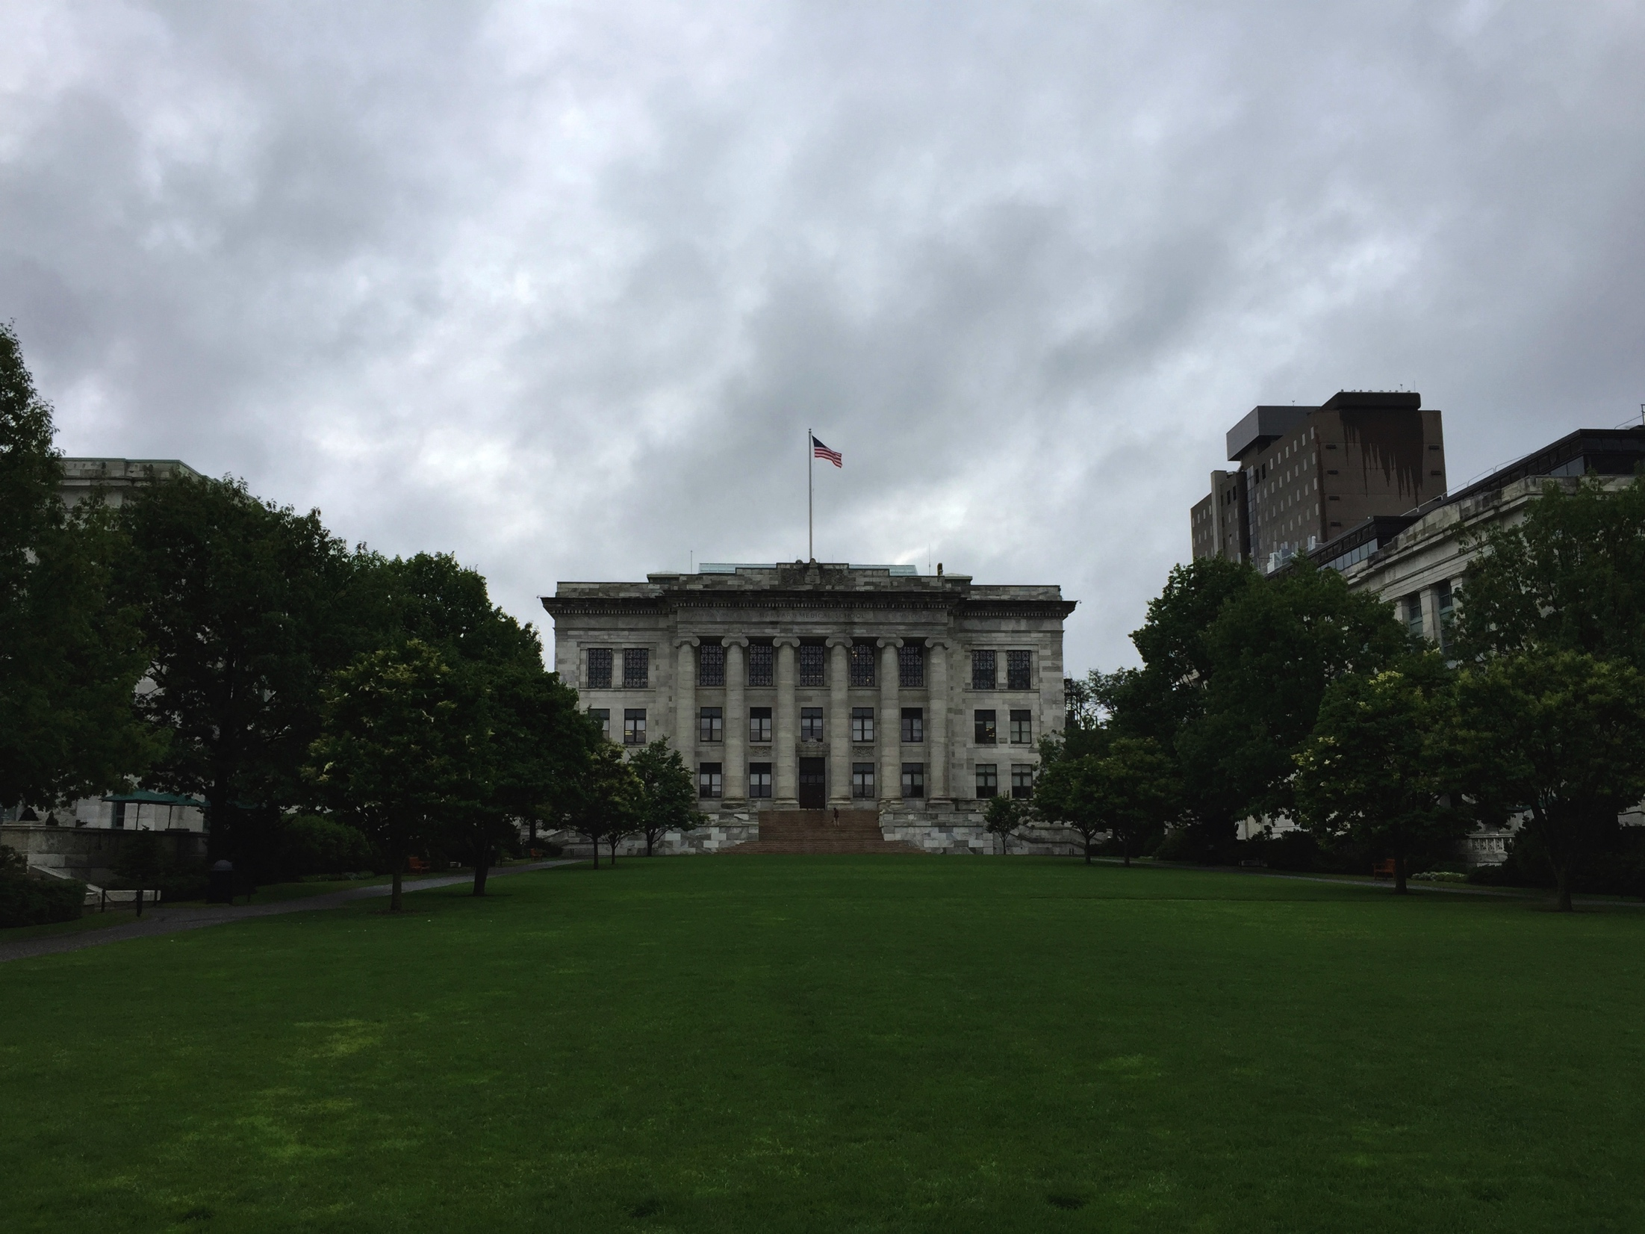

Commonwealth Fund Mongan Fellowship: The Fellow Perspective
Andrew K. Sanderson, II, M.D., M.P.H., F.A.S.G.E.
Medical Officer- Office of Minority Health
U.S. Department of Health and Human Services

Slide 15
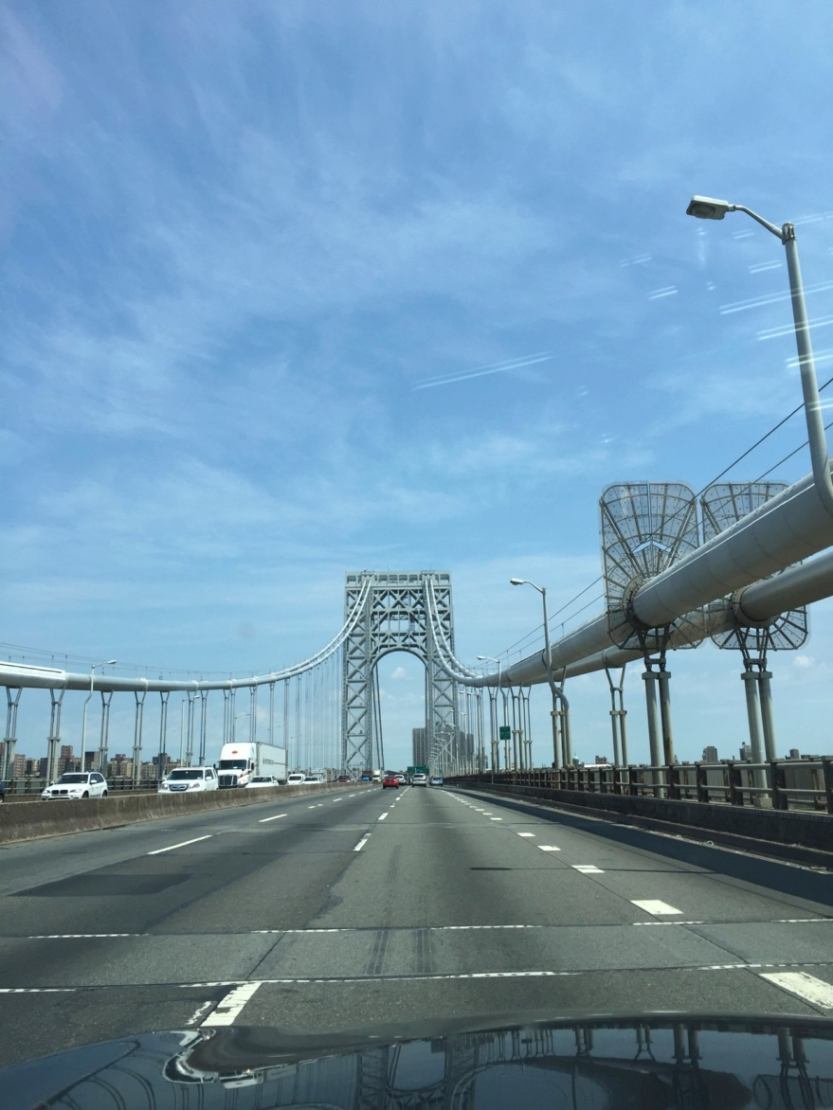
Why do a Fellowship?
Education
Exposure
Efficiency
Effectiveness

Slide 16
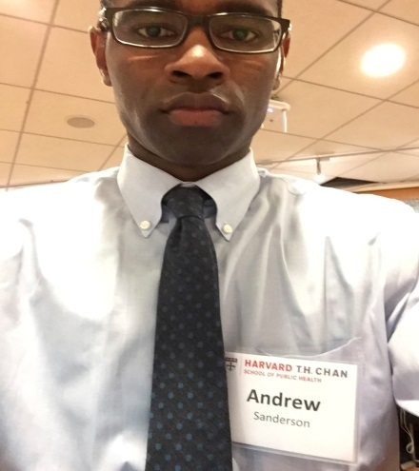
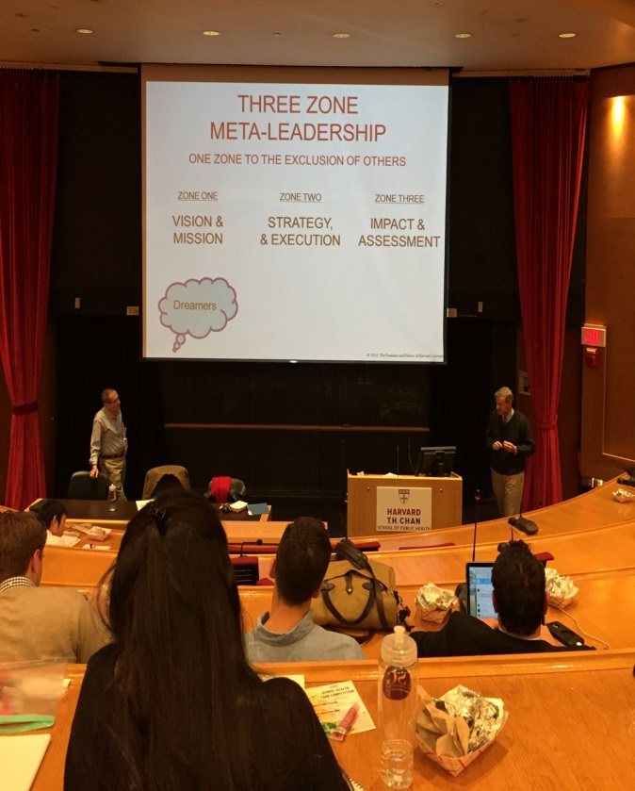
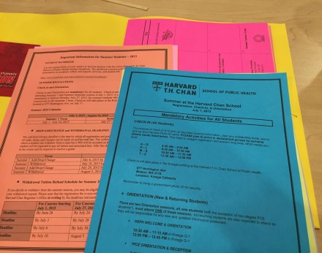
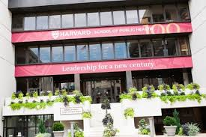
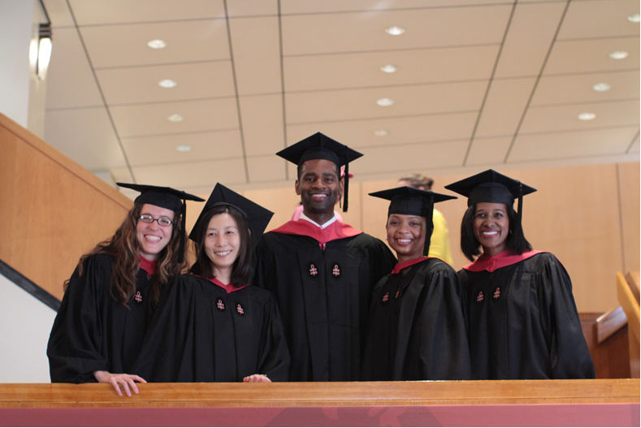
Education
Harvard T.H. Chan School of Public Health
Expert, dedicated faculty
Robert Blendon
Ichiro Kawachi
David Hemenway
David Williams
Seminars
Voices in Leadership
Leadership in Minority Health Policy (Dr. Reede)
Classmates

Slide 17
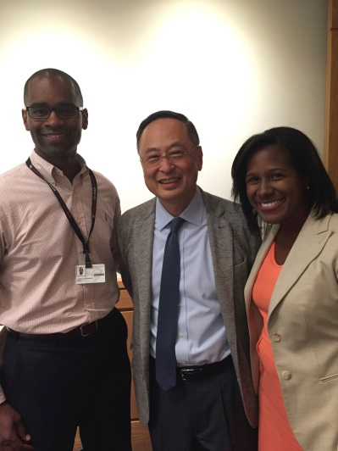
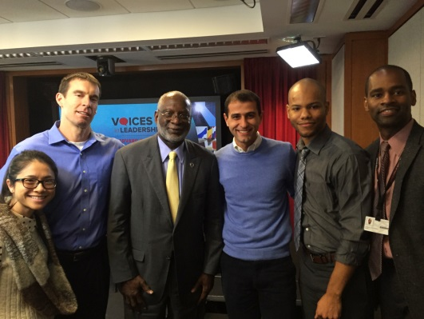
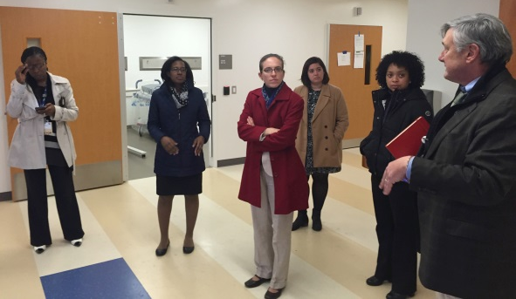
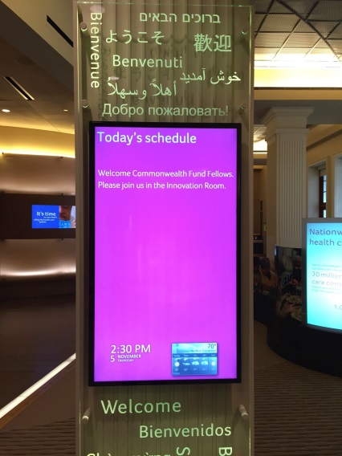
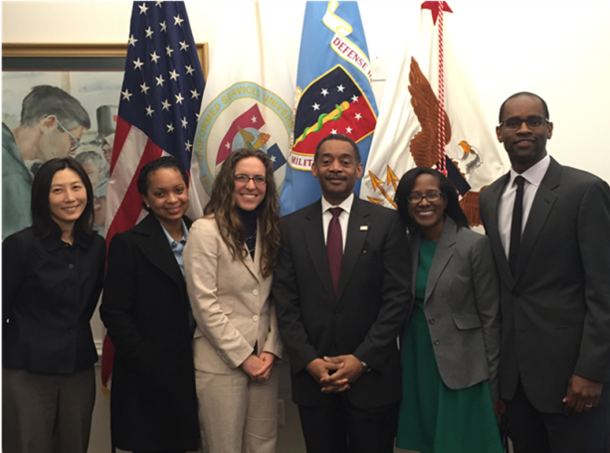
Exposure
Site Visits
Aetna
Department of Defense
UCSF Center for Excellence in Primary Care
FDA
Leadership Forums
Shadowing

Slide 18
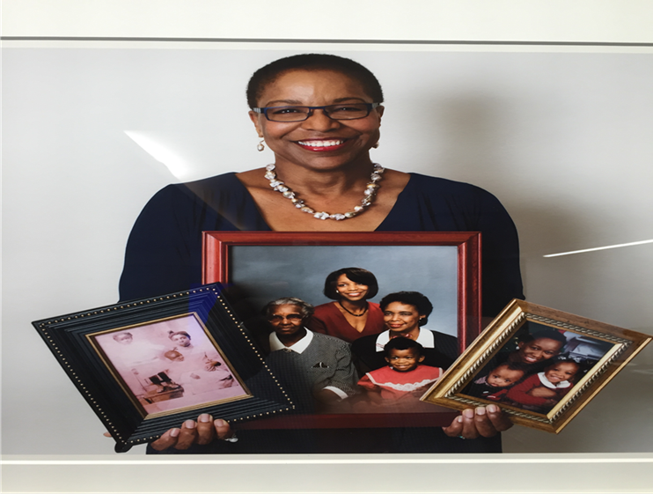

Efficiency
“Pick up the phone” Advocacy
Dr. Joan Y. Reede, MD, MS, MPH, MBA
Commonwealth Fund
Harvard

Slide 19
Effectiveness (Reede Scholars)
Roderick K. King, M.D., M.P.H.-Director of the M.D./M.P.H. Program and Assistant Dean for Public Health Education at the University of Miami
Dora Hughes, M.D., M.P.H. - Senior medicine and health policy advisor in Sidley Austin’s Government Strategies practice team.
Octavio Martinez, M.D., M.P.H.-Executive Director, Hogg Foundation for Mental Health, and Associate Vice-President, Division of Diversity and Community Engagement, The University of Texas at Austin
Muntu Davis, M.D., M.P.H.- Director, Alameda County Public Health Department (Oakland, CA)
Monica Bharel, M.D., M.P.H.- Commissioner, Massachusetts Department of Health
Alice Huan-mei Chen, M.D., M.P.H.- Chief Medical Officer, San Francisco Health Network. Professor of Medicine, University of California San Francisco
And so on, and so on…………………………..

Slide 20
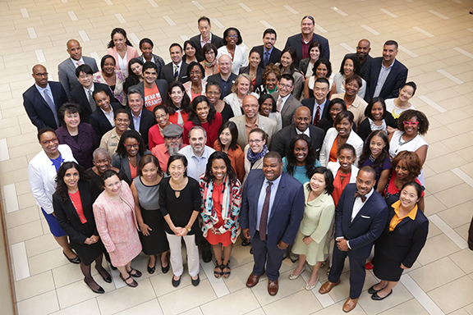
Reede Scholars
Photograph by Jeff Thiebauth

